Slide 1
B. Mechanical oil Extraction
One of the most usually method for oil extraction is the mechanical expression, also known as pressing. Pressing represents the operation which separates the oil from the oleaginous material (solid-liquid mixture), under the action of external forces, resulting crude oil and cake. The pressing process of oleaginous material occurs under the influence of compressive forces that arise in the equipment. The equipments used for mechanical oil extraction are the presses, which can be screw presses or hydraulic presses.
It can be executed by
Batch, mainly hydraulically
Continuous, mainly mechanically, working presses.

Slide 2
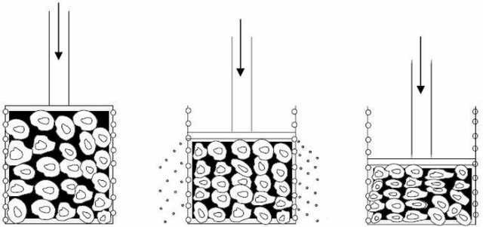
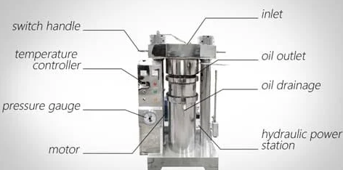
hydraulic presses
Hydraulic expression involves application of pressure to the oleaginous material found in a cylindrical cage perforated laterally..
The oil passes between the bars an flows out of the cage.
This permits easy control of the thicknesses of cakes and of the degree of pressure to which the cooked flakes are subjected.
Figure . Phases of hydraulic expressions

Slide 3
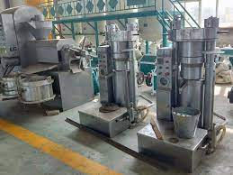
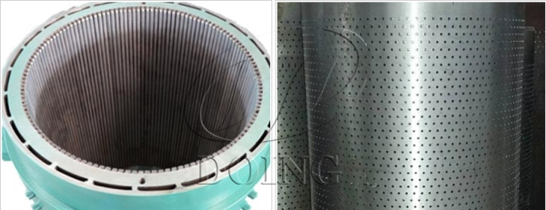
The inner structure of hydraulic press sunflower oil extraction machine

Slide 5
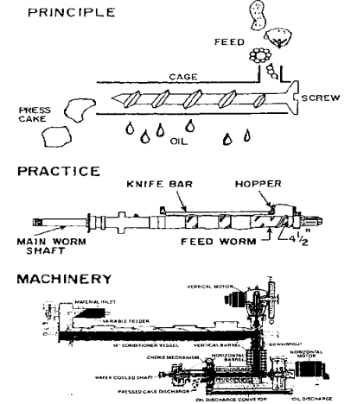
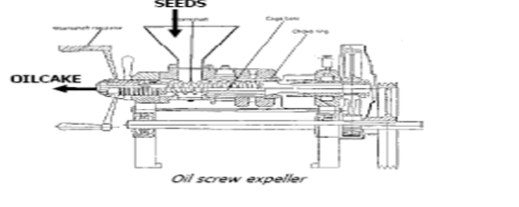
Screw presses;
In oil industry, screw presses (expellers)
are mostly utilized for expression.
The main parts of continous-screw press are;
Seed feeder,
Cone-shaped cage
Adjustable cone for press-cake outlet
Worm (pressure and feed)

Slide 6
C. Solvent extraction
(solid-liquid extraction-leaching)
Exhaustive removal of the oil present in the cake by mechanical means alone is impossible. The residual oil in cake , therefore, only be removed by a different approach, this being solvent aided extraction.
Basic principles of solvent extraction:
The extraction of oil from oilseeds by means of non-polar solvents is, basically, a process of solid-liquid extraction. The transfer of oil from the solid to the surrounding oil-solvent solution ( miscella ) may be divided into three steps:
* Diffusion of the solvent into the solid
* Dissolution of the oil droplets in the solvent
* Diffusion of the oil from the solid particle to the surrounding liquid

Slide 7
Types of Extractors
Solvent extractors are of two types:
Batch
Continuous
In batch processes, a certain quantity of flakes is contacted with a certain volume of fresh solvent. The miscella is drained off, distilled and the solvent is recirculated through the extractor until the residual oil content in the batch of flakes is reduced to the desired level.
In continuous extraction, both the oilseeds and the solvent are fed into the extractor continuously. The different available types are characterized by their geometrical configuration and the method by which solids and solvents are moved one in relation to the other, in counter-current fashion.

Slide 8
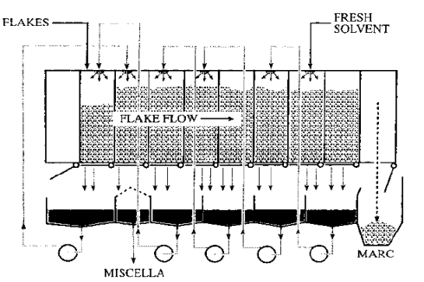

Slide 9
Two different methods can be used to bring the solvent to intimate contact with the oilseed material:
Percolation
Immersion

Slide 10
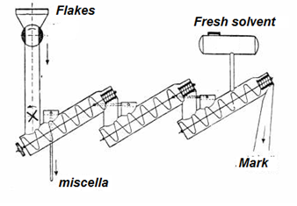
Schlotterhose Extractor

Slide 12
Refining
Crude oils as received from the extraction plant contain several nontriglyceride components which must be removed.
The two min industrial refining methods are chemical/alkali refining and physical refining ,with the former using caustic soda to reduce the free fatty acids (neutralisation), while the latter step method does not apply this step and removes the fatty acids during the deodorization step. The crude vegetable oil is then put through further refining techniques including:
Degumming
Neutralisation
Bleaching
Deodorisation
Sometimes Winterization

Slide 13
Degumming
A variety of chemical treatments to remove impurities, including most of the phospholipids (E.g.: lecithin).
Different degumming processes are carried out to remove phosphatides. For efficient and economic application of this procedure appropriate machines and equipments are used.
Water degumming
Acid degumming
Enzymatic degumming
Membrane degumming

Slide 14
Water Degumming Process Steps
• Heat oil to 60 -70 °C
• Water addition and mixing
• Hydration mixing 30 minutes
• Centrifugal separation of hydrated gums
• Vacuum drying of degummed oil
• Gums -dried for edible lecithin or recombined in meal
Acid Degumming Process
1.Dry acid degumming: Dry acid degumming is particularly suitable for processing oils with low gum contents such as palm oil, coconut oil, palm kernel oil or animal fats.
2.Wet acid degumming :Initially oils with higher gum contents (e.g. corn oil)

Slide 15
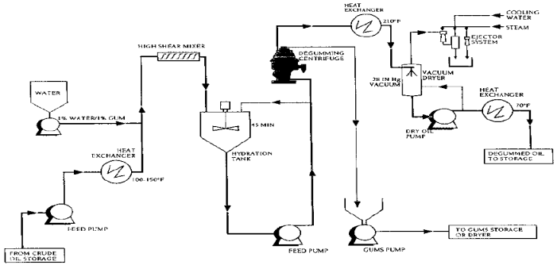

Slide 16
Acid Degumming Process Steps
• Heat oil to 60 -70 °C
• Acid addition and mixing
• Hydration mixing 30 minutes
• Centrifugal separation of hydrated gums
• Vacuum drying of degummed oil
• Gums -recombined in meal
Another method
consists of treating the oil with a small amount (0.05-5%) of water and phosphoric acid and the mixture is heated to about 90°C, followed by centrifugal separation of coagulated material (lecithin).

Slide 17
Enzymatic degumming
was first introduced by the German Lurgi Company as the »Enzy Max process« .The EnzyMax process can be divided into four different steps:
(i) The adjustment of the optimal conditions for the enzyme reaction, i.e. optimal pH with a citrate buffer and the optimal temperature;
(ii) The addition of the enzyme solution;
(iii) The enzyme reaction;
(iv) The separation of lysophosphatide from the oil at about 75 °C.
Enzymes for enzymatic degumming;
Lecitase® 10L (pancreatic phospholipase A2)
Lecitase® Novo (microbial lipase)
Lecitase® Ultra (microbial lipase)

Slide 18
Neutralisation
The reduction of free fatty acids by their reaction to an alkali solution (caustic soda), converting them into soap stock (a by-product).
The oil is treated with an excess of 0.1% caustic soda solution and the mixture is heated to about 75°C to break any emulsions formed.. The mixture is allowed to settle. The settlings, called “foots”, are collected and sold as “soapstock.
After the oil has been refined, it is usually washed with water to remove traces of alkali and soapstock.
After water washing, the oil may be dried by heating in a vacuum or by filtering through a dry filter and material

Slide 19
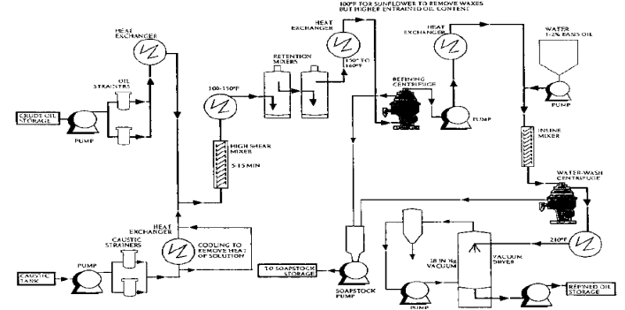

Slide 20
Saponification:
Ester is heated with aqueous alkali (sodium hydroxide) to form an alcohol
and the sodium salt of the acid corresponding to the ester. The sodium
salt formed iscalled a soap.
Fats and oils are esters of glycerol, the simplest triol (tri-alcohol),
in which each of the three hydroxyl groups has been converted to
an ester.

Slide 21
Bleaching :
The purpose of bleaching (or decolorizing) is mainly to reduce the levels of pigments by using the adsorptive capacity of bleaching clay.
The refined oils are usually dark in color due to the presence of some pigmented materials such as chlorophyll or carotenoids and minor impurities like residual phosphatides, soaps, metals and oxidation products.
Bleaching reduces the color by absorbing these colorants on bleaching earth (bentonite clays) and/or activated charcoal.
Bleaching clay also absorbs suspended matter and other minor impurities.

Slide 22
Natural bleaching clays are aluminum silicates,containing relatively high amounts of Mg, Ca or Fe.
The clays are generally activated by heat treatment.
The high metal content limits the adsorptive activity of these clays.
The metals can be removed from the reactive spots by means of acid treatment, yielding clays with much higher adsorptive capacity.
In some cases active carbon is added in the course of bleaching to improve the removal of blue and green pigments as well as polycyclic aromatic hydrocarbons.

Slide 23
Deodorizing:
removal of The trace components that cause odors and flavors by the application of heat, steam and vacuum.
Most fats and oils, even after refining, have characteristic flavors and odors due to the presence of minor amounts of free fatty acids, aldehydes, ketones and other compounds.
The concentration of these undesirable substances, found in most oils, is generally low, between 0.2 and 0.5%.
The efficient removal of undesirable substances depend on
- The vapor pressure of the different minor compounds,
- The deodorizing conditions (temperature, pressure, residence time),
- The amount of stripping steam
- The geometry of the vessel.

Slide 24
