Slide 1
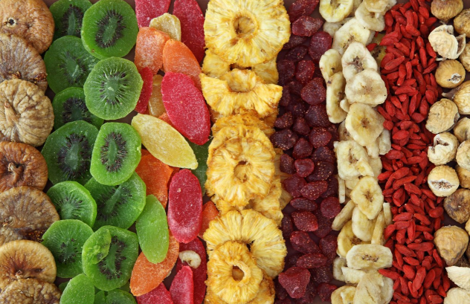

Dehydration
Dehydration (or drying) is defined as the application of heat under controlled conditions to remove the majority of the water normally present in a food by evaporation’ (or in the case of freeze drying by sublimation).
Optimum drying temperature for food is 140°F.

Slide 2
THERMAL PROCESSING
Thermal processing is defined as the combination of temperature and time required to eliminate a desired number of microorganisms from a food product.
The heat treatment can be done as a single preservation technique or it can be used as one step in conjunction with other preservation techniques.
The extent of heat treatment varies depending upon;
The specific objective concerning the preserving action of the heat treatment
The nature of the product.
Thermal processing operations can further be divided into ;
Blanching, Cooking, Pasteurization and Sterilization
A process where food is briefly heated by ;
1) Immersing in boiling water
2) Steam
3) Microwave
4)Ohmic heating
5) Hot gas

Slide 3
IRRADIATION
Food irradiation is a cold, non-chemical process that exposes food to ionizing radiation that can penetrate food to kill, or prevent reproduction of microorganisms, insects and pests.
Treatment of foods by subjecting them to ionizing radiation
Ionising Radiation
Radiation that has the ability to produce ions - electrically charged particles
Examples: alpha particle, beta particle, high energy electron, gamma ray, and x-ray
Nonionizing Radiation
Does not have sufficient energy to create ions - instead tends to excite molecules without removing electrons . Examples: visible light, television waves, radio waves, and microwaves

Slide 4
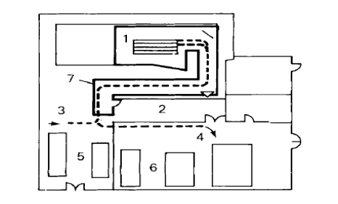
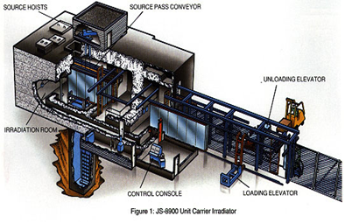

Equipment
Isotope irradiation plant:
1. Irradiation chamber
2. Control room
3. In feed conveyor
4. Outlet conveyor
5. Raw food store
6. Irradiated product store
7. Concrete shielding wall
Are irradiated foods safe to eat?
Foods cannot become radioactive at energies used in irradiation
Below 10 kGy there are no known toxicological, microbiological, or nutritional problems

Slide 5
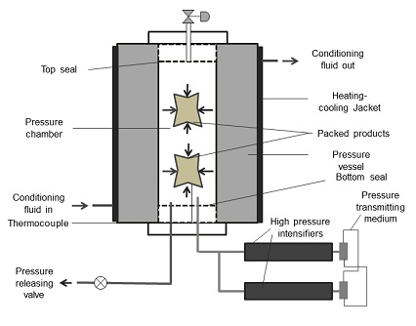
HYDROSTATIC HIGH PRESSURE
Hydrostatic High pressure (HHP), a non-thermal technology, which typically uses water as a pressure transfer medium, is characterized by a minimal impact on food characteristics (sensory, nutritional, and functional). Today, this technology, present in many food companies, can effectively inactivate bacterial cells and many enzymes.
HPP systems are available in two types: 1. Batch process 2- Semi-Continuous process

