Slide 1
Second Language Learning Theories
The Princess Group
Nura Jihad Asad
Sara Omed Ibrahim
Maryam Haji Ali
Supervisor:
A. P. Dr. Nada

Slide 2
Views of the language learner
Who is the second language learner ,and how are they introduced to us, in current SLL research?
What is speech community?
A social group ,who share a common set of norms and expectations regarding the use of language.

Slide 3
What was the highly target language of twenty-first century?
In the first part of the twenty-first century ,the target language is highly likely to be English; estimates suggest that while around 5 percent of the world’s population(approximately 350 million) speak English as their first language, between one and two billion are using it as a second language or a lingua franca, or learning to do so(Graddol,2006,p. 98).Consequently, much research on SLL, whether with children or adults, is concerned with the learning of English , or with a small number of other languages with global reach(French, German, Japanese, Mandarin, Spanish..).There are many multilingual communities today(foe example, townships around fast-growing mega- sities) where L2 learning involves a much wider range of languages.

Slide 4
Lingua franca
A language used for communication by a range of L2 Speakers who do not share a common L1; currently English has a pre-eminent global lingua franca role.

Slide 5
Three main sets of priorities among SLL researchers that the learner is concerned:
Linguistic & psycholinguistic [within the mind]
Social psychological [comprehension]
Sociocultural [social being]

Slide 6
The learner as language processor
What do we mean by language processor?
Language processor is like a software that is bridge between how the learner can learn and how is mental ability of individual learner.

Slide 7
Do child & adult L2 learners learn in essentially similar ways?
Or we can ask in another way which is that: is there a critical age which divides younger and older learners, a moment when early learning mechanisms atrophy and are replaced or at least supplemented by other compensatory ways of learning?
Many L2 researchers agree with some version pf a view that ‘younger= better in the long run’(Singleton, 1995, p. 3).

Slide 8
What is the language aptitude?
The potential talent of an individual for L2 learning, Including sub-skills such as the ability to detect grammatical patterns.

Slide 9
SLL success methods
Communicative approaches: Approach to language teaching that stresses meaning- based activities and learning experiences.
Longitudinal: Research approach where participants are tracked over a period of time to study their development.
Parsing: Decoding of the input to arrive at a meaning, usually including a syntactic analysis( typically at a subconscious level).

Slide 10
Language learning strategies
Language learning strategies are designed by ( Rebecca Oxford )in the1990s it's conscious thoughts and behaviors that have the explicit goal of improving knowledge and understanding of the second language.
What do these strategies do?

Slide 11
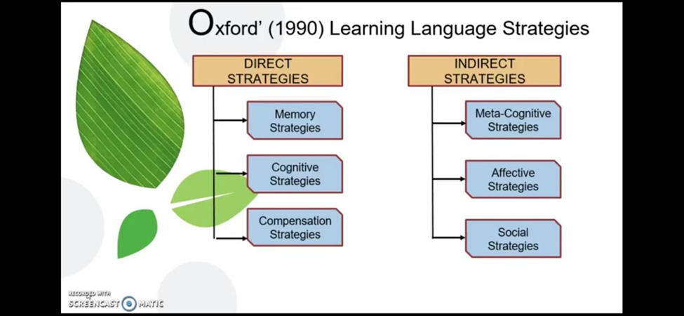

Slide 12
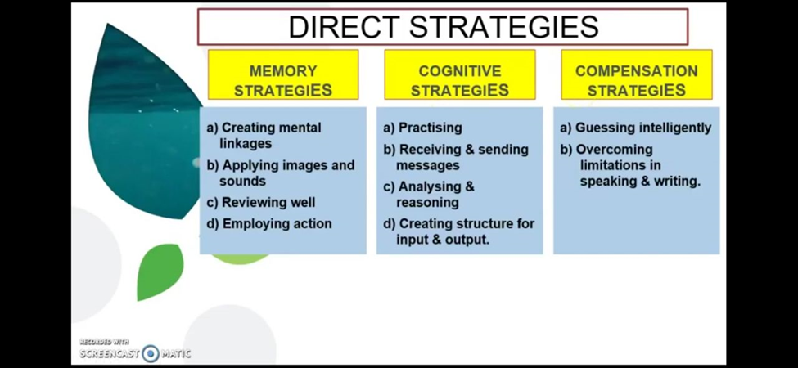

Slide 13
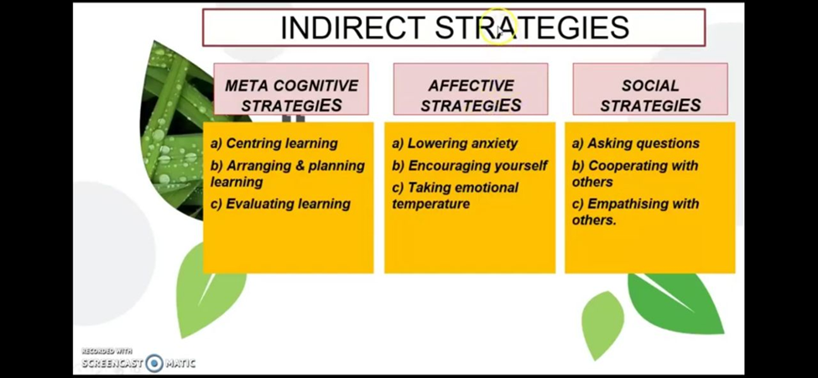

Slide 14
language attitudes
Social psychologists have long been interested in the idea that the attitudes of the learner towards the target language, its speakers and learning context may all play some part in explaining success or lack of it.

Slide 15
Motivation
Research into L2 motivation was dominated from the 1970s by the work of the Canadian social psychologist (Robert C Gardner)

Slide 16
Three main elements
Desire to achieve a goal:
Which means wanting to achieve a certain goal.
Effort extended in this direction:
Which means like efforts we make to learn the language.
Satisfaction with the task:
Which is like enjoying a task of learning.

