Slide 1
Dialysis
dialysis (from Greek "dialusis", meaning dissolution, "dia", meaning through, and "lysis", meaning loosening)
In biochemistry, dialysis is the process of separating molecules in solution by the difference in their rates of diffusion through a semipermeable membrane, such as dialysis tubing
Dialysis works on the principles of the diffusion of solutes and ultrafiltration of fluid across a semi-permeable membrane. Diffusion describes a property of substances in water. Substances in water tend to move from an area of high concentration to an area of low concentration

Slide 2
Dialysis may be used for those with an acute disturbance in kidney function (acute kidney injury, previously acute renal failure) or for those with progressive but chronically worsening kidney function–a state known as chronic kidney disease stage 5 (previously chronic renal failure or end-stage kidney disease).

Slide 3
Blood flows by one side of a semi-permeable membrane, and a dialysate, or special dialysis fluid, flows by the opposite side.
A semipermeable membrane is a thin layer of material that contains various sized holes, or pores. Smaller solutes and fluid pass through the membrane, but the membrane blocks the passage of larger substances (for example, red blood cells, large proteins)

Slide 4
Dialysis tube
Dialysis Tubing or visking tubing is a type of semi- or partially permeable membrane tubing[1] made from regenerated cellulose or cellophane. It can be used for diffusion with solutes or osmosis if used with water only.
Osmosis is when water passes through a semi-permeable layer to reach equilibrium. Diffusion, on the other hand, allows the movement of molecules from high concentration to low concentration. It will only allow molecules to pass through a semi-permeable membrane or layer if the molecule is small enough to fit through the membrane or a membrane's pore. This usually results with the effects of diffusion through a membrane only really affects small molecules,

Slide 5
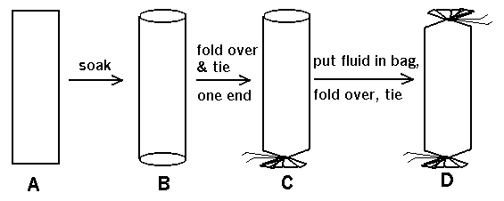
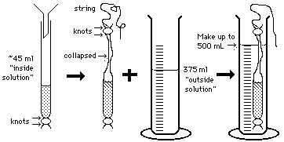
Preparation of dialysis tube

Slide 6
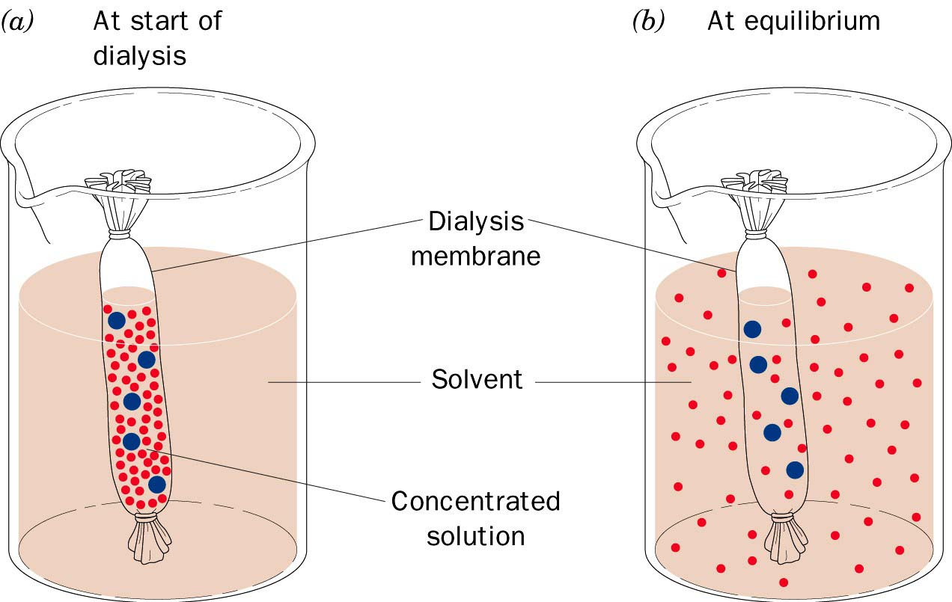

Slide 7
Procedure:-
Set up the apparatus as shown above.
Wash the filled visking tubing under water before immersion in the distilled water (to remove any starch and glucose on the outer surface).
Test for the presence of starch and glucose (reducing sugar) in the distilled water after 1 hour.
Result:-
Only glucose (simple sugar) is present in the distilled water outside the visking tubing.
Interpretation
Glucose molecules are small enough to pass through the tiny pores on the selectively permeable membrane of the visking tubing by diffusion. Starch molecules are too large so they cannot pass through the membrane.

Slide 8
