Slide 1
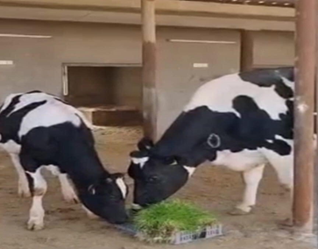
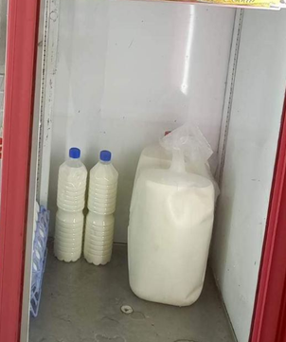
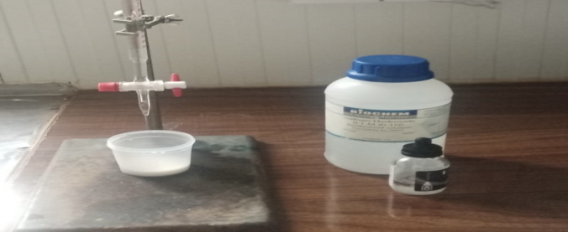
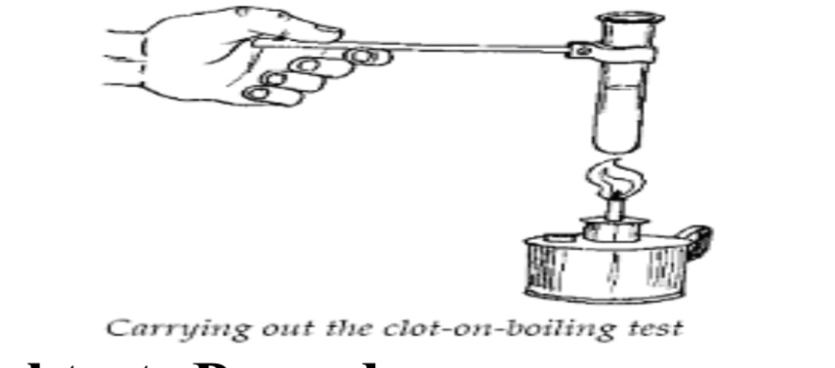
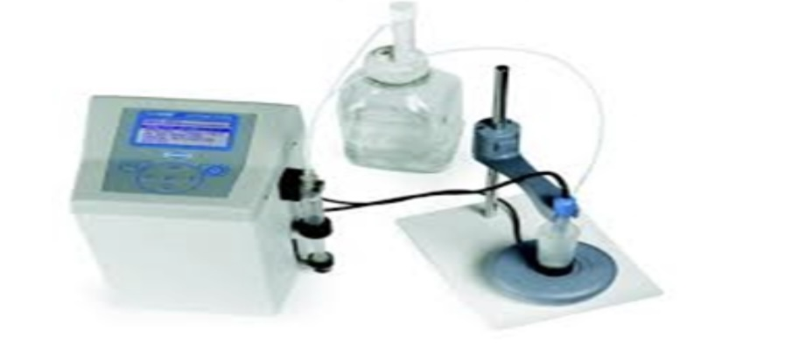
Evaluate the quality of milk produced at the Grdarash field in
College of Agricultural Engineering Sciences
Prepared by: Shanaz Saadulla Salih
College of Agricultural Engineering Sciences
Department of Food Technology
Supervised by :Assist.Prof. Dr. Narin M. Nanakali
In this project, the physicochemical and microbiological properties of cow's, sheep's and goat's milk were studied at the Grdarash farm belonging to the College of Agricultural Engineering Sciences/ Salahaddin University-Erbil. The samples were taken from the morning milking and kept in the refrigerator at a temperature of 4°C, then analyzed after 2 hours of refrigerated storage, and the results of the physicochemical properties of the samples examined were within the local and international standards, as well as all samples of high microbial quality.
Raw milk is a comprehensive source of nutrients, encompassing protein, fats, sugars, vitamins, and minerals, specialized cells in the mammary gland synthesize milk, and upon secretion into the udder's alveoli, it is essentially sterile . A sufficient consumption of milk has the potential to positively impact bone and dental health, prevent conditions like osteoporosis, metabolic syndrome, hypertension, and cardiovascular risks, as well as address concerns related to overweight, obesity, and promote gastrointestinal well-being and gut health.
The aim of this study
1.Knowing the quality of milk produced in the Grdarash field, affiliated with the College of Agricultural Engineering Sciences/ Salahuddin University - Erbil.
2.Knowing the extent of care received by the milk during the process of production and circulation within the field.
3.Detecting the:
4.Conducting physicochemical tests of milk to determine the changes occurring.
Milk quality testing procedures : -
physiochemical test of raw milk:
Detection the mean value our results for the Physicochemical properties in three samples for cow goat sheep The good hygiene quality of three types of milk due to good management, collecting milk aseptically, holding milk at cold condition immediately after production, good milker personal hygiene and cleaning of utensils and equipment.
Table1: Physiochemical measurements for the three studied samples.
Detection adulteration (Clot on Boiling and Alcohol test) of raw milk:
In the present study, the result of the COB test and Alcohol test for three samples (Cow, Sheep and goat milk) was negative as .Our results in three samples are identical to the Iraqi standards.
Table 2: Clot on Boiling (COB) and Alcohol test of raw milk.
Bacteriological of raw milk:
In this study, hygiene and management factors like udder cleaning, water and soap for cleaning the udder, hand washing, and water and soap used for milking vessels significantly affected the milk's bacteriological count. The growth of a low bacterial number in TBC is due to the quality of the milk. Total Psychrotrophic Bacteria and Coliform Bacteria. Our research in three types milk broadly in agreement with Iraqi standards.
Table3: Bacteria characteristics in the three type milk
Abstract
Introduction
Discussion
Parameter |  | Samples
 | Cow milk | Sheep milk | Goat milk
Fat % | 5.1 | 6.27 | 3.42
Solids-non-fat% | 8.194 | 10.24 | 9.97
Total Solids % | 13.294 | 16.51 | 13.39
Water % | 86.706 | 83.49 | 86.61
Density g/mL | 1.031 | 1.034 | 1.034
Protein% | 3.894 | 5.30 | 3.76
Lactose% | 4.94 | 4.57 | 5.3
Added water% | 00 | 00 | 00
Freezing point °C | -0.577 | -0.595 | -0.586
Salts% |  | 0.92 | 0.83
pH | 6.26 | 5.8 | 6.28
Acidity | 0.21 | 0.23 | 0.22
1.Collection Milk sample:
2.Milk quality testing procedures: -
A.
Detection physiochemical test of milk:
1)By Lactoscan:
2) By normal (classical) methods:
The determination of pH
The Titratable Acidit
- The Clot-on boiling test and Alcohol test
B. Microbiological examination:
1. Total mesophilic bacteria count
(Total Count Bacteria).
2. Total psychrotrophic bacteria count
3. Total Coliform count
Methodology
Raw milk is known for its high nutritional value and quality. It is rich in vitamins, minerals, and antioxidants, and is considered to be a highly efficient source of these nutrients. Raw milk also contains beneficial bacteria that are thought to aid in digestion, improve gut health, and support the immune system. Moreover, this result is due to proper health conditions and sanitary facilities from the production stage to the consumption stage. Microbiological quality requires further investigation into the health status of animals, especially mastitis. Furthermore, from a microbial safety point of view, it is recommended not to consume raw milk, and pasteurization of milk is highly recommended. More food safety education should be provided to producers, handlers, and consumers.
Conclusion
Bacteriological Tests (Milk Samples) |  | Mean
Total Count Bacteria (CFU/ml) | Cow milk | 107 ×10³
 | Sheep milk | 81 ×10³
 | Goat milk | 69 ×10³
Total Psychrotrophic Bacteria (CFU/ml) | Cow milk | 3 ×10³
 | Sheep milk | 2 ×10³
 | Goat milk | 1 ×10³
Total Coliform (CFU/ml) | Cow milk | 0 ×10³
 | Sheep milk | 0 ×10³
 | Goat milk | 0 ×10³
1.Scandurra, G.; Cardillo, E.; Ciofi, C. and Ferro, L. J. A. S. (2022). UHT Milk Characterization by Electrical Impedance Spectroscopy. Applied Sciences. 12(15): 7559.
2.Müller, T.; Maciel, M. J. and Rempel, C. J. C. A. B. (2022). Physicochemical and microbiological quality of bovine milk from Vale do Taquari in Rio Grande do Sul,
Brazil. Ciência Animal Brasileira. 23
3.Arrieta, G., Gomezcaceres, L., Albis, D., Calderón-Rangel, A. and Rodríguez, V., 2019. Quality of raw milk for human consumption in two locations in Sucre, Colombia. Revista Mvz Cordoba, 24(3), pp.7355-7361.
References

