Slide 1
Exp : ( 4 ) Spectrophotometric determination of
copper sulphate
Introduction:
The primary objective of this experiment is to determine the concentration of an unknown copper (II) sulfate solution. The CuSO₄ solution used in this experiment has a blue color.
Colored solutions are colored because they absorb certain wavelengths of light while allowing other wavelengths of light to pass through. As observers, we see the wavelengths of light that are not absorbed. By measuring the amount of light absorbed, we can find the concentration of solutions.

Slide 2
Anhydrous (without water) CuSO₄ is gray-white in colour.but the more common CuSO₄.5H₂O is a lovely shade of light blue, and CuSO₄ is dissolved in water and forms a blue solution. That is because it absorbs light in the red-orange region of the spectrum. So your eyes perceive it a being blue.
Before doing this type of spectral analysis, the wavelength at which absorbance is greatest needs to be determined. This is the wavelength to be used for the analysis.[maximum wave length λ max

Slide 3
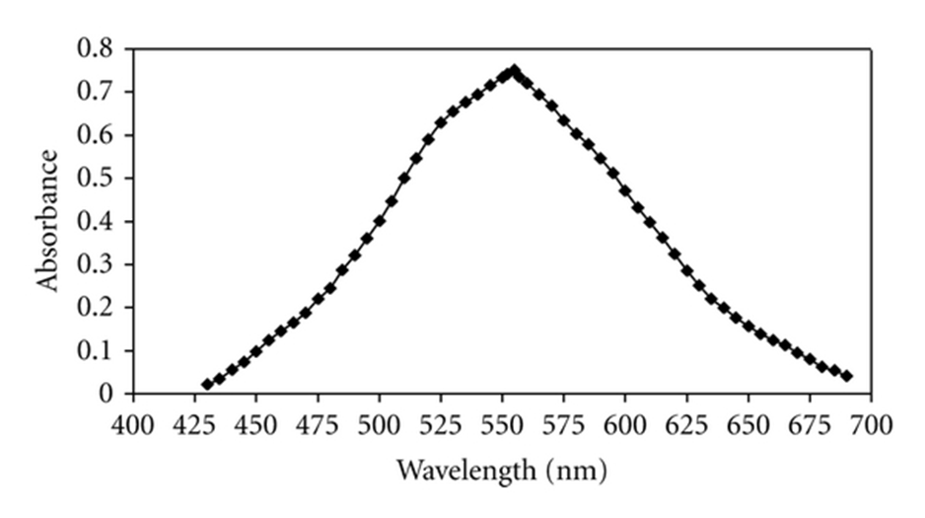
How to find maximum wave length ?
Maximum wave length gives a maximum absorbance. It can be found by taking the absorbance of a fixed concentration of color solution at different wave length. By plotting a curve between absorbance & wave length we can get the maximum wave-length as shown in this figure:
Maximum wave length
Wave length | Absorbance
590 592 594 596 --- ---- ---- ----- | ---- ------ ------ ----- ----- ----- ------ ------

Slide 4
Calibration curve
1- Preparation of standard solution ( stock solution)
2- Preparation of serial standard solution from the stock solution
3- Plot a graph between the concentration and absorbance
4- Find the absorbance of unknown sample
Test Tube | Concentration of CuSO$4$ (M) Absorbance
1 2 3 4 5

Slide 5
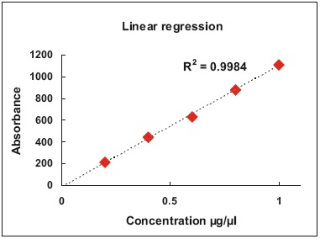
Beers Law

Slide 6
Procedure
Exp: ( 4 ) Spectrophotometric determination of CuSO₄.5H₂O
1- Prepare a standard copper solution at 0.4M by first calculating the required amount of pure CuSO_{4.}5H₂O in 100 ml distilled water. The obtained solution is named stock solution.
2-Label six clean, dry, test tubes 1–6. Use pipets to prepare five standard solutions according to the chart below.

Slide 7
Test Tube | 0.40 M CuSO₄(mL) | Distilled H₂O(mL) | Concentration(M)
1 2 3 4 5 6 | 0 2 4 6 8 10 | 10 8 6 4 2 0
3- Measure the absorption spectrum , of this CuSO₄.5H₂O standard between 590 nm and 700nm , from the absorption spectrum select the optimum wave length to use for all absorbance measurements. By drawing a curve between absorbance and wave length.

Slide 8
4- Measure the absorbance of all six standard solution and the unknown solution after measuring the absorbance of blank solution
5- Draw a calibration curve between absorbance and concentration and find the concentration of the unknown solution.

Slide 9
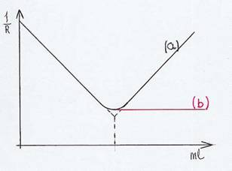
Conductometric Analysis

Slide 10
Electrolyte solutions behave as an electrically conductive medium. The change of electrolyte conductivity can indicate the change of the concentration of the total ions, this method is defined as counductumetric Analysis
Conductivity is measured by using conductometer.Units of conductivity is mhos (1Ω⁻¹ ) , where 1S=1Ω⁻¹
The magnitude of counductumetric titration is based on Ohm’s law.
10

Slide 11
Ohm’s law:
R = V / I
Where R = resistance (ohms), V = voltage (volts), I = current (amps)
Total conductance of the solution is directly proportional to the sum of the n individual ion contributions .
G = ∑c_{i}Λ_{i}
5

Slide 12
Factors affecting conductivity:
Size of ions
Temperature
Number of ions
Charge of ions
Uses of conductometric method
1- Determination solubility products.
2- Find the dissociation constants (K _{a}).
3- To detect the end point of titration.
4- Other properties of electrolyte solutions.
12
12

Slide 13
CONDUCTOMETRIC TITRATIONS:
The determination of end point of a titration by means of conductivity measurements are known as conductometric titrations.
Types of conductometric titrations:
Acid-base titration
Precipitation titration
Redox (oxidation-reduction) titration
Complexometric titration
13
13

Slide 14
conductance
H +
OH -
L
Equivalence Point
volume
V (ml) NaOH
( N x v ) Hcl = ( N x V ) NaOH
Conductometric Titration of Hcl with NaOH
14

Slide 15
A) Titration of HCl with NaOH
( A ) / Consider what happened when hydrochloric acid is titrated with
sodium hydroxide solution .:
1. Initially the conductivity is quite high because of the high equivalent
Conductance (mobility) of hydrogen ions.
2. The hydrogen ions are replaced by the same number of sodium ions
But those have a very low mobility, so that the over all conductance
decrease steeply to the equivalence point.
3. After this point is passed, the conductance increase again as both
the solution and hydroxide ions accumulate in the solution.
Mobility λ0 H + = 350 ohm-1 cm-1 : λ0 Na + = 50 ohm-1 cm-1 :
λ0 OH - = 198 ohm-1 cm-1
HCl → H ⁺ + Cl ⁻
HCl + NaOH → NaCl + H₂O
15

Slide 16
B) Titration of CH₃COOH with NaOH
Initially the solution has a law conductance :
CH₃COOH ↔ CH₃COO ⁻ + H ⁺
As neutralization proceeds ,conductance decrease
CH₃COOH + NaOH ↔ CH₃COONa + H₂O
After ( e.p) the conductance of the solution increase
because of increase the ( OH -) conc.
NaOH Na ⁺ + OH ⁻
16

Slide 17
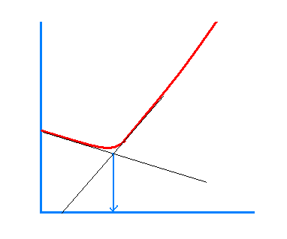
conductance
Equivalence Point
volume
V (ml) NaOH
( N x v ) CH₃COOH = ( N x V ) NaOH
Conductometric Titration of CH₃COOH with NaOH
17

Slide 18
Procedure
EXP . ( 5 )
Conductometric titration of HCl and CH₃COOH with
NaOH ,determination of Ka for acetic acid
1.Take ( 10 ml) of HCl sample and dilute to ( 100 ml) with
( D.W) . Place the beaker containing your sample on the
magnetic stirrer. Lower the conductivity cell into the beaker
until it is covered.
2.Take the initial reading and then add ( 0.5 ml) of NaOH
( 0.2 M) in burette.
3.In the same manner titrate ( 50 ml) of CH₃COOH unknown
sample . Add ( 0.2 until 2 ml ) of NaOH continue the
titration in ( 0.5 until 10 ml) of the ( 0.2 M) NaOH is add.
18

Slide 19
4.Rinse the conductivity cell and store in ( D.W) .
5.Calculate the M of HCl and CH₃COOH .And dissociation
constant for CH₃COOH.
19

Slide 20
Determination Ka for acetic acid :
Ka = [ H⁺] [ OAC⁻] / [ HOAC]
α = $\frac{\text{^ }\text{HOAC}}{\text{^}□}$ , ( $\text{^}□$ = 430.7 )
^ = L x 1000 / C
NOTE: Use platinum electrode in conductometry
measurement
Ka = C α ² / 1 - α
( Conc. CH₃COOH : ( N X V _{CH3COOH} ) = ( N X V _{NaOH} )
20

Slide 21
FLAME SPECTROSCOPY
The concentration of an element in a solution is determined by measuring the absorption, emission or fluorescence of electromagnetic by its monatomic particles in gaseous state in the flame.

Slide 22
Flame Emission
Atoms in gaseous state in the flam absorb
thermal energy from the flame itself ,some
of the atoms get excited & as they return
back to the ground state they emit radiation
having energy equal to that absorbed.
The emission is proportional to the number
of excited atoms, which is proportional to the
total number of atoms in the flame i.e. the
sample concentration
Na Na *
Na * Na + hν
Energy from flame
Proportional to conc.

Slide 23
Flame photometry: is an atomic emission method for the
routine detection of metal salts , principally Na , K , Li , Ca
and Ba .
The method is selective to ward detection of alkali and alkali
earth metals and simple, inexpensive, used for clinical,
biological ,and environmental analysis.
Flame photometry is limited because the temp. of flam is
not high enough to excite other or transition metals.

Slide 24
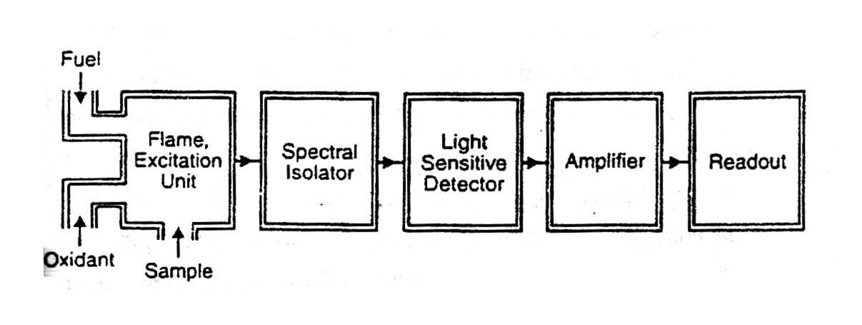
INSTRUMENT FOR FLAME EMISSION
1-Flame atomizer.
2- Monochromator
3- Detector.
4- Readout meter.

Slide 25
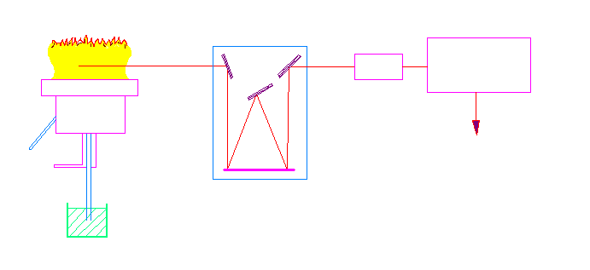
flame
Dc amplifier
Photo multiplier
fuel
recorder
oxidant
monochromator
sample
Flame photometry diagram

Slide 26
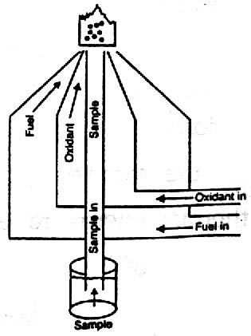
The temperature of the flame produced depends on (fuel-oxidant ) ratio and kind.
Fuels | Oxidants
Hydrogen | Air
Acetylene | Oxygen
Propane | Nitrous oxide

Slide 27
The process that done inside the flam :
1- The solvent is evaporated leaving minute particles of
dry salt ( S ).
2- The dry solids are converted into the gaseous state.
3- Apart of all the gaseous molecules are dissociated to
give neutral atoms' or radicals. The atomization step.
4-Apportion of the neutral atoms may be thermally
excited.
5-Some of the neutral atoms may combine with radicals
in the flame gases to form new gaseous compounds.

Slide 28
The process that done inside the flam :
Sample nebulization dessolvated
Vaporized
Atomized
hν
return to a lower ground stat ← excited electronic state
↓
(Flam photometry)
• Those which are activated (excited) will drop back to ground state with the emission
of a photon of radiation which can be identified and measured with a suitable
(flam photometry).

Slide 29
Exp. No. (6) Determination of sodium and potassium in soil by flame photometry
Procedure
1. Preparation of Stock solution:
Prepare (100 ppm) of Na⁺ from NaCl in (250 ml).
Prepare (100 ppm) of K⁺ frome KCl in (250 ml).
2. Preparation of Calibration Curve:
- Prepare (5,10,15, 20, 25 ppm) of Na⁺ from the stock solution,
Complete the volume to (50 ml) by (D.W.).
- Prepare (10, 20, 30, 40, 50 ppm) of K⁺ from the stock solution Complete the volume to (50 ml) by (D.W.).

Slide 30
3. Preparation of the unknown:
Weight (2 g) of soil, add (5 ml) of conc. HCl heat for (2 min), add a few drops of (D.W.) and filter the solution then complete the volume to (50 ml).
4. Set the instrument to read 100% for the most concentrate
Na⁺ solution, determine the intensity of the other Na⁺ solution as compared to this. Run of sample.
5. Set the instrument to 100% with the most concentrated K⁺
Solution. Read the intensity of the K⁺ solutions as compared
to this. Run an unknown sample.
6. Determine the concentration of Na⁺, K⁺ in the sample.

Slide 31
Emission %
conc. unknown
Conc. ppm ( Na )
Calibration curve for Na or K

Slide 32

Prepare (100 ppm) of Na⁺ from NaCl in (250 ml).
100 ppm = 100 mg /L
= $\frac{100}{1000}$ g
= 0.1 g / L
= 0.1 / 4
= 0.025 g/ml Na⁺
Na⁺ NaCl
At wt = 23 m.wt = 58.5
0.025 x
X= 58.5 x 0.025 / 23 x = 0.06gm
PPm = M x M.wt x 1000

Slide 33
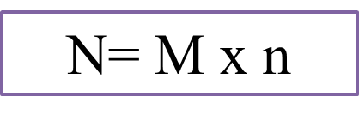

Slide 34
2- Preparation of solutions from Liquids.
1-First step
2- Second step
( M₁ V₁ ) concentration = ( M₂ V₂) dilution

