Slide 1
Quality Control Theory
Set by: Dr. Nashmeel Saeed Khudhur
Lecture: 06
28/3/2023. Tuesday. 8:30-10:30 am

Slide 2
Environmental quality management

Slide 3
Environmental quality management
Introduction.
Environmental quality management.
Environmental compliance.
Remediation.

Slide 4
Introduction
Environmental management practices, as part of the sustainability management movement, have become an integral (essential) part of the practices.

Slide 5
People are facing the problems that the earth is revenging انتقام humanity for destroying the nature balance.

Slide 6
Countries around the world pay more attention to environment protection issues.

Slide 7
Sustainable development can be achieved by means of scientifically making
use of natural resources and
balancing the relationship of humanity and nature.

Slide 8
Therefore, advanced and developing countries started to pay attention to ISO 14000 in Environmental Quality Management, and future industries must follow this standard to fulfill the responsibilities as international citizens.

Slide 9
ISO 14000 is a series of environmental management standards developed and published by the International Organization for Standardization (ISO) for organizations.

Slide 10
The ISO 14000 standards provide a guideline or framework for organizations that need to systematize (organize) and improve their environmental management efforts.

Slide 11
ISO 14000 help organizations to:
minimize how their operations negatively affect the environment;
comply with applicable laws, regulations, and other environmentally oriented requirements;

Slide 12
Environmental quality management
EQM is a leading environmental consulting, remediation, and construction company providing expertise in:
engineering and environmental compliance (conformance),
environmental remediation,
and construction services to the industrial, public, and government sectors.

Slide 13
Environmental compliance
(conformance or obligingness)
Environmental compliance means conforming to environmental laws, regulations, standards and other requirements such as site permits to operate.

Slide 14
In recent years, environmental concerns have led to a significant increase in the number and scope of compliance important across all global regulatory environments.

Slide 15
The environmental consultants provide clients or customers with active approach to guide them in all aspects of:
Air quality permitting,
Water quality management,
Waste management,
Chemical reporting,
Industrial hygiene, and
Other Environmental health and safety (EHS) services.

Slide 16
EHS stands for Environment, Health, and Safety. It's a general term used to refer to laws, rules, regulations, professions or occupation, programs, and workplace efforts to protect the health and safety of employees and the public as well as the environment from hazards associated with the workplace.

Slide 17
Environmental Compliance Monitoring
It is a continuous process of obtaining information to determine if the parties required under law to control their polluting discharges and emissions are doing so.

Slide 18
Remediation
Environmental remediation refers to reducing or removal of pollution or contamination from environmental media such as soil, groundwater, sediment, or surface water.

Slide 19
The purpose is more than just eliminating pollution sources; it is about protecting people and the environment against potential harmful effects from exposure to different pollutants and ecological risks.

Slide 20
A/ Site assessment
Once a site is suspected of being contaminated, there is a need to assess the contamination. Often the assessment begins with preparation of a Phase I Environmental Site Assessment.

Slide 21
The historical use of the site and the materials used and produced on site will guide the assessment strategy and type of sampling and chemical analysis to be done.

Slide 22
Often nearby sites owned by the same company or which are nearby and have been reclaimed, levelled or filled are also contaminated even where the current land use seems innocuous (not harmful).

Slide 23
Also it is important to consider off site contamination of nearby sites often through decades of emissions to soil, groundwater, and air.

Slide 24
Ceiling dust, topsoil, surface and groundwater of nearby properties should also be tested, both before and after any remediation.

Slide 25
This is a controversial جدلي step as:
No one wants to have to pay for the cleanup of the site.
If nearby properties are found to be contaminated, it may have to be noted on their property title, potentially affecting the value.
No one wants to pay for the cost of assessment.

Slide 26
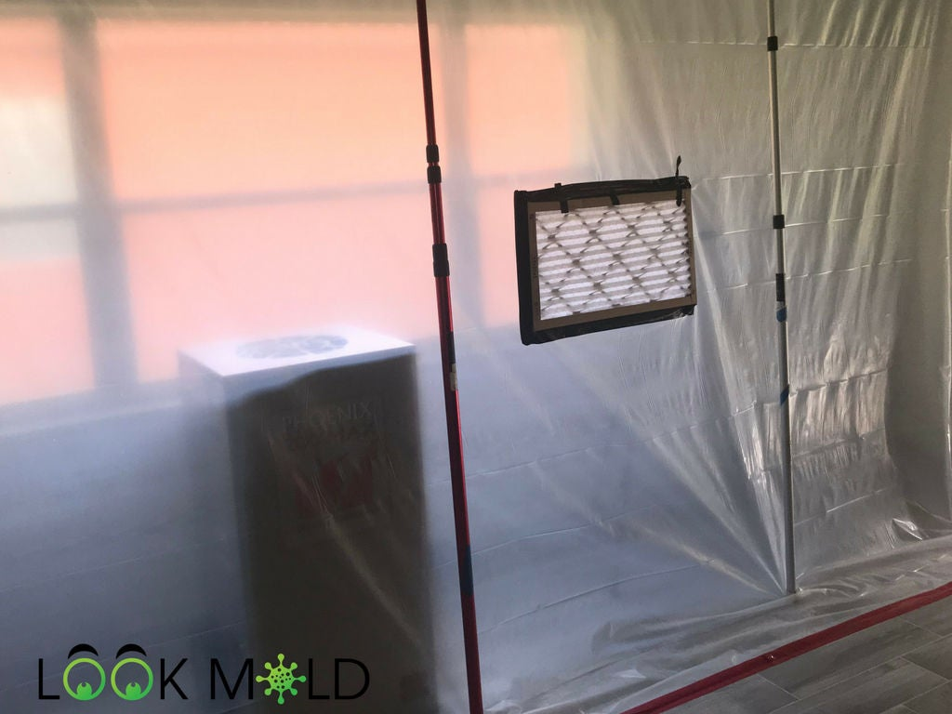
B/ Remediation technologies
Remediation techniques
which have been commonly
used include:
Containment: is the retention of hazardous material to ensure that it is effectively prevented from dispersing into the environment, or released only at an acceptable level.

Slide 27
Pump-and-treat: it is one of the most widely used ground-water remediation technologies.
Conventional pump-and-treat methods involve pumping contaminated water to the surface for treatment.

Slide 28
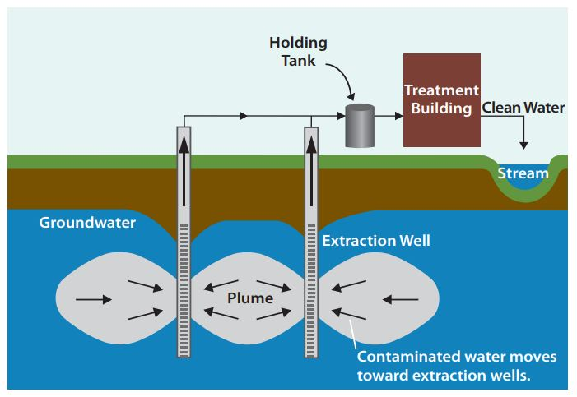

Slide 29
Extraction: solvent extraction is a promising technology for soil remediation. It is an ex-situ separation and concentration process in which a non-aqueous liquid is used to remove organic contaminants. Since water was present in the soil moisture, it was considered as a component of the extracting solvent.

Slide 30
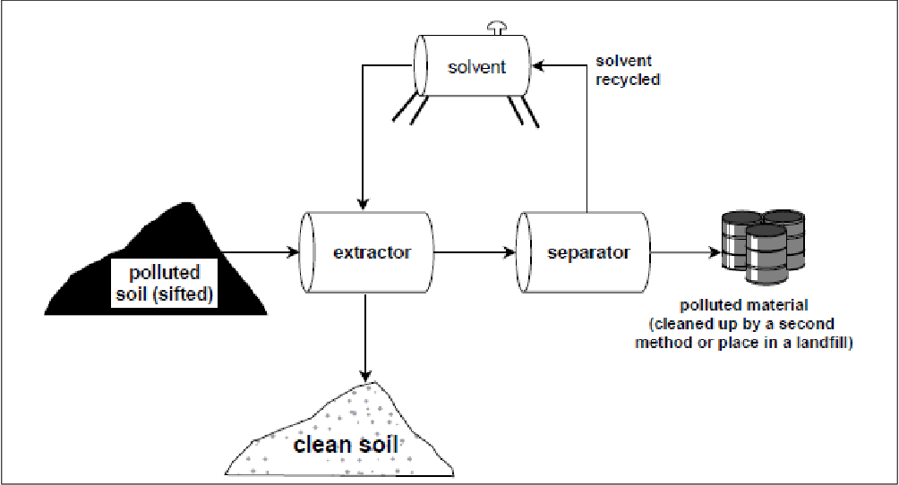

Slide 31
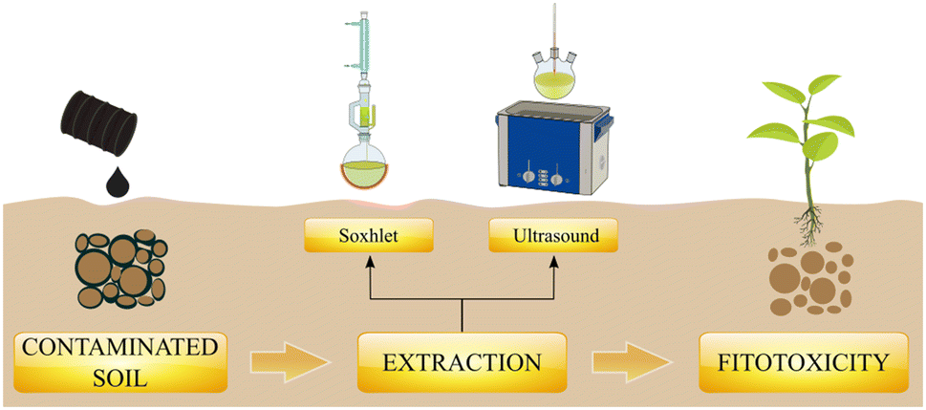

Slide 32
Stabilization/solidification (S/S): is a soil remediation process by which contaminants are rendered immobile through reactions with additives or processes. During this process, also called immobilization, fixation, or encapsulation, contaminants may chemically bound or encapsulated into a matrix.

Slide 33
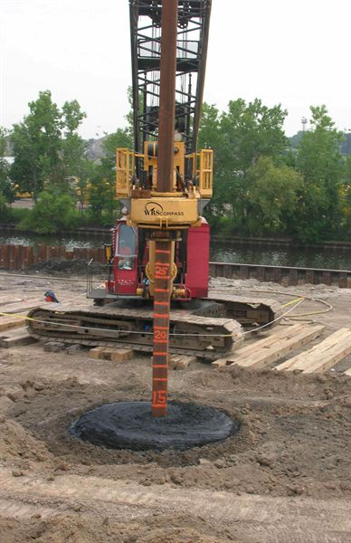
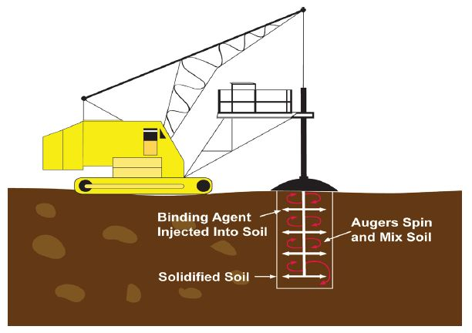

Slide 34
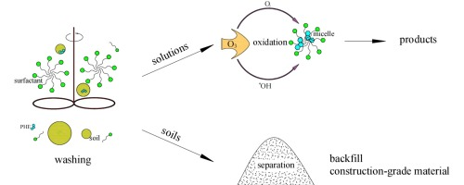
Soil washing: is an ex-situ remediation technique that removes hazardous contaminants from soil by washing the soil with a liquid (often with a chemical additive), scrubbing the soil, and then separating the clean soils from contaminated soil and wash-water.

Slide 35
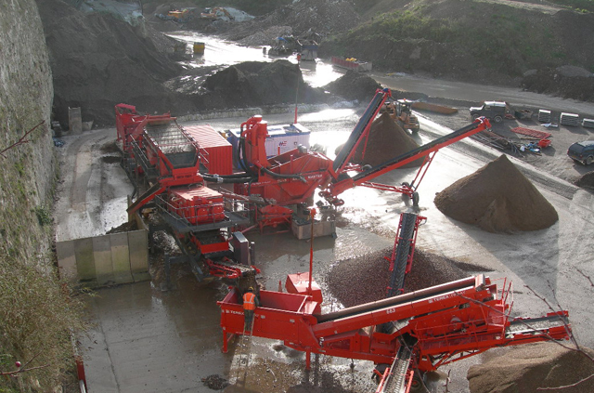

Slide 36
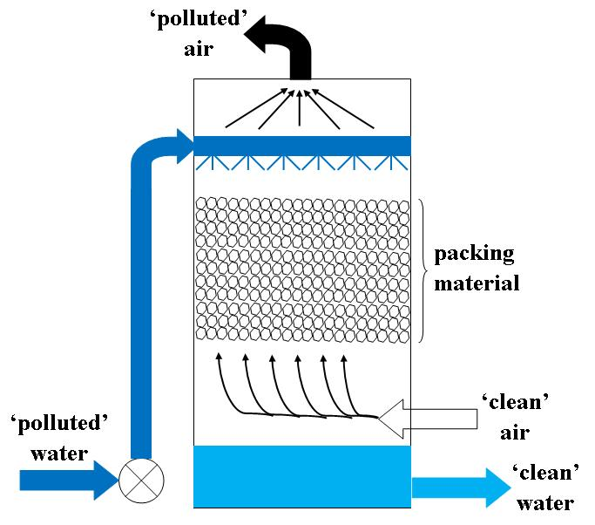
Air stripping: it is the transferring of volatile components of a liquid into an air stream and used for the purification of ground waters and wastewaters containing volatile compounds.

Slide 37
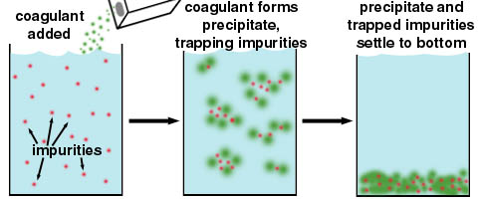
Precipitation: is the change in the form of materials dissolved in water into solid particles. It is becoming the most widely selected means for removing heavy metals from water and wastewater. Chemical precipitation is used to remove ionic constituents from water by the addition of counter-ions to reduce the solubility.

Slide 38
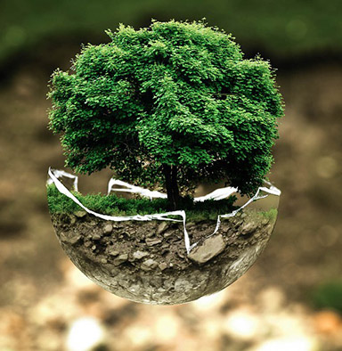
Biological remediation: is a process of using microorganisms or plants to detoxify or remove organic and inorganic xenobiotic compounds from the environment. It is a remediation option that offers green technology solution to the problem of environmental degradation.

Slide 39
?

