Slide 1
The environment at risk
Lecture 2
22/2/2023
What is environment?
Why care for environment?
Threats to environment:
1. Air pollution.
2. Water pollution
Set by:
Assist. Prof. Dr. Nashmeel Saeed Khudhur

Slide 2
What is environment
Environment means our surrounding which include: 1) air, 2) water, 3) soil, 4) biological environment- flora and fauna, 5) noise, 6) aesthetics, 7) cultural, 8) socio-economic and 9) political conditions.

Slide 3
Why care for environment?
Environment affects our ability to live on earth. It affects our health, our economy and our existence.

Slide 4
Threats to environment
1. Air pollution
Air pollution occurs when the air contains gases, dust, fumes or odor in harmful amounts which could be harmful to the health or comfort of humans and animals or which could cause damage to plants and materials.

Slide 5
Air pollution caused by tons of pollutants which dumped in by industries and vehicles which causing green coverage decreasing day by day.

Slide 6
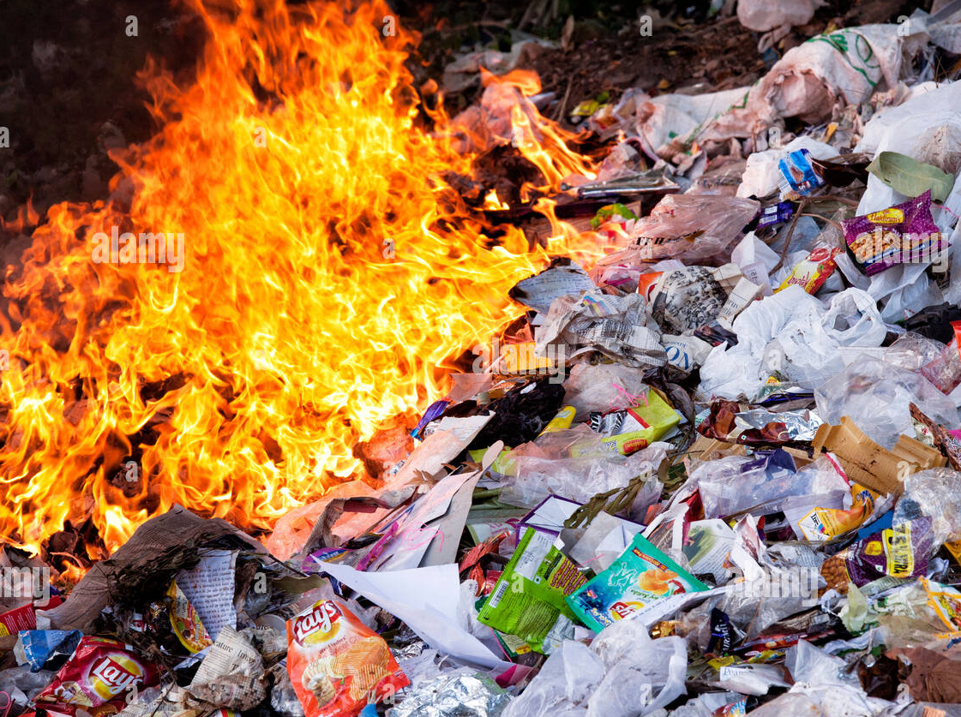
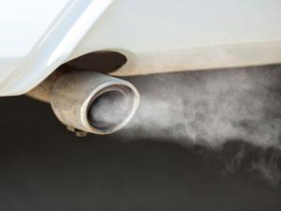
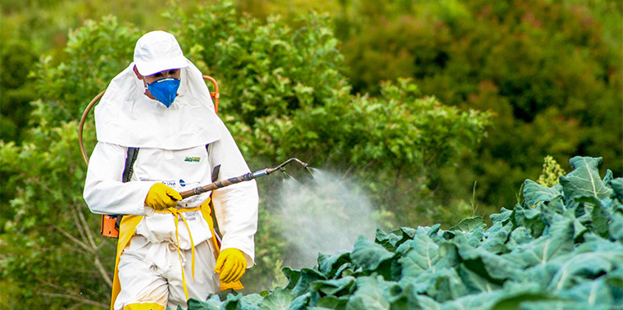
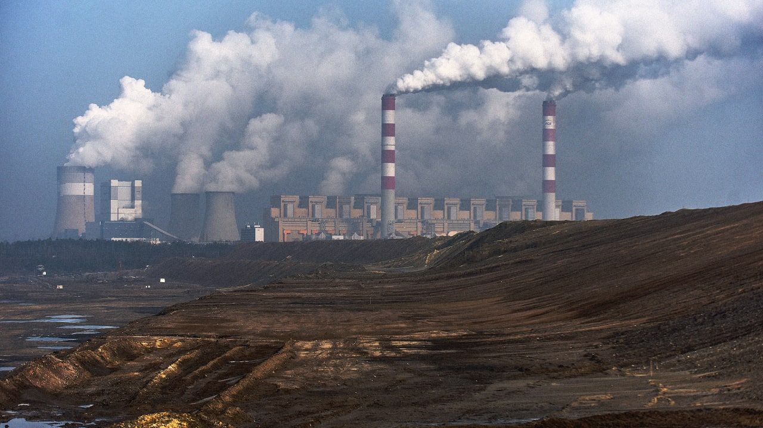
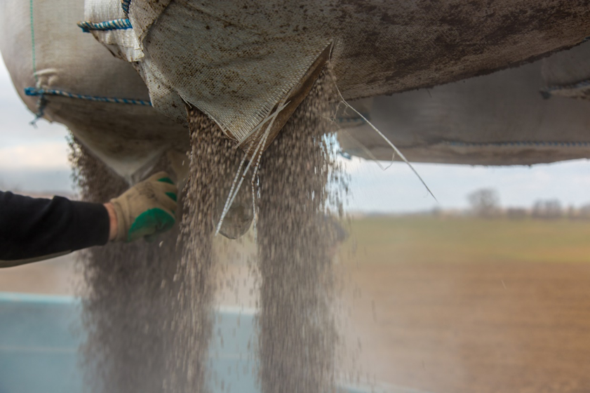
Causes of air pollution (human activity):
Open burning.
Combustion engine exhaust.
Plant emissions.
Pesticides used.
Radioactive fallout.
Fertilizer dust.

Slide 7
The major Air Pollutants are:
CO and CO₂.
Nitrogen oxides (NO_{x}).
Sulfur oxides.
Volatile Organic Compounds (VOCs).
Particulate matter.
Toxic metals- lead, cadmium.

Slide 8
Effects of air pollution:
Acid rain.
Global warming.
Greenhouse effect.
Respiratory problems like asphyxiation, asthma, etc.
Cancer and mutation.
The thinnest ozone layer.

Slide 9
Control measures for air pollution
Preventive action is the best.
Spread the awareness among people.
Conduct epidemiological studies– how air quality affects health?
Pressurize governments for proper policies for e.g. - prevent dieselization of private vehicles.
Promote usage of bicycles.

Slide 10
Use alternative energy resources like solar, wind, etc.
Zoning and transport infrastructure planning.
Introduction of cleaner engines and cleaner fuels like CNG (compressed Natural Gas).
Stricter regulations for vehicular and industrial emissions and regular compliance checking.
Stop burning of wastes.

Slide 11
2. Water pollution
Water pollution is the contamination of water bodies. Water pollution occurs when pollutants are discharged directly or indirectly into water bodies without adequate treatment to remove harmful compounds.

Slide 12
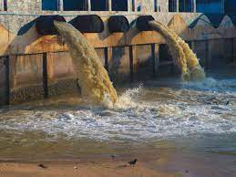
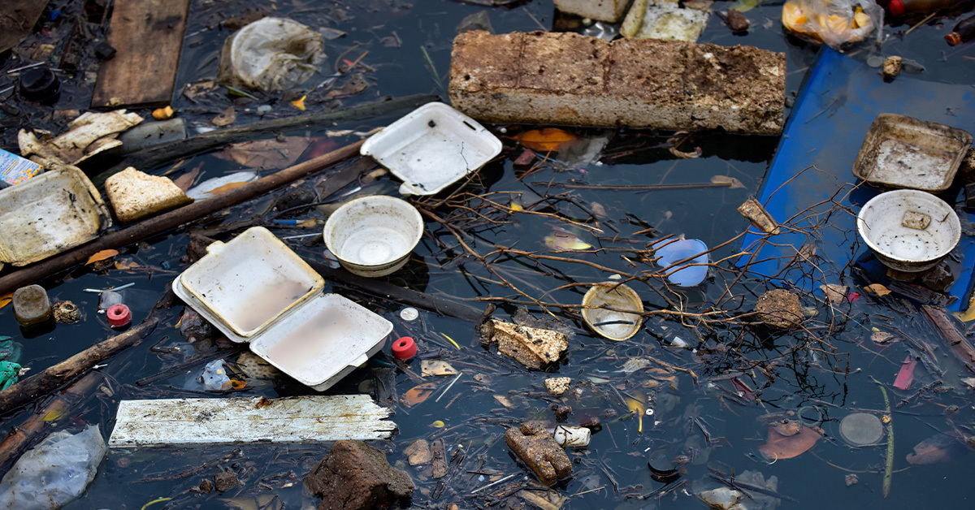
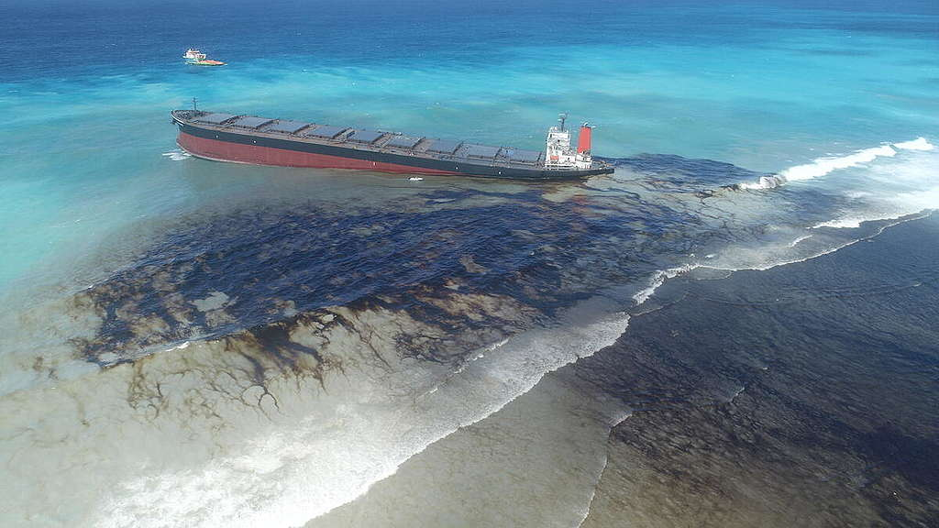
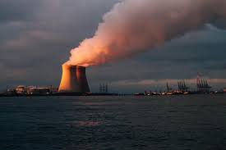
Causes of water pollution:
Industrial Waste.
Marine Dumping.
Sewage and Wastewater.
Oil Leaks and Spills.
Agriculture.
Global Warming.
Radioactive Waste.

Slide 13
Water Pollutants:
Heavy metals like chromium, nickel, copper etc.
Inorganic chemicals like acids, alkalis, inorganic salts.
Nutrients like Nitrogen, Phosphorus.
Disinfection byproducts like tri-halomethane etc.
Microorganisms.

Slide 14
Effects of water pollution
Destruction of biodiversity.
Contamination of the food chain.
Lack of potable water.
Disease.
Infant mortality.

Slide 15
Control measures for water pollution
Never throw rubbish away any how. Always look for the correct waste bin. If there is none around, please take it home and put it in your trash can. This includes places like the beach, riverside and water bodies.

Slide 16
Use water wisely. Do not keep the tap running when not in use. Also, you can reduce the amount of water you use in washing and bathing. If we all do this, we can significantly prevent water shortages and reduce the amount of dirty water that needs treatment.

Slide 17
Do not throw chemicals, oils, paints and medicines down the sink drain, or the toilet. In many cities, your local environment office can help with the disposal of medicines and chemicals. Check with your local authorities if there is a chemical disposal plan for local residents.

Slide 18
Buy more environmentally safe cleaning liquids for use at home and other public places. They are less dangerous to the environment.

Slide 19
If you use chemicals and pesticides for your gardens and farms, be mindful not to overuse pesticides and fertilizers. This will reduce runoffs of the chemical into nearby water sources. Start looking at options of composting and using organic manure instead.

Slide 20
If you live close to a water body, try to plant lots of trees and flowers around your home, so that when it rains, chemicals from your home does not easily drain into the water.

Slide 21
?

