Slide 1
Climate Change
Set by: Dr. Nashmeel Saeed Khudhur
Lecture: 03
5/10/2022. Wednesday.

Slide 2
Greenhouse effect

Slide 3
Greenhouse effect
Introduction.
Greenhouse effect definition.
Greenhouse gases (GHGs).
Factors affecting the impact of greenhouse gases on environment.
Sources of greenhouse gases.

Slide 4
Introduction
The Sun powers Earth’s climate, radiating energy at very short wavelengths, predominately in the visible or near visible (e.g., ultraviolet-UV) part of the spectrum.

Slide 5
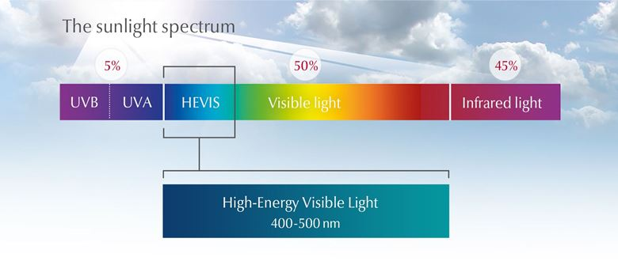

Slide 6
Roughly one-third of the solar energy that reaches the top of Earth’s atmosphere is reflected directly back to space. The remaining two-thirds is absorbed by the surface and, to a lesser extent, by the atmosphere.

Slide 7
To balance the absorbed incoming energy, the Earth must radiate the same amount of energy back to space.
Because the Earth is much colder than the Sun, it radiates at much longer wavelengths, primarily in the infrared-IR part of the spectrum (Figure 1).

Slide 8
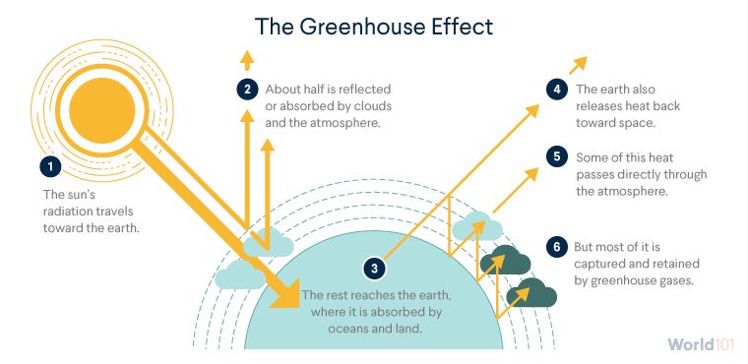
Figure 1. An idealized model of the natural greenhouse effect.

Slide 9
Much of this thermal radiation emitted by the land and ocean is absorbed by the atmosphere, including clouds, and reradiated back to Earth.
This is called the greenhouse effect.

Slide 10
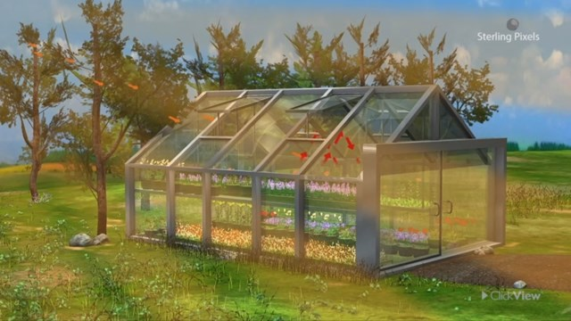
The glass walls in a greenhouse reduce airflow and increase the temperature of the air inside. Analogously, but through a different physical process, the Earth’s greenhouse effect warms the surface of the planet.

Slide 11
Without the natural greenhouse effect, the average temperature at Earth’s surface would be below the freezing point of water.
Thus, Earth’s natural greenhouse effect makes life, as we know it possible.

Slide 12
Greenhouse effect definition
The greenhouse effect is a natural process responsible for keeping the earth at the temperature needed to sustain life.

Slide 13
Acting just like the glass walls of a greenhouse, gases like carbon dioxide, methane, and nitrous oxide trap the sun’s heat in the atmosphere and prevent it from escaping into space.

Slide 14
Normally, the greenhouse effect keeps the earth just warm enough to sustain life.
Scientists say that without the greenhouse effect, the average temperature of the earth would drop from 14˚C (57˚F) to as low as −18˚C (−0.4˚F).
˚F – 32 × 5/9 = ˚C

Slide 15
The greenhouse effect has supported life on the earth for millions of years.
Today, however, the greenhouse effect is growing stronger as human activities such as deforestation and fossil fuel use release more and more greenhouse gases into the atmosphere.
This traps greater amounts of the sun’s radiation, which contributes to rising temperatures, also known as global warming.

Slide 16
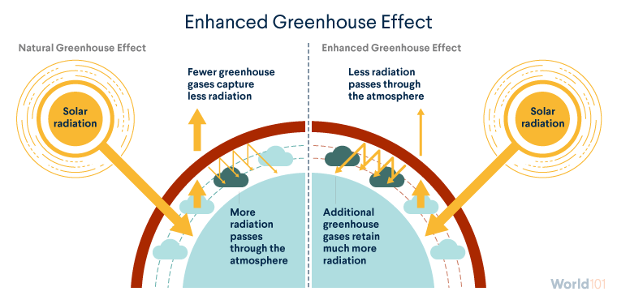

Slide 17
Greenhouse gases (GHGs)
Greenhouse gases are gases that absorb heat (thermal infrared range) from the atmosphere and re-emit it back toward earth causing a warming effect.

Slide 18
The two most abundant gases in the atmosphere, nitrogen (comprising 78% of the dry atmosphere) and oxygen (comprising 21%), exert almost no greenhouse effect.
Instead, the greenhouse effect comes from molecules that are more complex and much less common.

Slide 19
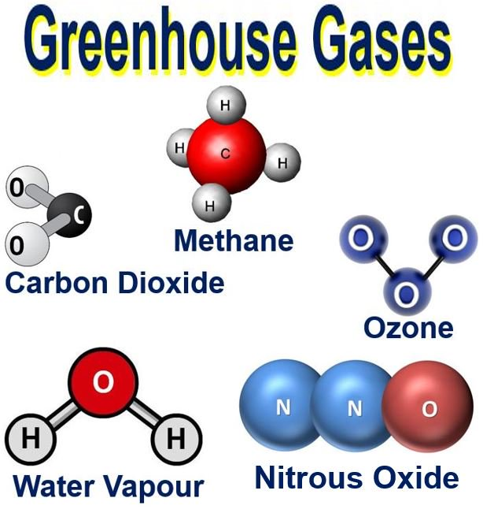

Slide 20
Water vapor: it is the most important greenhouse gas. It created via evaporation of water bodies (e.g. oceans) and transpiration.

Slide 21
Carbon dioxide (CO₂): is the second-most important gas and the best known, with natural sources including decomposition and animal respiration. The main source of excess CO₂ emissions is the burning of fossil fuels, while deforestation has reduced the amount of plant life available to turn CO₂ into oxygen. CO₂ is less damaging than N₂O and CH₄, but remains in the atmosphere for around 100 years, much longer than the other gases.

Slide 22
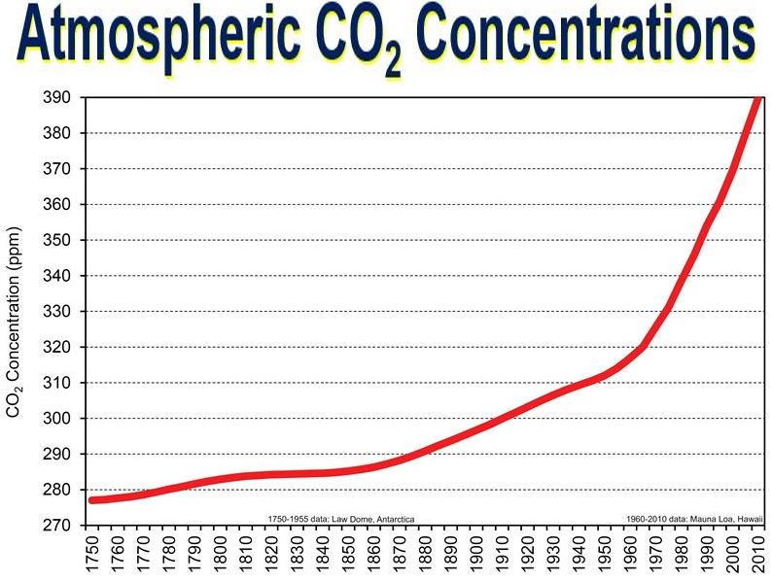

Slide 23
Methane (CH₄): it is a more potent but less abundant greenhouse gas, enters the atmosphere from farming both from animals such as cattle and arable farming methods including traditional rice paddies and from fossil fuel exploration and abandoned oil and gas wells as well as emitted from waterlogged habitats (like marshes) and landfills. It is up to 60 times more damaging than carbon dioxide, although it spends less time in the atmosphere

Slide 24
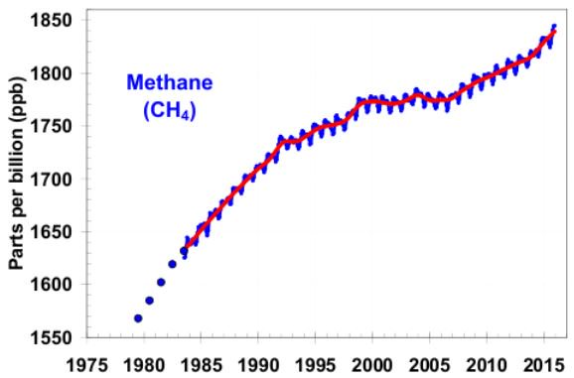

Slide 25
Nitrous oxide (N₂O): it released naturally by certain bacteria and emitted in the exhaust by certain vehicles. N₂O is over 300 times more harmful than carbon dioxide, so reducing output of this gas is particularly important.

Slide 26
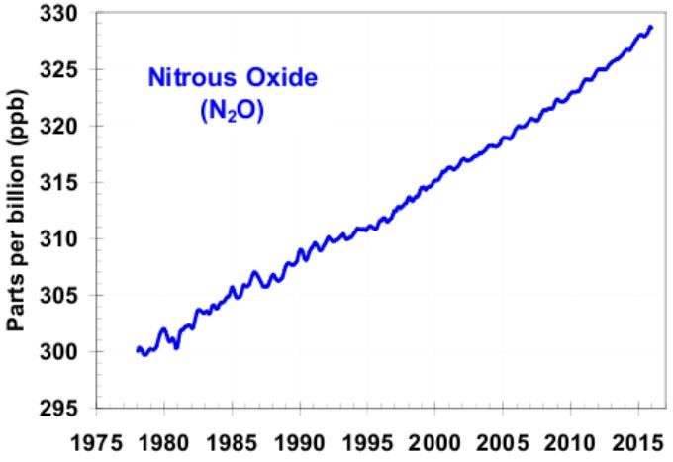

Slide 27
Ozone (O₃): ozone or tri-oxygen is formed from dioxygen by the action of UV and electrical discharges within the Earth's atmosphere. It acts as a greenhouse gas, absorbing some of the IR energy emitted by the earth.

Slide 28
Several other gases that present in small amounts are also contribute to the greenhouse effect. Chlorofluorocarbons and hydrofluorocarbons once widely used in industrial applications and home appliances such as refrigerators were key greenhouse gasses released during the 20th century, but are now heavily regulated due to their severe impact on the atmosphere, which includes ozone depletion, as well as trapping heat in the lower atmosphere

Slide 30
Factors affecting the impact of greenhouse gases on environment
Two factors determine how much the impact a greenhouse gas will have in warming the atmosphere:
Ability to absorb long-wave radiation: gases that have a greater capacity to absorb long-wave radiation will have a greater warming impact (per molecule).
Concentration within the atmosphere: the greater the concentration of a gas, the greater its warming influence will be within the atmosphere.
The overall impact of a greenhouse gas will be determined by the combination of both these factors.

Slide 31
Sources of greenhouse gases
Transportation: (28.9%): the transportation sector generates the largest share of greenhouse gas emissions.
Greenhouse gas emissions from transportation primarily come from burning fossil fuel for our cars, trucks, ships, trains, and planes.
Over 90% of the fuel used for transportation is petroleum based, which includes primarily gasoline and diesel.

Slide 32
Electricity production: (27.5%): electricity production generates the second largest share of greenhouse gas emissions.
Approximately 62.9% of our electricity comes from burning fossil fuels, mostly coal and natural gas.

Slide 33
Industry: (22.2%): greenhouse gas emissions from industry primarily come from burning fossil fuels for energy, as well as greenhouse gas emissions from certain chemical reactions necessary to produce goods from raw materials.

Slide 34
Commercial and residential: (11.6%): greenhouse gas emissions from businesses and homes arise primarily from fossil fuels burned for heat, the use of certain products that contain greenhouse gases, and the handling of waste.

Slide 35
Agriculture: (9.0%): greenhouse gas emissions from agriculture come from livestock such as cows, agricultural soils, and rice production.

Slide 36
Land use and forestry: (11.1%): land areas can act as a sink (absorbing CO₂ from the atmosphere) or a source of greenhouse gas emissions.

Slide 37
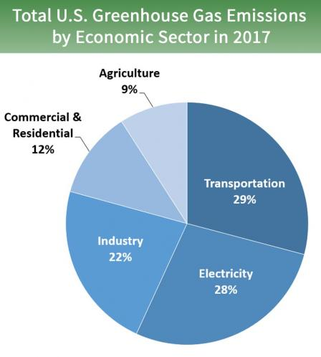

Slide 38
?

