Slide 1

Lab.7
Polymerase Chain Reaction
Technique PCR
(DNA Photocopier)

Slide 2
Objectives
:Students should able to know and explain
What is PCR?
What is the History of PCR?
What is the Purpose of PCR?
How is PCR Done?
What are the Typical (Essential) PCR Reaction Components?
What are Principle of PCR and Programming (The Basic Reaction of PCR)?
2

Slide 3
History OF PCR
The invention of the polymerase chain reaction (PCR) was first conceived by Mullis 1983 revolutionized the methodological repertoire of molecular biology.
In 1993 Kary Mullis was awarded the Nobel Prize in chemistry for this achievements.
PCR is the oldest in theory and the most versatile in practice

Slide 4
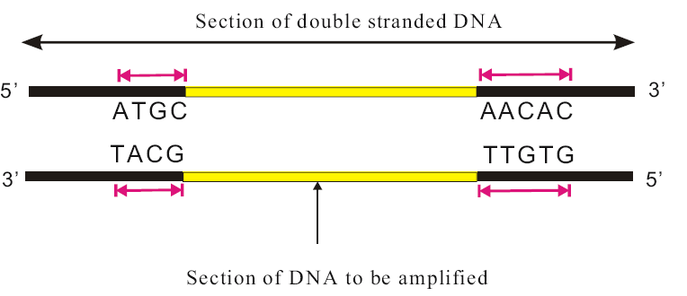
Purpose of Polymerase Chain Reaction
PCR

Slide 5
Definition
PCR can be defined as an in vitro method for amplification of specific DNA sequences from a complex sequences mixture such as genomic DNA using short oligonucleotides (primers) of arbitrary or known sequences, dNTPs and thermo stable polymerase such as Taq polymerase to make million copies of selected DNA segments in around an hour or so.

Slide 6
The Typical (Essential) PCR Reaction Components
Starting nucleic acid : Template DNA /RNA. (Tissue, cells, blood, hair root, saliva, semen).
Primers: (a pair of synthetic oligonucleotide to prime DNA synthesis) Primer design.
Heat-stable DNA polymerase: (to catalyze template-dependent synthesis of DNA or incorporation of dNTPs into DNA).
e.g. Taq Polymerase
Thermus aquaticus DNA polymerase
Thermophilic organism
Enzymes resistant to high temperatures
72-74ºC optimum

Slide 7
Deoxynucleoside Triphosphates (dNTPs): dNTPs include deoxyadenosine triphosphates (dATP), deoxyguanosine triphosphates (dGTP), deoxycytidine triphosphates (dCTP), and deoxythymidine triphosphate (dTTP), from which the DNA polymerase builds the new DNA.
PCR Buffer and Its Component: (100mM Tris-HCl (pH 8.3 at 25 °C room temperature), 50 mM KCl (monovalent cation) and 1.5 Mm MgCl₂ (cofactor divalent)

Slide 8
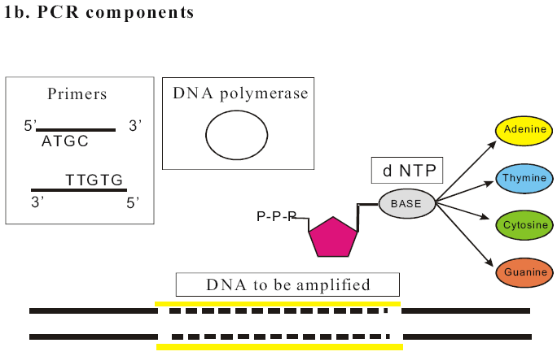
The Typical (Essential) PCR Reaction Components

Slide 9
Principle of PCR and Programming
PCR Steps:
Thermal Denaturation
Initial denaturation temperature of 94ºC-97ºC for 2-5 min. For subsequent cycles, 94ºC or 92ºC for 1-2 min.is usually adequate.
Denaturation
(92°C- 94°C)
Anneling
(40°C- 65°C)
Extension
(72°C)
Primer Annealing
Primer Annealing at 54°C: Primers annealed with denatured template DNA by lowering temperature to (36-65°C).
Primer Extension
DNA extension at 72°C: it is typically carried out at 72°C which is close to the optimum temperature of the Taq polymerase and it required times for about (1-2) minutes

Slide 10
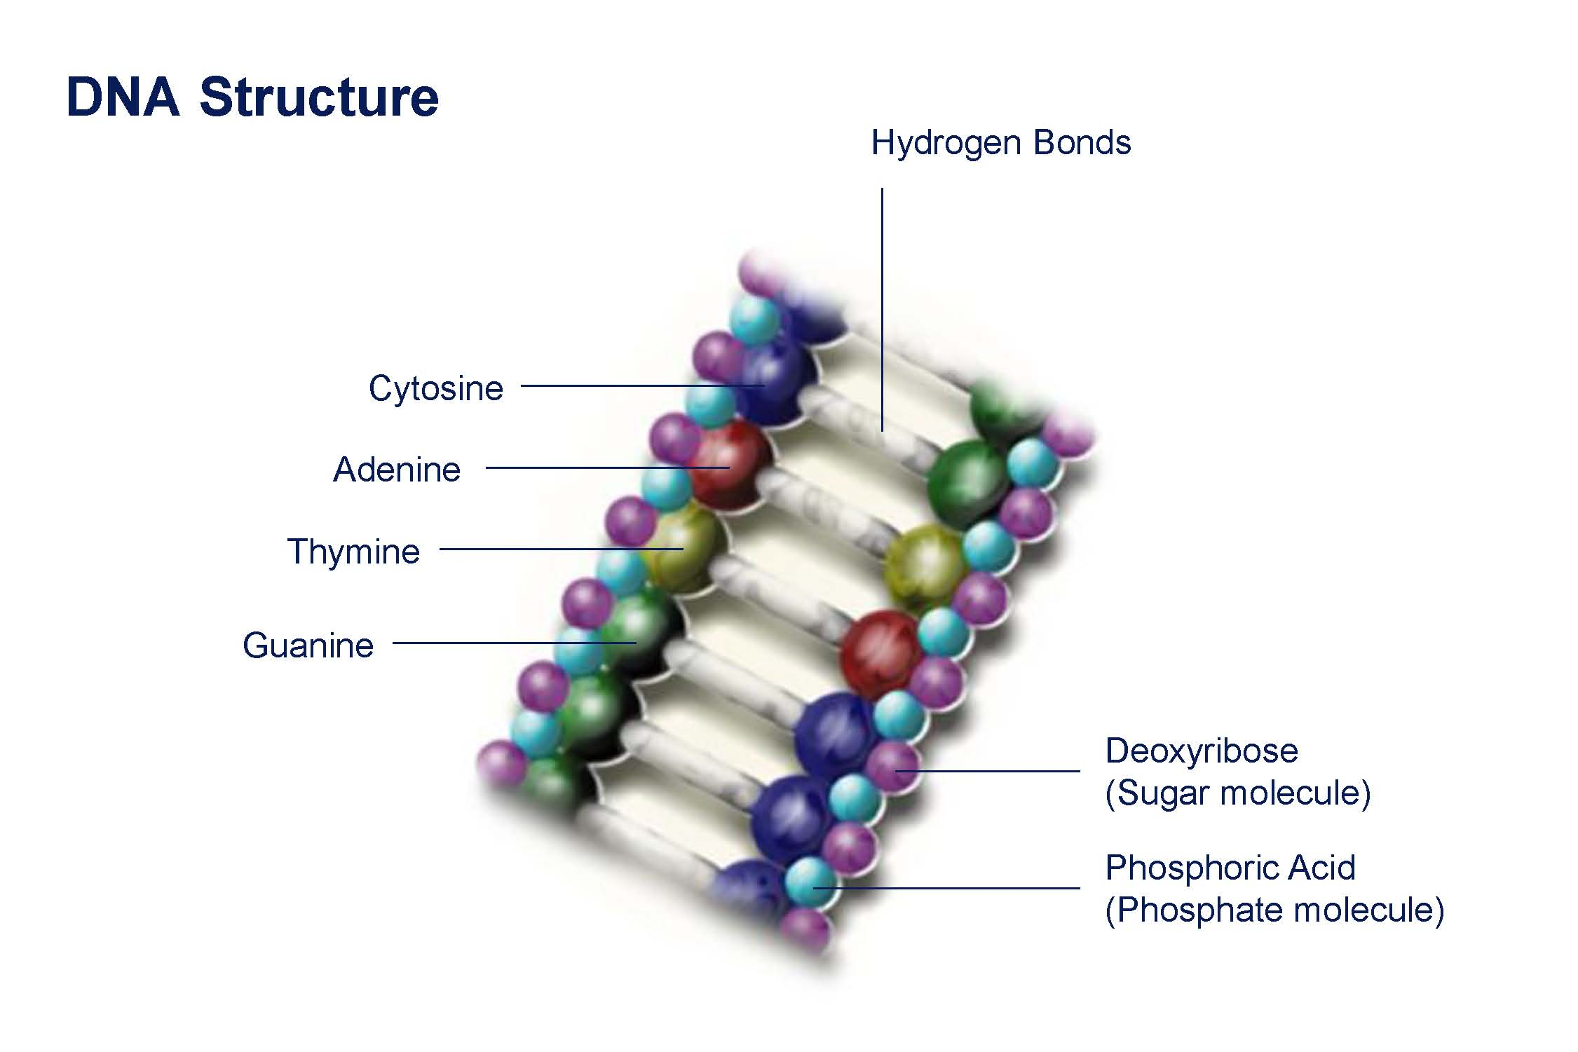

Slide 11
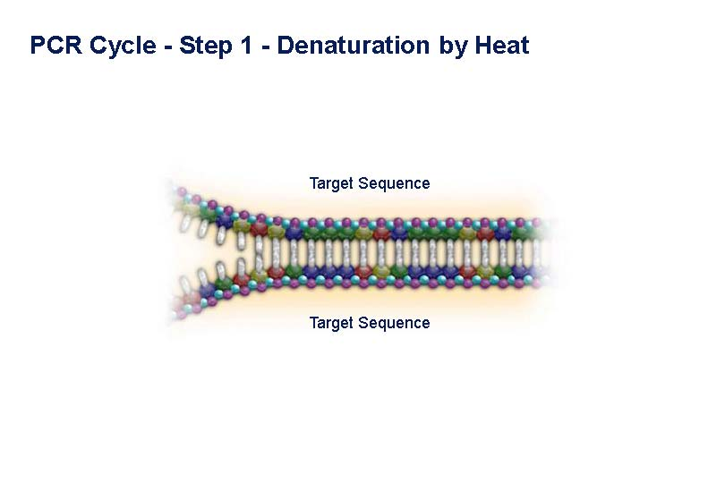

Slide 12
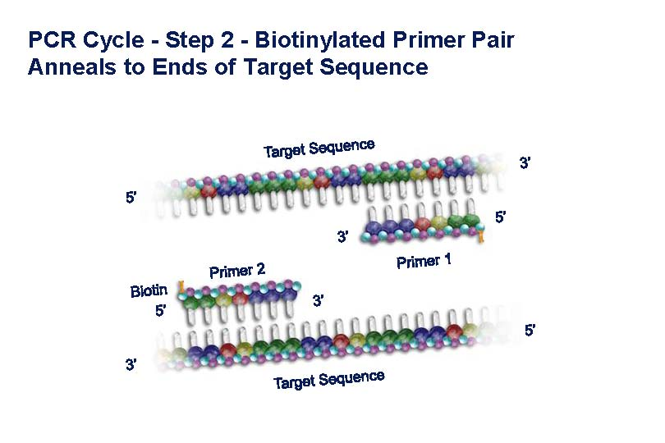

Slide 13
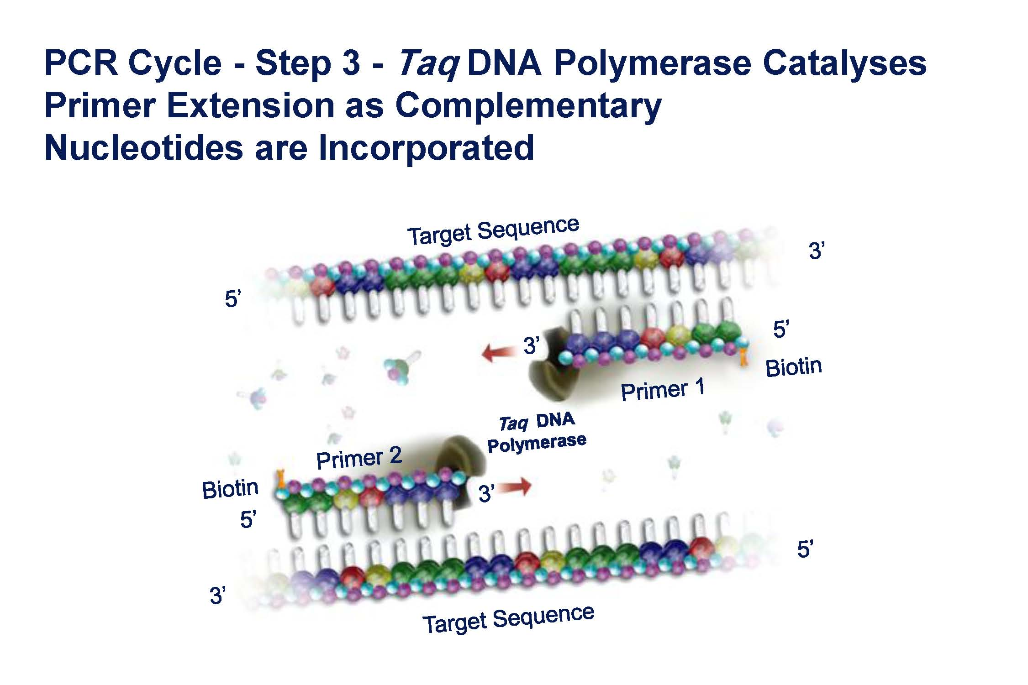

Slide 14
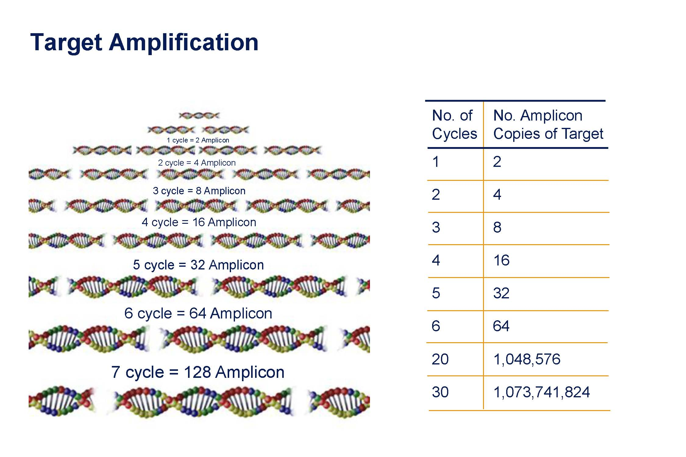

Slide 15
Procedure: PCR Protocol Methods
Procedure Example for PCR amplification of the ITS1–5.8S rRNA–ITS2 gene sequence. By using Universal primers
Forward primer ITS1 (5′-TCCGTAGGTGAACCTGCGG-3′).
Reverse Primer ITS4 (5′TCCTCCGCTTATTGATATGC-3′)
PCR Master Mixture Reactions:
PCR mixture (25μL) is make up of
1.25μL of each primer (Forward and Reverse Primer).
12.5μL of PCR Master Mix
2μL of Extracted DNA.
8μL of Deionized Distilled Water.

Slide 16
Procedure: PCR Protocol Methods
Procedure Example for PCR amplification of the ITS1–5.8S rRNA–ITS2 gene sequence. By using Universal primers
Forward primer ITS1 (5′-TCCGTAGGTGAACCTGCGG-3′).
Reverse Primer ITS4 (5′TCCTCCGCTTATTGATATGC-3′)
PCR Programming:
An initial Denat. Step: 95°C for 6min ……(One Cycle),
Denaturation Step: 95°C for 1min.
Annealing Step: 55°C for 1min. (35 Cycles)
Extension Step: 72°C for 1min.
Final Extension Step 72°C for 10min. …..…(One Cycle),

Slide 17
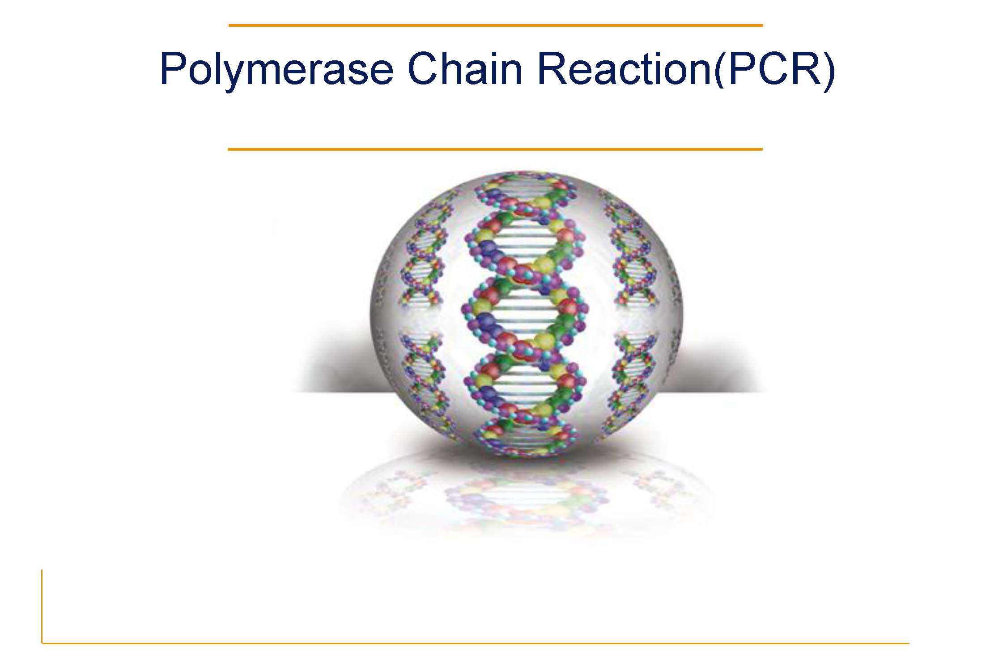
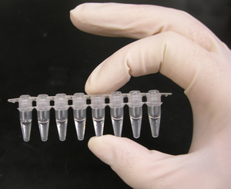
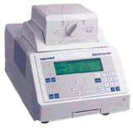


The Reaction
PCR tube
THERMOCYCLER

Slide 18
Applications of PCR
Basic Research
Applied Research
Mutation screening
Drug discovery
Classification of organisms
Genotyping
Molecular Archaeology
Molecular Epidemiology
Molecular Ecology
Bioinformatics
Genomic cloning
Site-directed mutagenesis
Gene expression studies
Genetic matching
Detection of pathogens
Pre-natal diagnosis
DNA fingerprinting
Gene therapy

