Slide 1
Hawler Polytechnic University Veterinary Department
Poultry Diseases and Management
4th stage / 7 Semsters (Morning ) Lecture 3
Lecture: Nawal Kamal Shokry
BVM & S, M.Sc , PhD Student

Slide 2
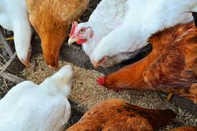
Poultry Feeding and Nutrition

Slide 3
Poultry feeding and nutrition:-
Nutrition is necessary for the production, reproduction, growth and maintenance. Feeding includes procurement, ingestion, digestion, and absorption.

Slide 4
Why we need good quality feed? Better health More eggs Birds grow faster

Slide 5
Nature and functions of poultry nutrients: These are classified into physical, chemical and biological properties. These are divided into following rules:- 1.Water 2.Protein 3.Carbohydrates 4.Fats and oils 5.Minerals 6.Vitamins 7.Feed additives

Slide 6
1. Water:
Water is an essential part of poultry nutrients. Some water is available in the feed itself (metabolic water), but the bulk of it must be separately provided in drinking cans. Cool, clean water should be provided at all times. The water should be free from the excess salt .

Slide 7
2. Proteins:
The poultry products are of high percentage of protein, therefore the protein is important ingredient in feed .Commonly used, protein feed ingredients for poultry ration formulation and feeding includes the following:
•Vegetable/plant sources such as soyabean , cotton seed
• Animal protein sources such as fishmeal, meat and bone meal, blood meal.

Slide 8
3.Carbohydrates:-
Carbohydrates provides energy. Poultry birds can not digest complex carbohydrates such as cellulose. Cereal grains like wheat and broken rice
4.Fats and oils:
Eggs and poultry meat have a good quantity of fats. Fats containing feeds such as barley, sunflower, wheat, rice bran .

Slide 9
Protein and Energy Requirement for Broilers

Slide 10
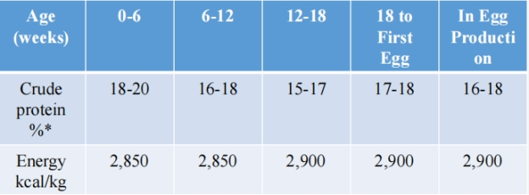
Protein and Energy Requirement for Layers

Slide 11
5. Minerals: Minerals such as Ca, P, Mg, I, Fe, Cu, Zn etc. are very essential for poultry feed. Laying hens requires extra Ca& P for the formation of egg shell. Grains and vegetables are poor source of these minerals. Therefore extra mineral supplement are required for poultry feed. These are some mineral supplements such as :-
Lime stone , Bone meal , Oyster shell , Sodium chloride and Potassium iodide.

Slide 12
6. Vitamins:
About 13 vitamins are essential for poultry. The vitamins are commercially available in pure form or as vitamin concentrate at relatively low cost. They can be added to a poultry feed by means of a premix which supplies specified amounts of each vitamin.

Slide 13
7. Feed additives:
These are not-nutrients but these help in :- Ø Digestion. Ø Works as stimulant. Ø Works as medicines. Ø Flavoring. Ø Help in change of texture of feeds.

Slide 14
Following additives are used in poultry feed:
1) Antioxidants:- These prevent oxidation of feed when spoiled feed is fed to the poultry. These are added at the rate of 0.01%.
2) Flavoring agent:- these are added at the rate of 0.05%.
3) Pellet binder:- Such as molasses and wood pulp wok as pellet binder and these change the texture of feed. These are mixed at the rate of 2.5%.

Slide 15
4) Grits:- Oyster shell and lime stone are common grits used in poultry feed. These help in digestion and grinding in the gizzard.
5) Chelates:- These increase the absorption of mineral
6) Enzymes:- These help in digestion of some complex proteins.

Slide 16
7) Probiotics:- These help in the growth of some useful bacteria in GIT.
8) Antibiotics:- These help in stop growth of harmful bacteria.
9) Hormones:- These are added in the poultry feed to bring desirable metabolic changes in the poultry which enhance egg and meat production.

Slide 17
10) Antifungal additives:- These are mixed to destroy some harmful fungus in the poultry feed.
11) Anticoccidial:- These are mixed to prevent Coccidiosis.
12) Anthelmintic drugs:- These are added to prevent internal and external parasitic infestation.

Slide 18
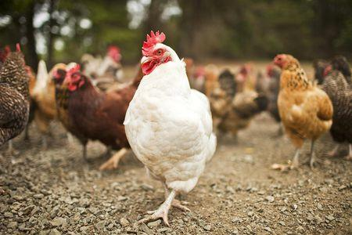
Thank you

