Slide 1
University of Sallahadin
College of Engineering
Electrical Engineering Dept.
Excel useful tips
Sarkar Jawhar
MSc in Electrical Engineering
sarkar.mhammed@su.edu.krd

Slide 2
1. Quickly Information

Slide 3
7. Auto Filter

Slide 4
8. Absolute cell reference (with $)

Slide 5
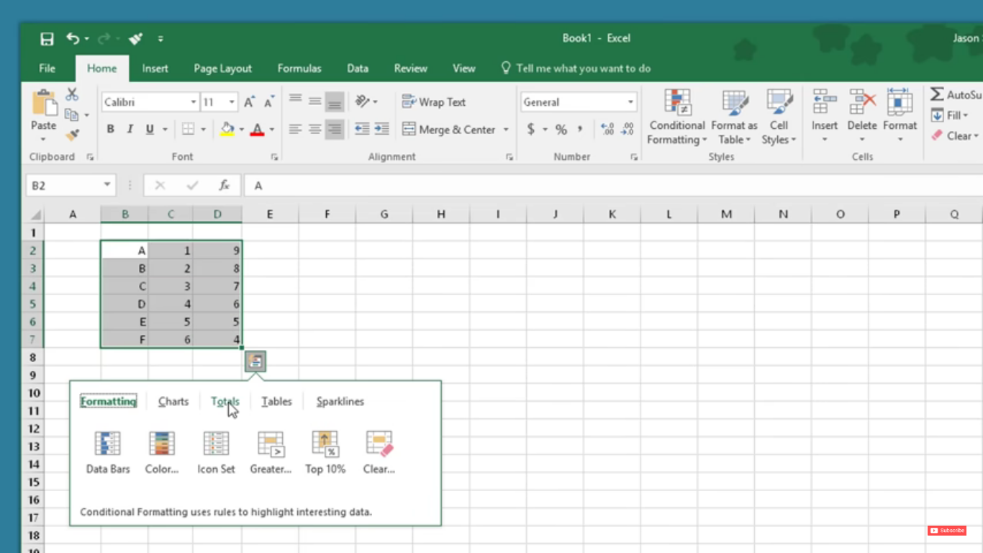
9. Quick Analyse Data

Slide 6
10. Goal Seek

