Slide 1
How to Download, Install, and Activate Endnote X9.3.3
L. Nawroz Ibrahim
00/00/2021

Slide 2
Download:
Link: https://www.endnote.com/downloads/
Activation Number: 79SHT-UQFTD-FE94J-FRRBW-UDHXL

Slide 3
When we go into the endnote program on our laptop, this page will appear,

Slide 4
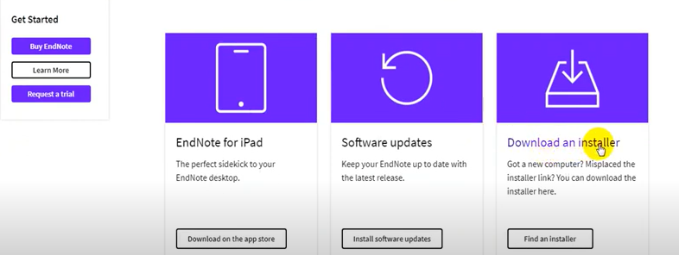
Go down and select this,
Notes:
You can select the software update icon for updating the version to the newest version for ex. You have X8 update it to X9 which is automatically becomes X9.33

Slide 5
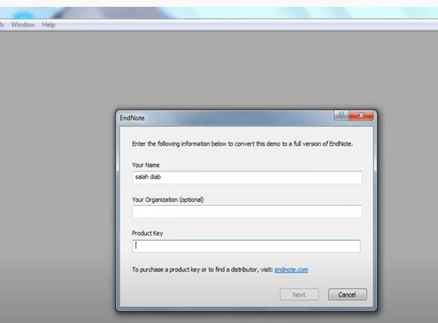
Write down your Name and Product Key

Slide 6
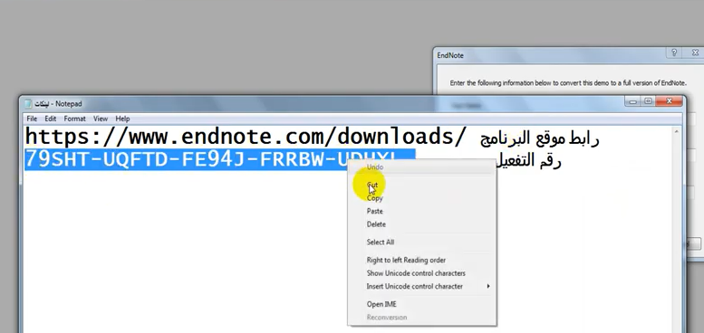
Cont.

Slide 7
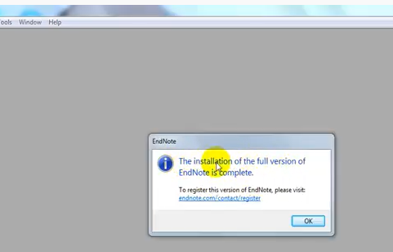
The message of Activating Endnote Program Appears

Slide 8
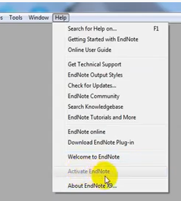
You can check it in Help button it is inactive which shows it is finished from activation

Slide 9
You can see from the right side of X9 your name, number and the version you use

Slide 10
Thank you

