Slide 1
Polar Coordinate System
Assistant Lecturer:
Nawroz Ibrahim

Slide 2
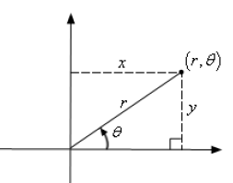
In the rectangular coordinate system, we identify points in the plane by their x- and y- coordinates. We can also identify points by using their distance from the origin and their angle from the positive x-axis.
This is called the Polar Coordinate System.

Slide 3
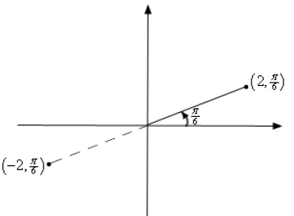
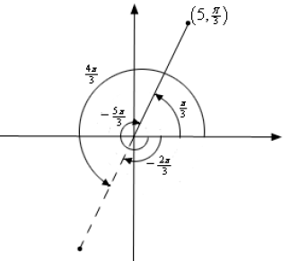
Sketch the two points:
The two points (2, π/6) and (-2, π/6)
(5, π/3) = (5, -5π/3) = (-5, 4π/3) = (-5, -2π/3)

Slide 4
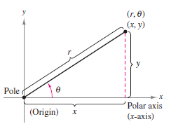
Converting Between the Two Coordinate Systems

Slide 5
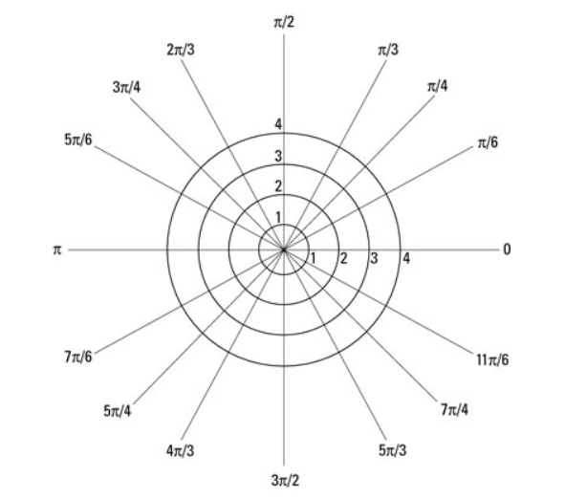
Polar Schema:

Slide 6
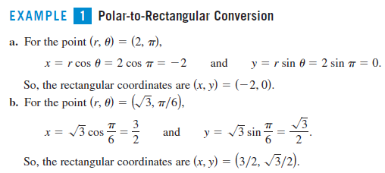
Examples:

Slide 7
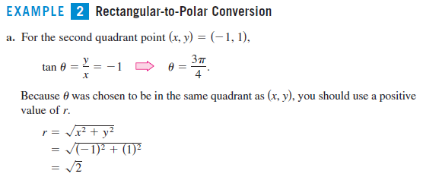

Slide 8
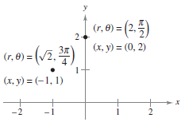
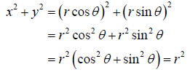
Cont.

Slide 9
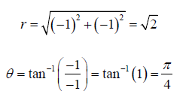
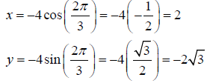
Tutorial: Convert each of the following points into the given coordinate system
(b)
(b)
Solution:
(a)
The point is in the third quadrant so we get the correct angle by adding π onto this.

Slide 10
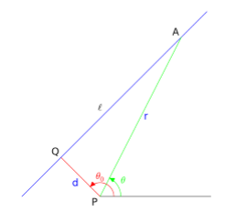
Polar Equations of Lines:
A polar coordinate system in the plane is determined by a point P, called the “pole”, and a half line known as the polar axis, shown extending from P to the right in the figure:

Slide 11
Cont.
In polar coordinates, lines occur in two species. A line through the pole making angle ϑ_{o} with the polar axis, has an equation
$θ=constant=θ_{o}$
Polar-coordinate equation for the line through given points.

Slide 12
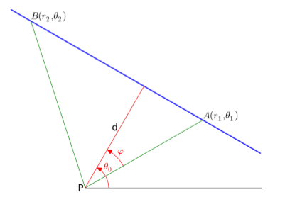
Polar-coordinate equation for the line through given points:
Given points A(r₁, ϑ₁) and B(r₂, ϑ₂) we see that the line AB passes through the pole if and only if ϑ₂- ϑ₁ is an integral multiple of π; and then it’s equation is $θ=θ_{1}$.
If not, the equation of the line AB is:
$\overline{AB}=\sqrt{{r_{1}}^{2}+{r_{2}}^{2}−2r_{1}r_{2}\cos{(θ_{2}−θ_{1})}}$

Slide 13
Exercises:
For each pair of points given in polar coordinates, find a polar-coordinate equation for the line determined by the points:

Slide 14
Distance Formula For Polar Coordinates:
Converting Polar Functions to Rectangular and vice versa:

Slide 15
Polar Equation of Circles:

Slide 16
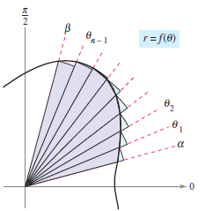
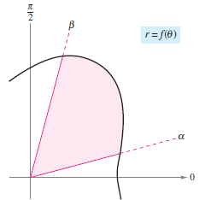
Area in Polar coordinates:

Slide 17
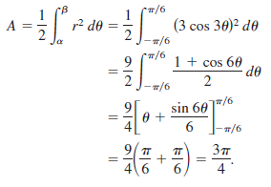
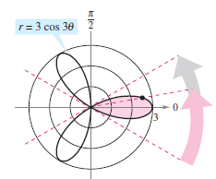
Ex.

Slide 18
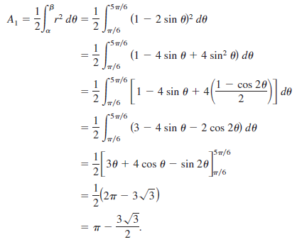
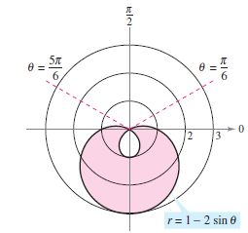
Ex.

Slide 19
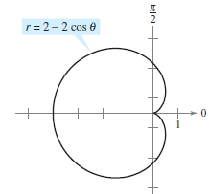
Arc Length of a Polar Curve:
Ex:

Slide 20
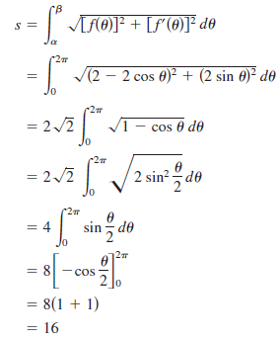
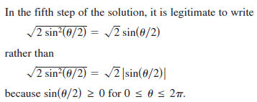
Solution:

