Slide 1
Techniques of Integration: Partial fractions
L. A. Nawroz Ibrahim

Slide 2
The Rules:
We are given a rational function $\frac{P(x)}{Q(x)}$, where P and Q are polynomials.
Ex: $\int{\frac{x^{2}+4x}{x^{3}+8x−3}dx}$ $\int{\frac{x+1}{x^{2}+4x+4}}dx$ $\int{\frac{1}{x^{2}+4x+4}dx}$
Condition: Degree of Numerator < Degree of Denominator.
If Not: ( Long Division)!
$\int{\frac{x^{3}+4x}{x+1}}dx$ $\int{\frac{x+1}{x^{2}−4}}dx$

Slide 3
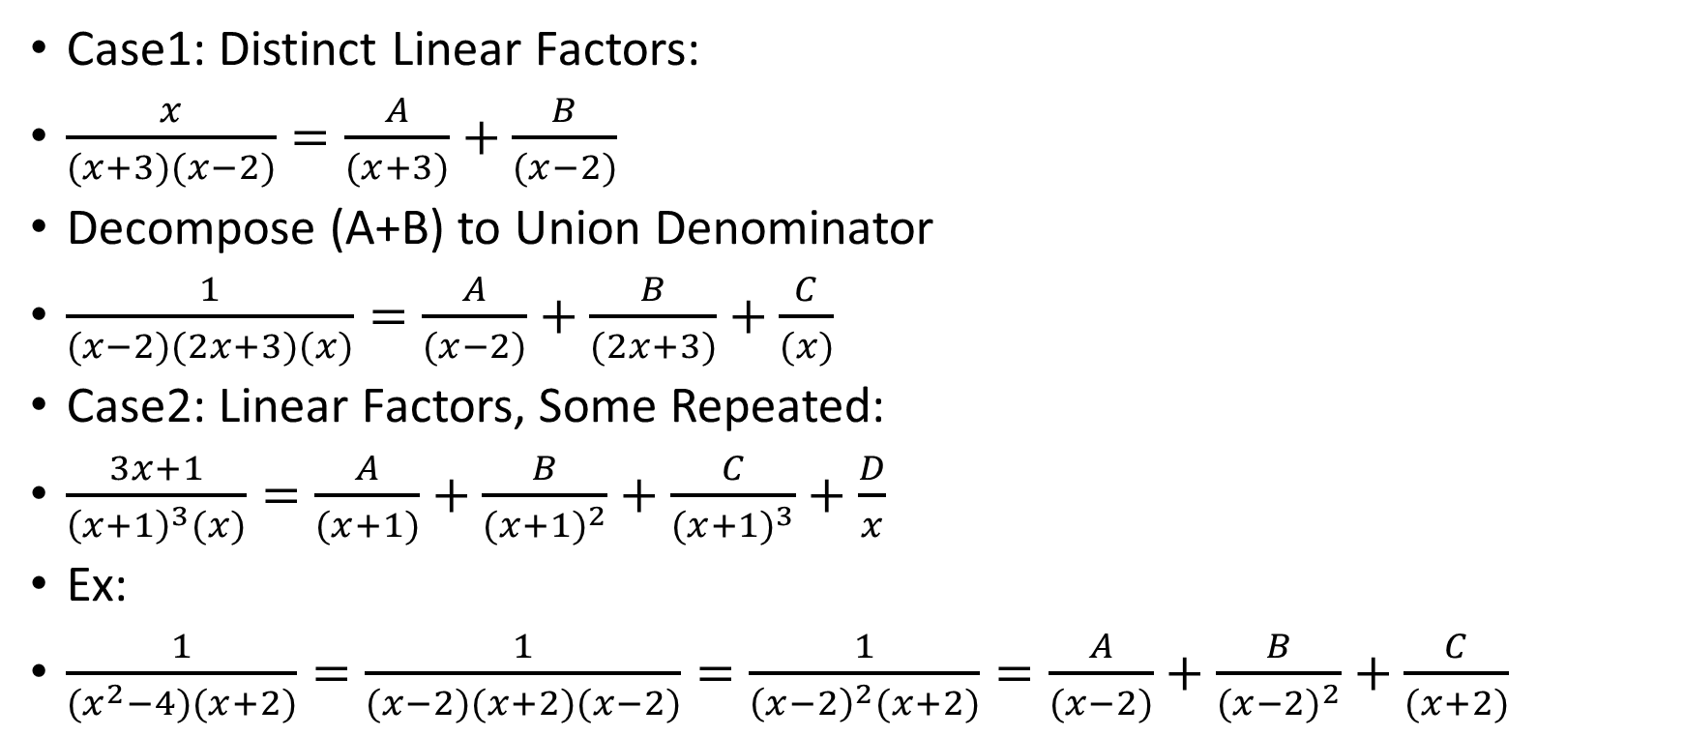
There is 4 Cases:
Case1: Distinct Linear Factors:
$\frac{x}{(x+3)(x−2)}=\frac{A}{(x+3)}+\frac{B}{(x−2)}$
Decompose (A+B) to Union Denominator
$\frac{1}{(x−2)(2x+3)(x)}=\frac{A}{(x−2)}+\frac{B}{(2x+3)}+\frac{C}{(x)}$
Case2: Linear Factors, Some Repeated:
$\frac{3x+1}{{\left(x+1\right)}^{3}(x)}=\frac{A}{(x+1)}+\frac{B}{{(x+1)}^{2}}+\frac{C}{{(x+1)}^{3}}+\frac{D}{x}$
Ex:
$\frac{1}{(x^{2}−4)(x+2)}=\frac{1}{(x−2)(x+2)(x−2)}=\frac{1}{{\left(x−2\right)}^{2}(x+2)}=\frac{A}{(x−2)}+\frac{B}{{(x−2)}^{2}}+\frac{C}{(x+2)}$

Slide 4
Case3: Distinct Quadratic Factors:
One degree less than Denominator,
$\frac{(x+1)}{{(x}^{2}+4)(x^{2}+9)}=\frac{Ax+B}{(x^{2}+4)}+\frac{Cx+D}{(x^{2}+9)}$
Case4: Quadratic Factors Some Repeated:
$\frac{x+1}{{\left(x^{2}+4\right)}^{3}(x^{2}+9)}=\frac{Ax+B}{(x^{2}+4)}+\frac{Cx+D}{{(x^{2}+4)}^{2}}+\frac{Ex+F}{{(x^{2}+4)}^{3}}+\frac{Gx+H}{(x^{2}+9)}$
EX: $\frac{x+4}{x^{2}(x+1){(x^{2}+3)}^{4}}$ Thy are not factor, you can’t break them.
$=\frac{A}{x}+\frac{B}{x^{2}}+\frac{C}{x+1}\frac{Dx+E}{(x^{2}+3)}+\frac{Fx+G}{{(x^{2}+3)}^{2}}+\frac{Hx+I}{{(x^{2}+3)}^{3}}+\frac{Jx+K}{{(x^{2}+3)}^{4}}$

Slide 5
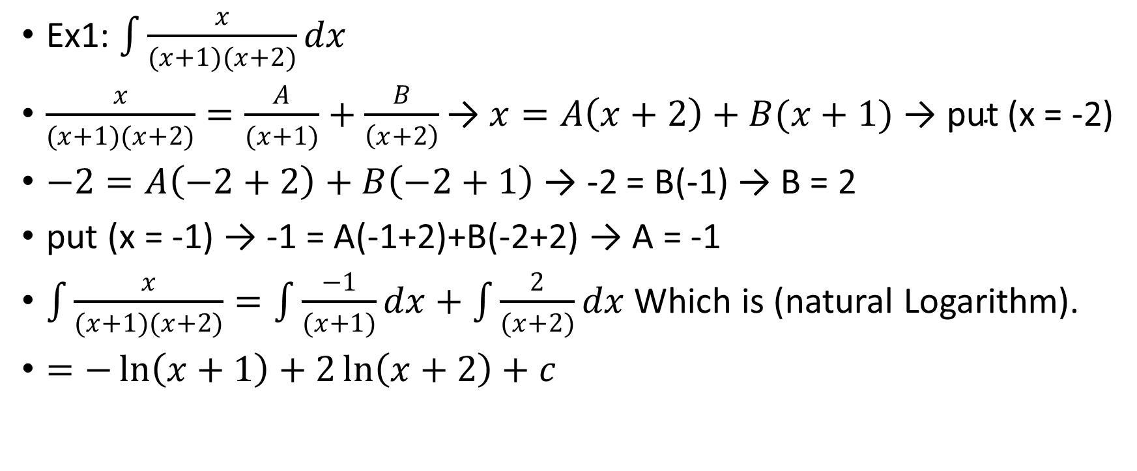
Determining Coefficients of Partial Fractions:
Ex1: $\int{\frac{x}{(x+1)(x+2)}dx}$
$\frac{x}{(x+1)(x+2)}=\frac{A}{(x+1)}+\frac{B}{\left(x+2\right)}\text{→}$ $x=A\left(x+2\right)+B(x+1)$ $\text{→} \text{put}$ (x = -2)
$−2=A\left(−2+2\right)+B\left(−2+1\right)$ $\text{→}$ -2 = B(-1) $\text{→}$ B = 2
$\text{put}$ (x = -1) $\text{→}$ -1 = A(-1+2)+B(-2+2) $\text{→}$ A = -1
$\int{\frac{x}{(x+1)(x+2)}}=\int{\frac{−1}{(x+1)}dx}+\int{\frac{2}{(x+2)}dx}$ Which is (natural Logarithm).
$=−\ln\left(x+1\right)+2\ln\left(x+2\right)+c$

Slide 6
Equating Coefficients:
X = A(x+2) + B(x+1)
X = Ax + Bx + 2A + B
1x + 0 = ( A+ B)x + (2A + B )
1 = A + B System of Linear Equations:
0 = 2A + B
1 – A = B
0 = 2A + ( 1 – A )
0 = A + 1 → ( A = -1 )
1 = -1 + B → ( B = 2 )

Slide 7
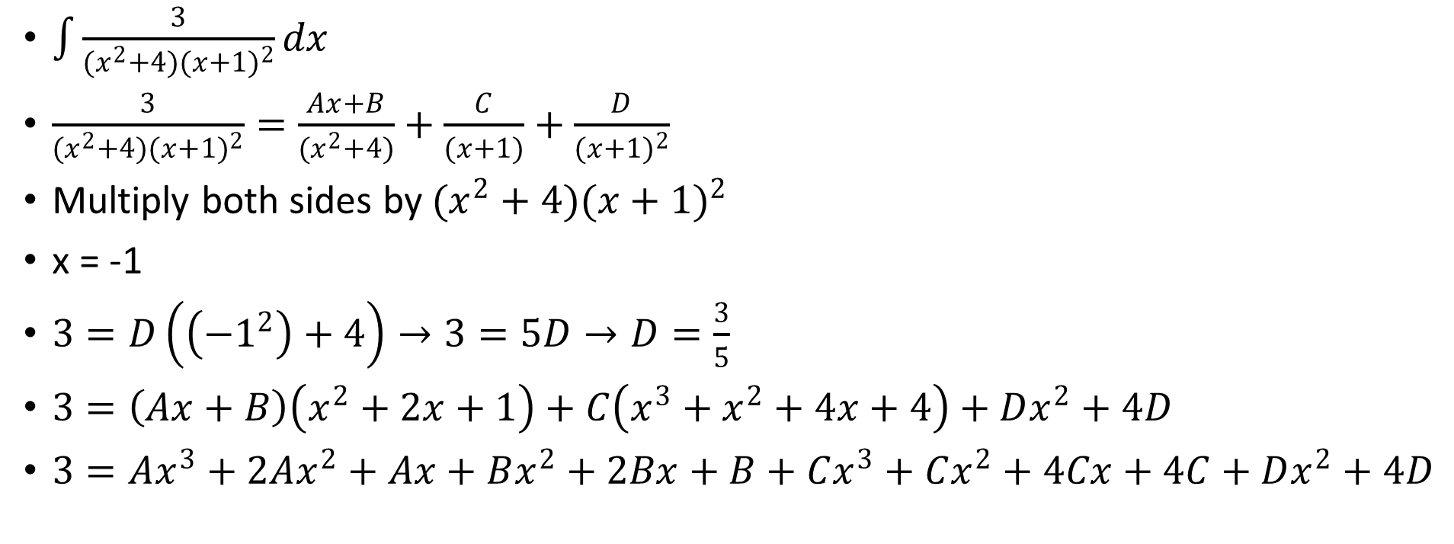
EX2:
$\int{\frac{3}{{(x}^{2}+4){(x+1)}^{2}}dx}$
$\frac{3}{(x^{2}+4){(x+1)}^{2}}=\frac{Ax+B}{(x^{2}+4)}+\frac{C}{(x+1)}+\frac{D}{{(x+1)}^{2}}$
Multiply both sides by $(x^{2}+4){(x+1)}^{2}$
x = -1
$3=D\left(\left({−1}^{2}\right)+4\right)→3=5D→D=\frac{3}{5}$
$3=\left(Ax+B\right)\left(x^{2}+2x+1\right)+C\left(x^{3}+x^{2}+4x+4\right)+Dx^{2}+4D$
$3=Ax^{3}+2Ax^{2}+Ax+Bx^{2}+2Bx+B+Cx^{3}+Cx^{2}+4Cx+4C+Dx^{2}+4D$
A + C = 0
2A + B + C + D = 0
A + 2B + 4C = 0
B + 4C + 4D = 3

Slide 8
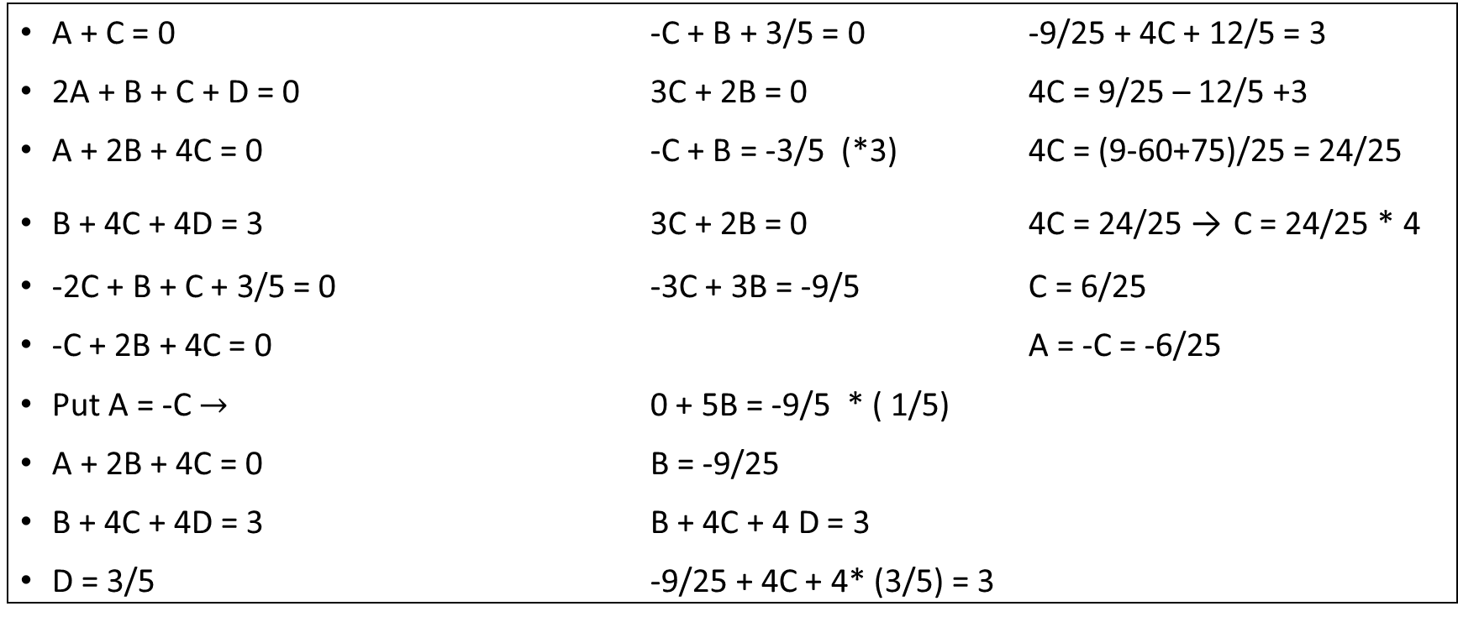
Cont.
A + C = 0 -C + B + 3/5 = 0 -9/25 + 4C + 12/5 = 3
2A + B + C + D = 0 3C + 2B = 0 4C = 9/25 – 12/5 +3
A + 2B + 4C = 0 -C + B = -3/5 (*3) 4C = (9-60+75)/25 = 24/25
B + 4C + 4D = 3 3C + 2B = 0 4C = 24/25 → C = 24/25 * 4
-2C + B + C + 3/5 = 0 -3C + 3B = -9/5 C = 6/25
-C + 2B + 4C = 0 A = -C = -6/25
Put A = -C $→$ 0 + 5B = -9/5 * ( 1/5)
A + 2B + 4C = 0 B = -9/25
B + 4C + 4D = 3 B + 4C + 4 D = 3
D = 3/5 -9/25 + 4C + 4* (3/5) = 3

Slide 9
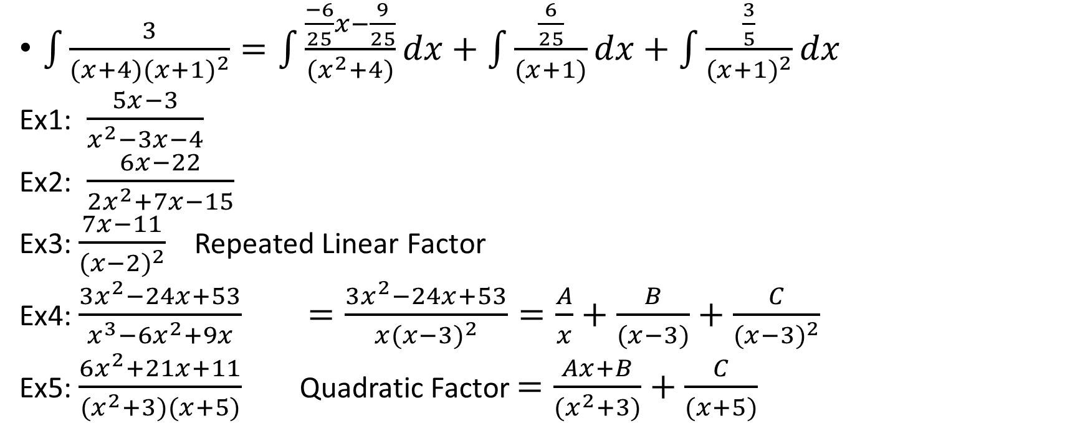
Cont.
$\int{\frac{3}{(x+4){(x+1)}^{2}}}=\int{\frac{\frac{−6}{25}x−\frac{9}{25}}{{(x}^{2}+4)}}dx+\int{\frac{\frac{6}{25}}{(x+1)}dx}+\int{\frac{\frac{3}{5}}{{(x+1)}^{2}}dx}$
Ex1: $\frac{5x−3}{x^{2}−3x−4}$
Ex2: $\frac{6x−22}{2x^{2}+7x−15}$
Ex3: $\frac{7x−11}{{(x−2)}^{2}}$ Repeated Linear Factor
Ex4: $\frac{3x^{2}−24x+53}{x^{3}−6x^{2}+9x}$ $=\frac{3x^{2}−24x+53}{x{(x−3)}^{2}}=\frac{A}{x}+\frac{B}{(x−3)}+\frac{C}{{(x−3)}^{2}}$
Ex5: $\frac{6x^{2}+21x+11}{(x^{2}+3)(x+5)}$ Quadratic Factor $=\frac{Ax+B}{(x^{2}+3)}+\frac{C}{(x+5)}$

Slide 10

Cont.
Ex6: $\frac{3x^{2}+5x−4}{(x^{2}−7)(x+1)}=\frac{Ax+B}{(x^{2}−7)}+\frac{C}{(x+1)}$

