Slide 1
Integration by Trigonometric Substitution
L. A. Nawroz Ibrahim

Slide 2
The Substitution Rule:
$\sqrt{a^{2}−x^{2}}$ $\sqrt{a^{2}+x^{2}}$ $\sqrt{x^{2}−a^{2}}$
Applicable when one of these expressions is in the integrand.
a is any positive number.
$\int{\sqrt{x^{2}−a^{2}}} dx$
We can change x into something else, then we can lose the radical.
How Simplify these expressions:
$x=a sin θ$
$\sqrt{a^{2}−{\left(a sin θ\right)}^{2}}=\sqrt{a^{2}−a^{2}\sin^{2} θ}=\sqrt{a^{2}(1−\sin^{2}θ)}$
$1−\sin^{2}θ=\cos^{2}θ$
$\sqrt{a^{2}\cos^{2}θ}=a cos θ$ , $−\frac{π}{2}<θ<π/2$
$a cos θ$

Slide 3
$\sqrt{a^{2}+x^{2}}$
$x=a\tan{θ}$
$\sqrt{a^{2}(1+\tan^{2}θ)}$
$\sqrt{a^{2}\sec^{2}θ}$
$a\sec{θ}$
$\sqrt{x^{2}−a^{2}}$
$x=a\sec{θ}$
$\sqrt{a^{2}(\sec^{2}θ−1)}$
$\sqrt{a^{2}\tan^{2} θ}$
$a tan{θ}$

Slide 4
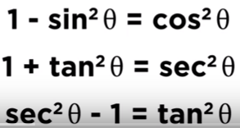

Slide 6
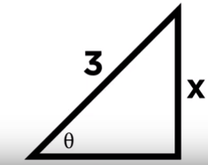
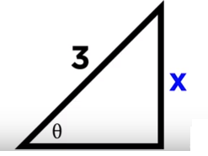
$$\sqrt{9−x^{2}}$$

Slide 7
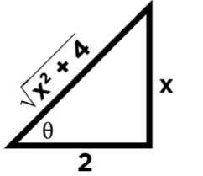
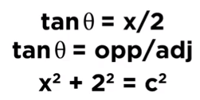
Example:
$$x^{2}+2^{2}=c^{2}$$

Slide 9
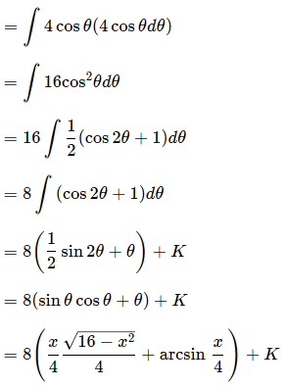
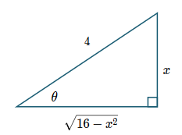
$$x=4\sin{θ}$$

Slide 10
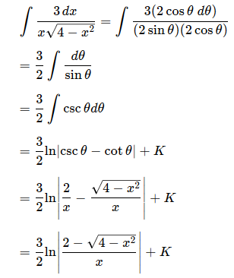
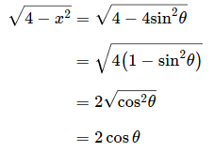
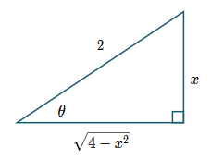

Slide 11
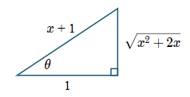

Slide 12
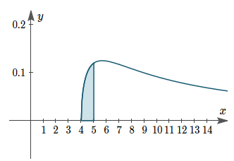
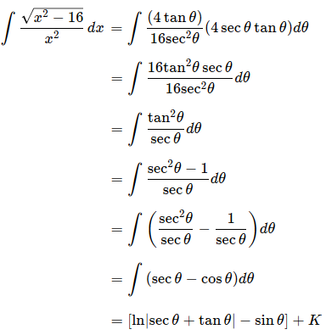
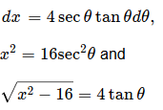
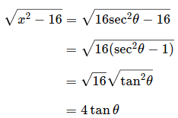

Slide 13
