Slide 1
Matrix
(Lecture – 4)

Slide 2
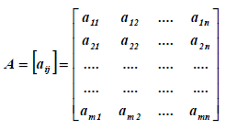
Matrices and Determinants:
A matrix is a rectangular array of elements (scalars) from a field. The order, or size, of a matrix is specified by the number of rows and the number of columns, i.e. A an “ m by n “ matrix has m rows and n columns, and the element in the i^{th} row and j^{th} column is often denoted by a_{ij}:

Slide 3
Introduction
A vector is a matrix with a single row (or column) of n elements i.e. the column vector is:
And row vector is:
The matrix is square if the number of rows and columns are equal (i.e. m = n) and the elements a_{ij} of a square matrix are called the main diagonal.

Slide 4
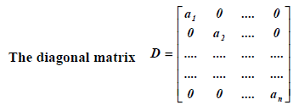
Cont.
With one in each diagonal position and zero else.
Has the elements

Slide 5
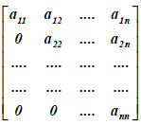
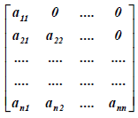
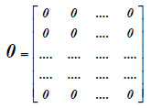
Cont.
An n n triangular matrix has the pattern:
Upper Triangle Matrix Lower Triangle Matrix
The m n null matrix:
Has zero in each of its position.

Slide 6
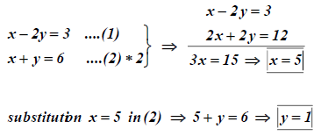
Elementary operations with matrices and vectors:
1- Equality:

Slide 7
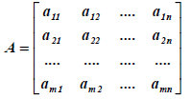
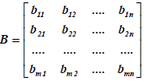
Cont.

Slide 8
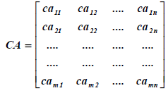
Cont.

Slide 9
Cont.
Condition:

Slide 10
Assume:

Slide 11
Properties of multiplication:-

Slide 12
Determinants:
Determinant of A, or
Calculated from the entries of A in the following way:
For n = 1 , A = [a] → = a.
For n = 2 ,
For n = 3 ,

Slide 13
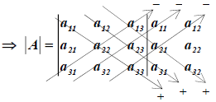
Cont.
To evaluate the determinant of order 3 or above we define minor and cofactors.
Minors: The minor of the element a_{ij} in a matrix A is the determinant of the matrix that remains when the row and column containing a_{ij} are deleted. For example, let:

Slide 14
Cont.
Cofactors: is a signed minor. The cofactor of a_{ij} is denoted by A_{ij} and is defined as
The minors and cofactors of a₁₁, a₁₂, a₁₃ of a third order determinant

Slide 15
Cont.
A determinant can be expanded using any row or column as given below:
(Expanding by R1)
(Expanding by C1)

Slide 16
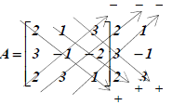
Hw.

Slide 17
Cont.

Slide 22
Cramer’s Rule:
When the determinant of the coefficient matrix A of the system
AX = B is not zero (i.e. |A| ≠ 0) the system has a unique solution that it may be found from the formulas:
Where |Ai| is the determinant of the matrix, comes from replacing the ith column in A by the column of constant B.

Slide 23
Solve the following linear equation:
AX = B Where

Slide 24
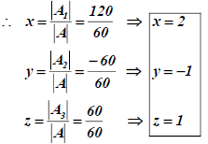

Slide 25
Problems:

