Slide 1
Volume of Hollow Regions
L.A. Nawroz Ibrahim

Slide 2
In the case that we get a solid Disk the area is: $A=π {(radius)}^{2}.$
Where the radius will depend upon the function and the axis of rotation.
In the case that we get a ring the area is:
$A=π[{(outer radius)}^{2}−{(inner radius)}^{2}]$.
Where again both of the radii will depend on the functions given and the axis of rotation.
Example: Determine the volume of the solid obtained by rotating the portion of the region bounded by $y=\sqrt[3]{x}$ and $y=\frac{x}{4}$. That lies in the first quadrant about the y-axis.

Slide 3
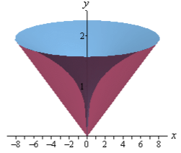
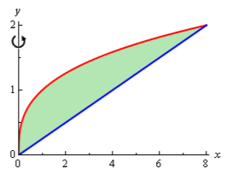
Solution:
First the graph is like the bellow:

Slide 4
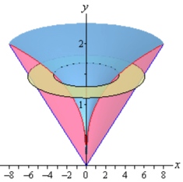
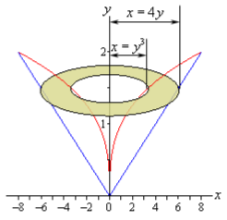
The cross section area is then,

Slide 5
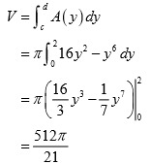
Cont.

Slide 6
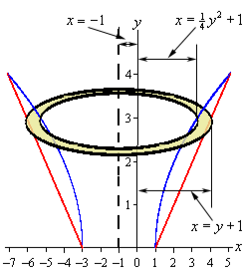
Ex:
Determine the volume of the solid obtained by rotating the region bounded by: $y=2\sqrt{x−1}$ and $y=x−1$ about the line $x=−1$.
Depending on the sketch given:

Slide 7
Solution:
So, the radii are then the function + 1.
The cross section area is then,
The first ring will occur at y = 0 and the final ring will occur at y = 4.

Slide 8
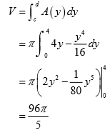
Cont.

