Slide 1
Area of Regions in Polar Coordinates (Examples & Solutions)
A. L. Nawroz Ibrahim

Slide 2
Contents:
Review: Few Curves in Polar Coordinates.
Formula For the Area or Regions in Polar Coordinates.
Calculating Areas in Polar Coordinates.

Slide 4
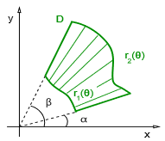
Formula for the area or regions in polar coordinates:
This result includes the case of r₁ = 0, which
are fan-shaped regions.

Slide 7
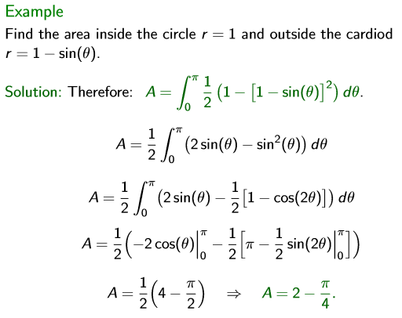
Calculating areas in polar coordinates:

Slide 8
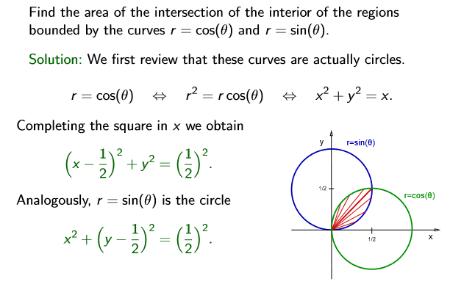
Example-4

Slide 9
Solution:

Slide 10

Cont.
$A=\frac{π}{8}−\frac{1}{4} or \frac{π−2}{8}$
$A=0.1426990817$

