Slide 1
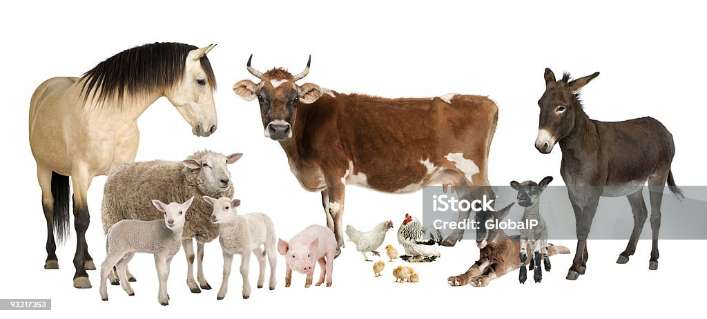
Principles of Animal production
Assist Professor
Dr. Nawzad Mohammed Aziz

Slide 2
Effect Poultry Management on Temperature and Humidity
Introduction
Chicken was existing on the earth for over 150 million years, during back to the original (Wild Jungle Fowl). Chicken has been domesticated, offered them a good environment and management. Poultry production is part of animal production, which give the human a large source of animal protein.
The poultry is the main source to produce eggs and meat, with the high feed efficient and easy in digested and rich in the feed material. The poultry has good ability to convert the food substance which does not been used by human food to use protein for human feedings such as eggs and meat.

Slide 3
Effect Poultry Management on Temperature and Humidity
The primary purpose of the poultry industry is to produce an inexpensive source of protein for human consumption. The number of eggs per layer has increased from 227 eggs per hen in 1973 to 289 in 2018. In the broiler industry before 1940, the broiler chicken body weight was not more than 1500 g at marketed age at 16 weeks or 112 days. In 1976 chicken body weight was not more than 2000g at the age of 63 days. In the year 2006, the average body weight for male and females was 3052g at 49 day (7week). There is a large growth speed today, the broiler chicken is being reared to heavier weight and is marketed at less than 36 days (6week).
The compound annual growth rate of poultry protein between 2015 and 2025 is estimated to be +2.4%.

Slide 4
Effect Poultry Management on Temperature and Humidity
Just like mammals, the avian species have the ability to regulate their body temperatures by losing or generating heat in response to environmental temperature. If the body temperature of the bird, which normally runs between 39.4 and 42°C, is increased, the bird will not perform well. Heat stress in poultry production had resulted in malnutrition, stunted growth, reduction in egg production and size, laying of premature eggs and even death. This problem is further compounded by the high body heat generated by genetically improved laying birds with increased metabolic activity resulting from the high rate of egg production.
Poultry housing design plays a vital role in the determination of the internal climatic conditions of the house for optimum health, growth and productive performance of the birds. Consequently, the type of poultry housing system employed by the proposed poultry farm is a function of the prevailing climatic conditions of the region where the farm is located. While open poultry house system has been adjudged a good method of housing in the hot countries because of the simplicity of its construction, ease of heat management and minimal
Management cost, the controlled housing system is the most common in the hot regions of the world.

Slide 5
The thermoregulatory mechanism in the chicken
Birds are warm-blooded ‘homoeothermic’ vertebrates that possess a high metabolic rate, with a normal breathing rate of 40–50 breaths per minute. On average, birds maintain an internal body temperature of between 39 and 42.2°C. During hot weather, poultry birds maintain thermo-neutral temperature by losing heat mainly through conduction, convection, radiation and evaporative cooling.
Sensible heat loss through convection, radiation, and conduction is only effective if the environmental temperature is below or within the bird’s thermoneutral zone.
However, evaporative cooling accounts for about 60% of the heat dissipated during
body temperature regulation within the thermoneutral zone. Sensible heat loss includes heat loss through opened surfaces such as wattles, shanks and other featherless areas around the neck and wings. Heat loss for body temperature regulation through this process does not alter the bird’s behavioral patterns, feed intake, or metabolism. The effectiveness of sensible heat loss is a function of the temperature difference between the bird and its environment.

Slide 6
The thermoregulatory mechanism in the chicken
Where the environmental temperature exceeds 24°C evaporative cooling becomes the major method of dissipating heat in birds regardless the age. Loss of heat through evaporative cooling at temperatures beyond the thermoneutral zone requires the bird to re-direct energy required for growth and development to panting. However, panting can lead to dehydration because of inadequate water supply and drop in blood pH due to excessive ejection of carbon dioxide. During panting, evaporative cooling occurs when water evaporates from the respiratory system of the bird. However, this can be hindered by high humidity. This is problematic in high humid environments where poultry farmers employ evaporation cooling as the primary method of air-temperature reduction during the hot periods of the year.
Increasing the volume and velocity of air moving over birds enhances heat loss in birds due to convection, removal of heat trapped within the poultry house, and reduction of the effect of high humidity on evaporative cooling.
Water is an essential commodity in poultry production for the nutrients it possesses and its impact on feed consumption. Nipple drinkers to provide cleaner water, reduce water spillage and labor for drinker cleaning has replaced the conventional open water system.

Slide 7
Effects of internal climate conditions on chicken
The information will provide guidance on parameters for the open poultry house architectural design that will alleviate heat stress to ensure optimum poultry production. The climatic factors of interest include temperature, relative humidity, air composition and velocity, and lighting condition.
Temperature:
Poultry is warm-blooded animal’s homeotherms regardless of the temperature surrounding the animal and has the ability to maintain its body temperature constant during the physiology of the thermal equilibrium, and the body temperature ranging between 39 - 42.2 °C.
The baby chicks have not the ability to regulate its body temperature compared with the adult birds due to the incomplete of its nervous system, therefore, the brooding and rearing of the small chicks considered the most important stage of poultry production.

Slide 8
Effect of low temperature on the poultry
Appearance the symptoms of respiratory disease in the developed chicks.
Increase food consumption and thereby effects the food conversion ratio.
Drop-in egg production, small size, and eggshell quality.
4. Ventilation problem in the cold season and difficulties in keep the houses warm.
5. Congestion of the chicken in the floor system and increase of pecking, cannibalism, and competition on feeders and drinker.

Slide 9
Effect of high temperature
Decrease food consumption which negatively effects on growth and production.
Increasing water consumption, which leads too much moisture in the droppings and more ventilation needed.
Drop-in egg production, eggshell, and size.
General idleness beside pecking and cannibalism.

Slide 10
Humidity:
Include water vapor in the house beside the moisture in the litter. Humidity considers a factor that severely influencing the growth and the production of poultry because it's associated directly with the environmental temperature.
Humidity is important at the beginning of chicks age. High humidity leads to stimulate the process of feathering. Low humidity leads to tolerating the high temperature by panting through respiration, therefore, the bird loose excess heat by evaporation.
The humidity considers an important factor should exist in the poultry houses in a limit quantity, the best relative humidity should be between (50-70%), which is very important to control it in the house and in the litter.

Slide 11
Effects of low humidity:
Damage the health of poultry and production.
Weak growth of feathers.
The slow growth of chickens.
Pecking and cannibalism.
Low humidity less than 30% causing dust that affects the respiratory system.
Low humidity less than 30% cause dry of the litter and difficulty in turning over.

Slide 12
Effects of high humidity:
1. Saturation of the litter and the house walls with a large amount of moisture in cold seasons.
2. The litter loses its characteristics such as insulation.
3. The litter becomes in the form of mud which is a good media to grow worms and pathological bacteria.
4. Increase the concentration of ammonia gas.
5. The birds may infect with respiratory diseases because sitting on the wet litter.

Slide 13
Sources and causes of moisture in poultry houses:
The birds itself throws dropping and water vapor into the house.
Outside air humidity especially in the winter.
Dispersion of water during the process of drinking water as a result of competition.
Few chances of leakage of water from the ground.
The arrival of rainwater leaked from water pipes.
Contamination of drinking water of some bacteria causing diarrhea and increase the proportion of waste and increasing the moisture in the litter.
The little number of ventilation fans to renew housing and low air temperature to the weak heating in the cold winter.

Slide 14
Methods to reduce moisture in the poultry houses:
Increase fresh air in the housing.
Using deep litter and replace of wet litter.
Using materials that absorb moisture such as hydrated lime rate of 1kg/20mt² for drying litter.
Waste disposal in the cage system.
Avoid the increase in density of birds.
Using insulation materials in poultry housing.
Using administrative methods to control valves and drinkers to reduce scattering of waters we should lift the drinkers to the back of bird level.

