Slide 1
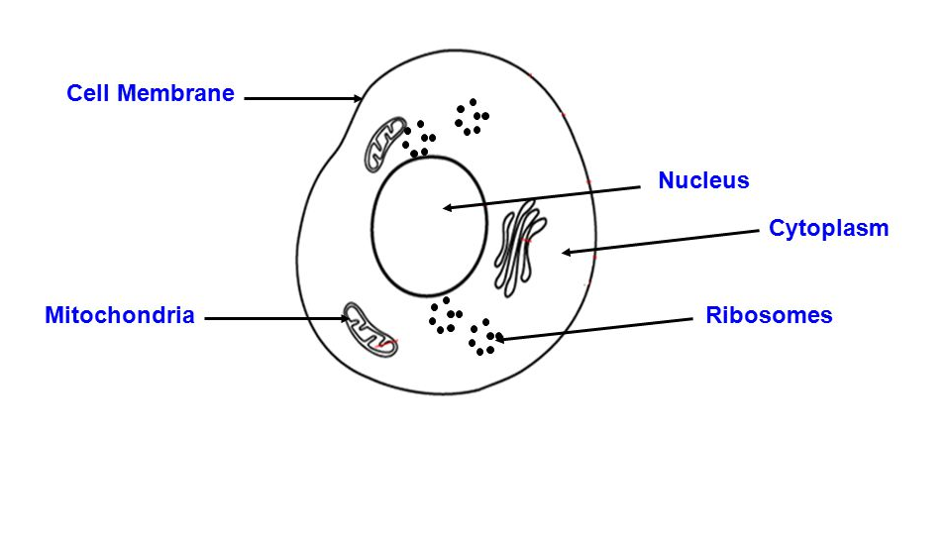
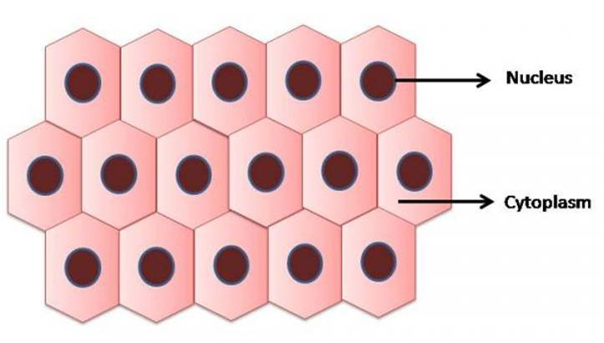
The Tissues
Tissues may be defined as an aggregate of cells, which perform one function or more, some tissues collect to form an organ, which perform one or more functions.

Slide 2
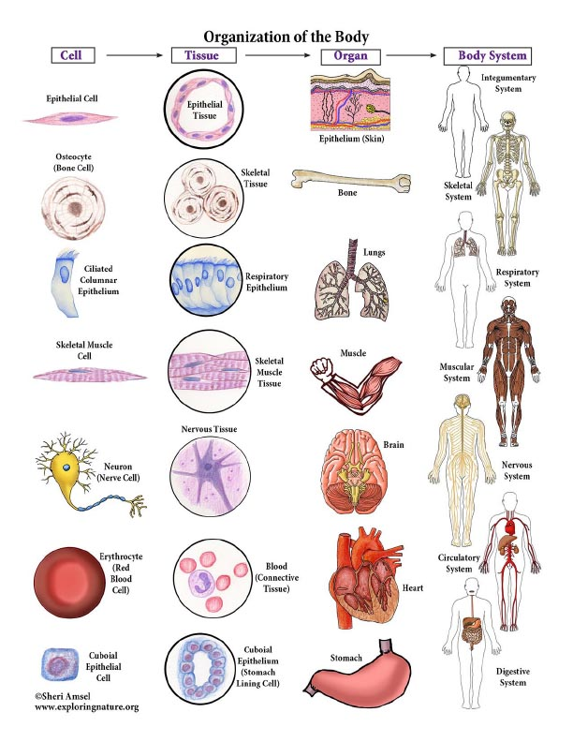
A tissue : is composed of cells that function together in a specialized activity.
Organs :Organs are composed of two or more tissues which function together to perform a common task. For example, the heart contains all 4 types of tissues.

Slide 3
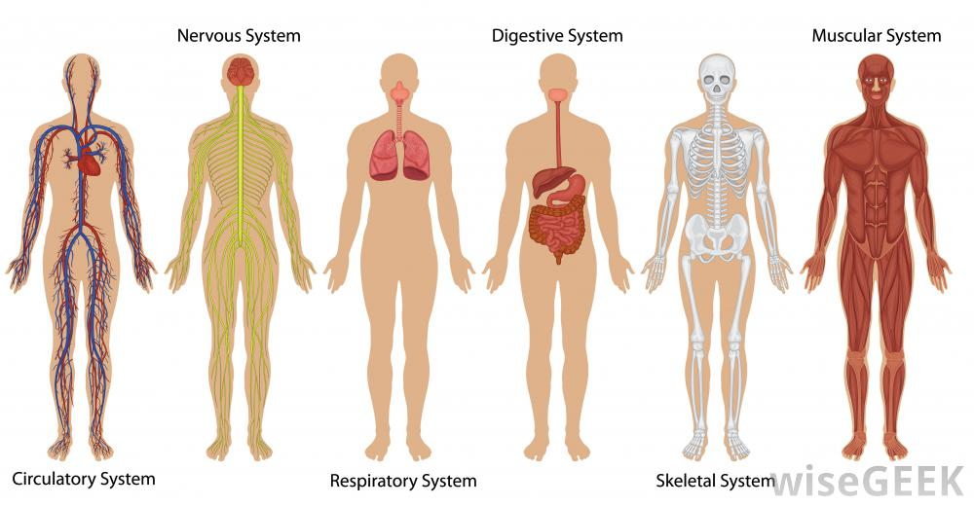
Organ systems :
An organ system consists of two or more organs which perform a specific task.

Slide 4
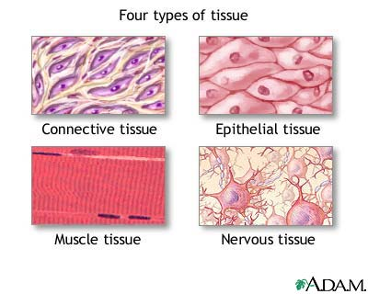
There are four main groups of tissues that are known in the body, these tissues are:
1. Epithelial Tissues
2. Connective Tissues
3. Muscular Tissues
4. Nervous Tissues

Slide 5
Epithelial Tissues
Epithelial tissue covers external surfaces and internal cavities and organs.
Glands are also composed of epithelial tissue.
Function of Epithelial Tissue
• Protection
• Absorption
• Secretion

Slide 6
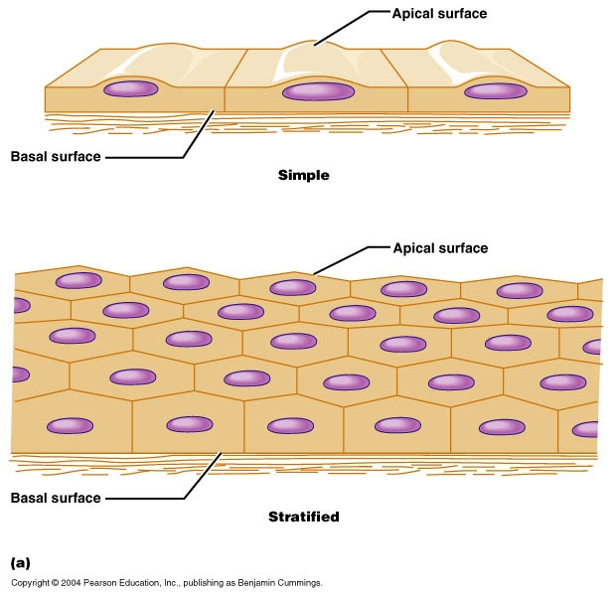
Epithelia are commonly classified based on the shape of the cells on the free surface, as well as the number of cell layers. Sample types include:
Simple Epithelium: A simple epithelium has a single layer of cells.
Stratified Epithelium: A stratified epithelium has multiple layers of cells.

