Slide 1
Osmosis

Slide 2
Osmosis: the movement of water molecules from an area of high concentration to an area of low concentration. More specifically, it is the movement of water across a semi-permeable membrane from an area of high water potential (low solute concentration) to an area of low water potential (high solute concentration). Cell membranes are completely permeable to water; therefore, the environment the cell is exposed to can have a dramatic effect on the cell.

Slide 3
Some examples of osmosis:
Absorption of water by plant roots.
Reabsorption of water by the proximal and distal convoluted tubules of the nephron.
Reabsorption of tissue fluid into the venule ends of the blood capillaries.
Absorption of water by the alimentary canal — stomach, small intestine and the colon.

Slide 4
Osmotic pressure: Diffusion of water across a membrane (osmosis) generates a pressure called osmotic pressure. If the pressure in the compartment into which water is flowing is raised to the equivalent of the osmotic pressure, movement of water will stop. This pressure is often called hydrostatic ('water-stopping') pressure.
Osmolarity: The term is used to describe the number of solute particles in a volume of fluid.
Osmoles: The term is used to describe the concentration in terms of number of particles - a 1 osmolar solution contains 1 mole of osmotically-active particles (molecules and ions) per liter.
Osmoregulation: Is the means by which cells keep the concentration of cell cytoplasm or blood at a suitable concentration.

Slide 5
Transport Across Cell Membranes:
Essential and continuous parts of the life of a cell are the taking in of nutrients and the expelling of wastes. All of these must pass through the cell membrane.
There are three kinds of membranes:
1- Permeable membrane: this kind of membrane allows all
molecules to pass through it.
2- semi- Permeable membrane: this kind of membrane allows part
of the solution (water) to pass through it but not another.
3- Selectively Permeable membrane: this kind of membrane allows
only certain substances to pass through it.

Slide 6
There are 3 types of situations in which this could vary:
1- Hypertonic Solutions: contain a high concentration of solute relative to another solution (e.g. the cell's cytoplasm). When a cell is placed in a hypertonic solution, the water diffuses out of the cell, causing the cell to shrivel.
2-Hypotonic Solutions: contain a low concentration of solute relative to another solution (e.g. the cell's cytoplasm). When a cell is placed in a hypotonic solution, the water diffuses into the cell, causing the cell to swell and possibly explode.
3-Isotonic Solutions: contain the same concentration of solute as another solution (e.g. the cell's cytoplasm). When a cell is placed in an isotonic solution, the water diffuses into and out of the cell at the same rate. The fluid that surrounds the body cells is isotonic.

Slide 7
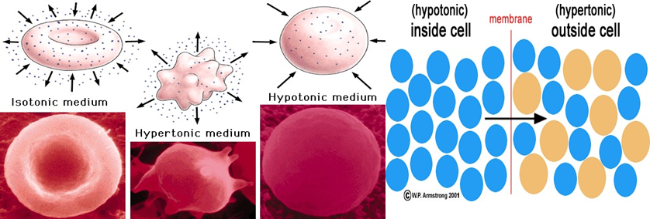

Slide 8
Osmosis in Erythrocytes:
If a red blood cell is placed in water, water enters the cell by osmosis. Because the membrane is quite weak the cell will burst as the volume and therefore the pressure in the cell increases. Red blood cells shrink when placed in concentrated solutions of sugar as water moves out of them by osmosis. This makes the cells appear wrinkled when viewed through a microscope.
This does not happen inside the body because the kidneys make sure the concentration of the blood stays about the same as the concentration of the solution inside the red blood cell.

Slide 9
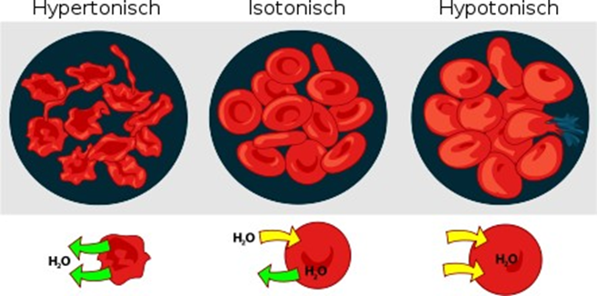
We can describe these points by using red blood cells with different kinds of solution,
RBC used because:
1-The plasma membranes of the RBC are very thin and flexible.
2-It has continuous cytoplasm.
3-The nucleus is absent.

Slide 10
Factors Affecting Fragility:
1. PH of the solution, the fragility of RBC is increased when the pH is decreased.
2. Arise in the temperature increases the fragility of the erythrocytes.
3. The relative volume of blood and saline.

