Slide 1
Numerical Analysis
Scientific computing FAQ
Numerical analysis DMOZ category
Links to Open Source Scientific Computing codes
Numerical Recipes Homepage - with free، complete downloadable books
Alternatives to Numerical Recipes

Slide 2
REFRENCES
1- An Introduction to numerical analysis by A.S. ELALOOSY 2- Introduction to Numerical Analysis by Oron Levy ( September 21th , 2010 ) 3- Atkinson K , an introduction to numerical analysis , second edition John , Willy & Sons New York, NY 1989
4- Introduction to approximation theory , second edition Chelsea publishing company , Cheney E.W .New York ,NY ,1982 5- Analysis of Numerical Methods, Isaacson E, Keller H.B, Second edition , Dover , Mineola, NY 1994 6- Analysis of Numerical Analysis ,Stoer J. Burlisch.R , second edition, Verlag, New York ,NY ,1993

Slide 3
7-Schaum's Outline" Numerical Analysis " by Francis Scheid
8-"Basic Numerical Analysis" by J.Ribbans
9-"Numerical Analysis" by W.A.Watson,T.Philipson and P.J.Oates
10-"Numerical Analysis" by G.A.Watson
11- INTRODUCTION TO NUMERICAL METHODS
by Dr. Ibrahim A. Assakkaf ,Spring 2001
ENCE 2003 - Computation Methods in Civil Engineering

Slide 4
المصادر العربیة
مقدمة فی التحلیل العددی تألیف د. احمدصالح الالوسی
التحلیل العددی للمهندسین تألیف د. سعدمحمد فضیلة
مقدمة في التحليل العددي ترجمة د. كاظم محمد اللامي , د.منتهى جرجيس
التحلیل العددی ترجمة د. علي محمد ابراهيم , د. محمد ماهر علي النجار
الرياضيات والتحلیل العددی تألیف د. صفاءعلي ناصر
التحلیل العددی تألیف خالد قاسم سمور

Slide 5
Course book CONTENT Chapter One: Errors Theorem 1-1 Definition of Error 1-2 Sources of Errors 1-2-1 Non-numerical Errors a-Modeling errors b-Blunders and mistakes c-Uncertainty in information and data 1-2-2 Numerical Errors a-Truncation errors b-Round-off errorsا c-Absolute Error d-The Relative True Error e-Initial Error: f-Propagation errors g- Mathematical-approximation errors h-Inherent Error

Slide 6
Chapter Two: Roots-finding for Non- Linear Equations 2-1Newton- Raphson Method [N.R.M] for Single Non- Linear Equations 2-1-1Applications of [N.R.M] 2-1-1-1 Finding the Square Root of number by [N.R.M] (proof)(Example) 2-1-1-2 Finding the Reciprocal of number by [N.R.M] (proof)(Example) 2-1-1-3Finding the Reciprocal of Square Root of number by [N.R.M] 2-2 Secant Method(Proof)and(Example) 2-3Newton- Raphson Method [N.R.M] for System of Non- Linear Equations (Proof)and(Example) 2-4 Bisection Method (Proof)and(Example) 2-5 False Position(Proof)and(Example)
Chapter Three: 3-Polynomial 3-1 Polynomial [Definition] 3-2Types of Polynomial(Proof)and(Example) 3-3 Degrees of polynomial(Proof)and(Example) 3-4 Evaluation of Polynomial(Proof)and(Example) 3-5 Representation Polynomial by power algebraic series(Proof)and(Example)

Slide 7
Chapter Four:Power Series [Power Expansion] 4-1Taylor series [Taylor Expansion ] 4-2 Maclawrian Series [ Maclawrian Expansion ] 4-3 The remainder of Taylor Series [Taylor Expansion ] 4-4 General Formula for Function Chapter Five: Finite Differences 5-1 Descending Difference[Forward Difference] 5-1-1 Table of Descending Difference [Forward Difference] 5-2 Ascending Difference[ Backward Difference] 5-2-1 Table of Descending Difference[Backward Difference] 5-3 Central Difference 5-3-1 Table of Central Difference 5-4 Relation between[Forward Difference] and Central Difference or Forward Difference effect on Central Difference 5-5 Relation between Backward Difference and Central Difference or Backward Difference effect on Central Difference

Slide 8
Chapter Six: 6- Interpolation: 6-1 What is Interpolation? 6-2 Newton’s Forward of the Interpolation Polynomial 6-3 Newton’s Backward of the Interpolation Polynomial 6-4The Lagrange Form of the Interpolation Polynomial 6-5 The Error in Polynomial Interpolation 6-6 Gaussian Forward of the Interpolation Polynomial 6-7 Gaussian Backward of the Interpolation Polynomial
Chapter Seven: Numerical Integration 7-1 Basic Concepts. 7-2 Integration via Interpolation 7-3 Newton –Cotes Formulas 7-4 Simpson’s Integration

Slide 9
Chapter Eight:
8-1Sets of number
8-2 [Polar and Cartesian] Coordinates and Deriving polar form (Proof)and(Example)
8-3 convert
8-3-1Polar to Cartesian and
8-3-2 Cartesian to Polar)
8-4 Deriving of Demoiver’s Theorem(Proof)and(Example)
8-5Representation Polar by Real Part and Imaginary Part (Proof)and(Example)
Exercise

Slide 10
هةلَةكان Chapter One: Errors
1-1 Definition of Error هةلَة ثيَناسةي
Defined as the difference between the true value in a calculation and the approximate value found using a numerical method etc.
True Error = True Value –Approximate Value
x_{T} – true value
x_{A} – approximate value
Error =

Slide 11
1-2 Sources of Errors
A discussion of errors In Science and Engineering there are several sources of errors that affect scientific results.
Types of Errors
Errors can be classified based on their sources as Numerical Errors and Non- Numerical Errors
1-2-1 Non-numerical Errors
a-Modeling errors:
Occur when a result of an experiment is approximated by a mathematical model. In general, models are valid under certain assumptions, thus models are acceptable approximations of this situation for some ranges .

Slide 12
b- Blunders and mistakes لةدةست دةرضون هةلَة ي
In the language of Numerical Analysis, a mistake (or blunder) is not an error! A mistake is due to fallibility (usually human, not machine). Mistakes may be trivial, with little or no effect on the accuracy of the calculation, or they may be so serious as to render the calculated results quite wrong. There are three things which may help to eliminate mistakes:
1- Care , 2-checks, avoiding repetition
3-knowledge of the common sources of mistakes
Common mistakes include: transposition of digits (for example, reading 6238 as 6328); misreading of repeated digits (for example, reading 62238 as 62338); misreading of tables (for example, referring to a wrong line or a wrong column); incorrectly positioning a decimal point; overlooking signs (especially near sign changes.
Blunders – programming error introduce error into the values
Errors in input – human errors and data transfer errors
Machine errors

Slide 13
C-Uncertainty in information and data
هةلَةي دلَنيا نةبوون
When we make a measurement of a quantity the result that we obtain is not the actual true value of the quantity, but only an estimate of the value. This is because no instrument is perfect there will be always a doubt about the result of any measurement

Slide 14
1-2-2 Numerical Errors
a-Truncation Error (T.E)هةلَةي ثضرِاو الخطأ المبتور
Refers to the error in a method, which occurs because some series (finite or infinite ( is truncated to a fewer number of terms. Such errors are essentially algorithmic errors and we can predict the extent of the error that will occur in the method.
Or Truncation error is defined as the error caused by truncating a mathematical procedure. For example, the Maclaurin series for is given as
Example1 :
Global Truncation Error for Euler’s Method
Example2

Slide 15
b-Round –off Error هةلَةي سورِاوة (دووبارة) الخطأ المدور Round off error occurs because of the computing device's inability to deal with certain numbers. Such numbers need to be rounded off to some near approximation which is dependent on the word size used to represent numbers of the device.
Example :1 Example2:
Example3:The following examples illustrate rounding to four decimal places (4D(
c- Absolute Error( A.E )هةلَةي نرخي رِووت
Absolute Error is the magnitude of the difference between the true value and the approximate value ,If x_{T} is a true value) and the x_{A} is an approximate value, then the absolute error | x_{T} - x_{A} | The Absolute error between two values is defined as( A.E) :
Example :

Slide 16
d .The Relative Error هةلَةي رِيَذةيي
is the absolute error relative to the exact value
True Relative Error in x_{A} =
Error =
e-Initial Error: We get the initial errors from primary data that from reading some of the equipment .
f-Propagation errors: The propagation of errors in individual mathematical operations, such as
1- Addition , 2- Subtraction,3-Multiplication, 4- Division,5-Raising numbers to powers, etc.
can be determined with specific analytical formulas. However, the analysis of the propagation of errors through a model is frequently most easily accomplished numerically.
Relative error =

Slide 17
g-Inherent Errorهةلَةي خؤرسك
Inherent errors are the errors involved in the statement of a problem may be this error is due to the measuring instrument used, an attempt has been made in this experiment to determine the amount of error that can be encountered in different measuring experiment.
Or when a problem is first presented to the numerical analysis it may contain certain data If the data are in some way determined by physical measurement, they will probably differ from the exact values.

Slide 18
h-Mathematical-approximation errors , Sources of Approximation
Suppose that we are attempting to solve a particular instance of a problem arising from a mathematical model of a scientific application. We say that such a problem is well-posed if it meets the following criteria:
1- The problem hasn’t a unique solution.
2- A small perturbation in the problem data results in a small perturbation in the solution; i.e the solution depends continuously on the data. perturbation series – that quantifies the deviation from the exactly solvable problem. The leading term in this power series is the solution of the exactly solvable problem, while further terms describe the deviation in the solution, due to the deviation from the initial problem. Formally, we have for the approximation to the full solution A, a series in the small parameter (here called ε), like the following:
In this example, A₀ would be the known solution to the exactly solvable initial problem and A₁, A₂, ... represent the higher-order terms which may be found iteratively by some systematic procedure. For small ε these higher-order terms in the series become successively smaller . An approximate "perturbation solution" is obtained by truncating the series, usually by keeping only the first two terms, the initial solution and the "first-order" perturbation correction

Slide 19
Chapter Two : Roots finding 2-1Newton - Raphson Method [N.R.M] for Single Non- Linear Equations .
b(x_{n},y_{n})
a(xn, 0)
c(x_{n+1}, 0)
Newton -Raphson Equation

Slide 20
Examples
Q1//
Compute the root of the function by the N.R.M .If starting point(Initial value)
Answer:
By N .R .M:

Slide 23
Exercise
First : Use N.R.M for Solving the following Equations:

Slide 24
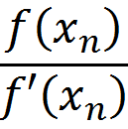
Note : Lahopital Law
If the value of ( ) unknown we must
use the (Lahopital Law )
i.e we take second derivative
Example: by (N.R.M) find the root of
if

Slide 25
2-1-1 Applications of [N.R.M] for making the Equation to finding Several Types of Numbers بةكارهيَناني(N.R.M)بؤ دروست كردني هاوكيَشة بؤ دؤزينةوة ضةندجؤريَك ذمارة
2-1-1-1 Equation to Finding the Square Root of number by [N.R.M
2-1-1-2Equation to Finding the Reciprocal of number by [N.R.M]
2-1-1-3 Equation to Finding the Reciprocal of Square Root of number by [N.R.M]

Slide 26
2-1-1-1Square Roots of numbers method 1-Square Roots

Slide 27
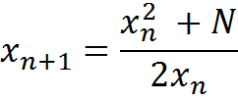
By N.R.M

Slide 28
Example
Find an approximation to to eight decimal places. Solution: Let

Slide 29
Exercise
Solve the following numbers by N.R.M

Slide 30
2-1-1-2Reciprocal Method
By N.R.M.)

Slide 31
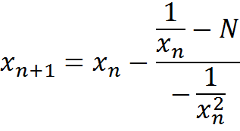
Reciprocal Method

Slide 32
Example
By:
Solve this number by N.R.M
Solution:
Let

Slide 33
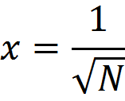
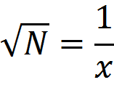
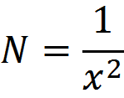
1-1-3 Reciprocal of Square Roots method -2

Slide 34
Example
Solve this number by N.R.M
Let

Slide 35
2-2 Secant Method
a[x_{n} , f(x_{n})]
b[x_{n-1},f(x_{n-1}) ]

Slide 37
Example
Solve this equation
by Secant Method if :
Solution: by Secant Method
First Step:

Slide 38
=-0.4957

Slide 39
The result in First step= The result in Second step
So the root is

Slide 40
Exercise
Solve the following equation by all possible Methods and compare between results?
If and

Slide 41
2-3 The bisection method طريقة التنصيف رِيَطاي لةت كردن
The Bisection Method
The bisection method in mathematics is a root-finding method that repeatedly bisects an interval and then selects a subinterval in which a rootmust lie for further processing. It is a very simple and robust method, but it is also relatively slow. Because of this, it is often used to obtain a rough approximation to a solution which is then used as a starting point for more rapidly converging methods ,The method is also called the interval halving method, the binary search method, or the dichotomy method

Slide 42
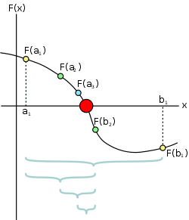

Slide 43
Iteration tasks
The input for the method is a continuous function f, an interval [a, b], and the function values f(a) and f(b). The function values are of opposite sign (there is at least one zero crossing within the interval). Each iteration performs these steps:
1-Calculate c, the midpoint of the interval, .
2-Calculate the function value at the midpoint, f(c).
3-If convergence is satisfactory (that is, c - a is sufficiently small, or |f(c)| is sufficiently small), return c and stop iterating.
4-Examine the sign of f(c) and replace either (a, f(a)) or (b), f(b)) with (c, f(c)) so that there is a zero crossing within the new interval.

Slide 44
Example: Finding the root of a polynomial
Suppose that the bisection method is used to find a root of the polynomial
First, two numbers (a) and (b) have to be found such that f(a) and f(b) have opposite signs. For the above function, a=1 and b=2 satisfy this criterion, as
and
Because the function is continuous , there must be a root within the interval [1, 2].

Slide 45
In the first iteration, the end points of the interval which brackets the root are and , so the midpoint is
The function value at the midpoint is
Because
is negative,
is replaced with
for the next iteration to ensure that
and
have opposite signs. As this continues,
the interval between
and
will become increasingly smaller,
converging on the root of the function.
See this happen in the following table:

Slide 46
Iterations
1 | 1 | 2 | 1.5 | −0.125
2 | 1.5 | 2 | 1.75 | 1.6093750
3 | 1.5 | 1.75 | 1.625 | 0.6660156
4 | 1.5 | 1.625 | 1.5625 | 0.2521973
5 | 1.5 | 1.5625 | 1.5312500 | 0.0591125
6 | 1.5 | 1.5312500 | 1.5156250 | −0.0340538
7 | 1.5156250 | 1.5312500 | 1.5234375 | 0.0122504
8 | 1.5156250 | 1.5234375 | 1.5195313 | −0.0109712
9 | 1.5195313 | 1.5234375 | 1.5214844 | 0.0006222
10 | 1.5195313 | 1.5214844 | 1.5205078 | −0.0051789
After 13 iterations, it becomes apparent (indicate) that there is a convergence to about 1.521: a root for the polynomial.

Slide 47
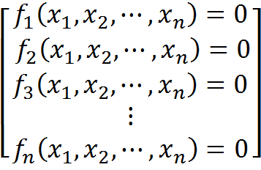
2-3 Newton - Raphson Method [N.R.M] for systems of non-linear equations
Consider the solution to a system of (n)non- linear equations in n unknowns given by
The system can be written in a single expression using vectors, i.e.
where the vector contains the independent variables, and the vector contains the functions
:

Slide 48
Newton-Raphson method to solve systems of non-linear equations

Slide 49
A Newton-Raphson method for solving the system of non linear equations requires the evaluation of a matrix, known as the Jacobian of the system, which is defined as:
If (a vector) represents the first guess for the solution, successive approximations to the solution are obtained from

Slide 50
Example
Solve the following system of non –linear Equation by N-R Method
Solution:
--------------- Let :n=0 for first Iteration

Slide 51
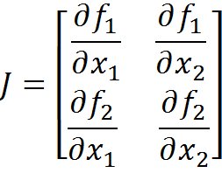
given the vector of functions f and the Jacobian J, as well as an initial guess for the solution
Whose Jacobian is
Since

Slide 52
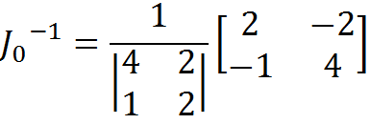
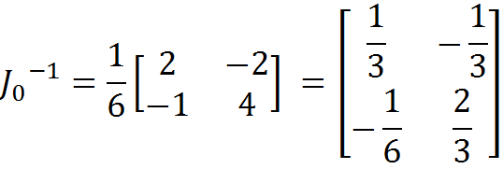

Slide 53
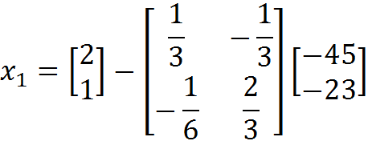
The new approximation to the solution, is calculated as:

Slide 54
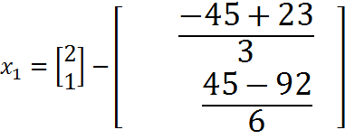
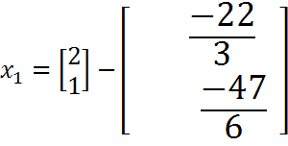
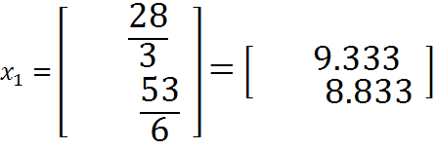

Slide 55
Second Iteration n=1 and
The result is:
Third Iteration n=2 and
The result is:

Slide 56
Exercises Solve the fowling Systems by N.R.M
((Q1
((Q2
((Q3

Slide 57
Chapter Three : Polynomial زؤر رِادةدار
3-1 Definition
An expression of more than two algebraic terms, especially the sum of several terms that contain different powers of the same variable.
3-2 Degrees of polynomial
P₀ (x)=a_{o}
P₁ (x)=a_{o} + a₁x
P₂ (x)=a_{o} + a₁x+ a₂x²
P₃ (x)=a_{o} + a₁x+ a₂x² + a₃x³
.
.
.
P_{n} (x)=a_{o} + a₁x+ a₂x² + a₃x³ +…+a_{n}x^{n}
3-3 Polynomials appear in many areas of mathematics and science.
3-3-1 A polynomial equation: also called an algebraic equation, is an equation of the form a_{o} + a₁x+ a₂x² +… + a_{n}x^{n} =0
3-3-2 polynomial functions, which appear in settings ranging from basic chemistry and physics to economics and social science;

Slide 58
3-3 Representation Polynomial by power algebraic series
Example :
Write this polynomial
in powers( x-2)
1 3 -4 1 1 2
0 2 6 18 28 58
-------------------------------------------
1 3 9 14 29 59
0 2 10 38 104
-----------------------------
1 5 19 52 133
0 2 14 66 ----------------------- 1 7 33 118
0 2 18 -------------- 1 9 51
0 2
----------- 1 11

Slide 59
Chapter Four 4-Power Series 4-1 Deriving Taylor Series or[Taylor Expansion ]
If we take the series of derivatives of variable(x) for general formula as follow:
P_{n}(x)=C₀+ C₁ (x-a) + C₂ (x-a)² + C₃(x-a)³ + C₄ (x-a)⁴ +… + C_{n-1}(x-a)^{n-1} +C_{n}(x-a)^{n}
P_{n}’(x)= C₁ +2 C₂ (x-a) +3 C₃(x-a)² + 4C₄ (x-a)³ +… +(n-1 )C_{n-1}(x-a)^{n-2} + nC_{n}(x-a)^{n-1}
P_{n}”(x)= 2.1 C₂ +3.2 C₃(x-a) + 4.3C₄ (x-a)² +… +(n-1 )(n-2)C_{n-1}(x-a)^{n-3} + n(n-1)C_{n}(x-a)^{n-2}
P_{n}⁽³⁾(x)= 3.2.1 C₃+ 4.3.2C₄ (x-a) +… +(n-1 )
(n-2) (n-3)C_{n-1}(x-a)^{n-4} + n(n-1) (n-2)C_{n}(x-a)^{n-3}

Slide 60
P_{n}⁽⁴⁾(x)= 4.3.2.1C₄+… +(n-1 )(n-2) (n-3) (n-4)C_{n-1}(x-a)^{n-} + n(n-1) (n-2) (n-3)C_{n}(x-a)^{n-4}
. .
. .
. .
P_{n} ^{(n-1)}(x)= (n-1 )(n-2) (n-3) (n-4)…C_{n-1}+ n(n-1) (n-2) (n-3)… [n-(n-2)] C_{n}(x-a)^{n-(n-1)}
P_{n}^{(n)}(x)= n(n-1)(n-2) …3.2.1 C_{n}(x-a)^{n-n} =n! C_{n}(x-a)⁰
P_{n}^{(n)}(x)=n! C_{n}

Slide 61
If x=a
P_{n}(a)= C₀ C₀=P_{n}(a)
P_{n}'(a)= C₁ C₁= P_{n}'(a)/ 1!
P_{n}” (a)= 2.1 C₂ C₂= P_{n}”(a)/ 2!
P_{n} ⁽³⁾(a)=3.2.1 C₃ C₃=P_{n}⁽³⁾ (a)/3!
P_{n}⁽⁴⁾(a)=4.3.2.1 C₄ C₄=P_{n}⁽⁴⁾ (a)/4!
. .
. .
. .
P_{n}^{(n)}(a)=n! C_{n} C_{n}=P_{n}^{(n)} (a)/ n!

Slide 62
P_{n}(x)=C₀+ C₁ (x-a) + C₂ (x-a)² + C₃(x-a)³ + C₄ (x-a)⁴ +… + C_{n-1}(x-a)^{n-1} +C_{n}(x-a)^{n}
P_{n}(x)= P_{n}(a) + [P_{n}'(a)/ 1! ](x-a) +[ P_{n}”(a)/ 2! ](x-a)² + [ P_{n}⁽³⁾ (a)/3!] (x-a)³ +[ P_{n}⁽⁴⁾ (a)/4!] (x-a)⁴ +…
+ [P_{n} ^{(n-1)} (a)/(n-1)!] (x-a)^{n-1} + [P_{n}^{(n)} (a)/ n!](x-a)^{n}
Or
f(x)= f(a) + [ f'(a)/ 1!] (x-a) + [ f”(a)/ 2!] (x-a)² + [f⁽³⁾ (a)/3!] (x-a)³ +[ f⁽⁴⁾ (a)/4! ](x-a)⁴ +… + [f_{n} ^{(n-1)} (a)/(n-1)!] (x-a)^{n-1} +[ f^{(n)} (a)/ n!](x-a)^{n}
Taylor Series [Taylor Expansion]

Slide 63
4-2 Maclaurian series[ MaclaurianExpansion]
Taylor series or[Taylor Expansion ] will change to Maclaurian expansion by taking a=0 as follows : f(x)= f(0) + [ f'(0)/ 1!] (x) +[ f”(0)/ 2!] (x)² +[f⁽³⁾ (0)/3!](x)³ +[ f⁽⁴⁾ (0)/4! ](x)⁴ +…+ [f_{n} ^{(n-1)} (0)/(n-1)!] (x)^{n-1} +[ f^{(n)} (0)/ n!](x)^{n}

Slide 64
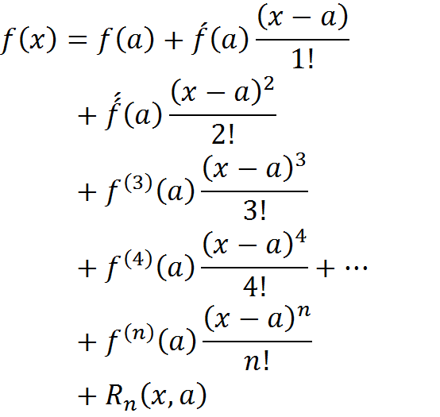
4-3 Taylor Series with Remainder
In Taylor Series:

Slide 65
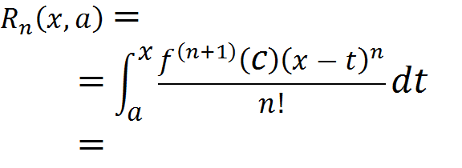
Remainder of Taylor Series

Slide 66
4-4 General Formula [ G.F ]

Slide 67
Exercise
1) f(x)= e^{x}
a)Find Taylor series around a point a=2
b) Find Maclaurian Expansion
c) Find remainder and general formula(G.F)
2) f(x)=cosx
a) Find Taylor series a round the point a= ∏ |4 .
b)Use five term of this series to estimate Cos ∏ |3.
c) Find Maclaurian series.
d) Find remainder and general formula(G.F)
3) f(x)=sinx :
a) Find Taylor series a round the point a= ∏ |2 .
b)Use six term of this series to estimate Sin ∏ |6.
c) Find Maclaurian series .
d) Find remainder and general formula(G.F)
4) f(x)= lnx
a) Can we find Maclaurian Expansion? Why? discuss it?
b) Find remainder and general formula(G.F)

Slide 68
Example
1(Find the Remainder of Taylor Series and General formula.

Slide 69
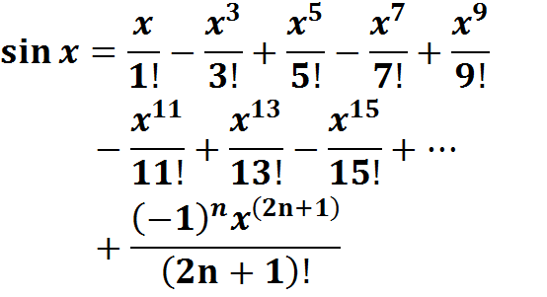
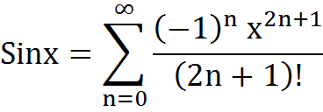
Maclaurain Series for
General Formula

Slide 70
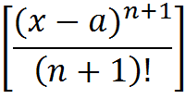
2)If f(x)=Cosx Find Remainder Maclaurian Series and G.F
Solution : Since the derivatives of Cosx Equal Sinx or Cosx and the greatest value of [ ] Equal One Taylor remainder:
= (1) =

Slide 71
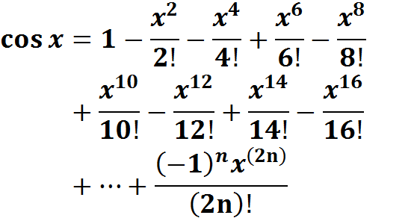
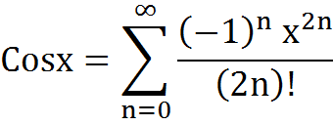
Maylaurain Series for cosx
General Formula [ G.F ]

Slide 72
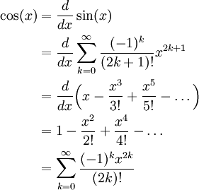

Slide 73
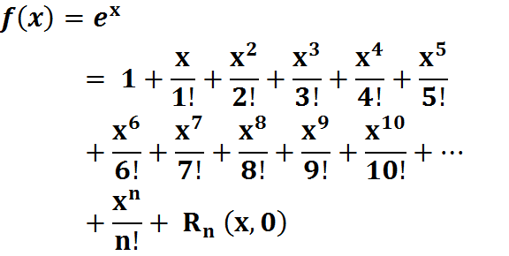
3) If Find the remainder of:

Slide 74
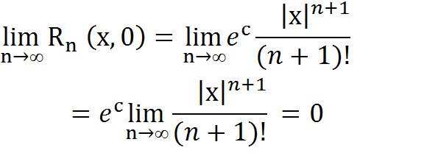
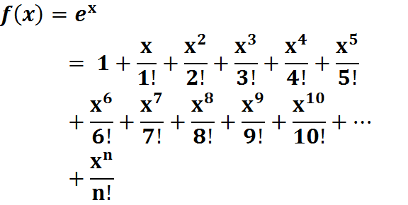
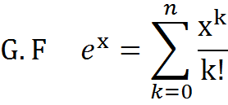

Slide 75
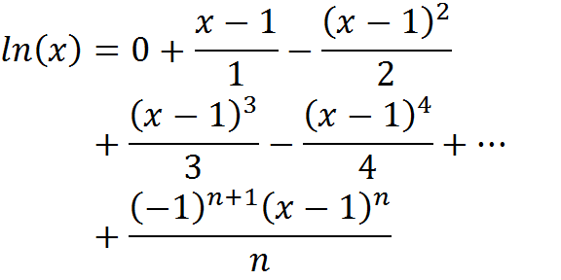
4)Find( G.F )and( R_{n} ) for

Slide 76
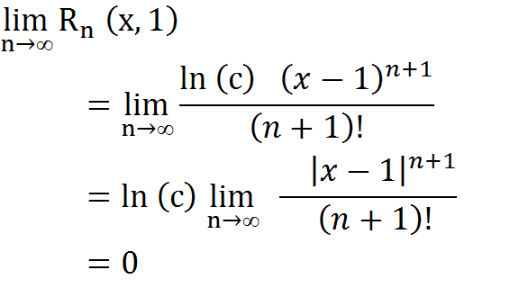

Slide 77
4-4 Euler's formula[Relation between Maclaurian expansion and Polar form]
Euler's formula:
Q5:
Euler's formula states that, for any real number x,where e is the base of the natural logarithm. This can be proved by observing that and so on, and by considering theTaylorseries
expansions of e^{ix}, cos(x) and sin(x):

Slide 78
Euler's formula Euler's formula states that, for any real number x,
Euler's formula states that, for any real number x,where e is the base of the natural logarithm. This can be proved by observing that and so on, and by considering the
Taylor series expansions of e^{ix}, cos(x) and sin(x):

Slide 79
Q5: If
1-Prove that :
2-Find the value of (e) or Prove that e=2.718281828459 …………
Q6:
Prove that :

Slide 80
Taylor and maclaurian
Exercise
=f(x)(e

Slide 81
5- Finite Differences جياوازيةسنووردارةكان (الفروق المنتهية)
Kinds of finite differences
5-1 Forward Differencesالفروق الأمامية
(Descending Differences)(الفروق النازلة)
( )It Symbol’s is Delta

Slide 82
Table of Forward Differencesالفروق الأمامية (Descending Differences)(الفروق النازلة)

Slide 84
Examples
Find the table(F.W.D. )for the follow تيَبيني لةم كاتةدا ثيَويستة نرخةكاني( ) بةرةوذوور رِيَكبخريَن functions:
1)
=0,1,2,3,4,5,6,7,8,9
2)
= 0, 3, 6,9, 12, 15

Slide 85
6-1-2 Error Propagation
Exercise
There is an error in printing the following
Data Find this error?
1- X= 1 , 2 ,3 , 4 , 5 , 6 , 7 , 8 , 9
Y= 1 ,2 ,4 , 8 , 16 ,26 , 42 , 64 , 93
2- Y=0,0,0,0,0,1,0,0,0,0

Slide 86
- 5-2 Ascending Differences[ Backward Differences](B.W.D) جياوازية بةرةوذوورةكان
In this kind the basis begin from(-n ) to (0)

Slide 87
6-2-1 Table Back- ward Differences Table Ascending Differences
===============================================================

Slide 88
Example
--------------------------------------------------------------------
0 1 3
-2
-1 3 5 3
-5 11
-2 5 10 -8 23
3 -12 37
-3 7 7 4 -14
-1 2
-4 9 8 2
-3
-5 11 11

Slide 89
جياوازية ناوةنديةكان 6-3 Central Differences
6-3-1 Table of Central Differences

Slide 90
Central Differences Example
========================================
-2 1 7
2
-1 2 9 -3
-1 6
0 3 8 3 -16
2 -10
1 4 10 -7
-5
2 5 5

Slide 92
Example
IF δf(x)= f( x + h/2)- f( x - h/2)
Find the value of δf(x) for the following functions:
1) f(x)= X³
^{Solution :}δf(x)= f( x + h/2)- f( x - h/2)=
(X + h/2 )³ - (X - h/2 )³
=3hX² + h³ /4
2)f(x) =ln(x)
Solution:
δf(x)= f( x + h/2)- f( x - h/2)
δf(x)= ln( x + h/2)- ln( x - h/2)
= ln [(2x + h)/(2 x – h)]

Slide 93
6-4 relation betweenCentral Differences and forward Differences or Effect of Central Difference on Forward Difference
If n=1 by find for the following Differences:
1) = =
2)
3)

Slide 94
6-5 Deriving relation betweenCentral Differences and forward Differences or Effect of Central Difference on Forward Difference
Let
By multiply both sides with ( )

Slide 95
6-6 Deriving Relation between[Central Differences] and[Backward Differences] or Effect of Central Differences o Backward Differences
If

Slide 96
6- Interpolation 6-1 What is Interpolation? Equal intervals 6-2 Newton Forward Interpolation Formula{N.F.W.I.F.}

Slide 97
N. F.W. I.F

Slide 98
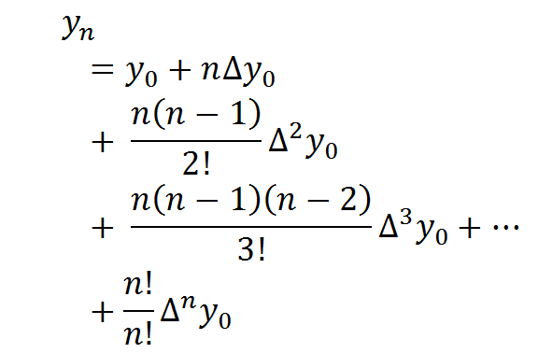
General formula for[N.F.W.I.F.]

Slide 99
Example Find [N.I.F.W.D]for this table

Slide 101
6-3Deriving Newton interpolation backward differences
if

Slide 103
Newton Back- ward Interpolation formula N.B.W.I.F
N.B.W.I.F

Slide 104
Newton Back- ward formula
Newton Back- ward formula

Slide 105
6-3 Gaussian Forward Interpolation Formula
If

Slide 107
6-4 Gaussian Backward Interpolation Formula
,
 | (2)

Slide 108
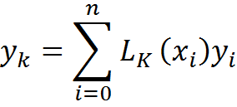
6-5Lagrange Interpolation for unequal intervals
if

Slide 109
If k=2 only we find

Slide 110
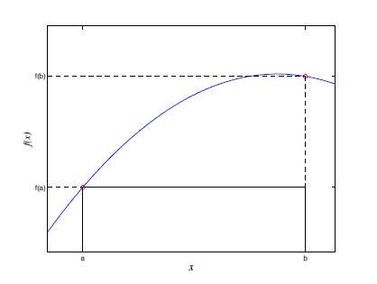
Chapter Seven Numerical Integration
7-1 Basic Concepts : In this chapter we are going to explore various ways for approximating the integral of a function over a given domain. Since we can not analytically integrate every function , the need for approximate integration formulas is obvious. In addition, there might be situations where the given function can be integrated analytically, and still, an approximation formula may end up being a more efficient alternative to evaluating the exact expression of the integral.
.
is called the rectangular method

Slide 111
while the lower (Darboux) sum of f(x) with respect to the partition P is defined
The upper integral of f(x) on [a, b] is defined as
and the lower integral of f(x) is fined as
where both the infimum and the supremum
are taken over all possible partitions, P, of the interval [a, b]. If the upper and lower integral of f(x) are equal to each other, their common value is denoted by
and is referred to as the Riemann integral of f(x).

Slide 112
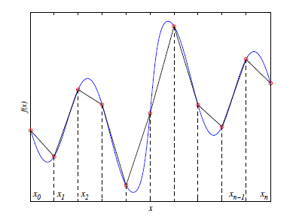
7-2Composite Integration Rules
In a composite quadrature, we divide the interval into subintervals and apply an integrationrule to each subinterval. We demonstrate this idea with a couple of examples.

Slide 113
If f (x) is a function, then the integral of f from a to b is Written by
This integral gives the area under the graph of f , with the area under the positive part counting as positive area, and the area under the negative part of f counting as negative area,

Slide 114
7-3 Integration via InterpolationMethods
In this section we will study how to derive quadratures by integrating an interpolant .
As always, our goal is to evaluate. We select nodes x0, . . . , xn [a, b],and write the Lagrange interpolate through these points Univariate quadrature methods are designed to approximate the integral of areal-valued function f depened on a bounded interval [a; b] of the real line.
7-4 -1 Newton-Cotes method are widely used,
7-4 -2 Simpson's Rule
Both rules are easy to implement and are typically adequate for computing the area under a continuous function

Slide 115
7-4-1Newton-Cotes Method
If is the Lagrange interpolation
Polynomial for the function y=f(x) for which the following(n+1) points are given:
, , , . . . ,
then

Slide 116
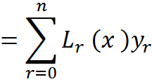
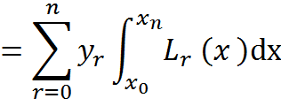
and
if

Slide 117
If n=1
-----------------------

Slide 120
7-5Simpsons Method
If is the Lagrange interpolation Polynomial for the function y=f(x) for which the following(n+1) points are given:
, , , . . . ,
then

Slide 121
If n=2
-----------------------

Slide 123
We must solve the final integral by part the result is :

Slide 124
Exercise 1
If
Prove that:
Proof:

Slide 125
Exercise(2)
If
Prove that:
Proof:

Slide 126
3-18-Set s of Numbers
8-1-1 Set of Natural Numbers: N ={0,1,2,3,4,…}
8-1- 2 Set of Integer Numbers:
Z ={ …,-3,-2,-1,0,+1,+2,+3,…}
8-1-3 Set of fractional numbers: F = {a/ b:a 𝛜 Z, b 𝛜 Z|{0}}
8-1-4 Set of Non fractional numbers
K= (Square Root for Positive Numbers ,Cubic Roots,…)
8-1-5 Set of Real Numbers : R=NυZ υF υ K
8-1- 6 Set of Complex Numbers:
C= x + i y { x is a real part, iy is an imaginary part }
Examples : 1) 6+9i , 2)3+5/8i

Slide 127
8-2 [Polar and Cartesian] Coordinates and Deriving Polar Form
(x , y)
y
r
θ
X
Note:
For every Point We have :Polar and Cartesian Coordinates
1-Cartesian Coordinates
2- Polar Coordinates
If C = x +iy : cos θ = x / r
sinθ = y / r
C = x +iy C= rcos θ + ir Sinθ

Slide 128
8-3Convert
8-3-1Polar → Complex number
Suppose we have a polar form and we want to Convert it to complex number . we can use two formulas and
8-3-2Complex number → Polar Conversion
On the other hand, suppose we have a complex number and we want to Convert it in polar form we can use two formulas. and
Hint:
arctan = Inverse tangent
arctan 1 = tan⁻¹ 1 = 45°

Slide 129
8-4 Deriving of Demoiver’sTheorem
Proof
If We take C₁= cos θ₁ + i sin θ₁
C₂= cos θ₂ + i sin θ₂
C₁ C₂ = cos(θ₁ + θ₂) i sin( θ₁ + θ₂)
In unity circle: r = 1
if ( θ₁ =θ₂ =θ)
_{Then} C₁ C₂ = cos(2θ)+i sin( 2θ )
So C₁₌ C₂ = c
C² =(cos θ + i sin θ)²= cos(2θ)+ i sin(2θ)
[cos(θ)+ i sin(θ )]³ = cos(3θ)+ i sin( 3θ )
[cos(θ)+ i sin(θ )]⁴ = cos(4θ)+ i sin( 4θ ) .
.
.
.
[cos(θ)+ i sin(θ )]^{n} = cos(nθ)+ i sin( nθ )

Slide 130
8-5Representation Polar by Real Part and Imaginary Part
If C= cosθ + i sinθ (1)
then C²= (cosθ + i sinθ)²
=cos²θ + i 2sinθcosθ- sin²θ
=[ cos² θ - sin² θ] + 2 i sinθ cosθ
Real Part= cos²θ – sin²θ .
Imaginary Part= i 2sinθ cosθ

Slide 131
Exercise
1-write cos(8θ)&sin(8θ) in term cosθ,sin θ
2-Write cos(3θ), cos(4θ) & cos(7θ)in term cosθ ,sinθ
3-Write the following Complex Numbers by
Polar Form: a)1+i , b) i , c) √ 3 + i , d) 1+ i √ 3 , e) 1 , f) (1+i) / (√ 3 + i ) , g) (√ 3 + i )/ (1+i)
4-Convert the polar form 5 ∠ 53° to complex number .
5-Convert the complex number 5 + 2 i to polar form.
6- Prove that :
7- show that:
the solution of the equation is

