Slide 1
Numerical Analysis with R Programming Language
Scientific computing FAQ
Numerical analysis DMOZ category
Links to Open Source Scientific Computing codes
Numerical Recipes Homepage - with free، complete downloadable books
Alternatives to Numerical Recipes

Slide 2
REFRENCES
1- An Introduction to numerical analysis by A.S. ELALOOSY
2- Introduction to Numerical Analysis by Oron Levy ( September 21th , 2010 )
3- Atkinson K , an introduction to numerical analysis , second edition John , Willy & Sons New York, NY 1989
4- Introduction to approximation theory , second edition Chelsea publishing company , Cheney E.W .New York ,NY ,1982
5- Analysis of Numerical Methods, Isaacson E, Keller H.B, Second edition , Dover , Mineola, NY 1994
6- Analysis of Numerical Analysis ,Stoer J. Burlisch.R , second edition, Verlag, New York ,NY ,1993

Slide 3
7-Schaum's Outline" Numerical Analysis " by Francis Scheid
8-"Basic Numerical Analysis" by J.Ribbans
9-"Numerical Analysis" by W.A.Watson,T.Philipson and P.J.Oates
10-"Numerical Analysis" by G.A.Watson
11- INTRODUCTION TO NUMERICAL METHODS
by Dr. Ibrahim A. Assakkaf ,Spring 2001
ENCE 2003 - Computation Methods in Civil Engineering

Slide 4
المصادر العربیة
مقدمة فی التحلیل العددی تألیف د. احمدصالح الالوسی
التحلیل العددی للمهندسین تألیف د. سعدمحمد فضیلة
مقدمة في التحليل العددي ترجمة د. كاظم محمد اللامي , د.منتهى جرجيس
التحلیل العددی ترجمة د. علي محمد ابراهيم , د. محمد ماهر علي النجار
الرياضيات والتحلیل العددی تألیف د. صفاءعلي ناصر
التحلیل العددی تألیف خالد قاسم سمور

Slide 5
Course book CONTENT Chapter One : Power Series 1-1The remainder of Taylor Series [Taylor Expansion ] 1-2 General Formula for Function 1-3 Euler’s Formula Chapter Two: Finite Differences 2-1 Descending Difference[Forward Difference] 2-1-1 Table of Descending Difference [Forward Difference] 2-2 Ascending Difference[ Backward Difference] 2-2-1 Table of Descending Difference[Backward Difference] 2-3 Central Difference 2-3-1 Table of Central Difference 2-4 Relation between[Forward Difference] and Central Difference or Forward Difference effect on Central Difference 2-5 Relation between Backward Difference and Central Difference or Backward Difference effect on Central Difference

Slide 6
Chapter Three: 3- Interpolation: 3-1 What is Interpolation? 3-2 Newton’s Forward of the Interpolation Polynomial 3-3 Newton’s Backward of the Interpolation Polynomial 3-4 The Error in Polynomial Interpolation 3-5 Gaussian Forward of the Interpolation Polynomial 3-6 Gaussian Backward of the Interpolation Polynomial 3-7The Lagrange Form of the Interpolation Polynomial
Chapter Four: Numerical Integration 4-1 Basic Concepts. 4-2 Integration via Interpolation 4-3 Newton –Cotes Formulas 4-4 Simpson’s Integration

Slide 7
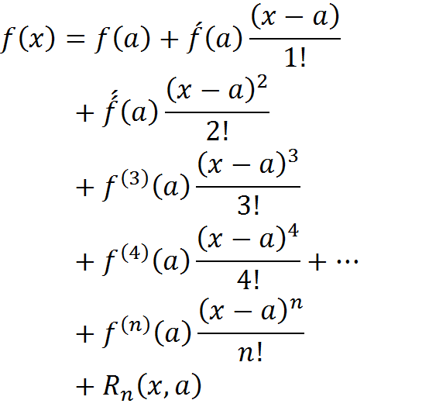
Chapter One : Power Series
1-3 Taylor Series with Remainder
In Taylor Series:

Slide 8
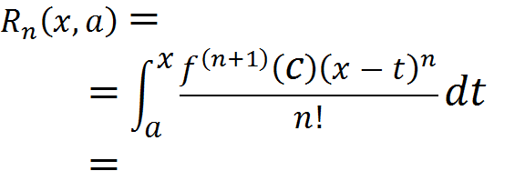

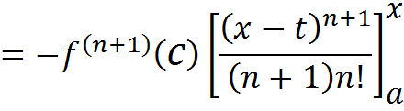
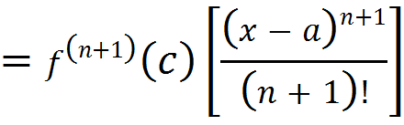
Remainder of Taylor Series

Slide 9
1-2 General Formula [ G.F ]

Slide 10

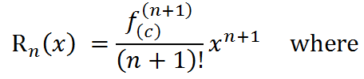



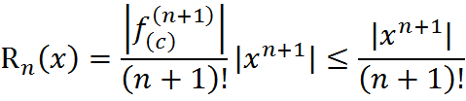



Example
1(Find the Remainder of Taylor Series and General formula.

Slide 11
Exercise
1) f(x)=sinx :
a) Find Taylor series a round the point a= ∏ |2 .
b)Use six term of this series to estimate Sin ∏ |6.
c) Find Maclaurian series .
d) Find remainder and general formula(G.F)
2) f(x)=cosx
a) Find Taylor series a round the point a= ∏ |4 .
b)Use five term of this series to estimate Cos ∏ |3.
c) Find Maclaurian series.
d) Find remainder and general formula(G.F)
3) f(x)= e^{x}
a)Find Taylor series around a point a=2
b) Find Maclaurian Expansion
c) Find remainder and general formula(G.F)
4) f(x)= lnx
a) Can we find Maclaurian Expansion? Why? discuss it?
b) Find remainder and general formula(G.F)

Slide 12
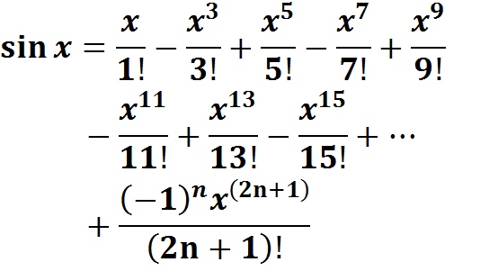
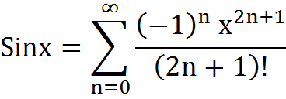
1-Maclaurain Series for
General Formula

Slide 13

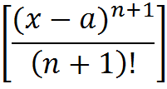
2)If f(x)=Cosx Find Remainder Maclaurian
Series and G.F
Solution : Since the derivatives of Cosx Equal Sinx or Cosx and the greatest value of [ ] Equal One Taylor remainder:
= (1) =

Slide 14
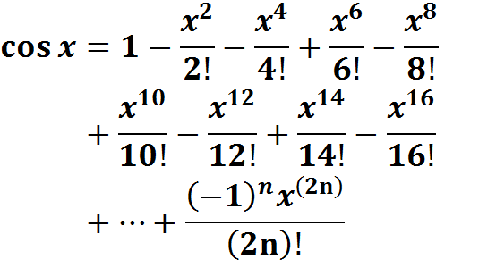
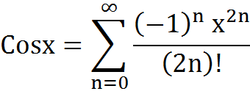
Maylaurain Series for f(x)=cosx
General Formula [ G.F ]

Slide 15
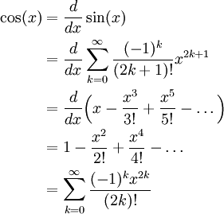

Slide 16

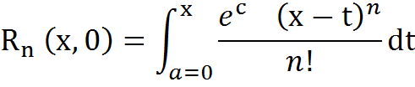
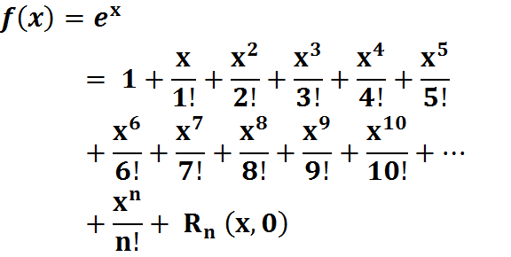
3) If Find the remainder of:

Slide 17
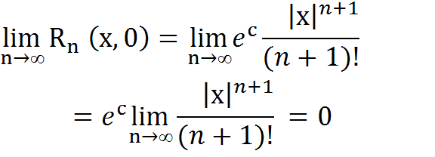
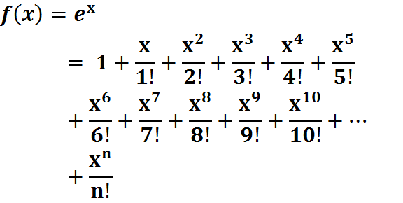
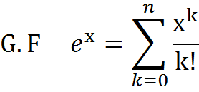

Slide 18

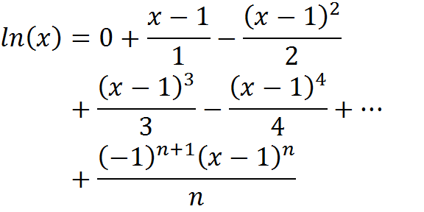
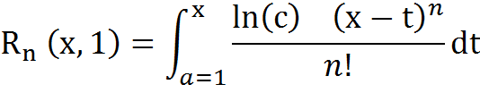
4)Find( G.F )and( R_{n} ) for

Slide 19
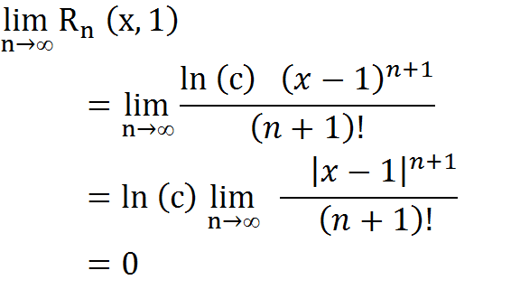
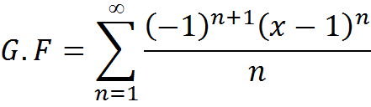

Slide 20

4-4 Euler's formula[Relation between Maclaurian expansion and Polar form]
Euler's formula:
Q5:
Euler's formula states that, for any real number x,where e is the base of the natural logarithm. This can be proved by observing that and so on, and by considering theTaylorseries
expansions of e^{ix}, cos(x) and sin(x):

Slide 21
Euler's formula Euler's formula states that, for any real number x,
Euler's formula states that, for any real number x,where e is the base of the natural logarithm. This can be proved by observing that and so on, and by considering the
Taylor series expansions of e^{ix}, cos(x) and sin(x):

Slide 22
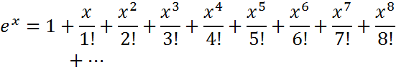





Q5: If
1-Prove that :
2-Find the value of (e) or Prove that e=2.718281828459 …………
Q6:
Prove that :

Slide 23






Taylor and maclaurian
Exercise
=f(x)(e

Slide 24
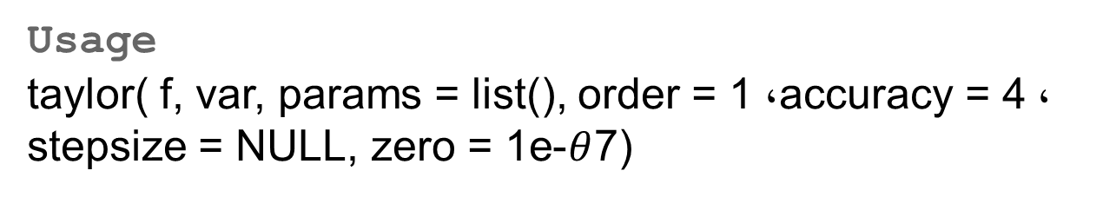
R Programming Language for Taylor and MacLaurin Series
R Documentation
Taylor Series Expansion
Description
Computes the Taylor series of functions or characters.
Usage
taylor( f, var, params = list(), order = 1, accuracy = 4, stepsize = NULL, zero = 1e-$θ$7)

Slide 25
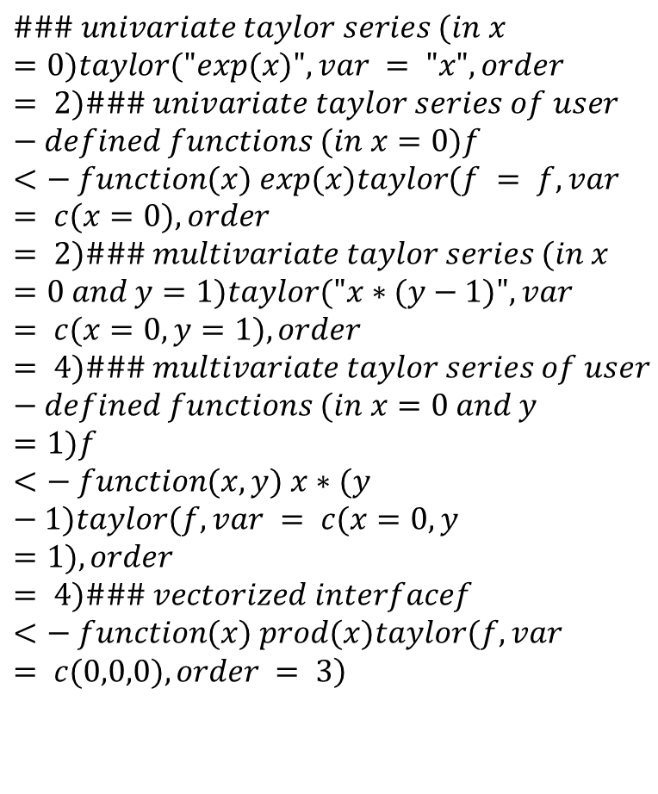
Examples
$$\left.\#\#\# univariate taylor series (in x=0)taylor("exp(x)", var = "x", order = 2)\#\#\# univariate taylor series of user−defined functions (in x=0)f <− function(x) exp(x)taylor(f = f, var = c(x=0), order = 2)\#\#\# multivariate taylor series (in x=0 and y=1)taylor("x∗(y−1)", var = c(x=0, y=1), order = 4)\#\#\# multivariate taylor series of user−defined functions (in x=0 and y=1)f <− function(x,y) x∗(y−1)taylor(f, var = c(x=0, y=1), order = 4)\#\#\# vectorized interfacef <− function(x) prod(x)taylor(f, var = c(0,0,0), order = 3\right)$$

Slide 26

2- Finite Differences
جياوازيةسنووردارةكان (الفروق المنتهية)
Kinds of finite differences
5-1 Forward Differencesالفروق الأمامية
(Descending Differences)(الفروق النازلة)
( )It Symbol’s is Delta

Slide 27





















Table of Forward Differencesالفروق الأمامية
(Descending Differences)(الفروق النازلة)

Slide 28






















Slide 29


Examples
Find the table(F.W.D. )for the follow تيَبيني لةم كاتةدا ثيَويستة نرخةكاني( ) بةرةوذوور رِيَكبخريَن functions:
1)
=0,1,2,3,4,5,6,7,8,9
2)
= 0, 3, 6,9, 12, 15

Slide 30
2-1-2 Error Propagation
Exercise
There is an error in printing the following
Data Find this error?
1- X= 1 , 2 ,3 , 4 , 5 , 6 , 7 , 8 , 9
Y= 1 ,2 ,4 , 8 , 16 ,26 , 42 , 64 , 93
2- Y=0,0,0,0,0,1,0,0,0,0

Slide 31




- 2-2 Ascending Differences[ Backward Differences](B.W.D)
جياوازية بةرةوذوورةكان
In this kind the basis begin from(-n ) to (0)

Slide 32

































2-2-1 Table Back- ward Differences
Table Ascending Differences
===============================================================

Slide 33
Example
--------------------------------------------------------------------
0 1 3
-2
-1 3 5 3
-5 11
-2 5 10 -8 23
3 -12 37
-3 7 7 4 -14
-1 2
-4 9 8 2
-3
-5 11 11

Slide 34
































جياوازية ناوةنديةكان 2-3 Central Differences
6-3-1 Table of Central Differences

Slide 35
Central Differences
Example
========================================
-2 1 7
2
-1 2 9 -3
-1 6
0 3 8 3 -16
2 -10
1 4 10 -7
-5
2 5 5

Slide 37
Example
IF δf(x)= f( x + h/2)- f( x - h/2)
Find the value of δf(x) for the following functions:
1) f(x)= X³
^{Solution :}δf(x)= f( x + h/2)- f( x - h/2)=
(X + h/2 )³ - (X - h/2 )³
=3hX² + h³ /4
2)f(x) =ln(x)
Solution:
δf(x)= f( x + h/2)- f( x - h/2)
δf(x)= ln( x + h/2)- ln( x - h/2)
= ln [(2x + h)/(2 x – h)]

Slide 38

2-4 relation betweenCentral Differences and forward Differences or Effect of Central Difference on Forward Difference
If n=1 by find for the following Differences:
1) = =
2)
3)

Slide 39







2-5 Deriving relation betweenCentral Differences and forward Differences or Effect of Central Difference on Forward Difference
Let
By multiply both sides with ( )

Slide 40


2-6 Deriving Relation between[Central Differences] and[Backward Differences] or Effect of Central Differences o Backward Differences
If

Slide 41
3- Interpolation
3-1 What is Interpolation? Equal intervals
3-2 Newton Forward Interpolation Formula{N.F.W.I.F.}

Slide 42


N. F.W. I.F

Slide 43
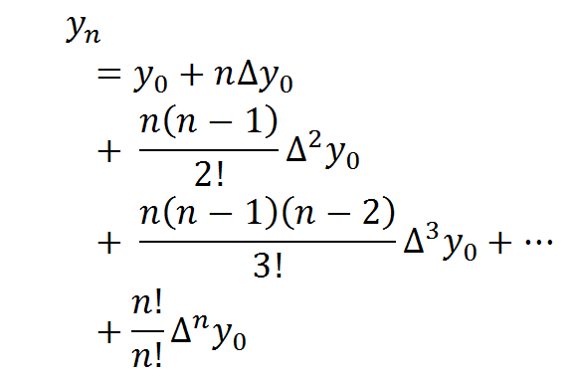
General formula for[N.F.W.I.F.]

Slide 44















Example
Find [N.I.F.W.D]for this table

Slide 46








3-3Deriving Newton interpolation backward differences
if

Slide 47




Slide 48




Newton Back- ward Interpolation formula
N.B.W.I.F
N.B.W.I.F

Slide 49
Newton Back- ward formula
Newton Back- ward formula

Slide 50



3-3 Gaussian Forward Interpolation Formula
If

Slide 51










Slide 52



3-4 Gaussian Backward Interpolation Formula
,
 | (2)

Slide 53
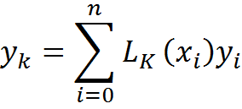
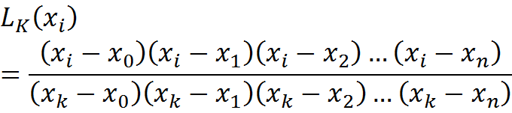
3-5Lagrange Interpolation for unequal intervals
if

Slide 54




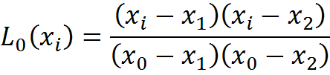
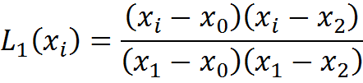
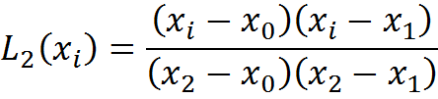
If k=2 only we find

Slide 55
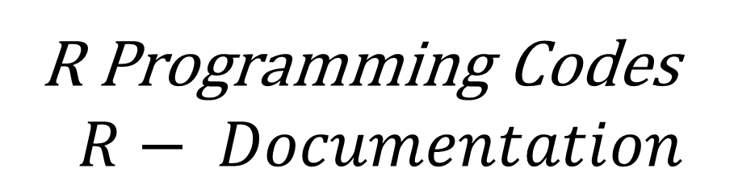
R Programming Codes
$$R− Documentation$$
Interpolation Functions
Description
Return a list of points which linearly interpolate given data points, or a function performing the linear (or constant) interpolation.
Usage
approx (x, y = NULL, xout, method = "linear", n = 50,
yleft, yright, rule = 1, f = 0, ties = mean, na.rm = TRUE)
approxfun(x, y = NULL, method = "linear",
yleft, yright, rule = 1, f = 0, ties = mean, na.rm = TRUE)
$$approxfun \{stats\}$$ | $$R Documentation$$

Slide 56
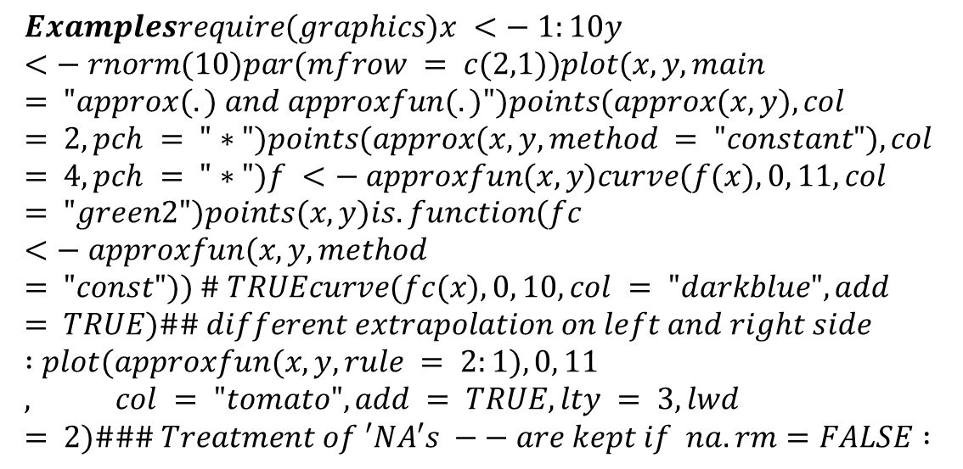
Interpolation Functions
Description
Return a list of points which linearly interpolate given data points, or a function performing the linear (or constant) interpolation.
Usage
approx (x, y = NULL, xout, method = "linear", n = 50,
yleft, yright, rule = 1, f = 0, ties = mean, na.rm = TRUE)
approxfun(x, y = NULL, method = "linear",
yleft, yright, rule = 1, f = 0, ties = mean, na.rm = TRUE)
$$Examplesrequire(graphics)x <− 1:10y <− rnorm(10)par(mfrow = c(2,1))plot(x, y, main = "approx(.) and approxfun(.)")points(approx(x, y), col = 2, pch = "∗")points(approx(x, y, method = "constant"), col = 4, pch = "∗")f <− approxfun(x, y)curve(f(x), 0, 11, col = "green2")points(x, y)is.function(fc <− approxfun(x, y, method = "const")) \# TRUEcurve(fc(x), 0, 10, col = "darkblue", add = TRUE)\#\# different extrapolation on left and right side :plot(approxfun(x, y, rule = 2:1), 0, 11, col = "tomato", add = TRUE, lty = 3, lwd = 2)\#\#\# Treatment of ′NA′s −− are kept if na.rm=FALSE :$$

Slide 57
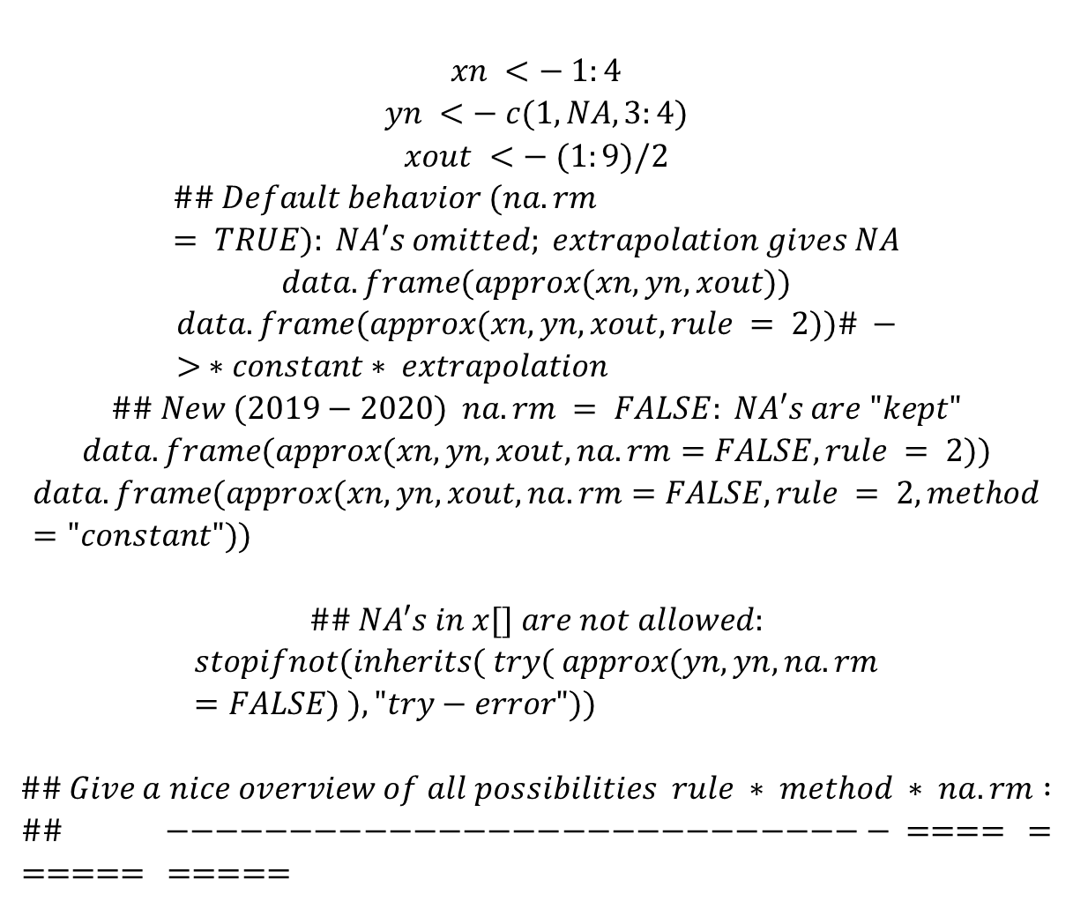
$$xn <− 1:4$$
$$yn <− c(1,NA,3:4)$$
$$xout <− (1:9)/2$$
$$\#\# Default behavior (na.rm = TRUE): NA′s omitted; extrapolation gives NA$$
$$data.frame(approx(xn,yn, xout))$$
$$data.frame(approx(xn,yn, xout, rule = 2))\# −> ∗constant∗ extrapolation$$
$$\#\# New (2019−2020) na.rm = FALSE: NA′s are "kept"$$
$$data.frame(approx(xn,yn, xout, na.rm=FALSE, rule = 2))$$
$$data.frame(approx(xn,yn, xout, na.rm=FALSE, rule = 2, method="constant"))$$
$$\#\# NA′s in x[] are not allowed:$$
$$stopifnot(inherits( try( approx(yn,yn, na.rm=FALSE) ), "try−error"))$$
$$\#\# Give a nice overview of all possibilities rule ∗ method ∗ na.rm :$$
$$\#\# −−−−−−−−−−−−−−−−−−−−−−−−−−−−− ==== ====== =====$$

Slide 58
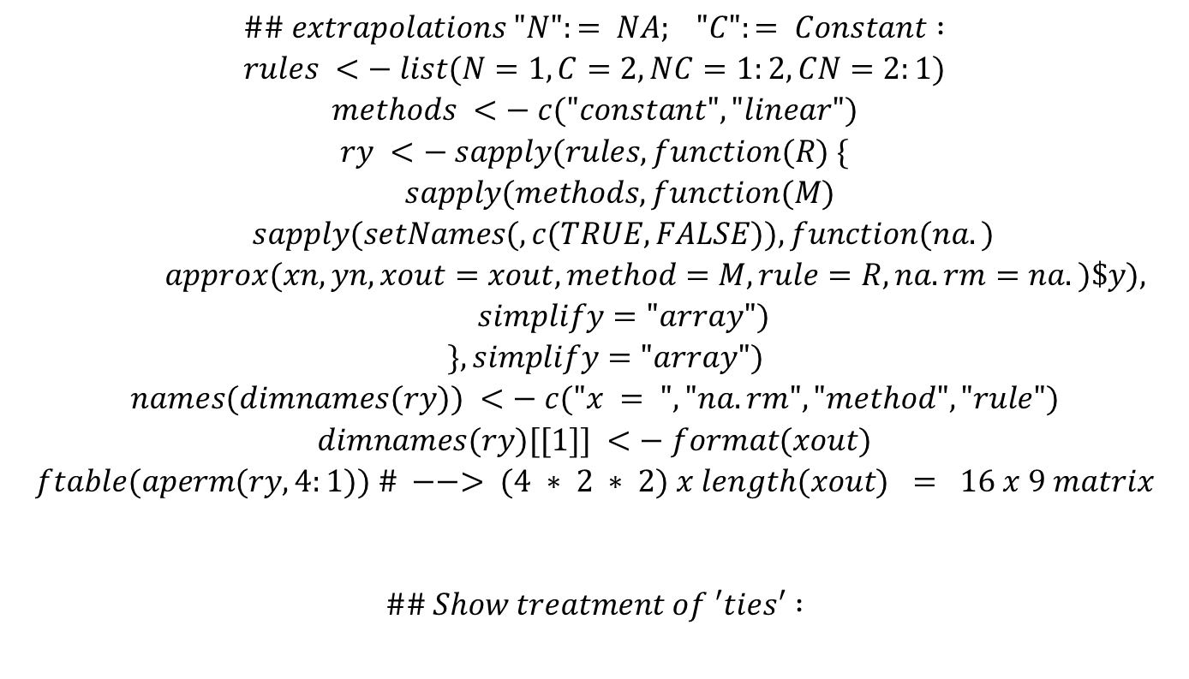
$$\#\# extrapolations "N":= NA; "C":= Constant :$$
$$rules <− list(N=1, C=2, NC=1:2, CN=2:1)$$
$$methods <− c("constant","linear")$$
$$ry <− sapply(rules, function(R) \{$$
$$sapply(methods, function(M)$$
$$sapply(setNames(,c(TRUE,FALSE)), function(na.)$$
$$approx(xn, yn, xout=xout, method=M, rule=R, na.rm=na.)\$y),$$
$$simplify="array")$$
$$\}, simplify="array")$$
$$names(dimnames(ry)) <− c("x = ", "na.rm", "method", "rule")$$
$$dimnames(ry)[[1]] <− format(xout)$$
$$ftable(aperm(ry, 4:1)) \# −−> (4 ∗ 2 ∗ 2) x length(xout) = 16 x 9 matrix$$
$$\#\# Show treatment of ′ties′ :$$

Slide 59
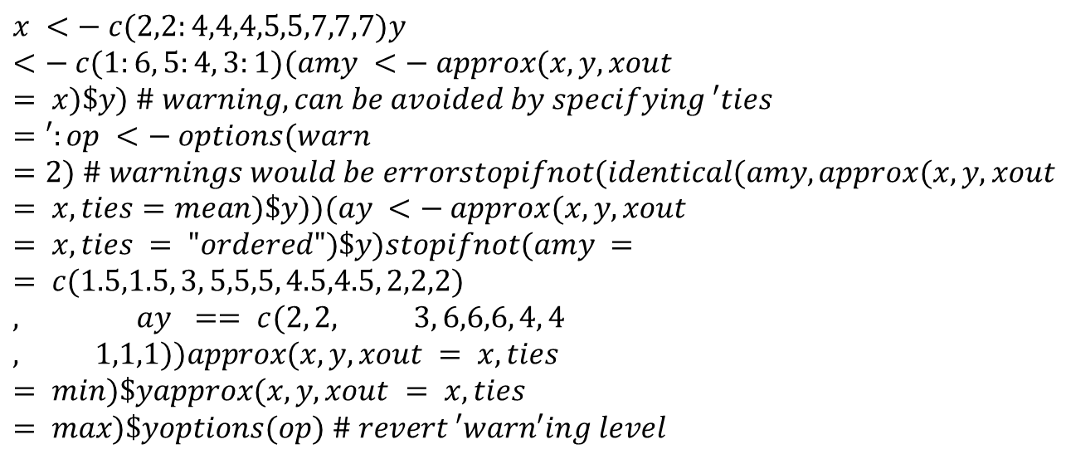
$$x <− c(2,2:4,4,4,5,5,7,7,7)y <− c(1:6, 5:4, 3:1)(amy <− approx(x, y, xout = x)\$y) \# warning, can be avoided by specifying ′ties=′:op <− options(warn=2) \# warnings would be errorstopifnot(identical(amy, approx(x, y, xout = x, ties=mean)\$y))(ay <− approx(x, y, xout = x, ties = "ordered")\$y)stopifnot(amy == c(1.5,1.5, 3, 5,5,5, 4.5,4.5, 2,2,2), ay == c(2, 2, 3, 6,6,6, 4, 4, 1,1,1))approx(x, y, xout = x, ties = min)\$yapprox(x, y, xout = x, ties = max)\$yoptions(op) \# revert ′warn′ing level$$

Slide 60
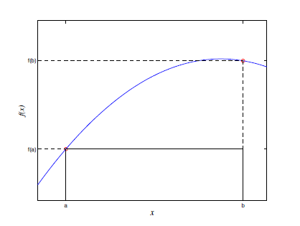
Chapter Seven Numerical Integration
4-1 Basic Concepts : In this chapter we are going to explore various ways for approximating the integral of a function over a given domain. Since we can not analytically integrate every function , the need for approximate integration formulas is obvious. In addition, there might be situations where the given function can be integrated analytically, and still, an approximation formula may end up being a more efficient alternative to evaluating the exact expression of the integral.
.
is called the rectangular method

Slide 61




while the lower (Darboux) sum of f(x) with respect to the partition P is defined
The upper integral of f(x) on [a, b] is defined as
and the lower integral of f(x) is fined as
where both the infimum and the supremum
are taken over all possible partitions, P, of the interval [a, b]. If the upper and lower integral of f(x) are equal to each other, their common value is denoted by
and is referred to as the Riemann integral of f(x).

Slide 62
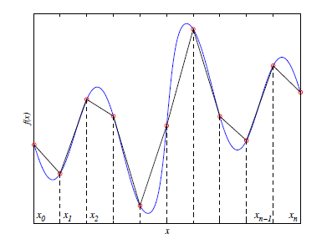
4-2Composite Integration Rules
In a composite quadrature, we divide the interval into subintervals and apply an integrationrule to each subinterval. We demonstrate this idea with a couple of examples.

Slide 63


If f (x) is a function, then the integral of f from a to b is Written by
This integral gives the area under the graph of f , with the area under the positive part counting as positive area, and the area under the negative part of f counting as negative area,

Slide 64
4-3 Integration via InterpolationMethods
In this section we will study how to derive quadratures by integrating an interpolant .
As always, our goal is to evaluate. We select nodes x0, . . . , xn [a, b],and write the Lagrange interpolate through these points Univariate quadrature methods are designed to approximate the integral of areal-valued function f depened on a bounded interval [a; b] of the real line.
7-4 -1 Newton-Cotes method are widely used,
7-4 -2 Simpson's Rule
Both rules are easy to implement and are typically adequate for computing the area under a continuous function

Slide 65
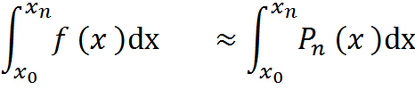
4-4-1Newton-Cotes Method
If is the Lagrange interpolation
Polynomial for the function y=f(x) for which the following(n+1) points are given:
, , , . . . ,
then

Slide 66
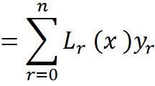

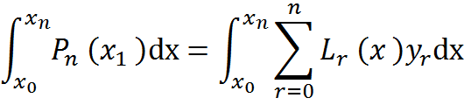
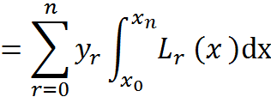
and
if

Slide 67








If n=1
-----------------------

Slide 68

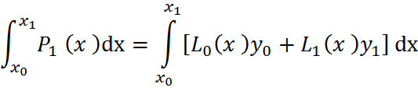


Slide 69




Slide 70
4-5Simpsons Method
If is the Lagrange interpolation Polynomial for the function y=f(x) for which the following(n+1) points are given:
, , , . . . ,
then

Slide 71


If n=2
-----------------------

Slide 72




Slide 73
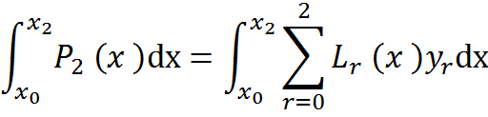

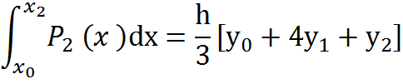
We must solve the final integral by part the result is :

Slide 74




Exercise 1
If
Prove that:
Proof:

Slide 75






Exercise(2)
If
Prove that:
Proof:

Slide 76
Calculate sine of a value in R Programming – sin() Function

