Slide 1
English for Specific Purpose 1st Year –Psychology Department
M. Nazenin
Theme Three
Work and Business- page.102,103

Slide 2
Example: advertising executive
Choose- a- career.com
The website that helps you find the right career for you. So you want to be an ... advertising executive

Slide 3
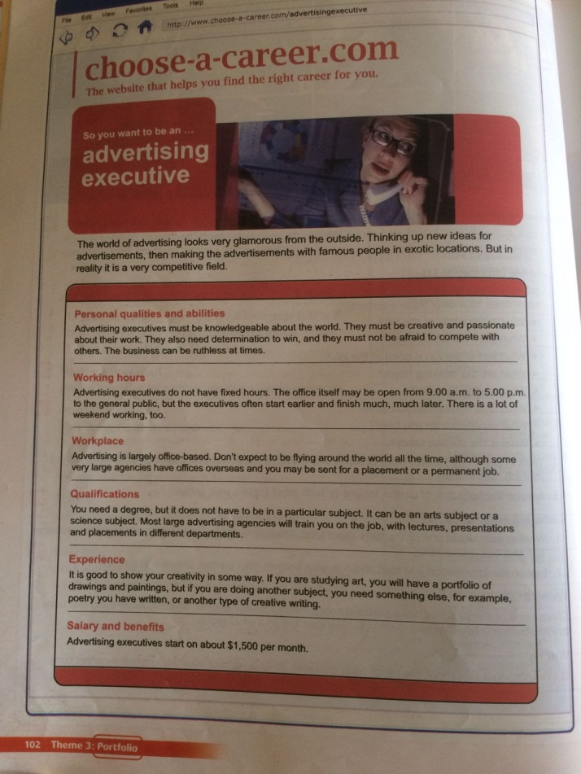
The world of advertising looks very glamorous from the outside. Thinking up new ideas for advertisements, then making the advertisements with famous people in exotic locations. But in reality it is a very competitive field.

Slide 4
1. Personal qualities and abilities Advertising executives must be knowledgeable about the world. They must be creative and passionate about their work. They also need determination to win, and they must not be afraid to compete with others. The business can be ruthless at times.

Slide 5
2. Working hours Advertising executives do not have fixed hours. The office itself may be open from 9.00 a.m. to 5.00 p.m. to the general public, but the executives often start earlier and finish much, much later. There is a lot of weekend working, too.

Slide 6
3. Workplace Advertising is largely office-based.
Don't expect to be flying around the world all the time, although some very large agencies have offices overseas and you may be sent for a placement or a permanent job.

Slide 7
4. Qualifications You need a degree, but it does not have to be in a particular subject. It can be an arts subject or a science subject. Most large advertising agencies will train you on the job, with lectures, presentations and placements in different departments.

Slide 8
5. Experience It is good to show your creativity in some way. If you are studying art, you will have a portfolio of drawings and paintings, but it you are doing another subject, you need something else, for example, poetry you have written, or another type of creative writing.

Slide 9
6. Salary and benefits Advertising executives start on about $1,500 per month.

Slide 10
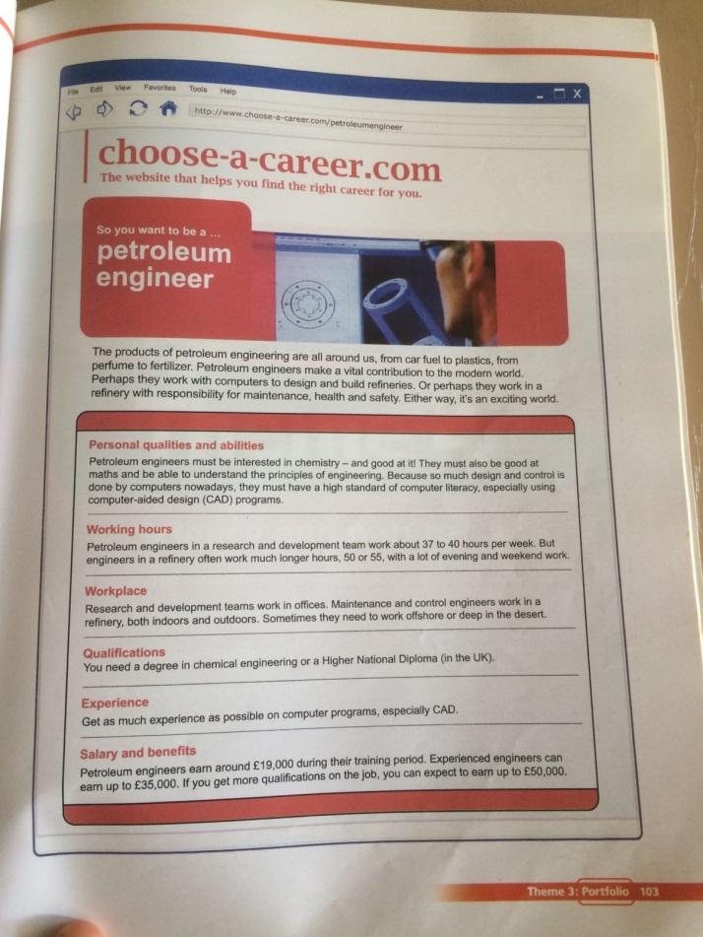
Portfolio- Choose-a-career.com
Example: engineer petrolem
The website that helps you find the right career for you. So you want to be a .. petroleum engineer

Slide 11
The products of petroleum engineering are all around us, from car fuel to plastics, from perfume to fertilizer. Petroleum engineers make a vital contribution to the modern world. Perhaps they work with computers to design and build refineries. Or perhaps they work in a refinery with responsibility for maintenance, health and safety. Either way, it's an exciting world.

Slide 12
1.Personal qualities and abilities Petroleum engineers must be interested in chemistry- and good at it! They must also be good at math and be able to understand the principles of engineering. Because so much design and control is done by computers nowadays, they must have a high standard of computer literacy, especially using computer-aided design (CAD) programs.

Slide 13
2. Working hours
petroleum engineers in a research and development team work about 37 to 40 hours per week. But engineers in a refinery often work much longer hours, 50 or 55, with a lot of evening and weekend work.

Slide 14
3. Workplace Research and development teams work in offices. Maintenance and control engineers work in a refinery, both indoors and outdoors. Sometimes they need to work offshore or deep in the desert.

Slide 15
4. Qualifications You need a degree in chemical engineering or a Higher National Diploma (in the UK). 5. Experience Get as much experience as possible on computer programs, especially CAD.

Slide 16
6. Salary and benefits Petroleum engineers earn around £19,000 during their training period. Experienced engineers can earn up to £35,000. If you get more qualifications on the job, you can expect to earn up to £50,000.

