Slide 1
Double Skin façade Materials, Advantages & Examples
University of Salahaddin
College of Engineering
Department of Architecture
Supervised by
Dr. Muhannad G. Rassam
2022-2023

Slide 2
Double Skin Facade
Double-Skin Facade system is a sustainable design solution.
In this lesson, you will learn about the materials used in this system, its advantages, and some examples.

Slide 3
Is Building Skin Like Human body skin?
How do you stay warm in winter? You wear layers of clothing to insulate your body, right?
If it's summer, you ventilate your face with a hand fan.

Slide 4
Is Building Skin Like Human body skin?
YES a building's exterior wall is like the skin of human body.
Architects use the same tactics to keep buildings warm or cool;

Slide 5
Passive facade Vs. Active Facade
The exterior wall is the barrier between the outside and inside of a building, which is called a facade.
A ''passive facade'' deals with the heating or cooling issues naturally.
An ''active facade'', actively influences the indoor climate by integrating mechanical or digital devices and systems. See Kraanspoor Building.

Slide 6
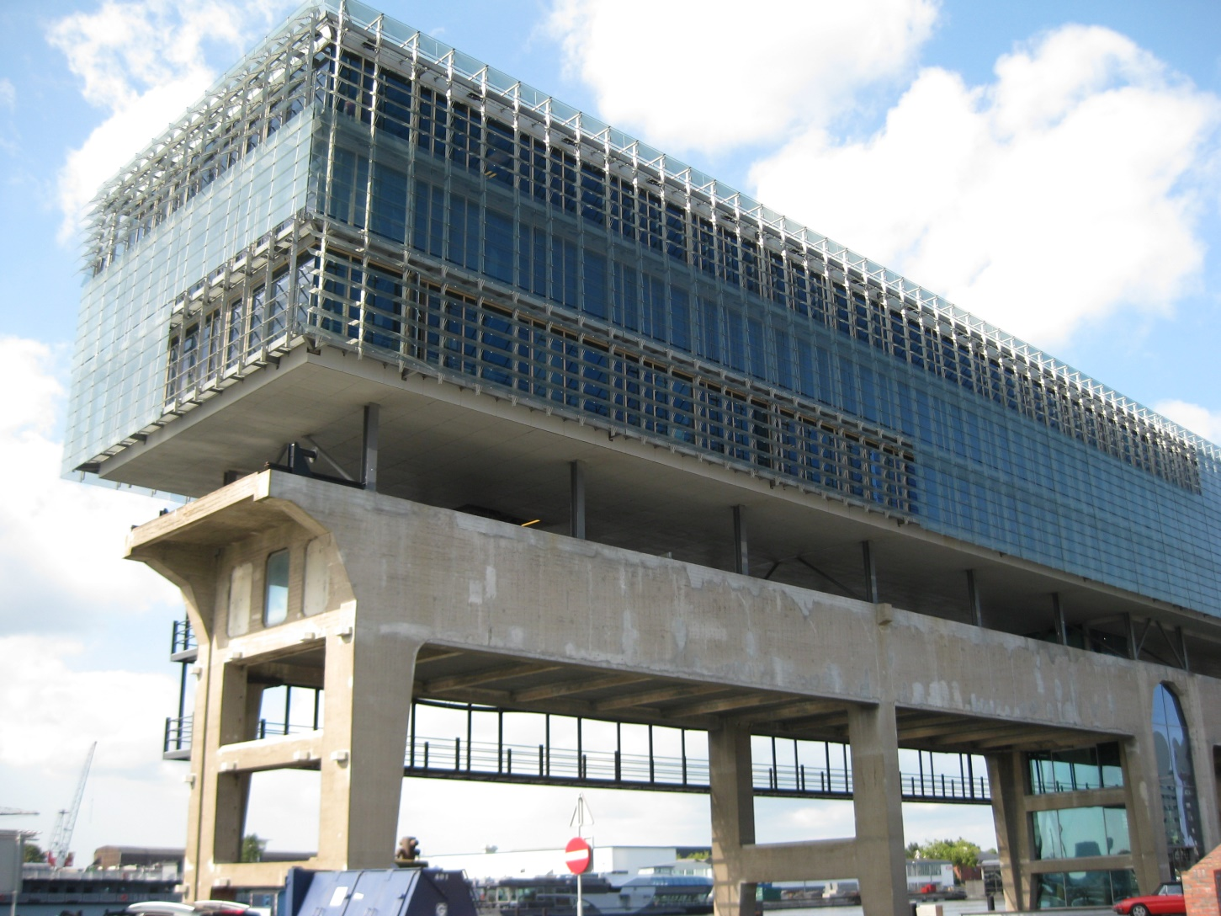
Kraanspoor Building in Netherland A seamless combination of industrial heritage and high-tech/innovative technology.

