Slide 1
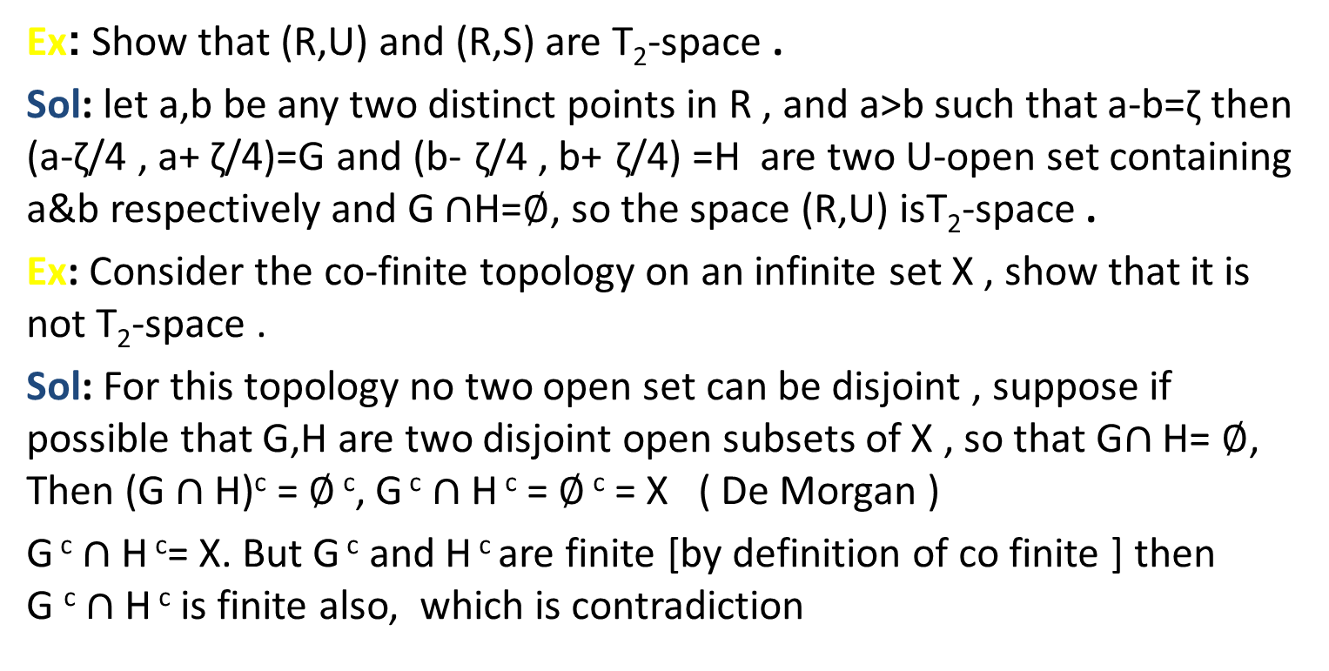
T₂ -space " Hausdorff space" Def: A topological space (X,$τ$) is said to be a T₂-space (hausdorff) iff for every two disjoint points x₁,x₂ ,there exist disjoint open sets G₁,G₂ such that , x₁$∈$G₁ and x₂$∈$G₂ , that is x₁,x₂$∈$X , x₁≠x₂ , there exist two open sets G₁,G₂ such that, x₁$∈$G₁, x₂$∈$G₂ and G₁$∩$G₂=$∅$
Ex: Show that (R,U) and (R,S) are T₂-space .
Sol: let a,b be any two distinct points in R , and a>b such that a-b=ζ then (a-ζ/4 , a+ ζ/4)=G and (b- ζ/4 , b+ ζ/4) =H are two U-open set containing a&b respectively and G $∩$H=$∅$, so the space (R,U) isT₂-space .
Ex: Consider the co-finite topology on an infinite set X , show that it is not T₂-space .
Sol: For this topology no two open set can be disjoint , suppose if possible that G,H are two disjoint open subsets of X , so that G$∩$ H= $∅$, Then (G $∩$ H)^{c} = $∅$ ^{c}, G ^{c} $∩$ H ^{c} = $∅$ ^{c} = X ( De Morgan )
G ^{c} $∩$H ^{c}= X. But G ^{c} and H ^{c} are finite [by definition of co finite ] then G ^{c} $∩$ H ^{c} is finite also, which is contradiction

Slide 2
Theorem: Let (X,$τ$) be any topological space and let (Y,$μ$) be a hausdorff space , let f:X$→$ Y be a 1-1 , onto and continuous function then X is also Hausdorff .
Proof: Let x₁,x₂ be any two distinct point of X , since f is 1-1 , and x₁≠x₂ then f(x₁)≠f(x₂). Let y₁=f(x₁) , y₂=f(x₂) so that x₁=f⁻¹(y₁) , x₂=f⁻¹(y₂). Then y₁,y₂ $∈$Y and y₁≠y₂ . Since (Y, $μ$) is a Hausdorff space, so there exist a $μ$-open sets G and H such that y₁$∈$G, y₂$∈$H and G$∩$H= $∅$, Since f is continuous, f⁻¹ (G) and f⁻¹ (H) are$τ$–open set
Now f⁻¹ (G) $∩$ f⁻¹ (H)= f⁻¹ (G$∩$H)= f⁻¹($∅$ )= $∅$
And y₁ $∈$ G then f⁻¹(y₁)$∈$ f⁻¹(G) hence x₁ $∈$ f⁻¹(G)
also y₂ $∈$H then f⁻¹(y₂) $∈$f⁻¹(H) hence x₂ $∈$ f⁻¹(H)
It follows that space (X,$τ$) is Hausdorff .

Slide 3
Theorem: Every subspace of T₂-space is a T₂-space .
Proof: Let (X,$τ$) be a T₂-space and let (Y, $τ$_{y}) be any subspace of X , Let y₁,y₂ be any two distinct points of Y, Since Y$⊆$ X , then y₁,y₂ are two distinct point in X but (X,$τ$) is T₂-space , so there exist open sets H,G such that y₁$∈$G, y₂$∈$H and G$∩$H=$∅$. But, G $∩$ Y and H $∩$Y are $τ$_{y}–open sets and (G$∩$Y)$∩$(H$∩$Y)= (G $∩$H)$∩$Y= $∅∩$Y= $∅$. Thus G $∩$Y, H $∩$Y are two disjoint $τ$_{y}–open sets , Hence the subspace (Y$,τ$_{y}) is T₂-space.
Theorem: Each singleton subset of a T₂-space is closed .
Proof: Let X be a Hausdorff space , Let x$∈$X. To show that {x} is closed , Let y be an arbitrary point of X distinct from x . Since the space is T₂-space ,there exist an open set G containing y such that x$∉$G it follows that y is not an accumulation points of {x} , so D({x})= $∅$ .
Hence cL{x}={x} it follows that {x} is closed set .

Slide 4
Theorem: Every T₂-space is a T₁-space but the converse is not true in general
Proof: Let (X,$τ$) be a T₂-space and let y₁,y₂ be any two distinct point of X , since the space X is a T₂ there exist open sets G,H such that y₁$∈$G, y₂$∈$H and G$∩$H = $∅$ this implies that y₁$∈$G but y₁$∉$H and y₂$∉$G but y₂$∈$H .
Hence the space is a T₁-space .
But the converse is not true as shown in co-finite topology on an infinite set X , which is not T₂-space , but it is a T₁-space , since for if x is an arbitrary point of X , then by Def of $τ$, X/{x} is open {being the complement of finite set } and consequently {x} is closed
Thus every singleton subset of X is closed and hence the space is T₁-space

Slide 5
Ex: Let (X,$τ$) be a topological space and let(Y,$μ$)be a Hausdorff space . if f and g are continuous function from X in to Y, show that the set A={x$∈$X; f(x)=g(x)} is closed
Sol: We shall show that X\A is open set. Now X\A={x$∈$X; f(x) ≠ g(x)}, Let p be an arbitrary point of X\A. then f(p) ≠g(p), with f(p) , g(p)$∈$Y. Since Y is a Hausdorff, there exist open set G and H such that f(p)$∈$G , g(p) $∈$ H and G$∩$H= $∅$ ………… 1
since f , g are continuous function f⁻¹(G) , g⁻¹(H) are open set in X, such that p$∈$f⁻¹ (G), p$∈$g⁻¹ (H), and so there intersection f⁻¹ (G) $∩$g⁻¹ (H) is also open set in X containing p. Let f⁻¹ (G)$∩$g⁻¹ (H)=V We have to show that V$⊆$X\A. Suppose if possible V is not subset of X|A. Then there is at least one point in V say (y) such that y is not in X\A. Now y$∈$V then y$∈$f⁻¹ (G) and y$∈$ g⁻¹ (H) then f(y)$∈$G and g(y) $∈$H ……..2
and y$∉$X\A then y$∈$A , hence f(y)=g(y)……..3
Now 2 and 3 shows that f(y)$∈$G and f(y)$∈$H and hence f(y)$∈$G$∩$H which contradict (1) . It follows that y$∈$V $⊆$X\A. We have shown that X\A contains a nbd of each of its points and consequently X\A is open set, that is A is closed .

Slide 6
H.W Theorem: the property of space being a T₂-space is preserved by 1-1 , onto open functions and hence is a topological property .

