Slide 1
Separations Axioms
Dr. Nehmat K. Ahmed
Department of mathematics
College of Education

Slide 2
$T_{0}$ -spaces. (KOLOMOGORV) A topological spaces $(X,τ)$ is said to be a $T_{0}$ -spaces if for any two distant point x,y there exist an open set containing one of them but not the other.
Example: The space (X,I) is not T₀-space ,but the space (X,D) is T₀-space .
Theorem: A topological space (X,$τ$) is T₀-space iff for all x,y$∈$X, x≠y then cL {x}≠cL{y}.
Proof : suppose that (X,$τ$) is T₀-space and , Let x≠y we have to show that cL{x}≠cL{y}. Since (X,$τ$) is a T₀-space , there exist an open set G containing x but not y . i.e x$∈$ G but y$∉$ G

Slide 3
then X\G is a closed set which does not containing x but contain y . By definition cL{y} is the intersection of all closed set containing {y}. it follows that cL{ y}$⊑$ X\G. Since x$∈$G , x$∉$X\G that is x $∉$cL{y}, thus x $∉$cL{y} but x $∈$cL{x}, it follows that cL{x}≠cL{y}. Conversely Let x≠y and cL{x}≠cL{y} we have to show that (X,$τ$) is T₀-space. Since cL{x}≠cL{y}, there exist at least one element z$∈$X s.t z$∈$cL{x} but z $∉$cL{y}, we claim that if x$∉$cL{y}, for suppose that x$∈$cL{y} then cl{x} $⊑$cL(cL{y}) =cL{y},and so z$∈$cL{x} $⊑$cL{y} which is contradiction so x$∉$cL{y} then x$∈$(cL{ y})^{c} =X\cL{Y} , also since cL{y}is closed. Hence X\cL{Y } is open set containing x but not y , it follows that (X,$τ$) is T₀-space

Slide 4
Theorem: Every subspace of a T₀-space is a T₀-space. And hence the property is hereditary
Proof : Let(X,$τ$) be a T₀-space and let (Y, $τ$_{y}) be any subspace of (X, $τ$).we have to show that (y, $τ$_{y}) is a T₀-space. Let y_{1,}y₂ be any two distinct point of Y , since Y$⊆$ X, so y₁,y₂ are two distinct point in X . but (X,$τ$) is a T₀-space , so there exist an open set G containing one of them (say) y₁ but not y_{2 .} Then G$∩$Y is an open set in Y, therefore G$∩$Y is a $τ$_{y}–open set containing y₁ but not y₂ it follows that (Y, $τ$_{y}) is a T₀-space

Slide 5
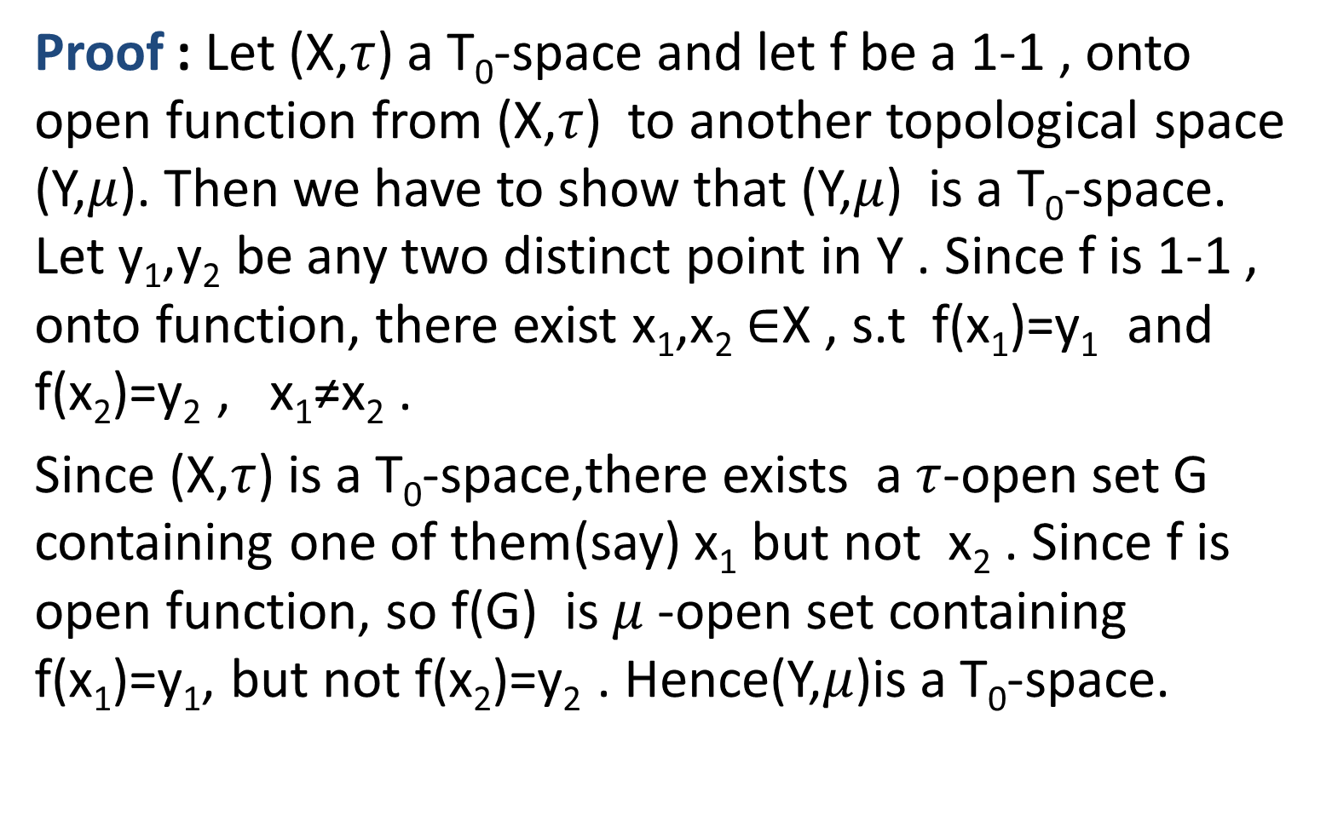
Theorem: The property of space being a T₀-space is preserved under 1-1, onto, open functions, so it is a topological property
Proof : Let (X,$τ$) a T₀-space and let f be a 1-1 , onto open function from (X,$τ$) to another topological space (Y,$μ$). Then we have to show that (Y,$μ$) is a T₀-space. Let y₁,y₂ be any two distinct point in Y . Since f is 1-1 , onto function, there exist x₁,x₂ $∈$X , s.t f(x₁)=y₁ and f(x₂)=y₂ , x₁≠x₂ .
Since (X,$τ$) is a T₀-space,there exists a $τ$-open set G containing one of them(say) x₁ but not x₂ . Since f is open function, so f(G) is $μ$-open set containing f(x₁)=y₁, but not f(x₂)=y₂ . Hence(Y,$μ$)is a T₀-space.

