Slide 1
Title
Prepared by:
College of Education - Mathematical Department
Supervised by : Neshtiman N. Sulaiman
Introduction
Desiccation
Conclusion
.
References
Methodology

Slide 5
Referencing is a system that allows you to acknowledge the contributions of others in your writing.

Slide 6
Referencing System
Harvard Referencing
MLA Referencing
APA Referencing
Oxford Referencing
OSCOLA Referencing
Vancouver Referencing Style
Turabian Referencing
Chicago Referencing
BMJ Referencing
Open University Referencing

Slide 7
The following details information are taking for each book, journal article, or electronic source.
For books, record:
The author’s or editor’s name (or names);
The year the book was published;
The title of the book;
If it is an edition other than the first;
The city the book was published in;
The name of the publisher.

Slide 8
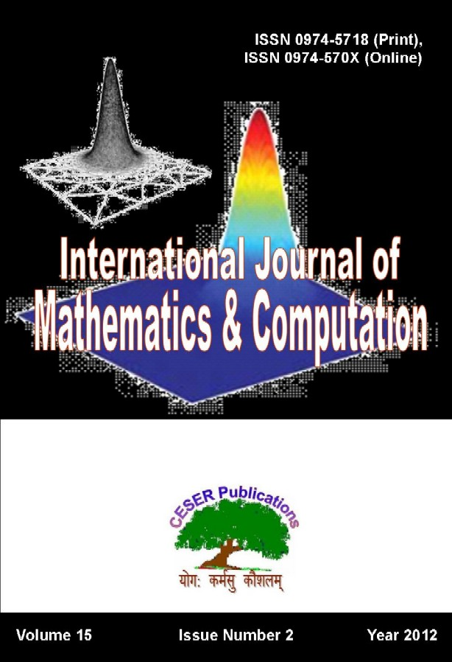
For journal articles record:
The author’s name or names;
The year in which the journal was published;
The title of the article;
The title of the journal;
The page number/s of the article in the journal;

Slide 9
For electronic resources, record:
The date you accessed the source;
The electronic address or email;
The type of electronic resource (email,
WWW page, etc).

Slide 10
Create a Bibliography using
Microsoft — Word

Slide 11
Step 1: Open your document in Microsoft Word and click on the Referencestab.

Slide 12
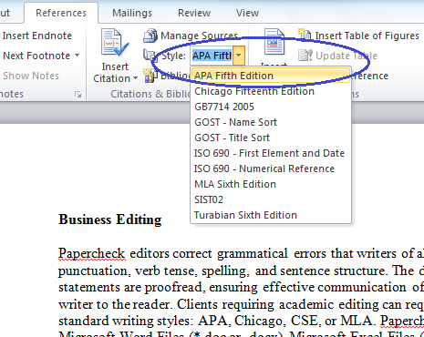
Step 2: Place your cursor where you would like the citation inserted. Select your style of references in the Style menu, shown in the screen shot below.

Slide 13
Step 3: In Click on the Insert Citation button to produce
the drop-down menu shown below, and select Add New Source.

Slide 14
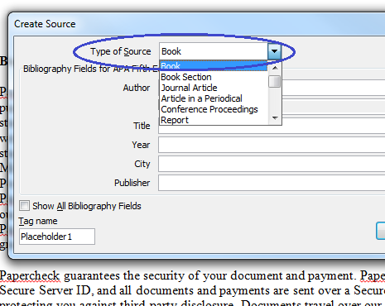
Step 4: A Create Source window will appear.
Choose the source type from the drop-down menu.

Slide 15
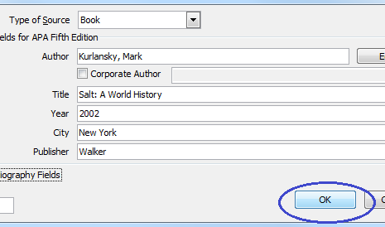
Step 5: Enter the source information in the fields provided and click OK.

Slide 16
Step 6: In the screen shot below, note that a reference has been entered. Follow Steps 2–5 to insert your remaining references.

Slide 17
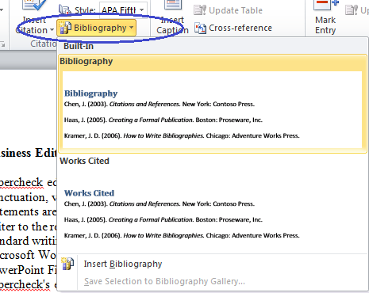
Step 7: Once you have entered all references and sources, place your cursor at the end of your document. Click on the Bibliography button, shown below, and select eitherBibliography or Works Cited.

Slide 18
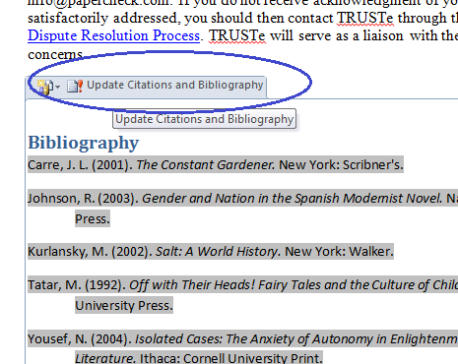
Step 8: To update the bibliography after entering new sources, click anywhere on the bibliography table. Click on Update Citations and Bibliography

Slide 20
Vancouver
Uses numeric references in the text;
either numbers in brackets (1) or superscript ⁽¹⁾;
The reference list lists publications in the order
they appeared in the text, not alphabetically.

Slide 21
BOOKS
Author(s)
Title (capitalize only the first letter of the first
word and any proper nouns)
Edition (only include the edition number if it is
not the first edition)
Place of publication: publisher; Year of publication
Dym CL, Little P, Orwin EJ, Spjut RE. Engineering design. 3rd ed.
Hoboken: Wiley; 2009.

Slide 22
Electronic books (ebooks)
Author(s)
Title of book[internet]
Publication details [cited…]
Available from: URL
Wear A. Knowledge and practice in English medicine [internet]. Cambridge: Cambridge University Press; 2000 [cited 2015 June 17]. Available from: http://site.ebrary.com/lib/bham/detail.action?docID=5004608

Slide 23
JOURNALS
Author(s)
Title of article
Title of journal (capitalise all initial letters)
Date of publication as year month day
Volume (issue):Page numbers (not preceded by p.)
Knapik JJ, Cosio LM, Reynolds KL. Efficacy of functional movement.
Strength Coned Res. 2015; 29 (5): 1157-1162.

Slide 24
E-Journal
Author(s)
Title of article
Title of journal (capitalise all initial letters)
[internet]
Date of publication as year month day
[cited year month day];
Volume (issue):Page numbers (not preceded by p.)
Available from: URL
Knapik JJ, Cosio-Lima LM, Reynolds KL. Efficacy of functional movement.
Strength Cond Res [internet]. 2015 [cited 2015 June 23];
29(5): 1157-1162. Available from: http://journals.lww.com/jscr/Abstrac

Slide 25
Papers from conference proceedings
published on the internet
Author(s)
Title of paper (in single quotation marks)
Title of conference(location and date of conference) [cited…]
Publisher
Available from: URL
Jones D. ‘Developing big business’, Large firms policy and research conference (University of Birmingham, 1999 Dec 18-19) [cited 2014 Jan 19]. Leeds: Institute for Large Businesses; 1999. Available from: http://www.bigbusinesses.co.uk/jonesd

Slide 26
How to paraphrase sources
Paraphrasing means formulating someone else’s ideas in your own words. To paraphrase a source, you have to rewrite a passage without changing the meaning of the original text.
Paraphrasing is an alternative to quoting, where you copy someone’s exact words and put them in quotation marks. In academic writing, it’s usually better to paraphrase instead of quoting, because it shows that you have understood the source and makes your work more original.

Slide 27
Every time you paraphrase, it’s important to cite the source. You also have to be careful not to use wording that is too similar to the original. Otherwise, you could be at risk of committing plagiarism.
How to paraphrase in five steps
Paraphrasing tips
How to cite a paraphrase
Paraphrasing vs. quoting
Paraphrasing vs. summarizing
Avoiding plagiarism

Slide 28
How to paraphrase in five steps
Read the passage several times to fully understand the meaning
Note down key concepts
Write your version of the text without looking at the original
Compare your paraphrased text with the original passage and make minor adjustments to phrases that remain too similar
Cite the source where you found the idea

Slide 29
What is your plagiarism score?
Compare your paper with over 60 billion web pages and 30 million publications.
* In partnership with Turnitin
* Best plagiarism checker of 2019
* Plagiarism report & percentage
* Largest plagiarism database

Slide 30
What makes a good poster?
1- Important information should be readable from about 10 feet away
2- Title is short and draws interest
3- Word count of about 300 to 800 words
4- Text is clear and to the point
5- Use of bullets, numbering, and headlines make it easy to read
6- Effective use of graphics, color and fonts
7- Consistent and clean layout
8- Includes acknowledgments, your name and institutional affiliation

