Slide 1
What Makes People do Research?
This is a fundamentally important question. No person would like to do research unless there are some motivating factors. Some of the motivations are the following:
(1) to get a research degree BSc, MSc or Ph.D. along with its benefits like better employment, promotion, increment in salary, etc.
(2) to get a research degree and then to get a teaching position in a college or university or become a scientist in a research institution
(3) to solve the unsolved and challenging problems
(4) to get joy of doing some creative work
(5) to acquire respectability.

Slide 2
(6) to get recognition
(7) Curiosity to find out the unknown facts of an event
(8) Curiosity to find new things
(9) to serve the society by solving social problems.
Some students undertake research without any aim possibly because of not being able to think of anything else to do. Such students can also become good researchers by motivating themselves toward a respectable goal.

Slide 3

What is a thesis?

Slide 4
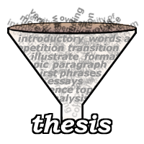
A dissertation or thesis is a document submitted in support of candidature for an academic degree or professional qualification presenting the author's research.

Slide 5
Thesis Structure
Title
Acknowledgements
Abstract
Table of Contents
List of Tables
List of Figures
List of Appendices
Chapter 1 – Introduction
Chapter 2 - Literature Review
Chapter 3 - What you thought and made
Chapter 4 - Experiments and Analysis
Chapter 5 – Conclusions and future Work
References
Appendices.
Abstract and the page in Kurdish and Arabic languges.

Slide 6
Structure of research article
Author and author's professional affiliation is identified
Abstract
Introduction
Literature review section (a discussion about what other scholars have written on the topic)
Methodology section (methods of data gathering are explained)
Results
Conclusions
Reference list with citations (sources of information used in the article)

Slide 7
1. Title
The Title should be neither too long nor too short.
It should be focused and interesting.
It should include the keywords you might use to describe your work in a scientific paper or thesis-abstracting system.
Try to use some verbs rather than a long list of nouns.

Slide 8
Information page
Information about your supervisors, information about yourself (name, student administration number and email address) and information about your educational program. Finally, end this page with the date on which the dissertation is submitted.

Slide 9
2. Acknowledgements
Acknowledgement should include:
Supervisor's assistance;
Faculty staff(University, college and department )
All those who have helped you with ideas, technical
assistance, materials;
Family and friends.

Slide 10
3- Abstract
What is an Abstract?
The abstract is an important component of your thesis. Presented at the beginning of the thesis, it is likely the first substantive description of your work read by an external examiner. You should view it as an opportunity to set accurate expectations.
That means: The abstract is a summary of the whole thesis. It presents all the major elements of your work in a highly condensed form.

Slide 11
It should state:
The problem in a general manner;
The problem in a specific manner;
The main objectives of the work;
The methods or tools used;
The main results and conclusions.
How not to write an abstract:
Do not refer extensively to other works;
Do not add information not contained in the original work;
Do not define terms.

Slide 12
Size and Structure
Currently, the maximum sizes for abstracts submitted to Canada's National Archive are 150 words (Masters thesis) and 350 words (Doctoral dissertation).

Slide 13
4- Table of Contents
List all headings and subheadings with their
corresponding page numbers.
5- List of Figures/ Tables
These should include the figure/ table with their titles
and their corresponding page numbers.
6- List of Appendices
Include titles and their corresponding page
numbers (such as figure, table , questioner)

Slide 14
7- Introduction
The introduction chapter of your thesis is to one which you provide all of the basic information that the reader will need to understand the report which is to follow. Such things as the background of your research,
How you came to research your topic,
What your topic is and how it relates to the world around it, and
What kind of general principles and methodology you will be using to

Slide 15
research your topic and evaluate your hypothesis.
Tell the reader the aims and objectives of the study. Give the reader a sense of how the thesis will be organized. Provide some kind of chapter by chapter breakdown to tell the reader what can be expected so that the reader will able to scan the report at first and have a good sense of what ended up happening.
Note: An introduction must not be so detailed that it includes everything you want to say. Remember that you are introducing an idea or topic, your structure of the essay, and your thesis statement

Slide 16
8. Literature Review
A literature review surveys books, scholarly articles, and any other sources relevant to a particular issue, area of research, or theory, and by so doing, provides a description, summary, and critical evaluation of these works in relation to the research problem being investigated. Literature reviews are designed to provide an overview of sources you have explored while researching a particular topic and to demonstrate to your readers how your research fits within a larger field of study.

Slide 17
Within each section of a literature review, it is important to discuss how the research relates to other studies (how is it similar or different, what other studies have been done) as well as to demonstrate how it relates to your own work.
The literature you identify must be read, summarized, discussed and analyzed, not just listed.
Literature refers to a collection of published information/materials on a particular area of research or topic, such as books and journal articles of academic value.

Slide 18
9- Questions a Literature Review should answer
* Are there any gaps in the research? Are there areas that haven’t been looked
at closely yet, but which should be? Are there new ways of looking at the topic?
* Are there improved methodologies for researching this subject?
* What future directions should research in this subject take?
* How will your research build on or depart from current and previous research
on the topic? What contribution will your research make to the field?

Slide 19
10. Source of the literature review
* Journals. The most important source
* Books –classic in the field
* Conferences-often from the supervisor(s)
* Standards, laws, etc.

Slide 20
11. Methods
What belongs in the “methods” section of a scientific paper?
Information to allow the reader to assess the believability of your results.
Description of your materials, procedure, theory., equipment
Calculation, technique, procedure, equipment and calibration plots.
Limitations, assumptions and range of validity.

Slide 21
The methods section should answer the following questions:
Could another researcher accurately find and reoccupy the sampling stations or track lines?
Is there enough information provided about any instruments used so that a functionally equivalent instrument could be used to repeat the experiment?
If the data is in the public domain, could another researcher lay his or her hands on the identical data set?
Could one replicate any statistical analyses?
Could another researcher approximately replicate the key algorithms of any computer software?
Note: Do not include descriptions of result.

Slide 22
12. Results
The results are actual statements of observations, including statistics, tables and graphs.
Mention negative results as well as positive.
Present sufficient details so that others can draw their own inferences and construct their own explanations.
Note: do not interpret results-save that for the discussion.

Slide 23
13. Conclusions
This should summarize your results and discussion. You should include a list of the most important findings of your study in descending order of importance.
Conclusions should also be linked with the objectives of the study. You should also provide a statement about the possibility of future study. What needs to be done and what does study contribute?

Slide 24
14. What is referencing?
Referencing is a system that allows you to acknowledge the contributions of others in your writing. Whenever you use any words, ideas or information from any source your assignments, you must reference those sources. This means that if you use the exact words of an author, if you paraphrase their words or if you summarize their ideas, you must provide a reference. Not referencing your sources means you may be charged with plagiarism and your work could be failed.

Slide 25
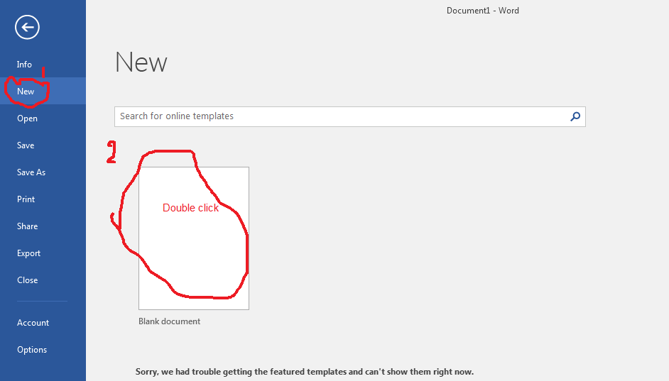
1. How to Create a blank document
1- Open Word. Or, if Word is already open,
select File > New.
2- Select Blank document.
3- Double-click a template to open it.

Slide 26
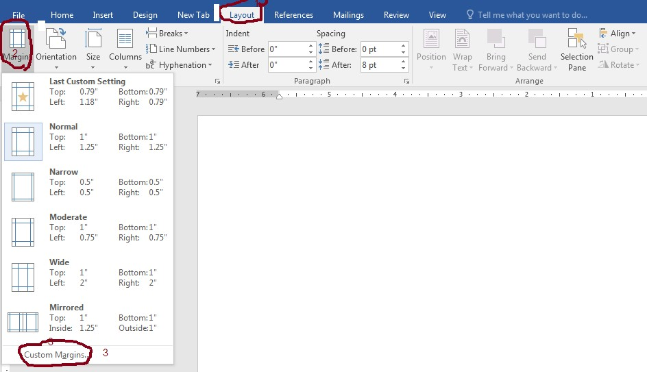
2. Click to layout, Margins then custom Margins

Slide 27
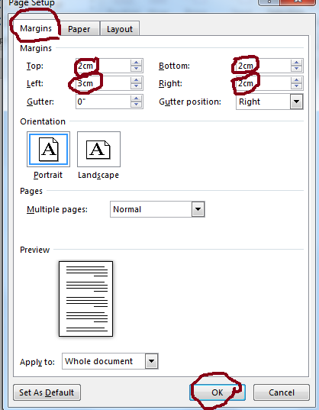

Slide 28
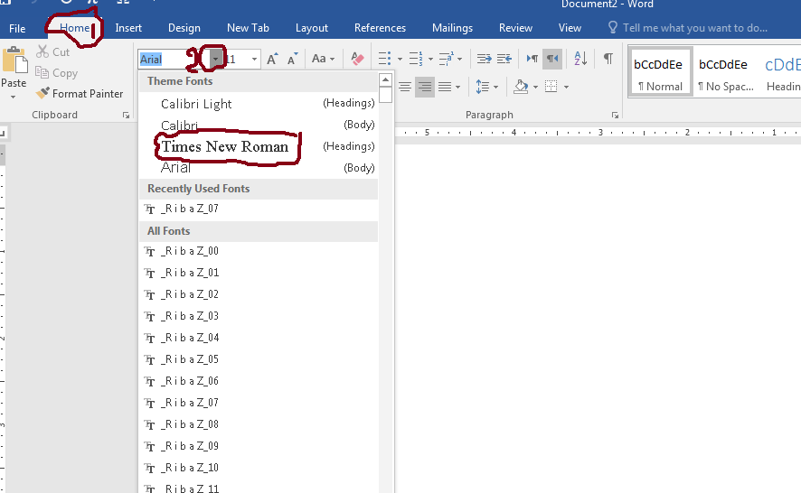
3. Choice the font type

Slide 29
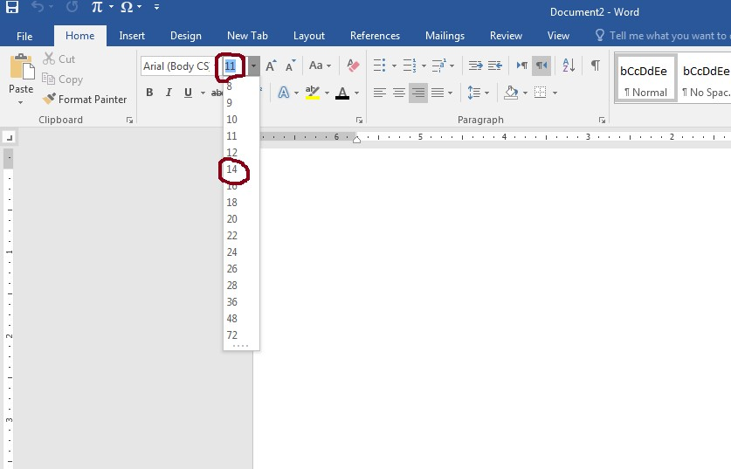
Writing an Argumentative Thesis
  - Research about your subject in
  the books or in the internet.
  2- define the keyword of subjects.
  Choice your main subject.

Slide 30
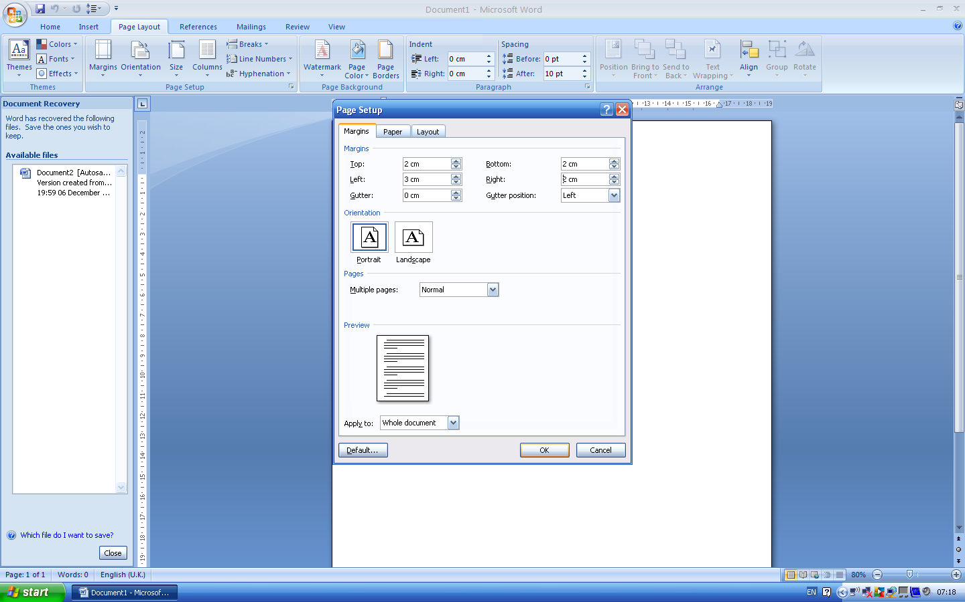
General Considerations
White papers A4 (297 X 210 mm) are used, and printing should be on one side of the
paper.
The margins should be as follows: 3 cm for the left margin and 2 cm for other
margins.
Page Layout ---- Page Setup -----Margins----- Custom Margins----page setup—Margins

Slide 31

The font type is “Times New Roman”.
Home----Font
The font size should be as follows: 14 for the text; 12 for table;
20 for titles of the body of the text parts ; 18 for headings and
16 for subheadings.

Slide 32
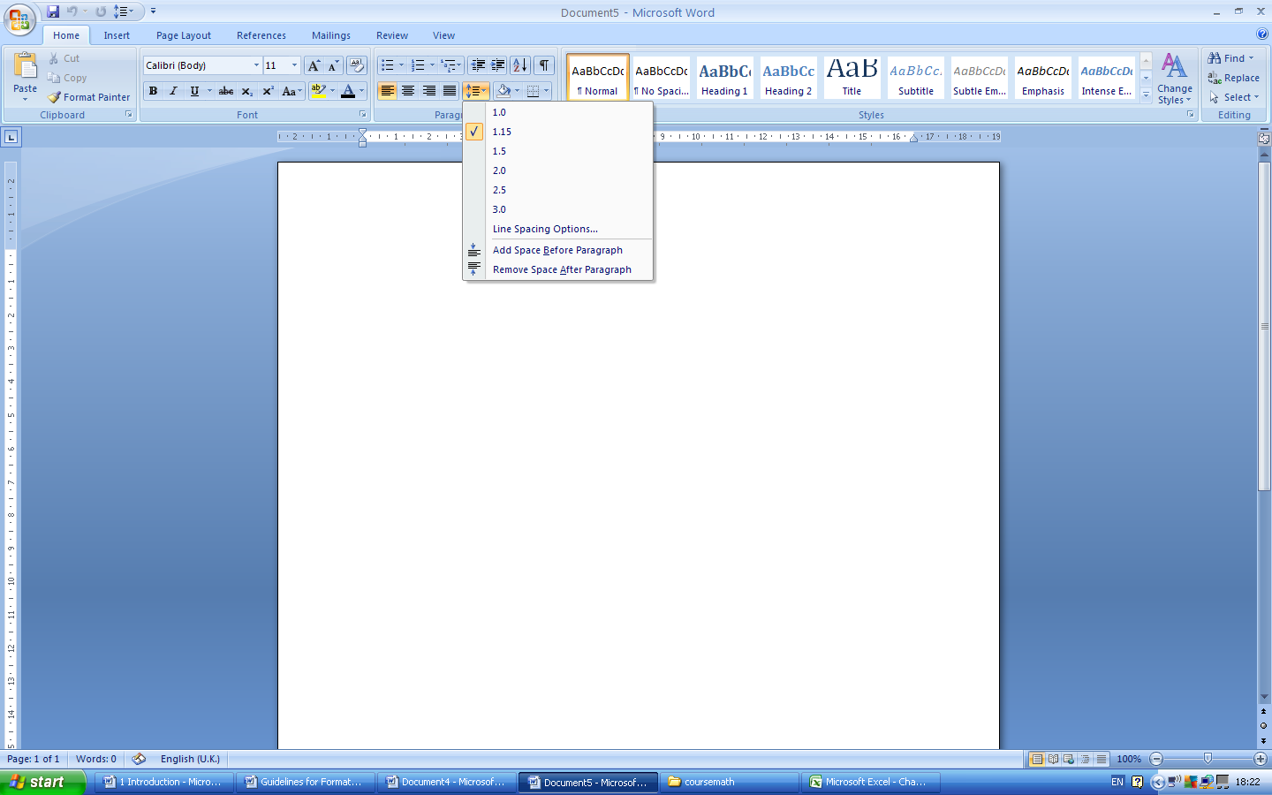
Line spacing should be 1.5 space of the Microsoft Word computer program throughout the text. 3 line spacing between the main title and the text. Single spacing may be used only in the Table of Contents, charts, graphs, tables, appendices, and bibliography.
Home ---Paragraph

Slide 33
Bold: Main title, heading and subheading
Home---Font

Slide 34
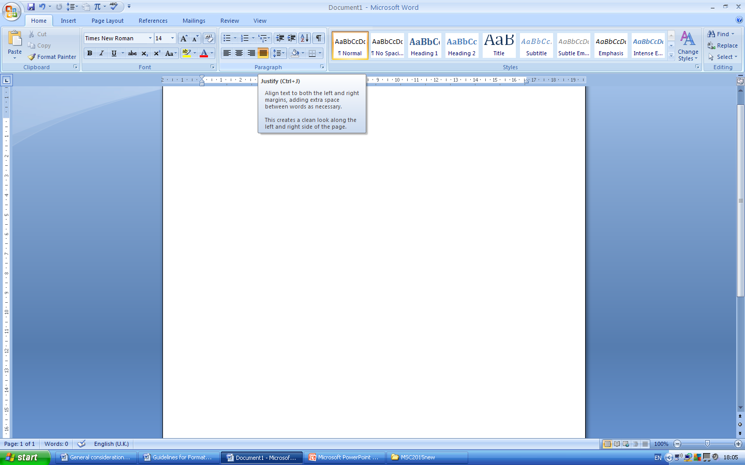
Right (or left) justification statements.
Home----- Paragraph

Slide 35
Numbering of Pages
Preliminary pages should be paginated with lower case
Roman numerals(e.g., i, ii, iii) starting with title page. However, the number on the title page should not be shown, although the page is counted as i.
Pagination in Arabic numerals starts with the first page of introduction through the appendices pages.
Ordinarily, page numbers should be centered at the top or
bottom of the page.

Slide 36
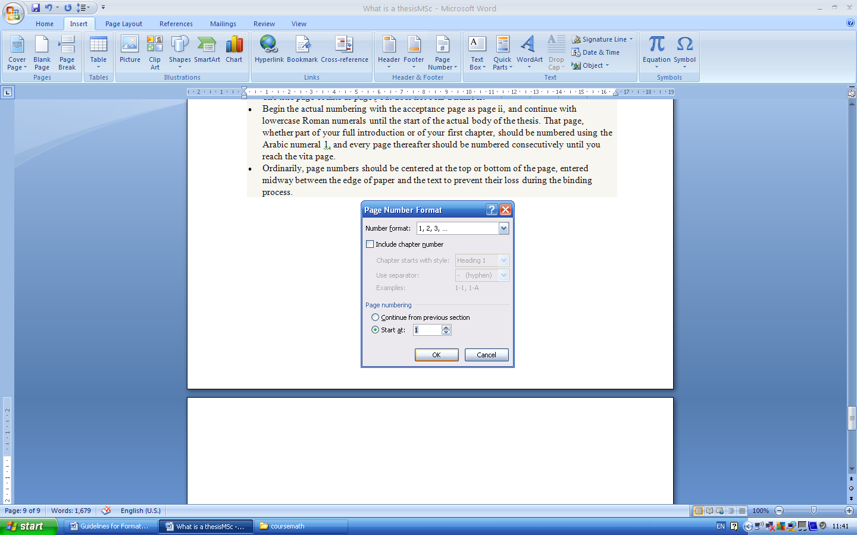
Insert------- Header &Footer-----page number-----format page numbers
.

Slide 37
Note:
To change the style of numbering pages for example, from Roman to Arabic:
Page layout----Breaks--- next page---- insert----page number----format page numbers
2. New paragraph preferably starts at column 1 of the
Microsoft word computer program, leaving 3 line spacing
between the paragraphs.
However, new paragraph may start at column 3 of the Microsoft word computer program without leaving extra space between paragraphs.

Slide 38
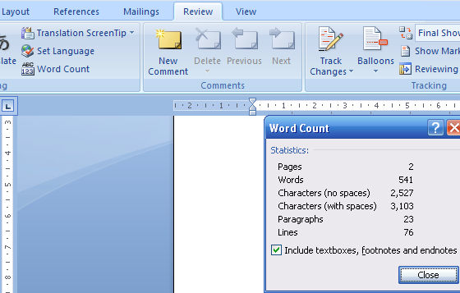
The number of pages is not more than 120 pages or 20000
words. for MSc thesis

Slide 39
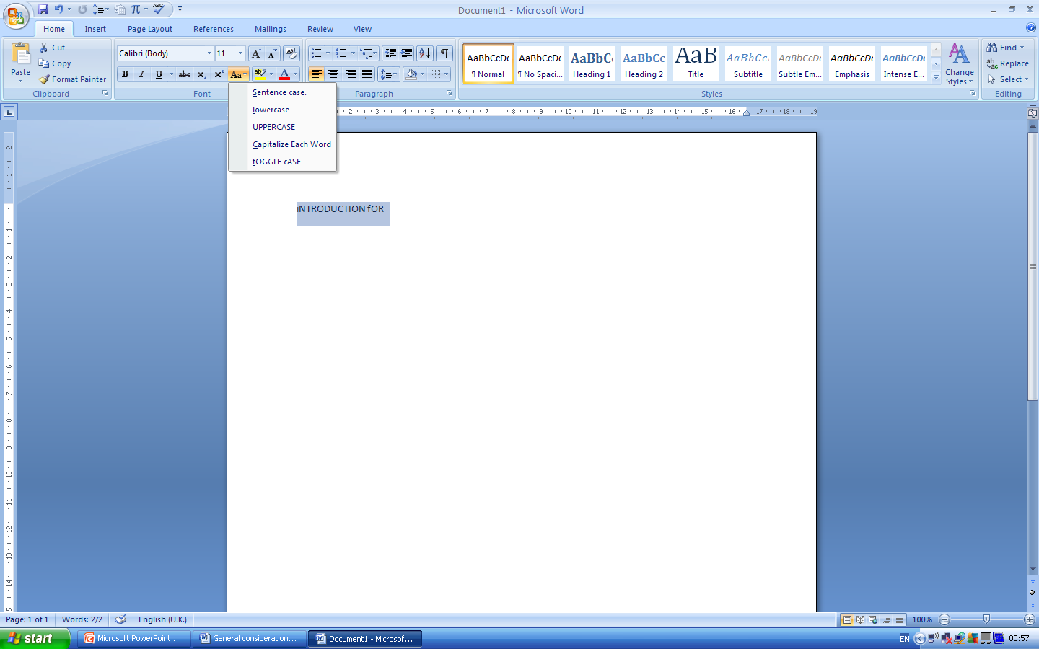
Titles of the body of text should be written in upper case letters,
For example, INTRODUCTION, LITERATURE REVIEW.
Home----Aa
The title of the sub-section should have the first letter in upper case.
General Considerations (Chapters of the Thesis)

Slide 40
Each sub-section of a chapter should be given a numerical index, e.g. the first section of chapter 1 is written as 1.1.
Further subsection / subheading of the above is written as 1.1.1.
The numerical index for the next section will be 1.2. and for further subsection as 1.2.1.

Slide 41

Using multi-level numbering for document
headings
To number all headings throughout the document, including within tables of contents:
Highlight the first title or heading within your document.
From the Home tab go to the Styles section and click on
one of the Heading options to apply it to the highlighted
text.

Slide 42
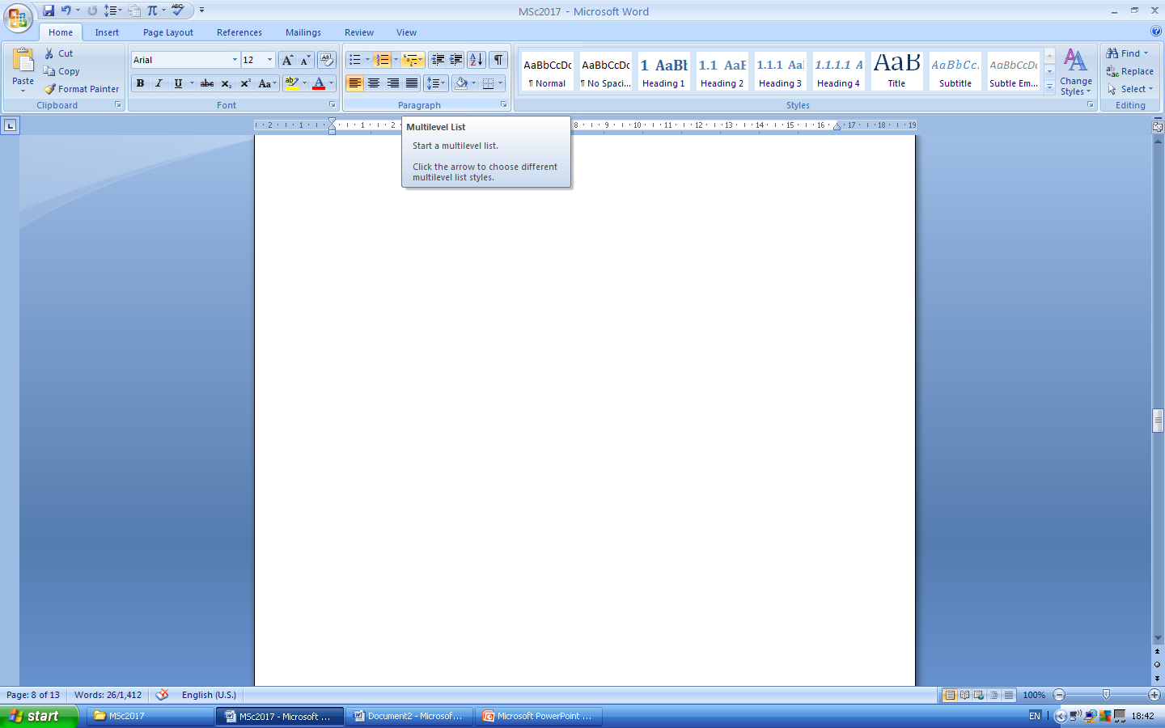
On the Home tab, click on Multilevel List in the Paragraph
group to display the List Library.

Slide 43
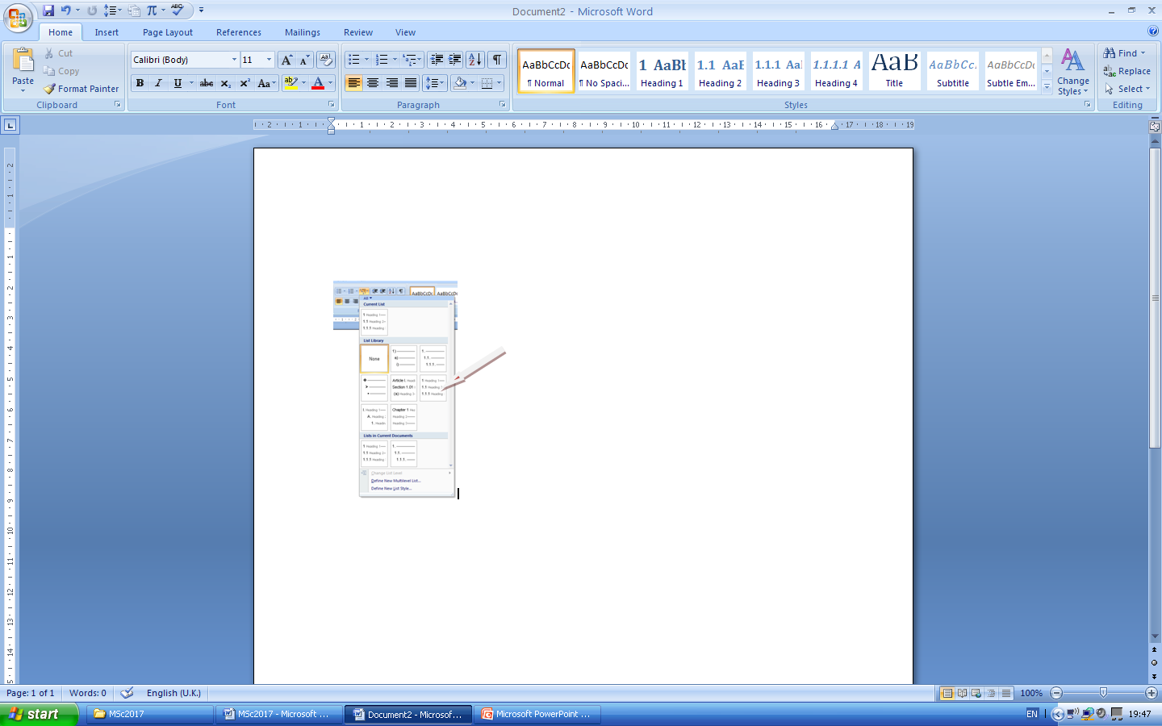
Choose a layout that includes the Heading style names

Slide 44
Creating a table of figures
If you have pictures, diagrams or tables in your document, it is useful to list
them in a table of figures. To create a caption:
Click on the image or table .
A References tab Insert Caption Captions
group to display the Caption dialog box.
At Label, select the appropriate label for the object.
You can choose from Equation, Figure or Table, or you can create your own through New Label.

