Slide 1
Chapter one Group theory

Slide 2
1- Basics
The basics of set theory: Sets, ∪, ∩, ∈ etc.
The notation for subsets of a given set A will be
The order or cardinality of a set A will be denoted by |A|. If A is a finite set the order of A is simply the number of elements of A.
.

Slide 3
The Cartesian product of two sets A and B is collection

Slide 4
(3) ℝ, denotes the real numbers
We shall use the following notation for some common sets of numbers.
Z= {0, ∓1, ∓2, … }, , denoted the integers.
.

Slide 5
2- Definitions and Examples.
Definition 2.1. Let S be a nonempty set. Any function * from Cartesian product S×S to S
called binary operation on S. Then for all a, b ∈ S we shall write *(a, b) as a*b.

Slide 6
Examples.
1- Ordinary addition and multiplication is a binary operation.
2- Ordinary subtraction is a binary operation on the set of integers but not binary operation on the set of Z⁺
3- The set of odd integers is binary oeration under multiplication (.) but not binary operation under addition (+).
4- Let A be a nonempty set and P(A) be the set of all subsets of (power set of A). Then ∪ and ∩ are binary operations on P(A).

Slide 7
Definition 2.2. A mathematical system is a nonempty set of elements together with one or more binary operations defined on this set.
Examples.
(Z, +), (Z, .) and (P(A),∩) are mathematical
system.
(2) (Z_{e} , +) is Mathathematical system but (Z_{o} , +) is not Mathematical system.
(3) Let S={ 1, -1, I, -i} with i² =-1 and (.) is a multiplication operation defined on S. Then (S, .)is a mathematical system.

Slide 8
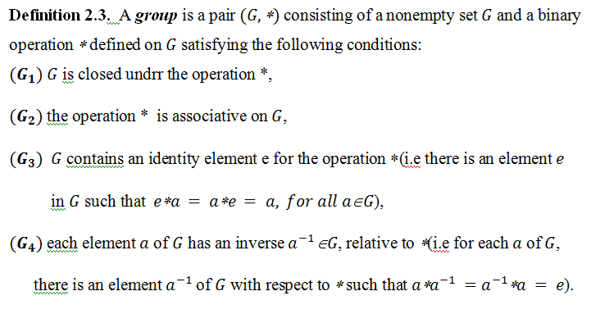

Slide 9
Examples.
1- (Z, +), (R, +), (R-{0}, .) are groups
2- ( P(X), ∆) is a group, but (P(X), ∪) and (P(X), ∩) are not groups.

Slide 10
Definition 2.4. A Semigroup is a pair (S, *) consisting of a nonempty set S together with an associative binary operation ∗ defined on S.
Example.
(P(A), ∩) and (P(A), ∪) are semigroups for any set A.

Slide 11
Definition 2.5. A group (G, *) is said to be a commutative if a*b = b*a, for all a,b ∈G
Examples.
1- Let a be any nonzero real number and consider the set G of integral multiples of a
Then (G, +) is a commutative group .

Slide 12
2- Let * be a binary operation defined of the set
as follows:
Show that is a commutative group.

Slide 13
3- Let S= R − {−1} and * defined of S as follows:
a*b = a+b +a.b, for all a, b ∈ S.
Show that (S, *) is a group.
4- Let = {∓1, ∓I, ∓j, ∓k} with

Slide 14
3- Certain elementary theorems on groups.
Theorem 3.1. Let (G, *) be a group. Then
1- The identity element of a group (G, *) is unique.
2- For all element a∈G has exactly one inverse.
3-
4- If a, b ∈G, then

Slide 15
Theorem 3.2. The group (G, ∗) is abelian if and only if

Slide 16
Theorem 3.3. (Cancellation Law) Let (G, ∗) be a group and a, b , c ∈G. Then
1- if a*b = a*c, implies b=c and
2- If b*a = c*a , implies b=c.
Corollary 3.4. The only solution of the group equation x*x= x is x=e.

Slide 17
Theorem 3.5. In a group (G, *) the equations a*x=b and y*a=b have unique solutions.

Slide 18
Permutation groups.
Definition 4.1. A permutation of a set A is a function from A into A that is both one-to-one and onto itself.
Example.
The function
f(x) = x+1 is a permutation of the set ℤ.

Slide 19
Remark. The set of all permutations of the set A will be denoted by the symbol
Suppose that A= { 1, 2, 3, …}
For any ,
Also we can represent f in

Slide 20
Theorem 4.2. Let be a nonempty set. Then
is a group ( called symmetric group of the set .
Remark.The set of all permutations of the set N={1, 2, 3, … , n} will be denoted by the symbol and contains n! distinct elements.

Slide 21
Example. Let A={1, 2, 3}. Then there are 3!=6 permutations in , namely

Slide 22
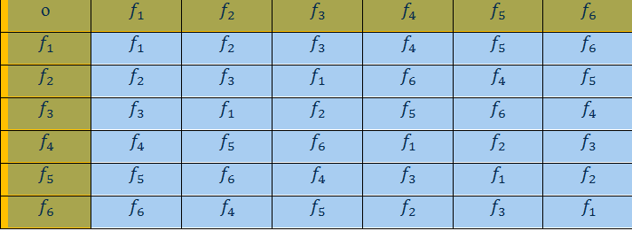

Slide 28
5- Cyclic Groups

Slide 37
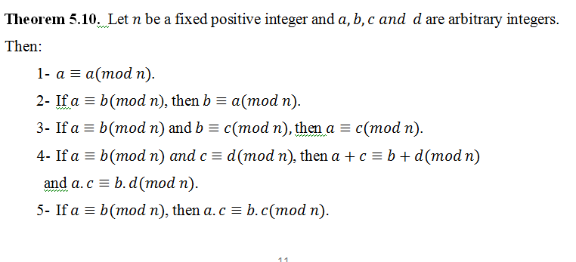

Slide 39
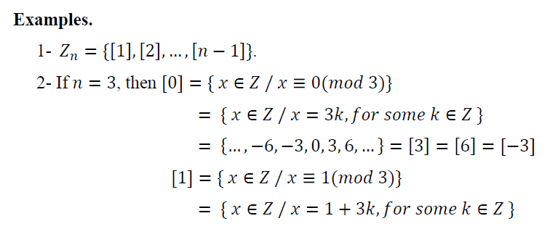

Slide 41
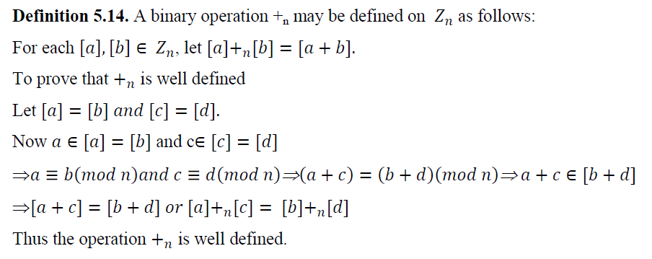

Slide 47
