Slide 1
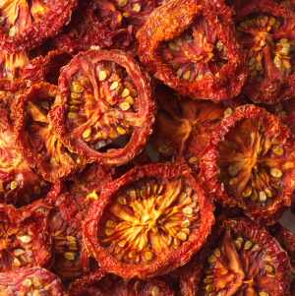
Effect of osmotic pressure on microbial growth

Slide 2
Osmosis
Is the net movement of a solvent (water) in living organisms from a region of higher water concentration to a region of lower water concentration

Slide 3
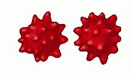
Hypertonic solution
Is any solution that has a higher osmotic pressure than another solution
In the biological field, high osmotic pressure removes water from cell, causing shrinkage of cell membrane (Plasmolysis)
In this environment, osmosis can cause cells to die from shriveling (Crenation)

Slide 4
At lower water content, microbial growth is inhibited and the enzymatic and non-enzymatic decay of food is slowed
Therefore this method is used to control spoilage and microbial growth
Most food preservation techniques used combine methods of
Drying
Sugar
Salt
Preservatives
Refrigeration
Acidity and others

Slide 5
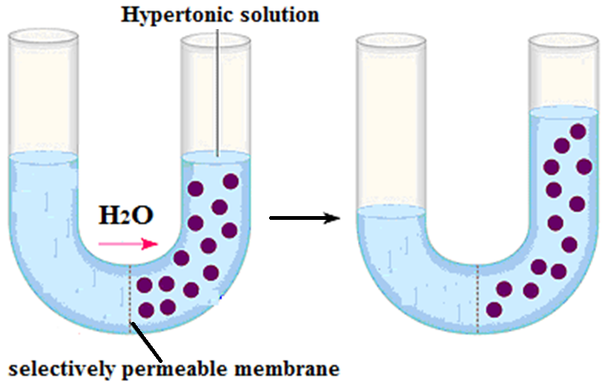

Slide 6
Hypotonic solution
Is any solution that has a lower osmotic pressure than another solution
In the biological field, this generally refers to a solution that has less solute and more water than another solution

Slide 7
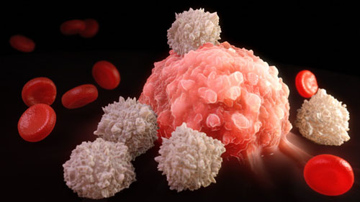
In most cases cell wall prevents excessive entry of water
Microbe may lyses or burst if cell wall is weak or cells not bound by a rigid wall
Such as red blood cells which may be burst in a medium of this kind
This phenomenon termed as plasmoptysis

Slide 8
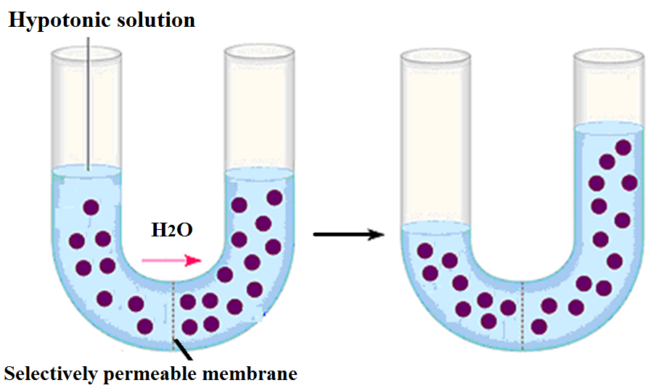

Slide 9
Isotonic solution
Is any solution that has the same osmotic pressure across a semi permeable membrane
This state allows for the free movement of water across the membrane without changing the concentration of solutes on either side of the membrane

Slide 10
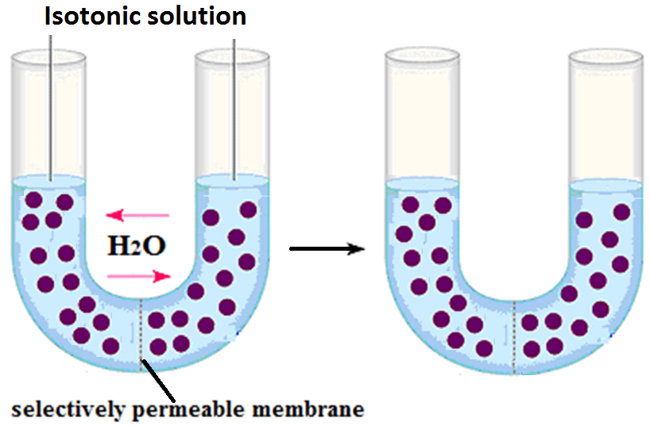

Slide 11
Osmophiles
Are those Microorganisms capable of living in moderate to high sugar concentrations

Slide 12
Halophiles
Are those Microorganisms which require moderate to high salt concentrations
Microorganisms that live in marine environments can tolerate high salt concentrations
a. Extreme or Obligate Halophiles
Require very high salt concentrations (20 to 30%)
such as bacteria in Dead Sea and brine vats
b. Facultative Halophiles
Do not require high salt concentrations for growth, but tolerate 2% salt or more
This idea has been well known for centuries where high salt content has been used to control the spoiling of food

Slide 13
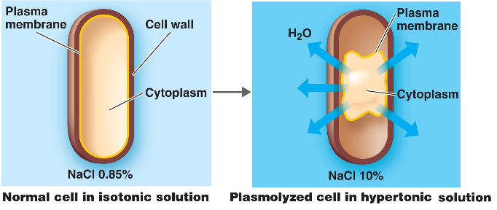

Slide 14
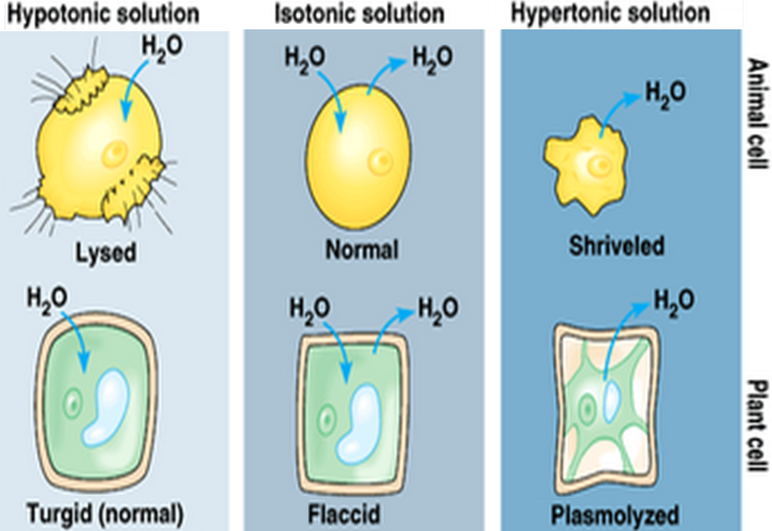
Notes:
Turgid=منتفخ flaccid=مترهل

Slide 15
Effects of Salt and Sugar
The major effect of salt as a preservative is that it withdraws water from microorganisms if the external salt concentration is high enough, the microbes would shrivel and die
Spores would not be killed but would not be able to germinate

Slide 16
Sodium chloride is the main ingredient used in the preservation of meats
Salting meat draws water out and tying up the water within, making it unavailable for chemical reactions that cause decay
High concentrations of salt also interfere with the replication of microorganisms

Slide 17
Salt curing frequently uses salts containing nitrates
Nitrates act as antioxidants in preserved foods, preventing decay and spoilage through oxidation and free radical generation
However, high consumption of preserved foods containing nitrates may be linked to a higher risk of cancer

Slide 18
Just like with salt, some forms of sugar can draw water out of food and tie up water within the food so it is not available for biochemical reactions
According to the Food and Agriculture Organization, fructose and sucrose are very effective for preserving food while glucose is not

Slide 19
Procedure
1. Prepare one liter of medium, distribute it in to 5 flasks (200ml for each flask)
2. Prepare different concentration NaCl and sugar for each flask of media with NaCl as following: (0.5%, 5%, 10% and 15% NaCl) (0%, 1.5%, 3%, 4.5% and 6% sugar)
3. Sterilize the medium in autoclave
4. Pour the sterilized medium in to 5 sterilized Petri dishes (one plate for each concentration); allow the plate to become solidified

Slide 20
5. Divide each plate into 3 sections, by using sterilized loop
6. Inoculate each plate with culture of: fungi and bacteria
7. Incubate the plates at 25˚C for 5-7 days (fungi) and 37˚C for 48h (bacteria)
8. Record your results on the laboratory report

