Slide 1
General biology 1st stage Geology
University of Salahaddin
College of Science
Department of Biology
1st Lab
Neveen N.Rajab
M.Sc. degree in Mycology

Slide 2
Biology: Is the branch of science dealing with the study of life. It is concerned with the characteristics, classification and behaviors of organisms.
Zoology: - is the science that studies the animal shape, structure, function, reproduction mode, genetic characteristic and animal relationship and
related to its environment.
Botany;-the scientific study of the physiology, structure, genetics, ecology, distribution, classification, and economic importance of plants.
Mycology:- is the branch of biology concerned with the study of fungi, including their genetic and biochemical properties, their taxonomy and their use to humans

Slide 3
Morphology: the science of the forms and structure of organisms.
Anatomy: The science of the structure of the animal body and the relation of its parts; it is largely based on dissection.
Taxonomy: The orderly classification of organism into appropriate categories (taxa) on the basis of relationships among them. Homo sapiens

Slide 4
Microscope
Micro= small thing Scope= to be seen
*Microscope:-Is a coordinated system of lens arranged to produce an enlarged focusable image slide.
*Types of microscope:-
1. Compound (light) microscope
2. Dissecting microscope
3. Electron microscope

Slide 5
*Parts of light microscope:-
1. Ocular lens (eye piece):-is the lens you look through, they made with different magnifications (6X, 10X, 15X)
2. Body tube:-is the hallow tube through which light travels to the ocular.
3. Revolving nose piece:-this part located at the bottom of the body tube, used for changing the magnification power of objective lenses which mounted on it.
4. Objective lenses:-are set of 3-4 lenses mounted on revolving nose piece which provide most of the magnification and improve resolution. are:-
a. Scanning (small) lens (4x, 5X)
b. Low power (medium) lens (10X)
c. High power (large) lens (40X)
d. Oil immersion (largest) lens (100X) which must always be used with drop of oil.

Slide 6
5. Arm:-metal part of microscope, by which we can carry microscope.
6. Stage:-horizontal surface on which slide is placed.
7. Condenser lens:-a system of lens that concentrates light on the specimen above, located directly under the stage.
8. Diaphragm:-regulate the amount of light that pass to the specimen.
9. Coarse adjustment knob:-they used for movement of stage up and down with large movement, used with scanning (4X) and low power lens (10X).
10. Fine adjustment knob:-they used for movement of stage up and down with slight movement, it used with high power and oil immersion lens.

Slide 7
11. Stage knobs:-they are knob used to move stage to left, right, forward, and backward direction.
12. Light sources:-the light source has on/off switch and may have adjustable intensities and color filters.
13. Base:-is the metal part of the microscope it is the part of stabling the microscope on the table and also used for carrying microscope.

Slide 8
Procedure: 1. Remove microscope from its cabinet & carry upright with arm & base by both hands & place on the table in front of you. 2. Clean all lenses with lens paper. 3. Turn on the light source. 4. Always begin examining slides with Low power Objective. 5. A. Place a microscopic slide of newsprint of the begin letter of your name on the horizontal stage B. Place a drop of pond water on clean microscopic slide, place the edge of clean cover slip at one edge of the drop & slowly lower the cover slip on to the drop so that no air bubbles are trapped. This specimen called Wet mount. 6. Examine your preparations & rotating the coarse adjustment knob, in case of wet mount; sketch the organism that you see

Slide 9
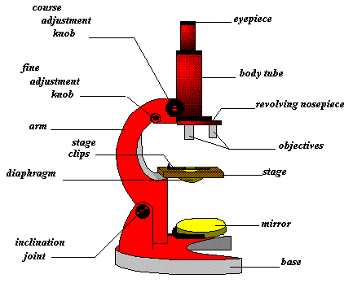

Slide 10
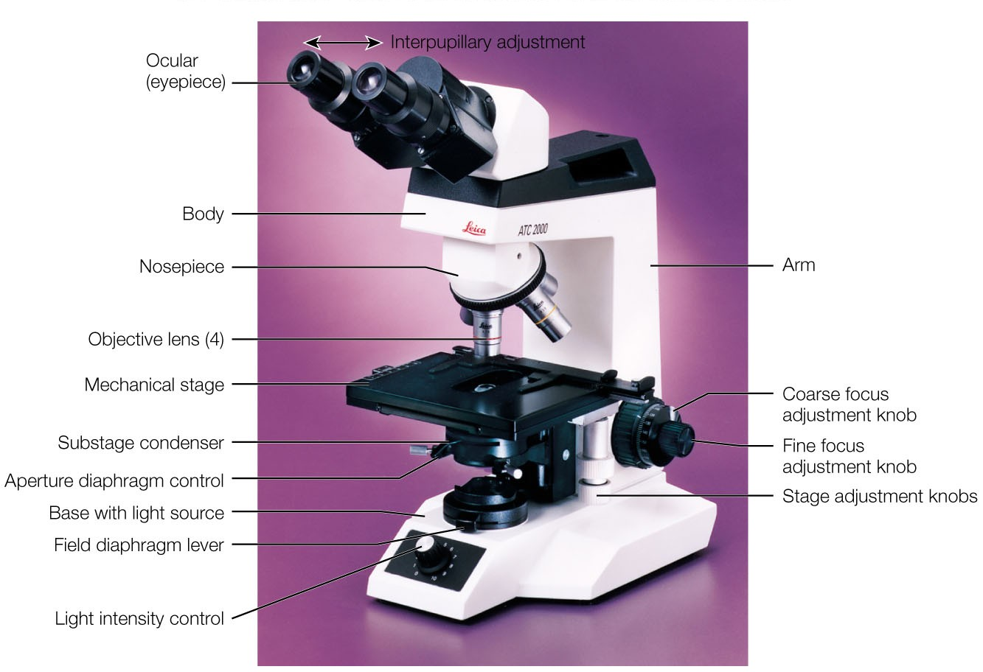

Slide 11
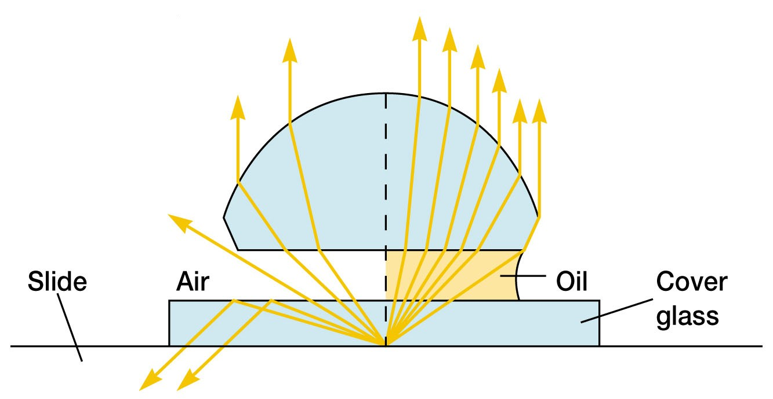

Slide 12
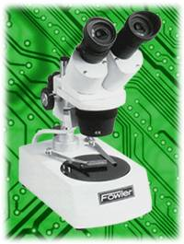
Dissecting Microscope

Slide 13
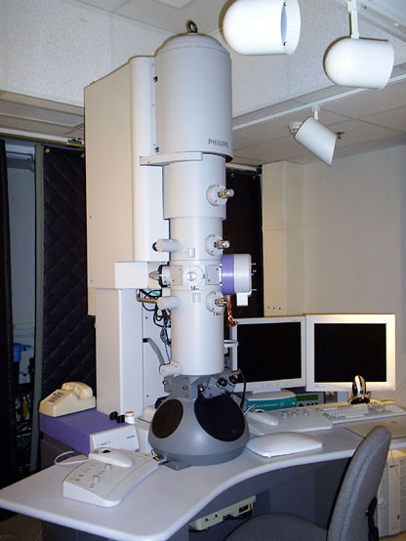
Electron Microscope

Slide 14
