Slide 1
Kurdistan Region-Iraq
Ministry of Higher Education
and Scientific Research
Salahaddin University-Erbil
Software Defined Radio
Base of
cognitive radio
by
Niyaz Othman Ali

Slide 2
Introduction
Over the last few years analog radio system are being replaced by digital radio system
Programmable hardware development
Software is more flexible than hardware
Promising technology is by using software

Slide 3
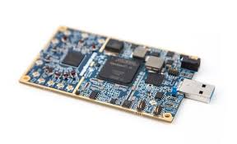
What is SDR
SDR refers to technology wherein software modules running on a generic hardware platform
SDR is a radio that which operating parameter can be altered by making a change in software without making any hardware change

Slide 4
SDR motivation
Constant evolution of link-layer protocol standard
Existence of incompatible wireless network technologies
Rolling – out new services/feature costly problem
Infrastructure updating and wireless operators

Slide 5
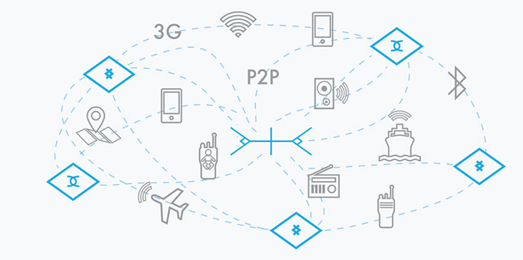
SDR advantages
Reusable device with long usage life
Device can be upgrade and heeling
some bug after manufacturer over the air
Reduce cost and time of design
Integrated handset and infrastructure
theoretically possible by hardware,
now it is practically possible
Ubiquitous connectivity
Efficient use of spectrum
It is the enabler of the future radio “cognitive radio”

Slide 6
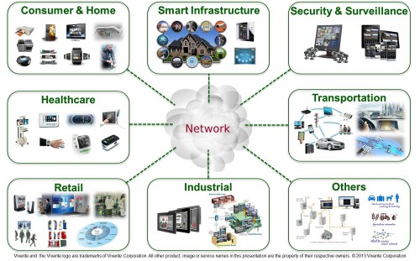
Application
6

Slide 7
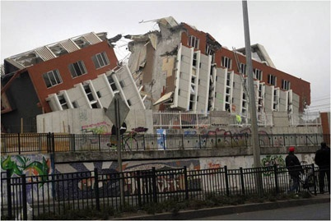
Different teams from different countries can communicate with each others

Slide 8
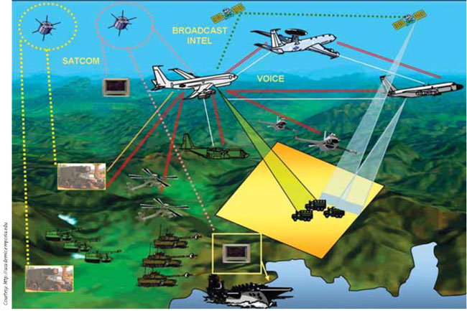
Military, different legions concurrently communicate with each others
8

Slide 9
Major obstacles in face of wideband SDR application
The antenna characteristic should be controlled by software
Complexity and throughput
Efforts of enhance both processing power and software

