Slide 1
University of Salahadden-Erbil School of Engineering Electrical Department
IM-OFDM
By
Niyaz O. Ali
niaz.ali@su.edu.krd

Slide 2
Index Modulation( A Promising Technique for 5G and Beyond Wireless Networks)
The increasing demand for higher data rates, better quality of service, fully mobile and connected wireless networks, will achieve by promising 5G which has ten times higher spectral and energy efficiency than current 4G wireless networks and will support data rates up to 10 Gbps .
These ambitious goals set for 5G wireless networks require comprehensive changes in the design of different layers for next generation communications systems. Within this perspective, massive multiple-input multiple output (MIMO) systems, more flexible waveforms such as generalized frequency division multiplexing (GFDM) and filter bank multi-carrier (FBMC) modulation, advanced relaying technologies, and millimeter-wave communications have been considered as some of the strong candidates for the physical layer design of 5G wireless networks is the potential and implementation of index modulation (IM) techniques for next generation MIMO and multi-carrier communications systems. In a specific manner,
focus on two promising forms of IM:
spatial modulation (SM) and
orthogonal frequency division multiplexing with IM (OFDM-IM).
Index modulation (IM) refers to a family of modulation techniques that rely on the activation states of some resources/building blocks for information embedding. The resources/building blocks can be either physical, e.g., antenna, subcarrier, time slot, and frequency carrier, or virtual, e.g., virtual parallel channels, signal constellation, space-time matrix, and antenna activation order.
A distinct feature of IM is that part of the information is implicitly embedded into the transmitted signal.

Slide 3
The 5G systems must be support higher spectrum efficiency (SE), higher energy efficiency(EE), and higher mobility.
Conventional MIMO may achieve high SE with massive antennas, but has compromised EE due to the scaled power consumption of a large number of RF chains. The OFDM modulation is prone to Doppler-induced ICI .
its inherent high peak-to-average power ratio (PAPR) also necessitates expensive power amplifiers. address these concerns, most recently, a new OFDM-based technique, termed as
index modulated (IM-)OFDM has arisen as a promising candidate that has the potential to meet the 5G requirements. Compared with plain OFDM, IM-OFDM has:
reduced PAPR, improved EE and BER performance, but with similar complexity.

Slide 4
Assuming that there are in total N OFDM subcarriers, Fig(1)
N subcarriers are split into G sub-blocks,
each consisting of L =N/G subcarriers.
The subcarrier activation and symbol modulation are performed within each subblocks according to the following procedure independently.
Firstly, b out of L subcarriers in each sub-block are set to be active.
Then, b symbols are drawn from the M-ary PSK/QAM constellation to be sent from the active subcarriers, where M is the cardinality of the constellation.
Finally, the remaining (L − b) are zero-padded.
Given L and b, there are in all C (L, b) combinations of active subcarrier indices,
where C (· , ·) denotes the binomial coefficient.
Hence, log2 C (L, b) bits can be modulated to the active subcarrier indices via either a look-up table or combinatorial methods.

Slide 5
Assuming that there are in total N OFDM subcarriers, Fig(1)
N subcarriers are split into G sub-blocks,
each consisting of L =N/G subcarriers.
The subcarrier activation and symbol modulation are performed within each subblocks according to the following procedure independently:
Firstly, b out of L subcarriers in each sub-block are set to be active
Then, b symbols are drawn from the M-ary PSK/QAM constellation to be sent from the active subcarriers, where M is the cardinality of the constellation.
Finally, the remaining (L − b) are zero-padded.
Given L and b, there are in all C (L, b) combinations of active subcarrier indices, where
C (· , ·) denotes the binomial coefficient.
Hence, log2 C (L, b) bits can be modulated to the active subcarrier indices via either a look-up table or combinatorial methods.

Slide 6
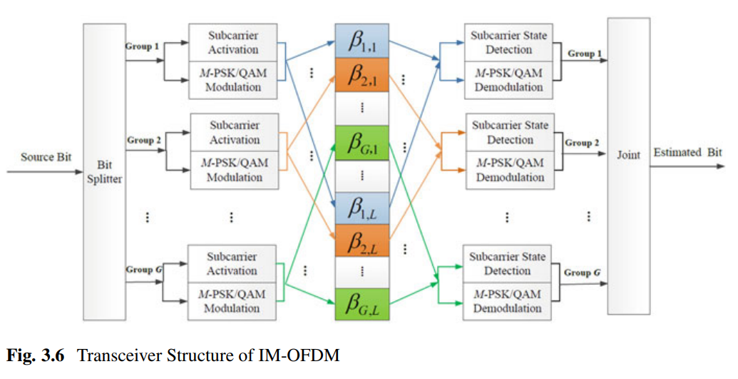
Fig (1)

Slide 7
Therefore, in conjunction with the information bits carried by the b constellation symbols, IM-OFDM can convey a total of
per sub-block
By concatenating the subcarrier sub-blocks, the original IM-OFDM block can be obtained, which is grouped in a localized manner with its i-th element represented as
Si, (i = 0, ··· , N−1).
To benefit from the uncorrelated channels and improve the system performance. The subcarriers are then go through an interleaving module which results in
as depicted in Fig. 1,
represents the subcarrier indices of the g-th sub-block, and Φ1 ∪···∪ ΦG = {0,··· , N − 1}.
Next, the inverse FFT is applied . Then a cyclic prefix (CP) is added to the beginning of the time-domain OFDM symbol before sent from the transmit antenna.

Slide 8
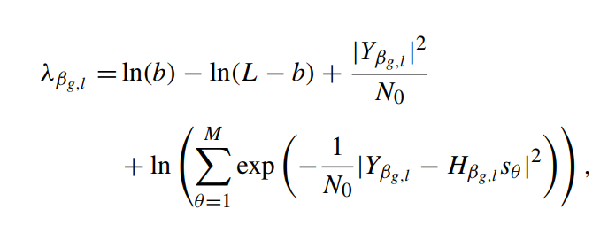
At the receiver, after CP reduction, FFT and de-interleaving, the received signal within the g-th sub-block in the frequency domain can be expressed by
Average transmit power of Xβg,l is P /b for IM-OFDM rather than P /L as in conventional OFDM
To demodulate the information bits at the receiver, the log-likelihood ratio (LLR) detector of IM-OFDM evaluates
the ratio of the posteriori probability of non-zero to that of zero for each subcarrier. This ratio gives information about
the status of the corresponding subcarriers and can be written as:
where {s1, ··· , sM} represents the M-ary constellation symbols.
The b subcarriers within the g-th sub-block having maximum
LLR values are determined to be active. Then the received
signals associated with the determined active subcarriers
are demodulated to get the estimated information bits.

Slide 9
The LLR detector may result in catastrophic error when deciding on an unused index combination. However, since the unused combinations are much less than the used Ones, the performance penalty is negligible.
the comparison between IM-OFDM and plain OFDM in terms of the maximum achievable rate (MAR) was evaluated, which indicates that with the same data rate, IM-OFDM provides improved MAR compared with plain OFDM and this advantage varies with different b values.
IM-OFDM with ICI Self-Cancellation

Slide 10
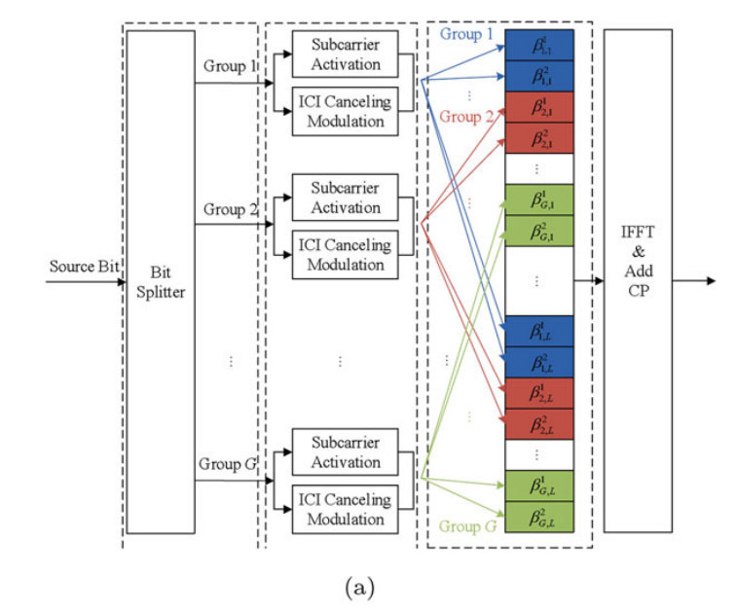

Slide 11
