Slide 1
University of Salahadden-Erbil School of Engineering Electrical Department
Covid-19
By
Niyaz O. Ali
niaz.ali@su.edu.krd

Slide 2
MythBusters
1- FACT: Vitamin and mineral supplements cannot cure COVID-19

Slide 3
2-FACT: Studies show hydroxychloroquine does not have clinical benefits in treating COVID-1

Slide 4
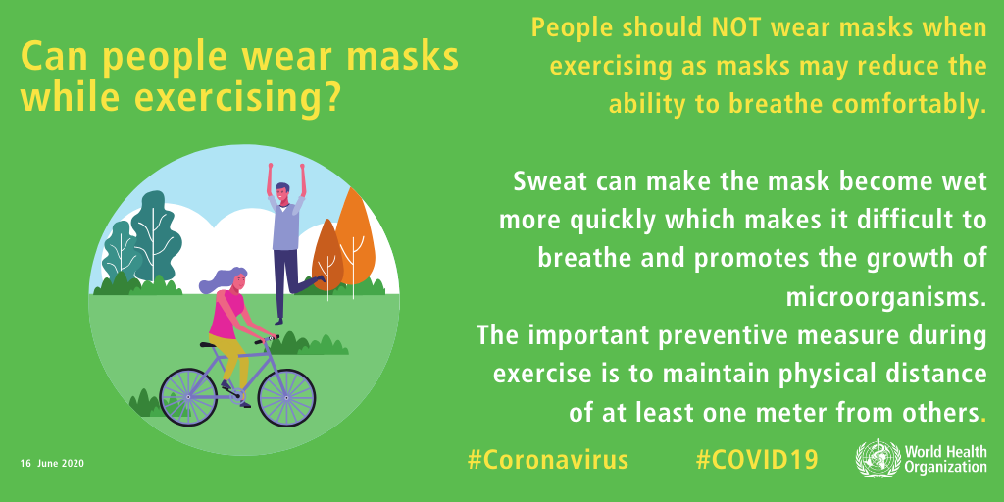
3- FACT: People should NOT wear masks while exercising
https://youtu.be/1_AxGswGnno

Slide 5
4-FACT: The likelihood of shoes spreading COVID-19 is very low
https://youtu.be/yLSHNV4pSwc

Slide 6
5- FACT: The coronavirus disease (COVID-19) is caused by a virus, NOT by bacteria
https://youtu.be/eXhbQU9rzYo

Slide 7
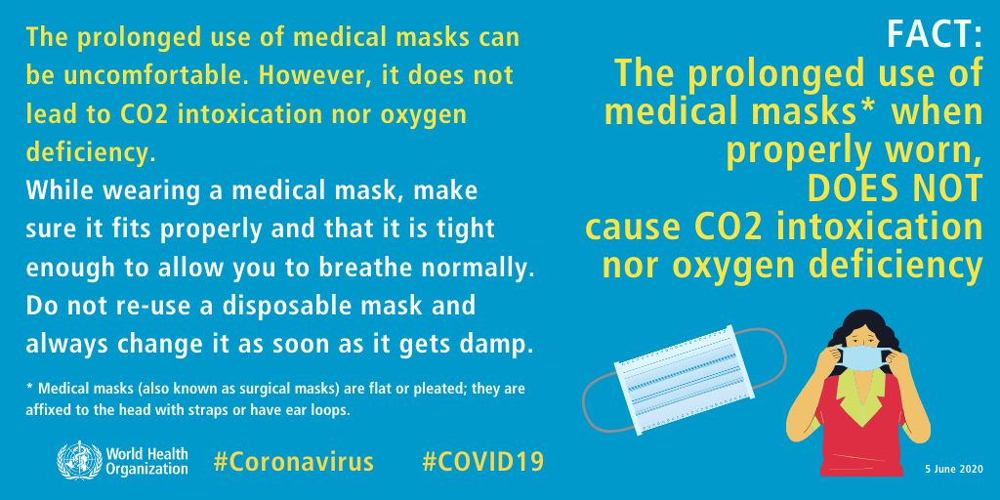
5- FACT: The prolonged use of medical masks when properly worn, DOES NOT cause CO2 intoxication nor oxygen deficiency
https://youtu.be/l33a25lchT8

Slide 8
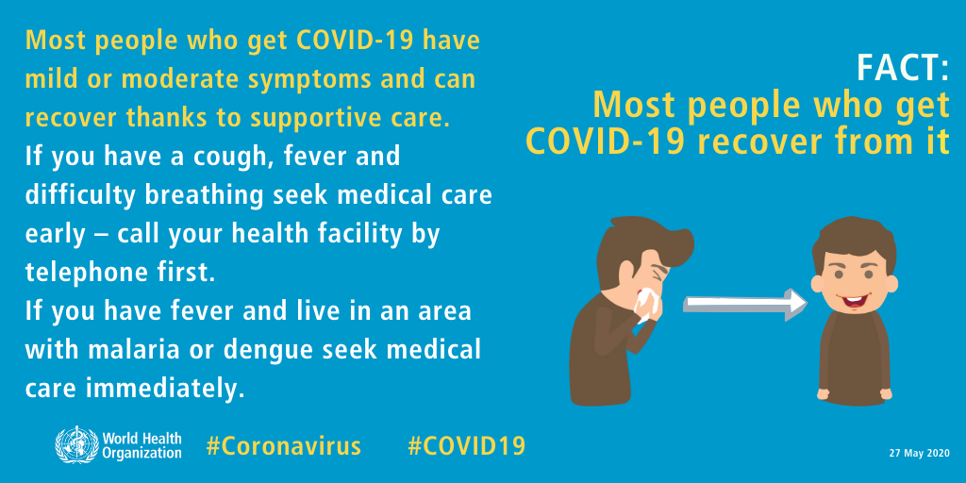
6-FACT: Most people who get COVID-19 recover from it

Slide 9
7-FACT: Drinking alcohol does not protect you against COVID-19 and can be dangerous
https://youtu.be/Rr6ABy2Kf_Y

Slide 10
8- FACT: Thermal scanners CANNOT detect COVID-19

Slide 11
9-FACT: There are currently no drugs licensed for the treatment or prevention of COVID-19

Slide 12
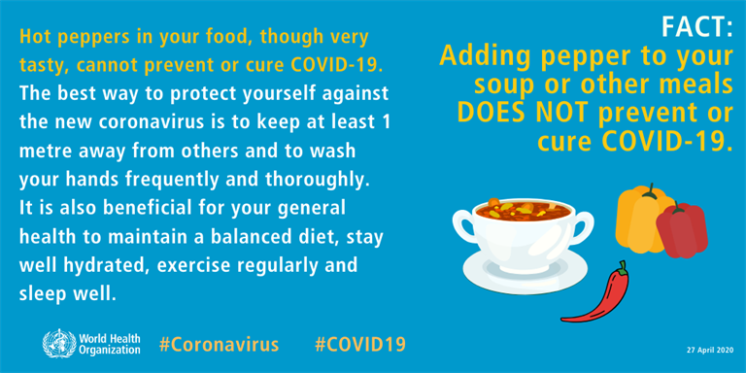
10-FACT: Adding pepper to your soup or other meals DOES NOT prevent or cure COVID-19

Slide 13
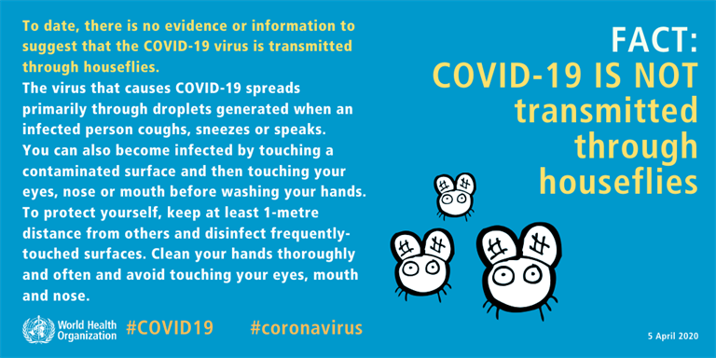
11- FACT: COVID-19 is NOT transmitted through houseflies

Slide 14
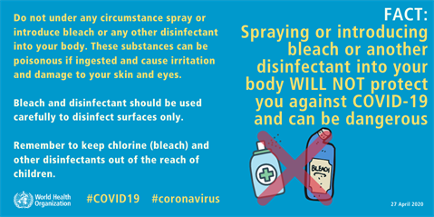
12-FACT: Spraying and introducing bleach or another disinfectant into your body WILL NOT protect you against COVID-19 and can be dangerous.
https://youtu.be/oRyuOLP5xUE

