Slide 1
Salahaddin University-Erbil School of Engineering Electrical Department
THz antennas challenges at 6G era
By
Niyaz O. Ali
niaz.ali@su.edu.krd

Slide 2
the huge increasing demand on spectrum due to ubiquitous of wireless application and devices which lead to move towards THz band (0.1-10) THz
The THz antennas have grate influence on performance and quality of communication

Slide 3
Advantages of THz antennas
Small size
Wide frequency bandwidth
High data rate
Low Damage :- low energy compare to X-ray
High spectral resolution : for sensing dangerous goods
Visualization : can penetrate metallic and nonmetallic material so it is perfect to scan body at airport

Slide 4
Disadvantages
High loss
Low fabrication precision
Low gain
Bad directivity

Slide 5
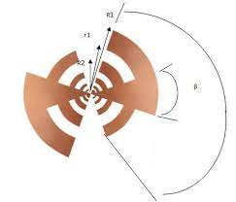
Basic of THz antennas
Metallic antennas : horn antennas
Dielectric antennas
New material
CMOS and SiGe technology

Slide 6
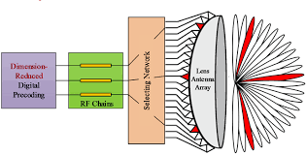
Lens antennas

Slide 7
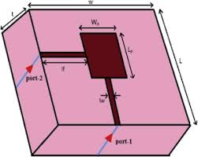
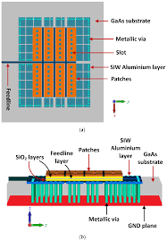
Microstrip antennas
On chip antennas

