Slide 1
University of Salahadden-Erbil School of Engineering Electrical Department Second Year- forth Semester 2019-2020
Digital Electronic Circuits
Signals and Number Systems & logic gate
Lecture 2
By
Asst. Lect. Niyaz O. Ali
digital.electronic.circuits@gmail.com

Slide 2
Homework
Convert the following Binary no. to Decimal
a)0001 b)0101 c) 1000 d)1011 e)1111 f)0111 g) 1000 0000
h) 0001 0000 hh) 01100100 J)100110011 k)0011111 l)1111 1111 m)11101110
Convert the following Decimal no. to Binary
a)23 b)39 c) 55 d)48 e)204
Convert the following octal no. to Binary equivalent
3 b) 7 c) 7642 d) 1036 E)2105
Convert the following Binary no. to octal equivalent
101 b) 110 c) 010 d) 111000101010 E) 001011000111 h)100110100101
Convert the following octal no. to decimal equivalent
6724 b) 2648 c) 26184.666
Convert the following hexadecimal no. to binary equivalents
cc b) 6 c) F D) E2 E) 1A h) 3D
Convert the following Binary no. to hexadecimal equivalent
1001 b) 1100 c) 1101 d) 1111 e) 10000000 f) 01111110 g) 00010101 h) 11011011
Convert the following hexadecimal no. to decimal equivalents
a) 7E b) DB C) 12A3 d) 34CF
Convert the following decimal no. to hexadecimal equivalents
217 b) 48373 c) 48373

Slide 3
Convert the following decimal no. to BCD equivalents
39 b) 65 c)40 d) 17 e) 82 h) 99
Convert the following BCD no. to decimal equivalents
a) 1000 0000 b) 00000001 c) 10010010 d) 01110110 E) 01000011 f) 01010101

Slide 4
Binary Arithmetic the rule for binary addition is:
$\frac{\begin{matrix}0 \\ +0 \end{matrix}}{0}$ $\frac{\begin{matrix}1 \\ +0 \end{matrix}}{1}$ $\frac{\begin{matrix}1 \\ + 1 \end{matrix}}{10 }$ $\frac{\begin{matrix}1 \\ 1 ←(Augend) \\ 1 ←(Addend)\end{matrix}}{11 }$
carry
Ex:
$\frac{\begin{matrix}1 \\ 59 \\ + 42 \end{matrix}}{ 101}$ $\frac{\begin{matrix} 64 32 16 8 4 2 1 \\ 1 1 1 0 1 1 \\ + 1 0 1 0 1 0 \end{matrix}}{ 1 1 0 0 1 0 1}$
Subtraction the rule for binary subtraction is:
$\frac{\begin{matrix}0 \\ −0 \end{matrix}}{0}$ $\frac{\begin{matrix}1 \\ −0 \end{matrix}}{1}$ $\frac{\begin{matrix}1 \\ − 1 \end{matrix}}{ 0 }$ $\frac{\begin{matrix} \\ 1 0 ←(minuend) \\ − 1 ←(subtrahend)\end{matrix}}{01 (difference) }$
Ex:
$\frac{\begin{matrix}1 \\ 85 \\ − 57 \end{matrix}}{ 28}$ $\frac{\begin{matrix} 64 32 16 8 4 2 1 \\ 1 0 1 0 1 0 1 \\ − 0 1 1 1 0 0 1\end{matrix}}{ 0 0 1 1 1 0 0}$

Slide 5
Multiplication the rule for binary multiplication is:
$\frac{\begin{matrix}0 \\ ∗ 0 \end{matrix}}{0}$ $\frac{\begin{matrix}1 \\ ∗ 0 \end{matrix}}{0}$ $\frac{\begin{matrix}1 \\ ∗1 \end{matrix}}{ 1 }$ $\frac{\begin{matrix} \\ 0 ←(maltiplicant) \\ ∗ 1 ←(multiplier)\end{matrix}}{0 (product ) }$
Ex:
$\frac{\begin{matrix} \\ 13 \\ ∗ 5 \end{matrix}}{ 65}$ $\frac{\begin{matrix} \\ 1 1 0 1 \\ ∗ 1 0 1\end{matrix}}{ \begin{matrix}1101 \\ 0000 \\ \frac{ 11 01 }{1000001} \end{matrix} }$
Ex:
$\frac{\begin{matrix} \\ 5.5 \\ ∗ 3.25 \end{matrix}}{ 17.875}$ $\frac{\begin{matrix} \\ 1 0 1 . 1 \\ ∗ 1 1 . 0 1\end{matrix}}{ \begin{matrix} \begin{matrix}1011 \\ 0000 \end{matrix} \\ 1011 \\ \frac{ 1011 }{10001.111} \end{matrix} }$

Slide 6
Division
$\begin{matrix} & 6 \\ 2 & 12 \\ − & \begin{matrix}12 \\ 00\end{matrix}\end{matrix}$ $\begin{matrix}10 & \begin{matrix}110←(quotient) \\ 1100←(divident)\end{matrix} \\ & −10 \\ & \begin{matrix}010 \\ −10 \\ 000\end{matrix} \end{matrix}$
Homework Solve the following
$\frac{\begin{matrix}1010 \\ ∗0101 \end{matrix}}{}$ $\frac{\begin{matrix}1101 \\ ∗0101 \end{matrix}}{}$ $\frac{\begin{matrix}01011011 \\ ∗00001111 \end{matrix}}{ }$ $\frac{\begin{matrix}00111111 \\ ∗00011111 \end{matrix}}{ }$
$\frac{\begin{matrix}1110 \\ −1000 \end{matrix}}{ }$ $\frac{\begin{matrix}1010 \\ − 0101 \end{matrix}}{ }$ $\frac{\begin{matrix}01100110 \\ − 00011010 \end{matrix}}{ }$ $\frac{\begin{matrix}01111000 \\ − 00111111 \end{matrix}}{ }$ $\frac{\begin{matrix}100000101 \\ − 11111111 \end{matrix}}{ }$
$\frac{\begin{matrix}1001 \\ ∗ 11 \end{matrix}}{ }$ $\frac{ \begin{matrix} 1101 \\ ∗ 1001 \end{matrix}}{ }$ $\frac{\begin{matrix}1111 \\ ∗ 101 \end{matrix}}{ }$ $\frac{\begin{matrix}1110 \\ ∗ 1110 \end{matrix}}{ }$

Slide 7
Binary complementary Numbers
One’s complement of a number (complement of a number)
The complement of 1 is 0 and the complement of 0 is 1. The complement of a binary number is calculated by complementing each bit of the number.
Ex: The complement of 101101 is 010010.
Two’s Complement of a number = One’s Complement of a number + 1
Ex: binary 1’s comp. 2’s comp.
1010 0101 0110
Ex: The two’s complement of 101011 is
010100 + 1 = 010101
There are another ways to calculate the 1’s comp. and 2’s comp.
1’s comp. = ($2^{n}−1)−A$
Ex: $10110→\left(2^{5}−1\right)−10110=11111−10110=01001$
2’s comp. = ($2^{n})−A$
2’s complement found by searching the first one bit starting from the LSB and keep all bits as well as the first “one” unchanged, while change the remanding bite by it’s complement one.
1010 0110
+1

Slide 8
The meaning of complement and 2’s complement
The no. 75 in decimal has 9’s complement 24 which make the addition of the 75 and 24 =99 while 10’complement is (24+1=25) make the addition with the 75 =100
The no. 1010 has 1’s comp. 0101 which make the addition of the (1010+0101=1111) and the 2’comp. of the no. is 0110 which make the addition with (1010+0110=10000)
$\frac{\begin{matrix}Ex:− \\ 85 \\ − 75 \end{matrix}}{ +10}$ $\frac{ \begin{matrix}using 1^{′}s \\ 85 \\ + 24 \end{matrix}}{\begin{aligned} 109 \\ +1\end{aligned}}$ $\frac{\begin{matrix}85 \\ \\ +25 \end{matrix}}{\begin{aligned}110 \\ 10\end{aligned}}$
+10
1’s complement Subtraction
$\frac{\begin{matrix} \\ 7 \\ − 4 \end{matrix}}{ +3}$ $\frac{\begin{matrix} 4 2 1 \\ 1 1 1 \\ + 0 1 1 \end{matrix}}{ 1 0 1 0 }$ $\frac{\begin{matrix} \\ 1010 \\ + 1\end{matrix}}{ 011}$ the result is +011
$\frac{\begin{matrix} \\ 5 \\ − 6 \end{matrix}}{ −1}$ $\frac{\begin{matrix} 4 2 1 \\ 1 0 1 \\ + 0 0 1 \end{matrix}}{ O 1 1 0 }$ $take the 1^{′}comp. of the result$the final result is (-001)
Over flow around carry
Over flow around carry

Slide 9
2’s complement Subtraction
$\frac{\begin{matrix} \\ 7 \\ − 4 \end{matrix}}{ +3}$ $\frac{\begin{matrix} 4 2 1 \\ 1 1 1 \\ + 1 0 0 \end{matrix}}{ 1 0 1 1 }$ the over flow is “1” just remove it then the result is +011
$\frac{\begin{matrix} \\ 5 \\ − 6 \end{matrix}}{ −1}$ $\frac{\begin{matrix} 4 2 1 \\ 1 0 1 \\ + 0 1 0 \end{matrix}}{ O 1 1 1 }$ the over flow is “0” just $take the 2′comp. of result$the final result is (-001)
Homework
Subtract using 1’s and 2’s complement
$\frac{\begin{matrix} \\ 12 \\ − 63 \end{matrix}}{ }$ $\frac{\begin{matrix} \\ 8 \\ − 5 \end{matrix}}{ }$ $\frac{\begin{matrix} \\ 89 \\ − 46 \end{matrix}}{ }$ $\frac{\begin{matrix} \\ 1 \\ − 6 \end{matrix}}{ }$ $\frac{\begin{matrix} \\ 20 \\ − 60 \end{matrix}}{ }$ $\frac{\begin{matrix} \\ 113 \\ − 50 \end{matrix}}{ }$ $\frac{\begin{matrix} \\ 3 \\ − 8 \end{matrix}}{ } \frac{\begin{matrix} \\ 4 \\ − 3 \end{matrix}}{ }$

Slide 10
It’s good to Know Unsigned, Signed Magnitude, and Signed Two’s Complement Binary Number
A binary number can be represented in form unsigned number or signed number or signed two’s complement, + sign represented by 0 and – sign represented by 1.

Slide 12
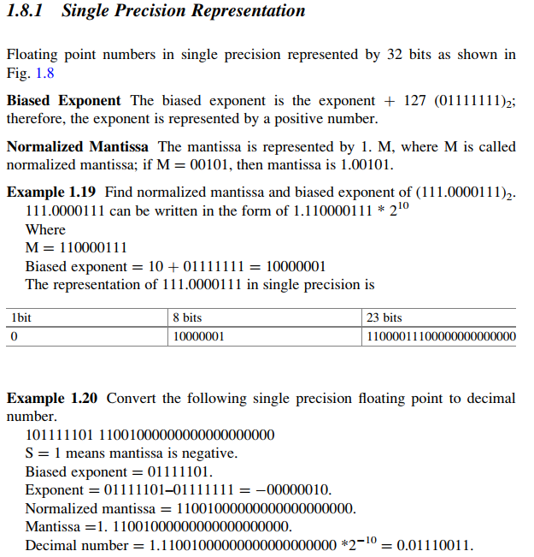
1

Slide 14
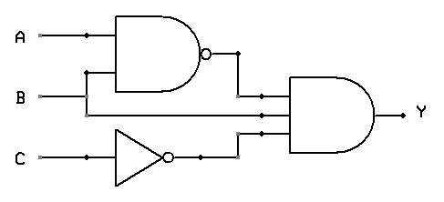
Definition of Truth Table and Various Logic Conventions
Logic Circuit :A logic circuit is an electronic circuit which
operates on digital signals according to some logic function.
Logic Gate: A logic gate is a logic circuit whose output
depends on the inputs in accordance with some logic rule.
Truth Table: One of the best statements in a tabular form that
Describes what a logic circuit can do or cannot do is called a truth table. “ Logic Diagram”
Function representation
Equation:- “ y$=\left(\overline{A+B}\right).B.\overline{C }$ ”
Truth table:-
Logic diagram
Note : unique truth table for the input and output, but for the same
input and output there may be several logic diagram and equation
A | B | C | y$=\left(\overline{A+B}\right).B.\overline{C }$
0 | 0 | 0 | 0
0 | 0 | 1 | 0
0 | 1 | 0 | 1
0 | 1 | 1 | 0
1 | 0 | 0 | 0
1 | 0 | 1 | 0
1 | 1 | 0 | 0
1 | 1 | 1 | 0

Slide 15
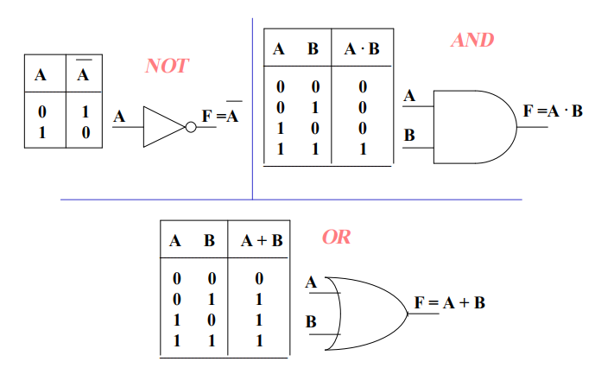
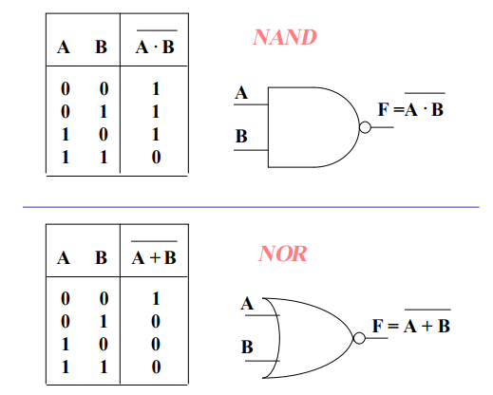
Logic Gates
Quite complex digital logic circuits (e.g. entire computers) can be built using a few types of basic circuits called gates, each performing a single elementary logic operation : NOT, AND, OR, NAND, NOR, etc..

Slide 16
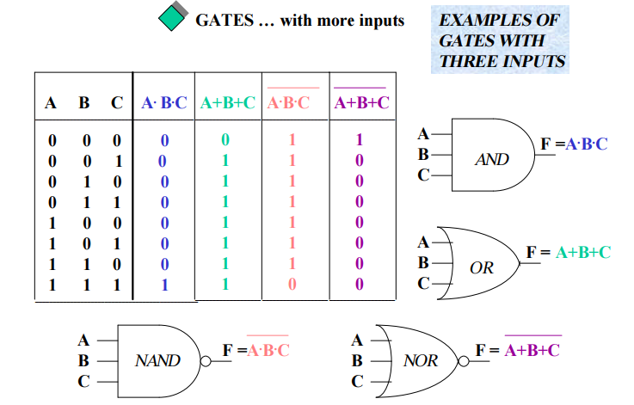
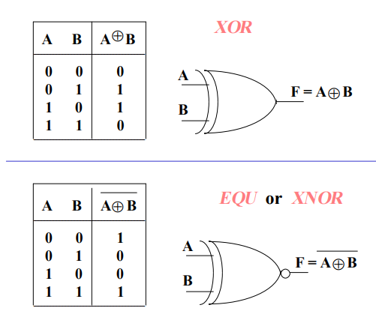
Positive logic system
In a positive logic system, the more positive voltage value of the two is assigned the logical 1 and the other is assigned logical 0.
For example of the voltage values 0 V and 5 V. The 5 V is logical 1 and 0 V is logical 0. Similarly, for voltage ranges −1 V and −5 V, −1 V is logical 1 and −5 V is logical 0.

Slide 17
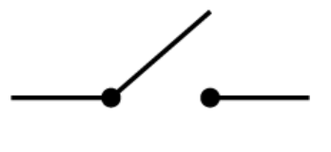
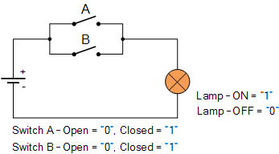
Negative logic system
In a negative logical system, the more negative voltage value of the two available voltage values is assigned logical 1 and the other is assigned logical 0.
For example, if there are two voltages values, 0 V and 5 V, 0 V is assigned logical 1 and 5 V is assigned logical 0. Similarly for voltage values –1 V and –5 V, –1 is assigned logical 0, and –5 V is assigned logical 1.
In most cases, we will assume positive logic. The AND gate positive logic system will not behave as AND gate in negative logic system.
Switching Algebra
Switch “off ” =logic “0”
While Switch “on ” =logic “1”
OR Gate AND Gate

Slide 18
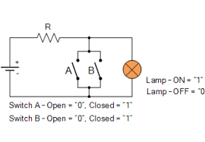
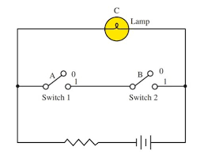
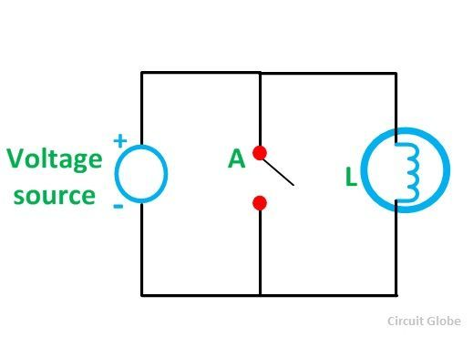
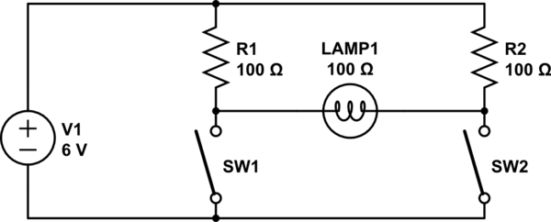
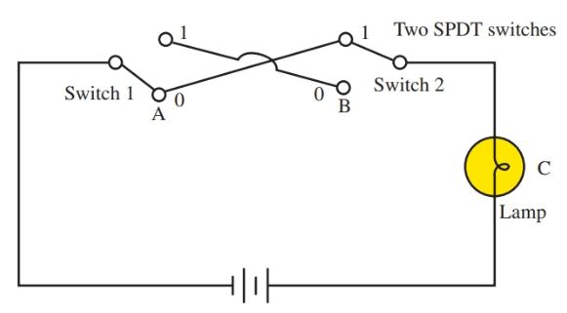
NOR Gate NAND Gate
NOT Gate XOR Gate
XNOR
0
1

Slide 19
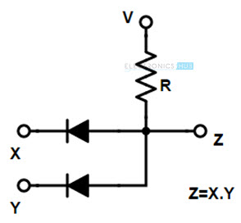
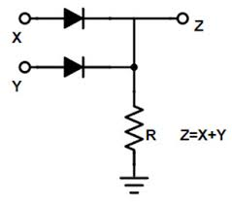
Diode Logic (DL)
In most cases, we will assume positive logic. The AND gate positive logic system will not behave as AND gate in negative logic system.
AND Gate OR Gate
The OR gate circuit shown before become AND Gate by using negative logic system
The AND gate circuit shown before become OR Gate by using negative logic system

