Slide 1
University of Salahadden-Erbil School of Engineering Electrical Department Second Year- forth Semester 2021-2022
Dynamics
Lecture 1
By
Asst. Lect. Niyaz O. Ali

Slide 2
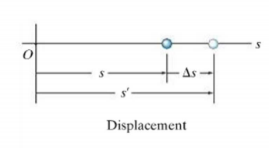
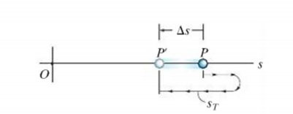
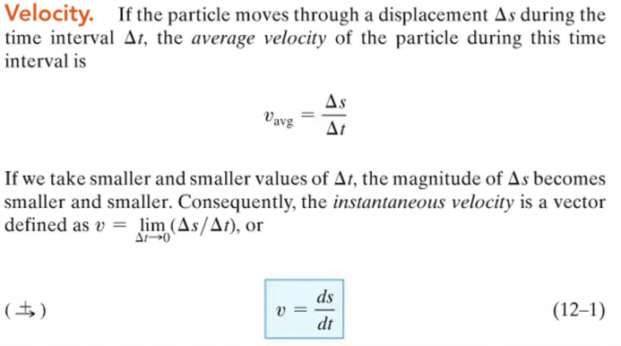
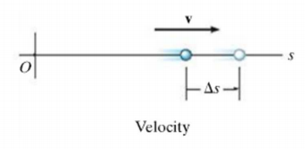
The displacement (Δs) of a particle is defined as its change in position .
$∆s=s′−$s (it is vector quantity)
$∆s$ is positive if particles final position is to the right of initial position
and vice versa.
The distance ($S_{T})$ travel is a positive scalar that represent
the total length of the path over which the particle travels.
( the “p” is represent the initial position and p’ is final one
while the $S_{T }$is the path which the particle travels.

Slide 3
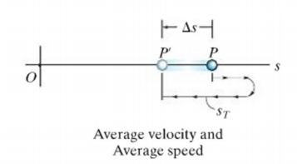
That is the average velocity $v_{avg}$is displacement divided by time interval.
$v_{avg}=\frac{∆S}{∆t}=[\frac{displacement}{time}]$
And the speed is the magnitude of the velocity,⇒ speed=| $v_{avg}$|, while
the term average speed = $\frac{total distance }{total time }=\frac{S_{T}}{∆t}$ which is scalar quantity
As example the velocity and speed of a particle shown on the right is
$$\underset{→}{+}v_{avg}=\frac{−∆S}{∆t} , speed=\frac{1m}{∆t}, {Speed}_{avg}=\frac{S_{T}}{∆t}$$
Instantaneous Velocity and Speed
• The instantaneous velocity v equals the limiting value of the ratio ΔS / Δt as Δt approaches zero
• The instantaneous speed of a particle is defined as the magnitude of its instantaneous velocity
At instantaneous: the magnitude of instantaneous velocity is the instantaneous speed
3m
4m

Slide 4
Acceleration
The average acceleration $a_{avg}$of the particle is defined as the change in velocity Δv divided by the time interval Δt during which that change occurs.
$a_{avg}=\frac{∆v}{∆t}$ while the instantaneous acceleration $\underset{t→0}{a=lim}\frac{dv}{dt}\underset{t→0}{=lim}{\frac{d2s}{dt^{2}}}{ }$
A particle that is speed up is acceleration While a particle that is slowing down is deceleration.
Particles influence by constant acceleration can use the following relations
$v_{f}=v_{i}+at$ …………………………………………….1
$S_{f}=S_{i}+v_{i}t+1/2at^{2}$ ……………………………….2
$v_{f}^{2}=v_{i}^{2}+2a\left(S_{f}−S_{i}\right)$……………………………….3

Slide 5
Review of important concepts
dynamics is concerned with bodies that have accelerated motion.
Kinematics is a study of the geometry of the motion.
Kinetics is a study of the forces that cause the motion.
Rectilinear kinematics refers to straight-line motion.
Speed refer to the magnitude of velocity.
Average speed is the total distance traveled divided by the total time.
Average velocity is the displacement divided by total time.
A particle that is slowing down is decelerating.
A particle can have an acceleration and yet have zero velocity.
The relationship $ads=vdv$ is derived from $a=\frac{dv}{dt}$ and $υ=ds/dt$ ,by eliminating dt.

Slide 6
-4+4t

