Slide 1
University of Salahadden-Erbil College of Engineering Electrical Department Second Year- Third Semester 2019-2020
Center Of Gravity
Lecture 5
By
Asst. Lect. Niyaz O. Ali

Slide 2
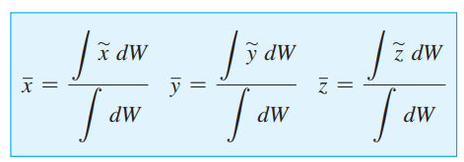
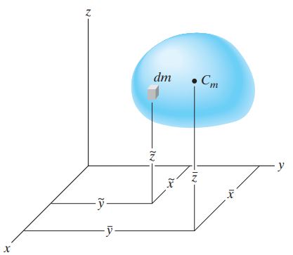
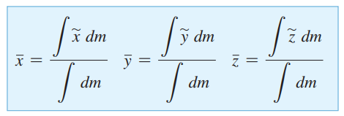
Center of Gravity, Mass, and the Centroid of a Body
Imagine the coordinate system rotate 90⁰then :
That is, the (x, y, z)
of center of gravity (Cg)is
And the (x, y, z)
of center of mass (Cm) is
**In order to study the
dynamic response or accelerated motion of a body, it becomes
important to locate the body’s center of mass Cm,

Slide 3
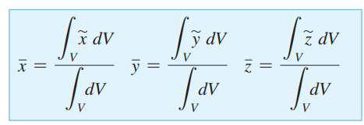
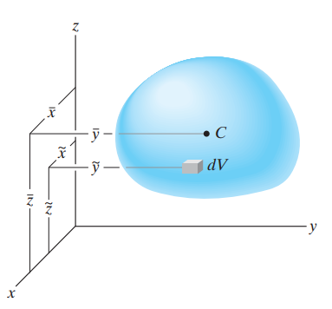
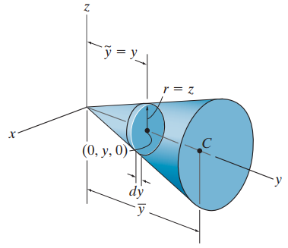
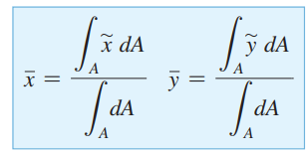
And the (x, y, z) of
centroid of a volume(C)
or geometric center is
** assume the body is made
from a homogeneous material, then its density 𝝆(rho) will be constant.
Therefore, a differential element of volume dV has a mass dm = 𝝆 dV. ,
Therefore, if the volume possesses two planes of symmetry, then its centroid
must lie along the line of intersection of these two planes. For example,
the cone in Fig. has a centroid that lies on the y axis so that x = z = 0 .
The location y can be found using a single integration.
……………………………………………………………………………………………………………………
The centroid of an area is

Slide 4
Vertical strip Horizontal strip
$dA=ydx dA=xdy$
$\tilde{x}=x and \tilde{y}=\frac{y}{2} \tilde{x}=\frac{x}{2} and \tilde{y}=y$

Slide 5
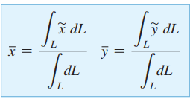
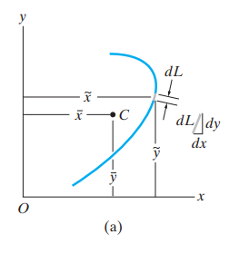
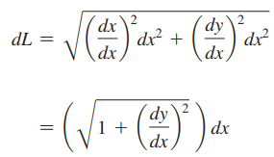
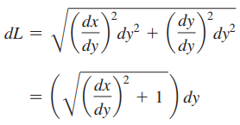
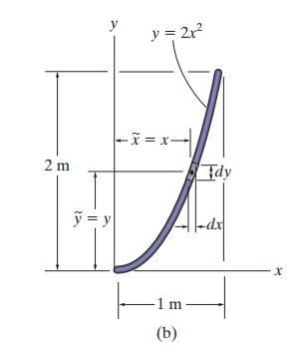
The centroid of a line is
or ⇒
Either one of these expressions can be used; however, for application,
the one that will result in a simpler integration should be selected. For
example, consider the rod in Fig. 9–6b , defined by $y=2x^{2}$
The length of element is $dl=\sqrt{1+{(4x)}^{2}}$ is easer than (${dx}/{dy }).$
Here, the length of the differential element is given by the Pythagorean theorem $dl=\sqrt{{(dx)}^{2}+{(dy)}^{2}}$ which can also be written in the form

Slide 6
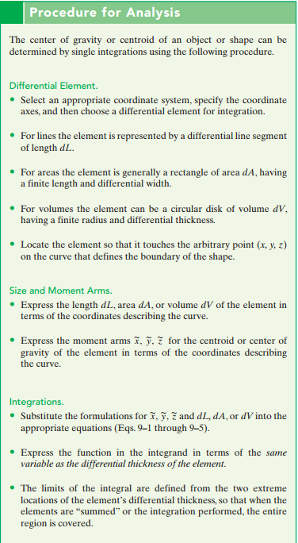
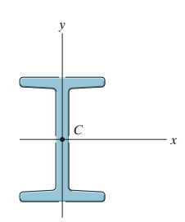

Slide 8
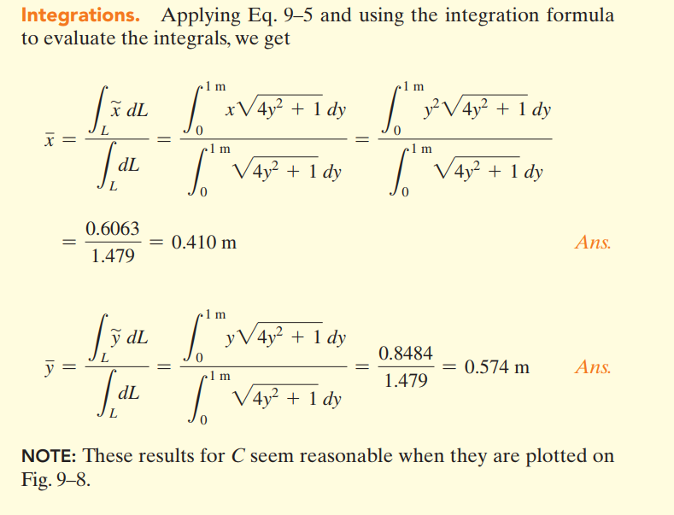

Slide 11
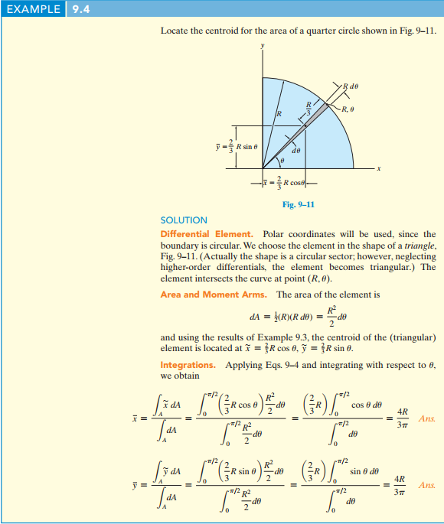

Slide 12
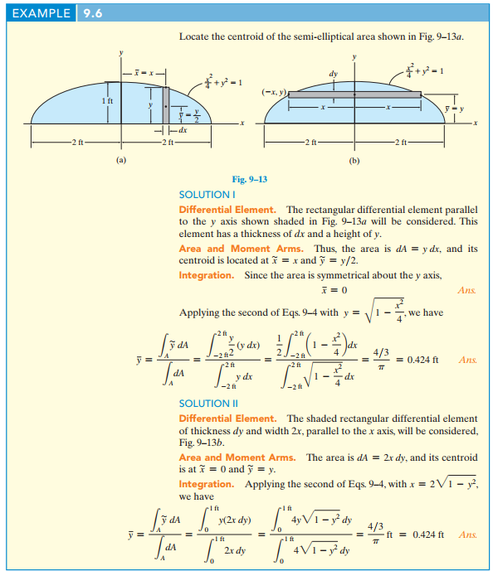

Slide 14
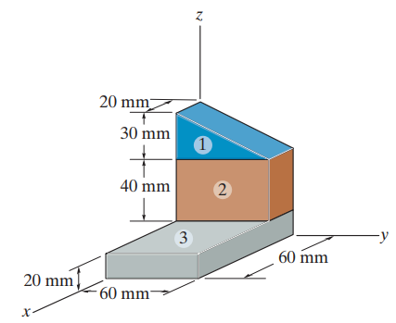
Composite Bodies
A composite body consists of a series of connected “simpler” shaped
bodies, which may be rectangular, triangular, semicircular, etc. Such a
body can often be sectioned or divided into its composite parts and,
provided the weight and location of the center of gravity of each of these
parts are known.*
$\overline{x}=\frac{\sum_{i=0}^{i=n}{{\tilde{x}}_{i}W_{i}}}{\sum_{i=0}^{i=n}{W_{i}}} ,$ $\overline{y}=\frac{\sum_{i=0}^{i=n}{{\tilde{y}}_{i}W_{i}}}{\sum_{i=0}^{i=n}{W_{i}}} , \overline{z}=\frac{\sum_{i=0}^{i=n}{{\tilde{z}}_{i}W_{i}}}{\sum_{i=0}^{i=n}{W_{i}}}$
Where
$\overline{x},\overline{y},\overline{z}$represent the coordinates of the center of gravity G of the composite body(entire body).
$\tilde{x},\tilde{y},\tilde{z}$represent the coordinates of the center of gravity of each composite part of the body.
When the body has a constant density or constant specific weight , the center of gravity coincides with the centroid of the body.
*If a composite body has a hole , or a geometric region having no material, then consider the composite body without the hole and consider the hole as an additional composite part having negative weight or size.

