Slide 1
Hydraulic Conductivity
Water in the subsurface serves as a critical resource for human consumption, both directly and indirectly Groundwater resources serve as one of the two primary sources of potable water supply in the world (the other being surface water). In addition, water in the soil profile supports plant life, upon which humans are dependent in several ways.

Slide 2
An important soil property involved in the behavior of soil water flow systems is the conductivity of the soil to water
Qualitatively the conductivity is the ability of soil to transmit water.

Slide 3
The rate of movement of water through soil is of considerable important in many aspects of agriculture and urban life.
the entry of water into soil
the movement of water to plant roots
the flow of water to drains and well
the evaporation of water from the surface of soil

Slide 4
Measurements of conductivity of saturated soil have long been made. These include drainage of soils for agriculture as well as engineering purpose:
Drainage of highways, airport, and construction sites, and seepage below dams.
The data also provide indirect information about the structure and structure stability of soil .

Slide 5
Water moves through a soil is response to the various forces acting up on it. Among these are:
pressure gradient
gravitational
adsorptive
osmotic force.
In addition, thermal and electrical gradients may impose force upon the water in soil and cause its movement under certain circumstances

Slide 6
Hydraulic conductivity is a critical piece of information required for evaluating aquifer performance, characterizing contaminated sites for remediation, and determining the fate and transport of contaminant plumes in subsurface environments. For example, for water management issues, one needs to know the hydraulic conductivity to calculate the water-transmitting and storage capacities of the aquifers

Slide 7
Unsaturated hydraulic conductivity is always lower than saturated hydraulic conductivity. Unsaturated hydraulic conductivity is a function of soil water content. As the soil-water content decreases, so does K. In fact, a small drop in the soil-water content of a porous medium, depending upon its texture, may result in a dramatic decrease (e.g.10³ and 10⁶) in the unsaturated hydraulic conductivity. As we discussed earlier, the hydraulic conductivity of sands is always greater than that of clays for saturated porous media.

Slide 8
Hydraulic conductivity: symbolically represented as K, is a property of vascular plants, soil or rock, that describes the ease with which water can move through pore spaces or fractures. It depends on the intrinsic permeability of the material and on the degree of saturation.
Saturated hydraulic conductivity, K_{sat}, describes water movement through saturated media.

Slide 9
Methods of determination
There are two broad categories of determining hydraulic conductivity:
Empirical approach by which the hydraulic conductivity is correlated to soil properties like pore size and particle size (grain size) distributions, and soil texture
Experimental approach by which the hydraulic conductivity is determined from hydraulic experiments using Darcy's law

Slide 11
Constant-head method
The constant-head method is typically used on granular soil. This procedure allows water to move through the soil under a steady state head condition while the quantity (volume) of water flowing through the soil specimen is measured over a period of time. By knowing the quantity Q of water measured, length L of specimen, cross-sectional area A of the specimen, time t required for the quantity of water Q to be discharged, and head h, the hydraulic conductivity can be calculated:
Using Darcy's Law:

Slide 12
In 1856, a French hydraulic engineer, Henry Darcy, established a relationship that bears his name to this day. The relationship is based on studies of water flow through columns of sand, similar to the schematic shown in Figure below. In Darcy’s experiment, the column is packed with sand and plugged on both ends with stoppers. Water is introduced into the column under pressure through an inlet in the stopper and allowed to flow through it until all the pores are fully saturated with water and inflow and outflow rates are equal. Water pressures along the flow path are measured by the manometers installed at the ends of the column.

Slide 13
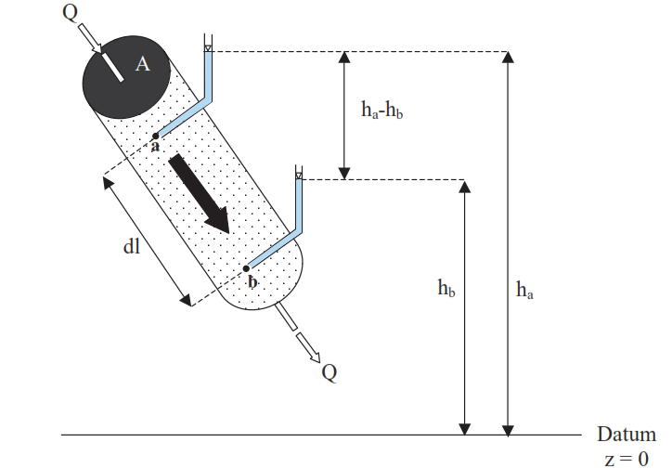

In his series of experiments, Darcy studied the relationship between flow rate and the head loss between the inlet and outlet of the column. He found that:
-The flow rate is proportional to the head loss between the inlet and outlet of the column:

Slide 14





-The flow rate is inversely proportional to the length of flow path
-The flow rate is proportional to the cross-sectional area of the column:
-Mathematically, these experimental results can be written as:
where h is the difference of hydraulic head over distance L, yields
Solving for K gives:

Slide 15

Falling-head method
The falling-head method is totally different than the constant head methods in its initial setup; however, the advantage to the falling-head method is that can be used for both fine-grained and coarse-grained soils. The soil sample is first saturated under a specific head condition. The water is then allowed to flow through the soil without maintaining a constant pressure head.

Slide 16
Table of saturated hydraulic conductivity (K) values found in nature

