Slide 1
Lab.4 Insects of Leguminous Plants
Salahaddin University - Erbil Collage of Agricultural Engineering sciences Horticulture Department
Asst. Lecturer:Noor nadhir polus
Field crop insects
4th stage plant protection

Slide 2
Leguminous Plants Include the following crops:
(broad bean, Bean, Pea, Cowpea, Lentil, Chickpea, Green gram, Alfalfa and Clover)

Slide 3
Some Insects of Leguminous Plants:
1- Large Bean Seed Weevil
2- Black Bean Aphid
3- Pea Blue Butterfly (Long-tailed Blue)
4- Alfalfa Weevil
5- Cowpea Weevil
6- Bean Leaf Borer

Slide 4
7- Green Leafhopper
8- Pea Leaf Miner
9- Spotted Alfalfa Aphid
10- Green Peach Aphid
11- Cotton Whitefly
12- Cotton Aphid
13- Lentil Aphid

Slide 5
1- Large Bean Seed Weevil
Bruchus rufimanus (Boheman)
(Coleoptera : Bruchidae)

Slide 6
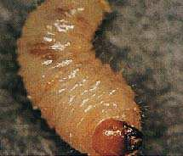
Description:
Egg: 0.6 mm long, greenish yellow.
Larva: the 2nd-instar larva reaches 5 to 6 mm once its development is complete; apodous, brown head and white body.

Slide 7
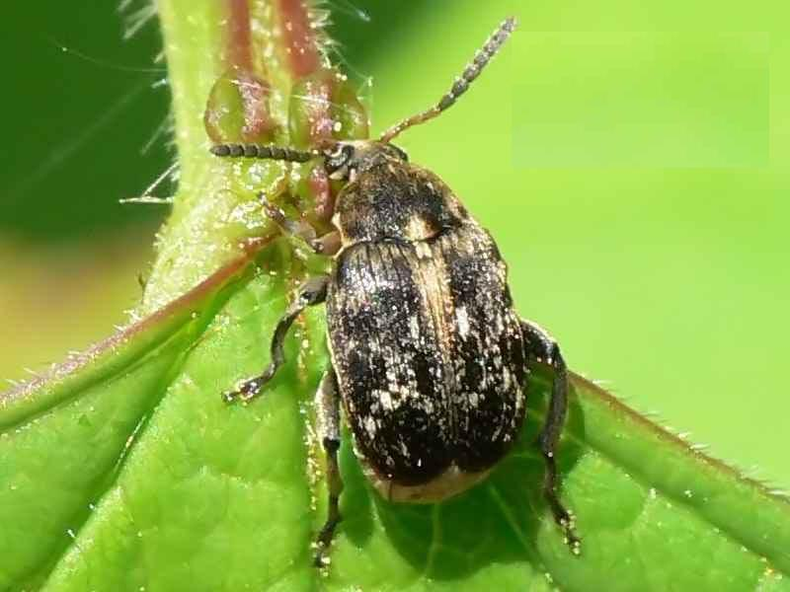
Adult: size of the adult 3.5 to 5 mm. Prothorax a little shorter than wide, anterior legs entirely yellow, middle and posterior legs black. Posterior tibias bearing a long spike on the internal angle.

Slide 8
Damage:
1- The presence of beetles in the seeds of broad beans, peas or beans renders them unsuitable for consumption,
2- reduces the germination rate of the sowings and presents a risk of re-infestation of crops.
One broad bean can harbor 5 to 6 individuals.

Slide 9
2- Black Bean Aphid
Aphis fabae Scopoli
(Homoptera : Aphididae)

Slide 10
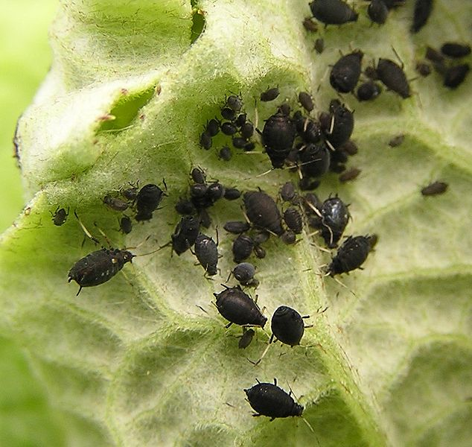
Description:
The black bean aphid is a small, soft-bodied insect that has specialized piercing and sucking mouthparts which are used to suck the juice from plants. This aphid is usually seen in large numbers and is a tiny, plump insect about two millimeters long with a small head and bulbous abdomen. The body is blackish or dark green in colour.

Slide 11
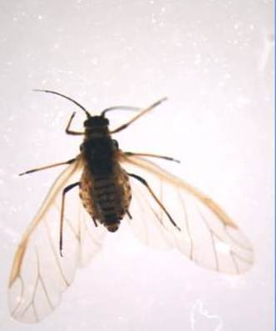
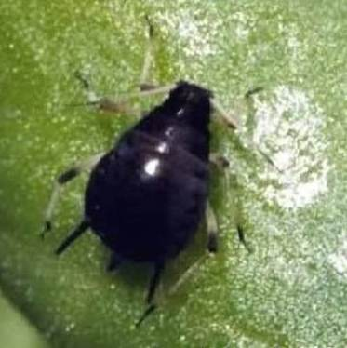
Many adults are devoid of wings, a state known as aptery. Winged forms, known as alates, are longer and more slender than aptery and have shiny black heads and thoraxes. The membranous wings of the alates are held angled over the body.

Slide 12
Damage:
This well-known aphid is a major pest of field bean and Broad beans.
1- They suck the plant sap also contaminate host plants with honeydew.
2- Sooty molds and chocolate spot disease can also develop on excreted honeydew.
3- The aphid transmit bean yellow mosaic, bean leaf roll, beet yellow net, pea mosaic and potato leaf roll.

Slide 13
4- Heavy infestations on field and vegetable crops can reduce yields significantly.
leaves and shoots may become malformed and plants noticeably stunted.

Slide 14
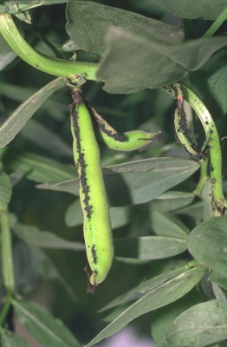

Slide 15
3- Pea Blue Butterfly
(Long-tailed Blue)
Lampides boeticus (L.)
(Lepidoptera: Lycaenidae)

Slide 16
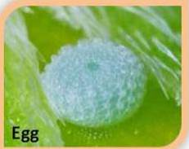
Description:
The eggs are flattened, white and only 0.2 mm across.

Slide 17
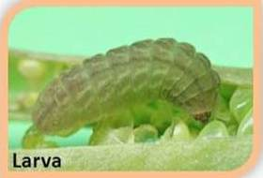
Larvae reach 10 mm in length. Larvae are variable in colour ranging from a uniform pale cream to pale pink with darker pink markings.

Slide 18
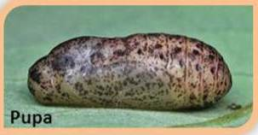
Pupae are mottled brown with a length of 8 mm.

Slide 19
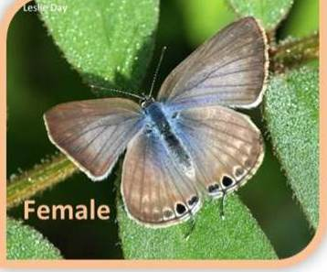
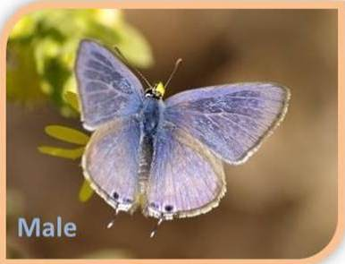
Adults :-
The Adult males’ wings are pale blue on top, whereas females are blue with wide dark brown edges. Underneath, both sexes are pale brown with white markings and have a distinctive broad white band across the outer sector of both wings

Slide 20
. Both sexes have a small thin tail on each hind wing. There are two small black eye spots, ringed with orange, at the base of each tail, on the underside of the wings. The wingspan is 24–32 mm for males and 24–34 mm for females.

Slide 21
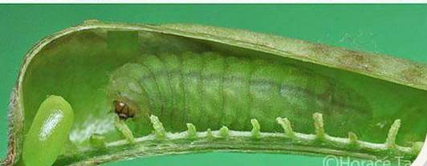
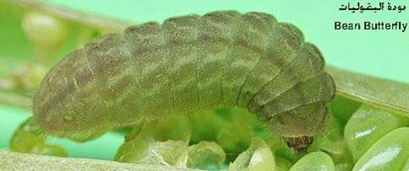
Damage:
1-The larvae feed on pods of long beans and other beans,
eating the young seeds.
2-on small pods the larvae makes a hole in the pod and feeding on pod contents.
The damage characterized by round holes in pods.

Slide 22
4- Alfalfa Weevil
(Clover Leaf Weevil)
Hypera punctata (Fabricius),
(Coleoptera: Curculionidae)

Slide 23
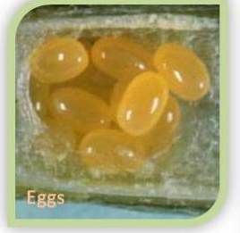
Description:
Egg:- The oval, 1 mm long, egg is pale yellow when first laid but gradually darkens to black.

Slide 24
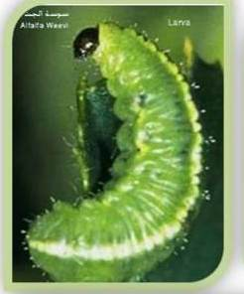
Larva:- The young, legless larva is green. Reaching a mature length of 12 to 13 mm, the grub is greenish or yellowish with a white or pink line down the center of the back and a dark line along each side.

Slide 25
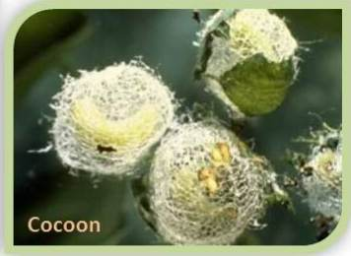
Pupa :-
The yellow-green pupa is 5.5 to 7 mm long and has a dark green abdomen. It is enclosed by a straw colored cocoon 9 to 10 mm in length.

Slide 26
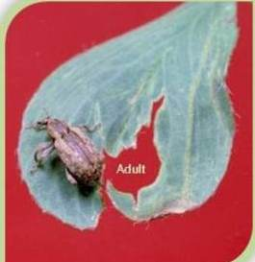
Adult :–
About 5 to 10 mm long, this snout beetle is covered with small gray, brown, and yellow scales which make it appear mottled and indistinctly striped.

Slide 27
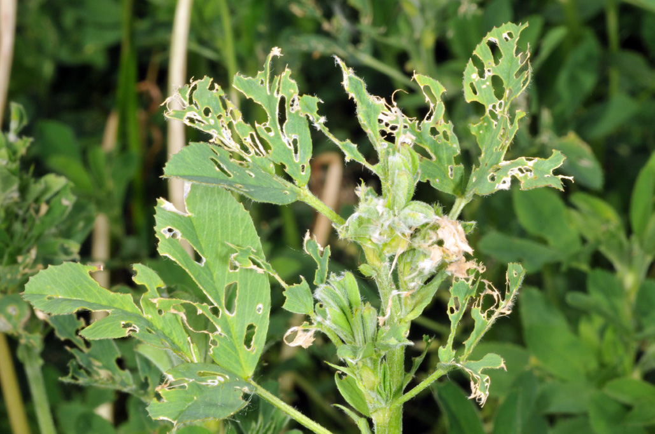
Damage:
The larvae begin feeding on plants early in the spring. Infested plants become ragged as the grubs chew out small holes and irregular patches from leaves. Damage is most severe during late, cool, dry springs. During wet or humid weather, many larvae are killed by a fungal disease.

Slide 28
