Slide 1
University of Salahaddin – College of Engineering Software & Informatics Dep. Computer Architecture II 2022-2023 Lecture 1 Lecturer Nyan D. Sallman

Slide 3
Micro processor Architecture
A computer system has three main component
CPU
Memory
I/O device
The main internal H/W feature of a computer system are:
The processor
Memory (ROM, RAM,..)
Registers
External H/W feature are
I/O device such as (Keyboard, printer, hand scanner,…..)
Software :
Operating system
Program and data file stored on disk

Slide 4
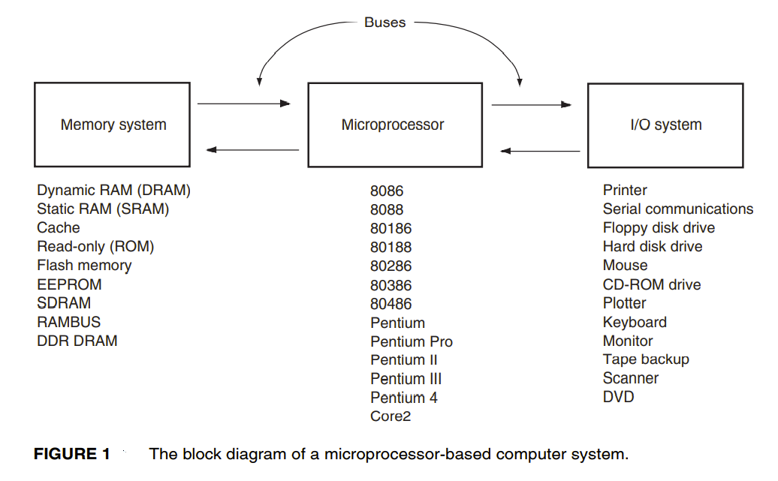

Slide 5
Micro
Processor
MWTC
MRDC
IOWC
IORC
Address Bus
Data Bus
ROM
RAM
Keyboard
printer
Block diagram of a computer system showing the address, data, and control bus structure

Slide 6
System bus
Definition : common group of wires connect the component of the system {processor, memory, and peripherals} .
Address bus
Data bus
Control bus

Slide 7
Internal Architecture of 8086
8086 has two Main Units BIU and EU:
The BIU performs all bus operations such as instruction fetching, reading and writing operands from and to memory and calculating the operands address.
* The instruction bytes are transferred to the instruction queue.
EU executes instructions from the instruction system byte queue.
* Both units operate Asynchronously to give the processor an overlapping instruction fetch and execution mechanism which is called as Pipelining. This results in efficient use of the system bus and system performance.

Slide 8
Internal Architecture of 8086
* BIU is responsible for performing all external bus operations.
* BIU contains Instruction queue, Segment registres, Instruction pointer, Address adder.
* Processor provides a full 16 bit bidirectional data bus and 20 bit address bus (memory of 1 Mbyte size).
contains Control circuitry, Instruction décoder, ALU, Pointer and Index register, Flag register.

Slide 10
BIU
Fetching the next instruction :
1. place the instruction in the holding area “ queue”.
2. Update the program counter (IP).
Decode
Perform code translation
Reading operand from memory
Execute the instruction
Perform required calculation
Store the result in memory or registers
Sets the status flags attached to the processor
EU

