Slide 1
University of Salahaddin – College of Engineering Software & Informatics Dep. Computer Architecture II 2022-2023 Lecture 3 Lecturer Nyan D. Sallman

Slide 2
Addressing mode
Register addressing mode
Immediate addressing mode
Direct addressing mode
Register Indirect addressing mode
Base plus index addressing mode
Register Relative addressing mode
Base relative plus index addressing mode

Slide 4
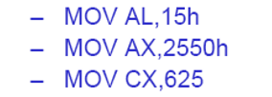
Addressing Mode types
1- Register Addressing Mode - references the data in a register or in a register pair.
Example:
2- Immediate Addressing Mode - the data is provided in the instruction.
Example:
3- Direct Addressing Mode operand specifies the memory address where data is located. (only from Data Segment )
Example:
- MOV CX,[1234h]

Slide 5
1
3
2

Slide 6
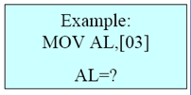
Example : Use the memory configuration in the previous example to execute the instruction

Slide 7
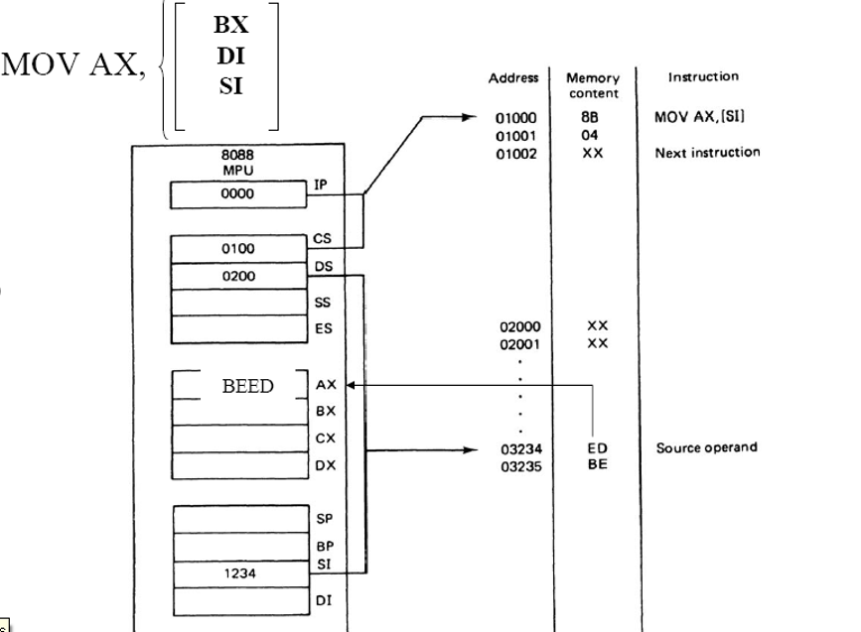
4- Register indirect Addressing Mode - instruction specifies a register (BX,SI,DI) containing an address, where data is located
1
4
∑
3
2

Slide 8
Physical Address : DS shift left +SI = 13698
Lower Byte [13698] = FE
Higher Byte [13699] =17

Slide 9
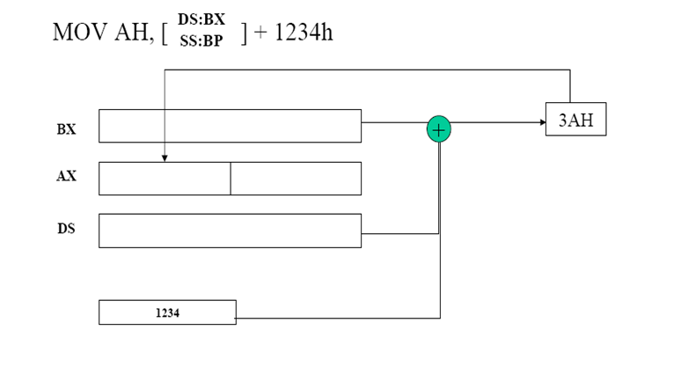
5- Based relative Addressing Mode - 8-bit, 16-bit or 32 bit instruction operand is added to the contents of a base register (BX or BP), the resulting value is a pointer to location where data resides.
Example:
1000h
22234
Content Location
2000 h
2000
1000
6- Indexed relative Addressing Mode :- 8-bit, 16-bit or 32 bit instruction operand is added to the contents of an index register (SI or DI), the resulting value is a pointer to location where data resides.

Slide 11
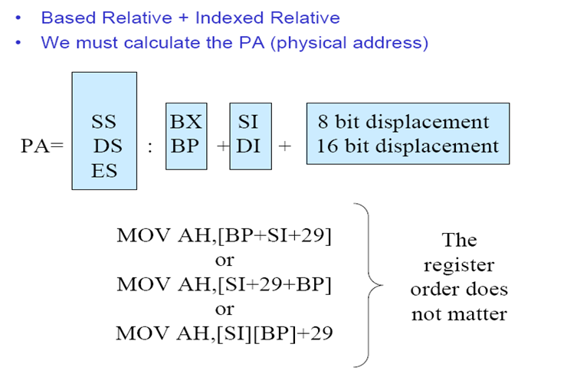
7- Based Indexed Addressing Mode :- the contents of a base register (BX or BP) is added to the contents of an index register (SI or DI), the resulting value is a pointer to location where data resides.

