Slide 1
Engineering Analysis
Lec.1
Fall course 2022-2023
3rd Year
Nyan Dawood

Slide 2
Differential Equations
Ordinary differential equations (ODEs) are differential equations that depend on a single variable.
The more difficult study of partial differential equations (PDEs), that is, differential equations that depend on several variables,

Slide 3
ODE
An ordinary differential equation (ODE) is an equation that contains one or several derivatives of an unknown function, which we usually call y(x)
or sometimes y(t), if the independent variable is time t.
The equation may also contain y itself, known functions of x (or t), and constants. For example,

Slide 5
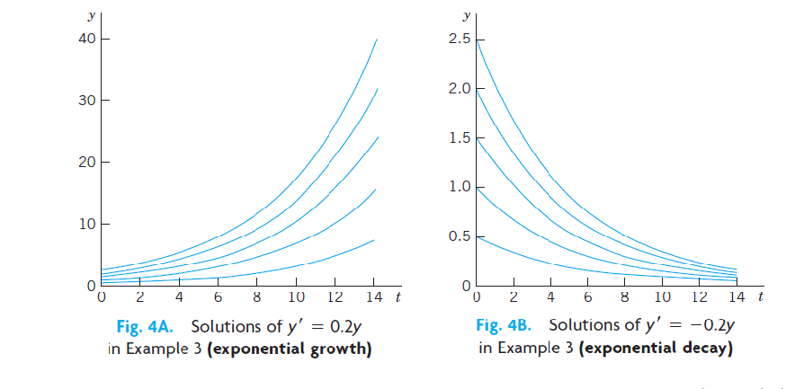
y$=Ce^{0.2t}$
y$=Ce^{−0.2t}$
Geometrically, the general solution of an ODE is a family of infinitely many solution curves, one for each value of the constant c.

Slide 6
Initial value problem
by an initial condition ($X_{0}$ , $Y_{0}$)with given values $X_{0}$and $Y_{0}$ that is used to determine a value of the arbitrary constant C.
, if the ODE is explicit, Y’=f(X , Y) and the initial value problem f($X_{0}$)=$Y_{0}$
Example:

Slide 7
First-order ODE
Equations contain only the first derivative y’ and may contain y and any given functions of x. Hence written as
F(x,y,y’)=0 ; implicit form
or
Y’=f(x,y) ; explicit form
Example1 : y=c/x , y’= -c/$x^{2}$ explicit form
or xy’+y=0 implicit form

Slide 8
a) Verify that y is a solution of the ODE. (b) Determine from y the particular solution of the initial value problem.

Slide 9
Type of equations
Separated equations ( y-term )dy =(x-term) dx +C
Homogeneous methods check firstly if f(kx,ky)=f(x,y)
Solving by Reduction to Separable Form
Solution by Integration Factor
Exact Differential Equation

Slide 10
Homogeneous Method Reduction to Separable Form
We discuss this technique for a class of ODEs of practical importance, namely, for equations$Y^{′}=f\left(\frac{y}{x}\right) ,\text{Here}\text{, }\text{f} \text{is} \text{any}\text{ (}\text{differentiable}\text{) }\text{function} \text{of}$ y/x, such as: sin(y/x) , (${y/x)}^{4}, ….$
The form of such an ODE suggests that we set u= y/x; thus,
y=ux ; and by product differentiation y’= u’x + u
Substituting y’=f(y/x) =f(u) , so f(u)=u’x+u and u’x=f(u)-u
, know variables separated $\frac{du}{f\left(u\right)−u}=\frac{dx}{x}$
Note: or suggests that we set u= x/y

Slide 11
Example : Solve ($x^{2}$+$y^{2}$)dx+2xydy=0
Let u=y/x …
And then let u=x/y

Slide 12
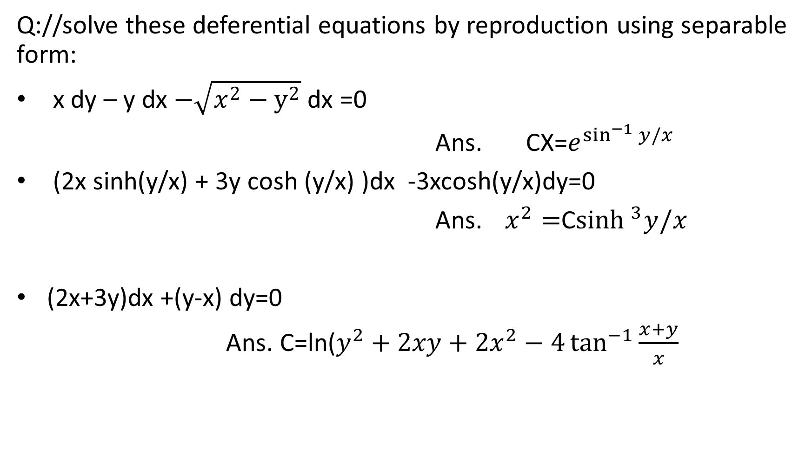
Tutorial C.W.
Q://solve these deferential equations by reproduction using separable form:
x dy – y dx $−\sqrt{x^{2}−y^{2}}$ dx =0
Ans. CX=$e^{\sin^{−1}{y/x}}$
(2x sinh(y/x) + 3y cosh (y/x) )dx -3xcosh(y/x)dy=0
Ans. $x^{2}=$C$\sinh^{3}y/x$
(2x+3y)dx +(y-x) dy=0
Ans. C=ln($y^{2}+2xy+2x^{2}−4\tan^{−1}{\frac{x+y}{x}}$

Slide 13
ODEs. Integrating Factors
The general form of DE that must be solved by Integration factor :
Y’+P(x)y=Q(x)
IF: ƪ(x)= $e^{\int{P\left(x\right)dx}}$
The solution will be ƪ(x) y=$\int{\text{ƪ(}\text{x}\text{)} Q\left(x\right)dx+C}$
Or ,
The DE that will written in the form $\frac{dx}{dy}$ +P(y) x=Q(y)
IF: ƪ(y)= $e^{\int{P\left(y\right)dy}}$
The solution will be ƪ(y) x=$\int{\text{ƪ(}\text{y}\text{)} Q\left(y\right)dy+C}$

Slide 14

Solve the following DE using integration factor.
xy’ +3y= $\frac{\sin{x}}{x^{2}}$
($y^{2}+1$)dx+(2xy+1)dy=0
${(x−1)}^{3}\frac{dy}{dx}+4{(x−1)}^{2}y=x+1$

Slide 15
Exact DE
Standard Form :
M(x,y) dx + N(x,y) dy=0
Step1:
Observe if the equation in S.F.
Step2:
Identify M(x,y), N(x,y), or My ,Nx
Step3:
Check if its Exact DE cont. , else stop
Step 4:
Integrate either M(x,y) part or N(x,y) part
Find partial derivative of M with resp. to y
Find partial derivative of N with resp. to x
(My’ == Nx’ ) ?
No
Stop
Yes
$$\int{M\left(x,y\right)dx +g(y)}$$
Or
$$\int{N\left(x,y\right)dy+h(x)}$$

Slide 16
Differentiate (partially) with respect to y
$\frac{d}{dy}$[…..+g(y) ]
Differentiate (partially) with respect to x
$\frac{d}{dx}$[…..+h(x) ]
Step 5:
Differentiate (partially) with respect to y
$\frac{d}{dy}$[…..+g(y) ]
Differentiate (partially) with respect to x
$\frac{d}{dx}$[…..+h(x) ]
Step 6:
To solve for g(y), set final equation with N
$\frac{d}{dy}$[…..+g(y) ]=N
To solve for h(x), set final equation with M
$\frac{d}{dx}$[…..+h(x) ]=M
To solve for g(y), set final equation with N
$\frac{d}{dy}$[…..+g(y) ]=N
To solve for h(x), set final equation with M
$\frac{d}{dx}$[…..+h(x) ]=M
Step 7:
integrate both side
$$\int{…..dy}$$
integrate both side
$$\int{…..dx}$$
integrate both side
$$\int{…..dy}$$
integrate both side
$$\int{…..dx}$$
Step 8:
Substitute g(y) part with g(y) result from step 4
Substitute h(x) part with h(x) result from step 4
Substitute g(y) part with g(y) result from step 4
Substitute h(x) part with h(x) result from step 4

Slide 17

Solve the following ODE
Cos(x+y) dx+(3$y^{2}+2y+\cos\left(x+y\right))dy=0$
(3$x^{2}+1)+($3$y^{2}+2y$)y’=0

