Slide 1
Engineering Analysis
Lec.2
Fall course 2022-2023
3rd Year
Nyan Dawood

Slide 2
Second order Linear ODEs with Constant Coefficients
(Homogeneous)
We consider second-order homogeneous linear ODEs whose coefficients a and b are constant
………………….(1)
The equation can be solved by using ƛ operator where each
ƛ = $\frac{d}{dx}, and { \text{ƛ}}^{2}= \frac{d^{2}y}{dx^{2}}$
Re write equation (1) substituting ƛ instead of derivative
${\text{(}\text{ƛ}}^{2}$+a ƛ +b) y=0 …………..(2)
The proportional Integral solution is :
Yh =${ C}_{1}e^{{\text{ƛ}}_{1} X}$+ $C_{2}e^{{\text{ƛ}}_{2} X}$

Slide 4
example
Y’’- y = 0 will be ${\text{ (}\text{ƛ}}^{2}−1)$y=0 , Solve to find ƛ value
(ƛ+1)(ƛ-1)=0 or ƛ=$±1$

Slide 5

If ( $a^{2}−4b= 0 ) this will result of just one root\text{, }\text{ƛ}=−a/2$
This will make $y_{1}= C_{1} e^{\text{ƛ}x}$ , and y2 = $C_{2}$ x $e^{\text{ƛ}x}$
So the corresponding general solution will be :

Slide 6
The complex conjugate root result :
$ƛ1=−\frac{a}{2}+iw ; ƛ$2=$\frac{−a}{2}$ - $iw$
To find bases of real solution
And general solution :

Slide 7
Tutorials : Solve 2nd order linear ODE
y’’+y’-2y =0 , y(0)=4 , y’(0)=-5
.
.

Slide 8
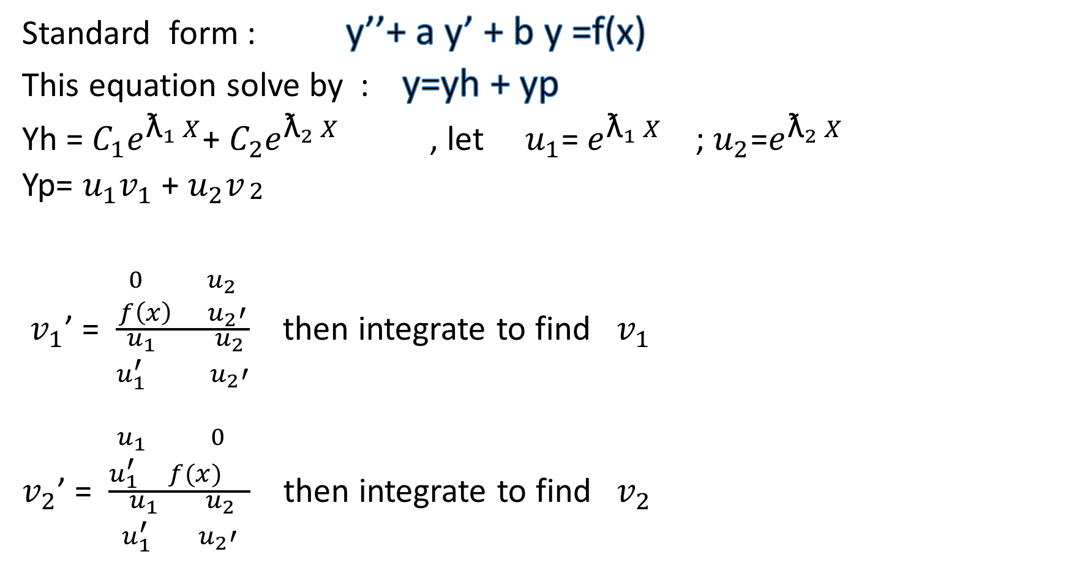
Second order Linear ODEs with Constant Coefficients (non-Homogeneous)
Standard form : y’’+ a y’ + b y =f(x)
This equation solve by : y=yh + yp
Yh =${ C}_{1}e^{{\text{ƛ}}_{1} X}$+ $C_{2}e^{{\text{ƛ}}_{2} X}$ , let $u_{1}$= $e^{{\text{ƛ}}_{1} X}$ ; $u_{2}$=$e^{{\text{ƛ}}_{2} X}$
Yp= $u_{1}v_{1}$ + $u_{2}v_{\begin{aligned}2 \\ \end{aligned}}$
$v_{1}$’ = $\frac{\begin{aligned}0 u_{2} \\ f\left(x\right) u_{2}′\end{aligned}}{\begin{aligned} u_{1} u_{2} \\ u_{1}^{′} u_{2}′\end{aligned}}$ then integrate to find $v_{1}$
$v_{2}$’ = $\frac{\begin{aligned}u_{1} 0 \\ u_{1}^{′} f(x) \end{aligned}}{\begin{aligned} u_{1} u_{2} \\ u_{1}^{′} u_{2}′\end{aligned}}$ then integrate to find $v_{2}$

Slide 9
Solve the following DE
y’’+ 3y’+2y =$e^{x}$
Ans.: $C_{1}$ $e^{−x}+C_{2 }e^{−2x}+\frac{1}{6}$ $e^{x}$
y’’+ y =tan x
Ans.: $C_{1}$Cosx+ $C_{2} Sin x$ – Cos x ln | sec x + tan x|

