Slide 1
Engineering Analysis
Lec.3
Fall course 2022-2023
3rd Year
Nyan Dawood

Slide 2
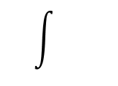
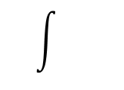
Partial Differential Equations PDE
Partial differential equations are equations that involve partial derivatives of an unknown function depends on two or more independent variables.
ODE : $\frac{d u(x)}{dx}$=0 u(x)=C ;constant
PDE : $\frac{∂ u(x,y)}{∂x}$ =0 u(x,y) =f(y) ; arbitrary function
Some important abbr. $\frac{∂u}{∂x}$ named $u_{x ; }$ $\frac{∂u}{∂y}$ named $u_{y };\frac{∂^{2}u}{∂x∂y}$ named $u_{xy }$
$\frac{∂^{2}u}{∂x^{2}}$ named $u_{xx ; }$ $\frac{∂^{2}u}{∂y^{2}}$ named $u_{yy ; so on }$

Slide 3
Second – order PDE Standard form
A $u_{xx} +B u_{xy }{+ Cu}_{yy}+Du_{x}+E{ u}_{y}$+ F u =G
A, B, C, D, E , F, G { constant or function of (x,y), or function of u }
Type of PDE
Linear PDE : if A,B,C……F independent on u
Non linear PDE if A,B,C…… dependent on u
Homogenous PDE : if G=0
Non homogenous PDE if G≠ 0

Slide 4
Examples of types of PDE :
$\frac{∂u}{∂x}$ + $\frac{∂u}{∂y}$ =0 L.H. PDE
$u_{x}$ + ${ u}_{y}$ =$u^{3}$ NL. H. PDE
$x^{2}$ $\frac{∂^{2}u}{∂x^{2}}$ + $y^{2}$ $\frac{∂^{2}u}{∂y^{2}}+$ $\frac{∂u}{∂x}$ =1 L. NH. PDE
$u_{x}$ $u_{xx }$+ $u_{xy }{+ 3u}_{yy}$+5$u_{x}+{ u}_{y}$+ u= $x^{3}$ NL. NH. PDE

Slide 5
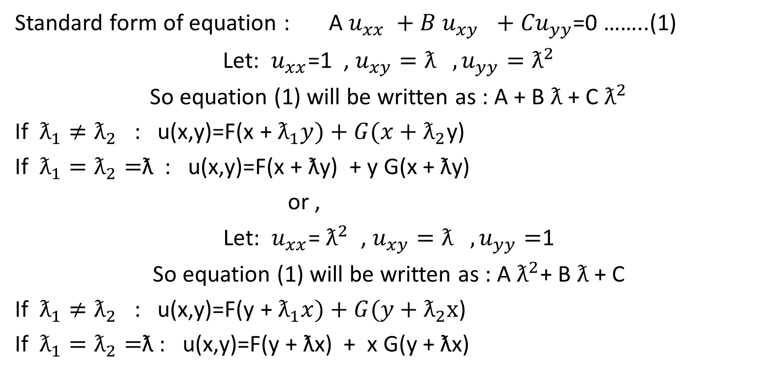
Euler Solution of P.D.E
Standard form of equation : A $u_{xx} +B u_{xy }{+ Cu}_{yy}$=0 ……..(1)
Let: $u_{xx}$=1 , $u_{xy}=ƛ ,u_{yy}=ƛ^{2}$
So equation (1) will be written as : A + B $ƛ$ + C $ƛ^{2}$
If $ƛ_{1}≠ƛ_{2}$ : u(x,y)=F(x + $ƛ_{1}y)+G(x+ƛ_{2}$y)
If $ƛ_{1}=ƛ_{2}=$ƛ : u(x,y)=F(x + ƛy) + y G(x + ƛy)
or ,
Let: $u_{xx}$= $ƛ^{2}$ , $u_{xy}=ƛ ,u_{yy}=$1
So equation (1) will be written as : A $ƛ^{2}$+ B $ƛ$ + C
If $ƛ_{1}≠ƛ_{2}$ : u(x,y)=F(y + $ƛ_{1}x)+G(y+ƛ_{2}x$)
If $ƛ_{1}=ƛ_{2}=$ƛ : u(x,y)=F(y + ƛx) + x G(y + ƛx)

Slide 6

Find the solution of P.D.E
Ex1: $u_{xx} +2 u_{xy }{+ u}_{yy}$=0
Sol: Let: $u_{xx}$=1 , $u_{xy}=ƛ ,u_{yy}=ƛ^{2}$
$ƛ^{2}$+2 $ƛ$+1=0
$ƛ_{1}$= $ƛ_{2}=−1$
General solution : u(x,y) =F(x -y) + y G(x -y)

Slide 7

Ex2: $u_{xx} {+ u}_{yy}$=0
sol: $ƛ^{2}$+1=0 , $ƛ_{1}=+i , ƛ_{2 }=−$ $i$
General solution : u(x,y) =F(x +iy) + G(x -iy)
Ex3: $u_{xx} +5 u_{xy }{+ 6u}_{yy}$=0
Ex4: $u_{xx}=\frac{1}{C^{2}}{ u}_{tt}$ (wave equation)

Slide 8
Ex5: Find particular solution of PDE
$u_{xx} −2 u_{xy }{+ u}_{yy}$=0 , if u(x,0)=$e^{x}, u\left(0,y\right)=y^{3}+e^{y}$
Sol:
let ${ u}_{yy}$=$ƛ^{2}$, $u_{xy }$=$ƛ$, $u_{xx}$=1
1 - 2$ƛ+ƛ^{2}$=0
($ƛ$-1)($ƛ$-1)=0 $, ƛ$1= $ƛ$2=1
u(x,y)=F(x+y) + yG(x+y)
if u(x,0)=$e^{x}=F\left(x\right)+0$, F(x+y)=$e^{x+y}$
So; u(x,y)= $e^{x+y}$+ y G(x+y) , $u\left(0,y\right)=y^{3}+e^{y}=e^{y}$+ yG(y)
G(y)= $y^{2}$ ; and G(x+y)= ${(x+y)}^{2}$
u(x,y)=$e^{x+y}$+y ${(x+y)}^{2}$

Slide 9
Ex 6: find Particular solution of the following PDE
$u_{xx}+2 u_{xy }{+ u}_{yy}$=0 , if u(x,0)=cos x $, u\left(0,y\right)=y^{2}+\cos{y}$

