Slide 1
Simulating Natural phenomena
Lec.1
Randomness and probability
HD course 2023-2024
Nyan Dawood

Slide 2
Outlines
Randomness and probability
Random walk
Uniform Distribution
Probability and non uniform Distribution

Slide 3
Randomness and probability
Objectives :
- Review a programming concept central by OOP.
The random walker will serve as a template for how to moving objects around a Processing window.
Non uniform probability distributions to increase the chance of important outcome cases.

Slide 4
Random Walks
An object in Processing is an entity that has both data and functionality.
A class is the template for building actual instances of objects.
Let’s begin by defining the Walker class, what it means to be a Walker object. Have x , y location.
class Walker { int x;
int y;
Also must contains constructor .
a constructor special function that is called when the object is first created.
Walker() {
x = width/2; // initialize first location in the
y = height/2; // center of window
}

Slide 5
Walker class has two functions:
first function that allows the object to display itself (as a white or black dot).
void render() { //function to display black dot
stroke(0);
point(x,y);
}
Second function directs the Walker object to take a step.
There are four possible steps. X++, X--, Y++, Y–
,By randomly pick from four choices using random().
void step() {
int choice = int(random(4)); //The random “choice” determines Four step.

Slide 6
if (choice == 0) { x++; } // right
else if (choice == 1) { x--; } //left
else if (choice == 2) { y++; } //down
else { y--; } //up
} }
in the main part of our sketch declare one global variable of type Walker. Walker w;
Then create the new object and setup window size and color
void setup() {
size(640,360); //Window size
w = new Walker(); //Create the Walker object.
background(255); // white background
}

Slide 7
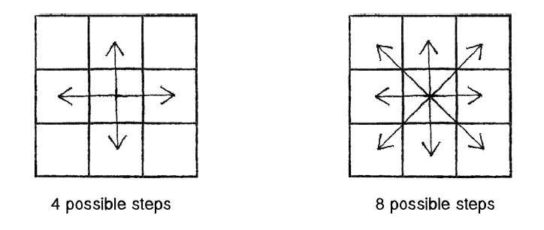
void draw() { // Run the walker object
w.step();
w.render();
}
This Walker’s step choices are limited to four options—up, down, left, and right. But any given pixel in the window has eight possible neighbors, and a ninth possibility is to stay in the same place.

Slide 8
Randomly step to eight possible neighbors
void step() {
int stepx = int(random(3))-1; //Yields -1, 0, or 1
int stepy = int(random(3))-1;
x += stepx;
y += stepy;
}
Probability of four neighbor step = $\frac{1}{4}$ = 25% chance
Probability of eight neighbor or remaining in its location = $\frac{1}{9}$ = 11% chance

Slide 9
Probability and non uniform Distribution
We can change the way to use random() to produce “non-uniform” distributions of random numbers by many ways:
First: fill an array with a selection of numbers—some of which are repeated then choose random numbers from that array and generate events based on those choices.
Then print stuff[index]
int[] stuff = new int[5];
stuff[0] = 1; //1 is stored in the array twice
stuff[1] = 1; // probability to pick 1 will be 40%
stuff[2] = 2; // probability to pick 2 will be 20%
stuff[3] = 3; // probability to pick 3 will be 40%
stuff[4] = 3;
Int index = int(random(stuff.length)); //Picking a random element from an array

Slide 10
Second : allow an event to occur only if our random number is within a certain range.
Example: Let’s say that Outcome A has a 60% chance of happening, Outcome B has 10% chance, and Outcome C, a 30% chance.
between 0.00 and 0.60 (60%) –> Outcome A
between 0.60 and 0.70 (10%) –> Outcome B
between 0.70 and 1.00 (30%) –> Outcome C
Sol.
float num = random(1);
if (num < 0.6) {
println("Outcome A");
} else if (num < 0.7) {
println("Outcome B");
} else {
println("Outcome C");
}

Slide 11
We could use the above methodology to create a random walker that tends to move to the right. Here is an example of a Walker with the following probabilities:
chance of moving up: 20%
chance of moving down: 20%
chance of moving left: 20%
chance of moving right: 40%
void step() {
float r = random(1);
if (r < 0.4) { //40% chance of moving to the right!
x++;
} else if (r < 0.6) {
x--;
} else if (r < 0.8) {
y++;
} else {
y--;}
}

Slide 12
Exercise
Create a random walker with dynamic probabilities. As instance you can give it a 50% chance of moving to mouse direction ?

