Slide 1
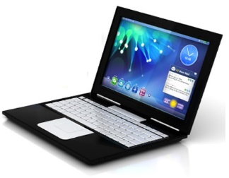
UNIVESITY OF SALAHADDIN
COLLEDGE OF ENGINEERING
CIVIL ENGINEERING DEPT.
FIRST YEAR STUDENTS
information technology
2021 - 2022

Slide 2
Introduction
A computer is an electronic machine, operating under the control of instructions stored in its own memory, that can accept data, manipulate the data according to specified rules, produce results, and store the results for future use. Computers process data to create information.
Data is a collection of raw unprocessed facts, figures, and symbols.
Information is data that is organized, meaningful, and useful. To process data into information, a computer uses hardware and software.
There are four types of data and information, which are:
1. Text 2. Graphic 3. Audio 4. Video
Hardware is the electric, electronic, and mechanical equipment that makes up a computer.
Software is the series of instructions that tells the hardware how to perform tasks.
1

Slide 3
Computer Hardware
Computer Hardware is the physical part of the computer system, the machinery and equipment, (Parts of the computer we can see).
Computers Hardware
System unit
Input devices
Output devices
Storage devices
1. System Unit
The system unit is a case that contains electronic components of the computer used to process data.
Common components inside the system unit are:
Motherboard B. Power Supply C. Cooling Fan
D. Ports E. Drive Bays

Slide 4
2. Input devises
An input device is used to enter the data and instructions into the computer.
Input
devises
keyboard
Mouse
Cam
Microphone
Scanner
Used to type alphabets, numbers, and operators, and also to control the cursor on the screen.
Used to select objects, opening programs and files and to control the cursor on the screen.
Captures the voice data and input to the computer
Allows the user to record videos as input to their computer
Generates a digital representation of an image for data input to a computer

Slide 5
Cursor Shapes
The mouse cursor is smart and will change appearance depending on what it is pointing at.
Normal select
Vertical resizing
Help select
Horizontal resizing
Wait: A program or web page is loading.
Diagonal resizing
Text can be typed or selected.
Move
Unavailable
Link select

Slide 6
3. Output devises
An output device is hardware that is capable of delivering or showing information to one or more users.
Output
devises
Display
(Monitor)
Printer
Projector
Speakers
Plotter
Presents output information in the form of text, graphics, or video on the monitor screen.
Takes information (usually text and pictures) from the computer and prints it on paper.
Used to generate or reproduce voice, music, and other sounds.
Shows the monitor in a larger view on a wall or a reflector to audiences.
Specially designed to produce outputs of diagrams, illustrations and other graphics.
4

Slide 7
4. Storage (Memory) Devices
Computer Memory
Main
RAM
ROM
Secondary
Optical
Disk
Memory
Drive
Magnetic
Disk
BD
DVD
CD
Hard Disk
Floppy Disk
External Hard Disk
Internal Hard Disk
USB Flash
Solid State
Online
Storage
Sky drive
Drop box
Google drive
iCloud
5

Slide 8
Storage measurements
The amount of storage space available on a disk is usually described in terms of bits, bytes, Kilobyte (KB), Megabyte (MB), or Gigabyte (GB).
Description | Unit | No.
1 byte = 2³ = 8 bit | byte | 1
1 KB = 2¹⁰ = 1024 Bytes | Kilobyte (KB) | 2
1 MB = 2¹⁰ = 1024 KB | Megabyte (MB) | 3
1 GB = 2¹⁰ = 1024 MB | Gigabyte (GB) | 4
1 TB = 2¹⁰ = 1024 GB | Terabyte (TB) | 5
1 PB = 2¹⁰ = 1024 TB | Petabyte (PB) | 6
Usually the unformatted text of a whole book can fit In some KB. while for an Image In a good resolution (let’s say ready to be printed on A4 paper) or for a modern song some MB are required, while a film In high quality needs some GB.
6

Slide 9
Cleaning Up Hard Disk
You can gain a small performance increase by simply removing the old files you no longer need. This will obviously free up extra disk space too.
Click Start ►All Programs ► Accessories ► System Tools ► Disk Cleanup
Defragmenting Hard Disk
A deleted file leaves a “hole” in the continuity of the data. Some smaller files can help fill that empty space, but the chances that the hole will be exactly filled are slim. Therefore, as time goes on, your hard disk will become full of empty space with files scattered throughout your drive. This is called fragmentation, and can cause considerable slowdown to your computer.
Click Start ► All Programs ► Accessories ► System Tools ► Disk Defragmenter

Slide 10
Computers Software
Instructions that provide the computer with step-by-step actions that need to be executed to complete a specific task. A computer will not function without software.
Computers Software
Operating
System
Programs
(Applications)
Data and Information
1. Operating System
The operating system takes care of controlling computer hardware and human-computer Interaction. There are currently the following widely used operating systems:
7

Slide 11
Microsoft Windows, which is the market leader.
Macintosh computers have their own operating system Mac OS X.
Linux (It is a family of very similar operating systems), which is a costless operating system.
Android, a family of very similar Linux-based operating systems for mobile devices.
iOS, for Apple mobile devices.
Windows Phone. Microsoft's operating system for mobile devices.
Microsoft Windows
Microsoft Windows is currency the market leader operating system, it is the usual interface which appears when the user turns on a personal computer with Windows operating system.

Slide 12
Windows OS vs Mac OS
Macs Have Less number of products available.
Mac versions are produced months or years after the Windows products.
Macs are more expensive than comparable Windows machines.
Macs Have Fewer Viruses and Require Less Maintenance.
Windows security is weak and easier for hackers or viruses to penetrate.
8

Slide 13
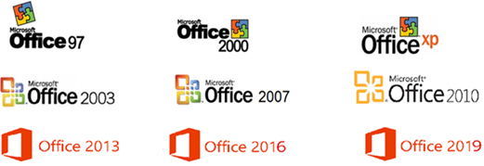
A large selection of applications and software programs to different purposes have been made for Windows, while there are fewer software choices available for Macs .
2. Programs
Programs are software which is used to do particular tasks, or that tell the computer what to do, Examples: • Word for document writing.
Explorer for Internet navigation.
AutoCAD for engineering design and drawings.
Calculator for mathematical operations.
Microsoft Office Programs

Slide 14
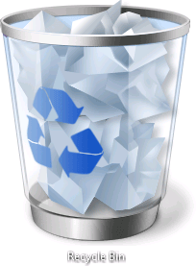
Icon
Icon: A small picture that represents processing options such as programs, documents, and shortcuts. When you click on the icon, the file or program will open. The most easily recognized icon is the Recycle Bin.
File extension
A file extension sometimes called a file suffix or a filename extension is the character or group of characters after the period that makes up an entire file name.
The file extension helps an operating system, like Windows, determine which program on your computer the file is associated with.
Executable File Extensions
Some file extensions are classified as executable, meaning that when clicked, they don't just open for viewing or playing. Instead, they actually do something all by themselves, like install a program, start a process, run a script, etc.

Slide 15
File type | Program | Extension | Icon
Document | MS Word / Acrobat | .doc / .pdf
Presentation | MS PowerPoint | .ppt
Sheet | MS Excel | .xls
Image | Office picture manager / Paint | .jpg / .bmp
Video | Media Player / VLC Player | .mpeg / .wmv
Audio | Media Player / VLC Player | .mp3 / .wav
Drawing | AutoCAD | .dwg
Web page | Google chrome / Fire fox | .htm / .html
10

Slide 16
Files’ operations
When double clicking on a file. Windows usually starts a program. The user Is often unaware of an Important difference:
double clicking on a program runs the program which was double clicked.
double clicking on a file calls the program associated with that file and runs it, at the same time telling the program to open the file. If no program is associated with that file type, Windows asks the user which program should open the file.
Saving a File
The first time you save a new document, you must use Save As in order to specify location, name etc., as in the example below.
The next time you save the same document, you may use Save, unless you wish to change the location or other settings. In other words, the Save command will always use the settings that you specified the last time you used Save As.

Slide 17
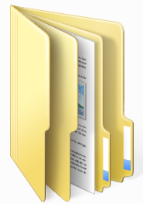
Deleting a File.
To delete a file or a folder, click on the file or the folder to select it and then press the delete key on the keyboard. Confirm in dialog box with Yes.
Folder
Folder: Method for organizing files that is related by topic, by purpose, by type, by program, or even by a project that you are working on. NOTE: When an application program is loaded onto your computer, it will group similar applications in a folder. As you add or create files, you can organize them however you want.
11

Slide 18
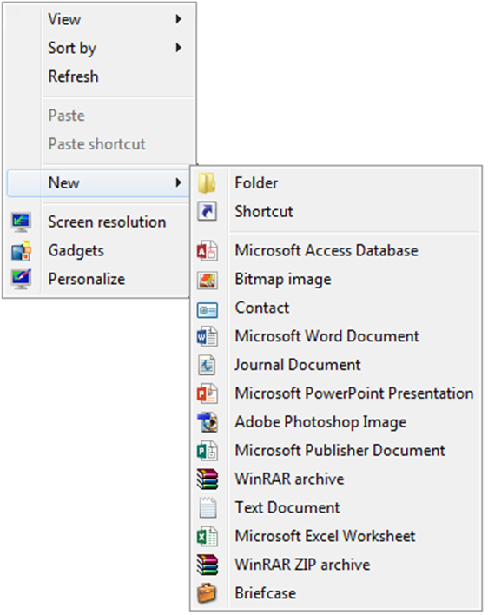
Creating a new Folder
Right click in the blank (clear) portion of the window. On the menu that appears, click on New and then on Folder in the next menu.
While the folder caption is dark, type Your name. Then click on a clear area.
Open the folder you just made by double clicking on it, or single clicking and pressing the Enter key.

Slide 19
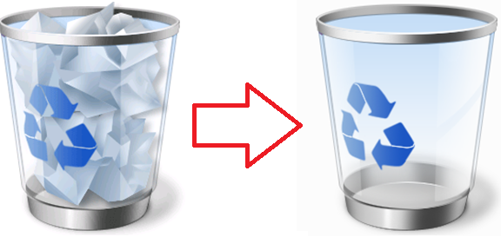
Retrieving deleted files from the recycle bin
Drag the Calculator shortcut to the Recycle bin. The Calculator is now in the recycle bin and not on the Desktop...
Double click on the Recycle bin. Right click on the Calculator shortcut. Select Restore.
Note: When the Recycle bin is open, never choose Empty the Recycle bin or Restore all items. Instead, just click on what you want to remove or restore.
12

Slide 20
3. Data
Data can be defined as a representation of facts, concepts or instructions in a formalized manner which should be suitable for communication, interpretation, or processing by human or electronic machine.
Data is represented with the help of characters like alphabets (A-Z, a-z), digits (0-9) or special characters(+,-,/,*,<,>,= etc.).
Data Flow in a computer system
Input device- allows the user to enter data manually
Main memory- temporarily stores data entered by the user [i.e. the RAM]
CPU- processes data transferred from main memory and returns the results it calculates back to main memory
Output device – displays results of the processed data as information [e.g. on a monitor]
Backing storage – more permanently loads and saves data [e.g. hard disk drive]

Slide 21
Main Memory
CPU
(Processing)
Output (Information)
Backing Storage
Input (Data)
13

Slide 22
Types of computer networks
LAN (Local Area Network) interconnects computers in a limited area such as a home, school, computer laboratory, or office building.
Cables (wires) or low-power radio (wireless) are used for the connections in a LAN.
WAN (Wide Area Network) is a network which is geographically spread over large areas with links between computers.
The long distance connections are done using technologies such as fiber optical cables, satellite radio links or microwave radio links.
Server and client
The server is the computer which is offering its resource, usually programmed to wait until someone asks for its resource.
The client is the computer which uses the resource. which sends the request to a waiting server.

Slide 23
For example, when sending a document to the printer, the user's computer is the client while the printer is the server.
Internet
The world’s largest network is the Internet, which is a worldwide collection of networks that links together millions of businesses, government agencies, educational institutions, and individuals. Users connect to the Internet to send messages, access information, shop for goods and services, meet or converse with other users.
Most users connect to the Internet through an Internet Service Provider (ISP). The World Wide Web (www) is a popular segment of the Internet that contains billions of documents called Web pages. These documents can contain text, graphics, sound, video, and links, to other Web pages stored on computers throughout the world.
15

Slide 24
Web browsers
Web browser a client program to navigate the WWW and retrieve web pages. It runs directly on the user's computer as a client and connects to external web servers, identified with the www prefix in the Internet name, to retrieve web pages. The market leader is the browser from Google Chrome, Mozilla Firefox, Microsoft edge, Opera Browser etc.
Search engines
A search engine is a special program running on a website which offers to the user the possibility of searching other websites for specific web pages. The user needs to connect to the search engine website and digit the keyword, or sometimes even a complete question and the website returns the list of relevant web page.
The most popular search engines are Google, Yahoo, Bing etc.

Slide 25
Webpage : is a single digital page of information on a website, written in a computer language called HTML (Hyper Text Markup Language ).
Website: is a collection of one or more related Web pages, linked to one another to form a global web of information.
Homepage: is the first page which appears on the screen as soon as you open a website.
Uniform Resource Locator (URL)
Is a standardized naming convention for addressing documents accessible on Internet. Every page on the Internet has a unique address through which it is called. Example :
http:// www.google.com / sciencefair / index .html
protocol
Domain name
pathname
File name
File extension
17

Slide 27
E-mail
E-mail (electronic mail) is an electronic message sent form one computer to another. We can send or receive personal and business-related messages with attachments, such as pictures, formatted documents and programs
Advantages of E-mail
Messages can be prepared and sent any time convenient for the sender.
Message can be received at the convenience of the recipient.
The transmission takes place instantly and the message gets stored in the mailbox of the recipient.
The system can confirm delivery of message.
Copies of message can be sent to multiple recipients.
It reduces paper work.
18

Slide 28
E-mail service providers
Free email service still remains the main way of business communication on the Internet. There are lots of free Email service providers available online and selecting the best ones for your specific needs is essential. All of these free Email Service providers grant their users with an Email address on their top-level domain and some storage space for holding your documents and attachments.
Gmail
Yahoo Mail
Outlook
(formerly known as Hotmail)
GMX Mail

