Slide 1
University of Salahaddin – Hawler
College of Engineering
Civil Engineering Department
HYDRAULIC STRUCTURES
Lecturer: Othman K. Mohammed

Slide 2
Contents
Chapter 1 | Canal Design and Lining
Chapter 2 | Hydraulic Structures on Pervious Foundations
Chapter 3 | Hydraulic Jump and Energy Dissipation
Chapter 4 | Design of Main Canal Head Works
Chapter 5 | Drop or Fall Structures
Chapter 6 | Design of Dams and Reservoirs
Chapter 7 | Spillways
1

Slide 3
Set by: Othman K. Mohammed
CHAPTER ONE
CANAL DESIGN AND LINING
Introduction
A hydraulic structure is a structure submerged or partially submerged in any body of water, which disrupts the natural flow of water.
Types of Hydraulic Structures
According to the purpose of its function
Storage Structures: to store water such as Dams & Tanks.
Conveyance Structures: to convey water from place to another such as pipelines, Siphons, Culverts, Tunnels, aqueducts and open channels.

Slide 4
Flow Diversion Structures: to regulate and divert the quantities of flow to another structures or canals such as barrages and regulators.
Flow measurement structures: to measure the flow passing through it such as Weirs, Orifices, nozzles, Venturi and Parshall flume.
Energy dissipation structures: to protect the floor of hydraulic structure from erosion and damage due to severe waves which impact with the body of structure such as Stilling basins, Surge tanks, Check dams and vertical drop.
Sediment and Chemical Control Structures: to control or remove sediments and other pollutants such as Sedimentation tanks, Screens, Traps, Filters & mixing basins.
2

Slide 5
Set by: Othman K. Mohammed
Open Channel
An open channel is the one in which stream is not complete enclosed by solid boundaries and therefore has a free surface subjected only to atmosphere pressure. The flow in such channels is caused only by gravitational component along the slope of channel. Examples of open channel are Rivers, canals, streams, & sewerage system etc.
Types of channels
based on material
Lined channels
(Rigid boundary channels)
Minimum velocity
to prevent sedimentation
Unlined channels
(erodible or earthen channels)
Maximum velocity
to prevent erosion

Slide 6
Set by: Othman K. Mohammed
Shapes of channels
Circular channel
Rectangular channel
Trapezoidal channel
Triangular channel
Open Channel Design
It is the process to obtain a shape, slope and geometry of channel/canal which should not have objectionable silting and scouring.

Slide 7
For example for a trapezoidal channel, it consists of determining;
depth,
bed width,
side slope and
longitudinal slope of the channel so as to produce a non-silting and non-scouring velocity for the given discharge and sediment load.
Manning formula
$$FB$$
$$Q=\frac{1}{n} A R^{\left(2/3\right)} S^{\left(1/2\right)}$$
m
m
1
A
$$d$$
1
where: Q : discharge in m³/sec,
A : wetted cross-sectional area in m²
R : hydraulic radius in m, R = A / P
P
4

Slide 8
Set by: Othman K. Mohammed
CHAPTER TWO
HYDRAULIC STRUCTURES ON PERVIOUS FOUNDATIONS
Introduction
Hydraulic structures such as dams, weirs, barrages, head regulators, cross-drainage works, etc. may either be founded on an impervious solid rock foundation or on a pervious foundation.
Whenever, such a structure is founded on a pervious foundation, it is subjected to seepage of water beneath the structure, in addition to all other forces to which it will be subjected when founded on an impervious rock foundation.

Slide 9
Set by: Othman K. Mohammed
Causes of Failure of Hydraulic Structures on Pervious Foundations
Failure by Subsurface Flow
Failure by Surface Flow
By Piping or undermining
By Direct uplift
By Hydraulic Jump
By Scouring
Controlled by Floor Length (b)
Controlled by Floor Thickness (t)
Controlled by Protection Works

Slide 10
Failure by Subsurface Flow
The water seeping below the body of the hydraulic structure, endanger the stability of the structure and may cause its failure, either by
(a) Failure by Piping or undermining
The water from the upstream side continuously percolates through the bottom of the foundation and emerges at the downstream end of the weir or barrage floor. The force of percolating water removes the soil particles by scouring at the point of emergence.
(b) Failure by Direct uplift
The percolating water exerts an upward pressure on the foundation of the weir or barrage. If this uplift pressure is not counterbalanced by the self weight of the structure, it may fail by rapture.
9

Slide 11
3. Khosla’s theory of seepage flow
In this method. a composite weir or barrage section is split up into a number of simple standard forms where analytical solutions are known
Exit gradient (GE)
Gradient at the exit end is called exit gradient (GE) which is determined from the equation below:
$$G_{E}=\frac{ΔH}{d_{o}}×\frac{1}{π\sqrt{λ}}$$
$$λ=\frac{1+\sqrt{1+α^{2}}}{2}$$
ΔH
$$α=\frac{b}{d_{o}}$$
$$d_{o}=d+t$$
$$d_{o}$$
b
10

Slide 12
Set by: Othman K. Mohammed
In order to keep the structure safe against piping.
$$\text{Exit} \text{gradient} { (G}_{E})<\text{Safe} \text{Exit} \text{Gradient}\text{ (}\text{Gs}\text{)}$$
Values of Khosla’s Safe Exit Gradient for different types of Soils
No | Type of Soil | Gs
1 | Shingle | $$\frac{1}{4} to \frac{1}{5}$$
2 | Coarse Sand | $$\frac{1}{5} to \frac{1}{6}$$
3 | Fine Sand | $$\frac{1}{6} to \frac{1}{7}$$

Slide 13
Uplift Coefficients at Key Points in Standard forms
Straight horizontal floor of negligible thickness with Pile at downstream end.
ΔH
$$φ_{E}$$
$$φ_{C}$$
$$d_{o}$$
b
$$φ_{D}$$
$$φ_{E}=\frac{1}{π}\cos^{−1}\left(\frac{λ−2}{λ}\right)$$
$$φ_{D}=\frac{1}{π}\cos^{−1}\left(\frac{λ−1}{λ}\right)$$
$$φ_{C}=0$$
$$λ=\frac{1+\sqrt{1+α^{2}}}{2}$$
$$α=\frac{b}{d_{o}}$$
11

Slide 14
Set by: Othman K. Mohammed
Straight horizontal floor of negligible thickness with Pile at upstream end.
ΔH
$$φ_{E1}$$
$$φ_{C1}$$
$$φ_{E}$$
$$φ_{C}$$
$$d_{o}$$
b
$$φ_{D1}$$
$$φ_{D}$$
$$φ_{C1}=1−φ_{E}$$
$$φ_{E}=\frac{1}{π}\cos^{−1}\left(\frac{λ−2}{λ}\right)$$
$$φ_{D1}=1−φ_{D}$$
$$φ_{D}=\frac{1}{π}\cos^{−1}\left(\frac{λ−1}{λ}\right)$$
$$φ_{E1}=1$$
$$φ_{C}=0$$
$$α=\frac{b}{d_{o}}$$
$$λ=\frac{1+\sqrt{1+α^{2}}}{2}$$

Slide 15
Straight horizontal floor of negligible thickness with Pile at intermediate points.
ΔH
$$φ_{E}$$
$$φ_{C}$$
b1
b2
$$d_{o}$$
$$φ_{D}$$
$$φ_{E}=\frac{1}{π}\cos^{−1}\left(\frac{λ1−1}{λ}\right)$$
$$φ_{D}=\frac{1}{π}\cos^{−1}\left(\frac{λ1}{λ}\right)$$
$$φ_{C}=\frac{1}{π}\cos^{−1}\left(\frac{λ1+1}{λ}\right)$$
$$λ=\frac{\sqrt{1+α_{1}^{2}}+\sqrt{1+α_{2}^{2}}}{2}$$
$$λ1=\frac{\sqrt{1+α_{1}^{2}}−\sqrt{1+α_{2}^{2}}}{2}$$
$$α_{1}=\frac{b_{1}}{d_{o}} α_{2}=\frac{b_{2}}{d_{o}}$$
12

Slide 16
Set by: Othman K. Mohammed
Straight horizontal floor of Depressed thickness below the bed (with no cutoff)
$$φ_{E′}=1$$
$$φ_{C′}=0$$
do
$$φ_{D_{1}^{′}}$$
b
$$φ_{D′}$$
$$φ_{D_{1}^{′}}={1−φ}_{D′}$$
$$φ_{D′}=φ_{D}−\frac{2}{3}\left(φ_{E}−φ_{D}\right)+\frac{3}{α^{2}}$$
$$φ_{D}=\frac{1}{π}\cos^{−1}\left(\frac{λ−1}{λ}\right)$$
$$φ_{E}=\frac{1}{π}\cos^{−1}\left(\frac{λ−2}{λ}\right)$$
$$α=\frac{b}{d_{o}}$$
$$λ=\frac{1+\sqrt{1+α^{2}}}{2}$$
$$G_{E}=0.84 \frac{ΔH}{d_{o}}φ_{D′}$$

Slide 17
Uplift Pressure Coefficients at Key Points
$$φ_{E1}$$
$$φ_{C1}$$
$$φ_{E2}$$
$$φ_{E3}$$
$$φ_{C3}$$
$$φ_{C2}$$
$$φ_{D1}$$
US
sheet pile
$$φ_{D3}$$
$$φ_{D2}$$
DS
sheet pile
Intermediate
sheet pile
13

Slide 18
Set by: Othman K. Mohammed
Corrections in Khosla’s theory
The pressures obtained at the key points by considering simple profile are then corrected for the following:
Correction for floor thickness
The correction to the evaluated values at key points E and C that is applied considering a floor thickness t
t
$$φ_{E}$$
$$φ_{C}$$
$$d_{o}$$
$$Corr. for φ_{E}=\frac{φ_{D}−φ_{E}}{d_{o}}\left(t\right)$$
$$Corr. for φ_{C}=\frac{φ_{D}−φ_{C}}{d_{o}}\left(t\right)$$
$$φ_{D}$$

Slide 19
Correction for mutual interference of sheet piles
The correction C for interference of one sheet pile on the other.
$$C=± 0.19\sqrt{ \frac{D}{b^{′}} } \left(\frac{d+D}{b}\right)$$
Where,
D = vertical distance measured from the key point to the bottom of the interfering sheet pile.
b′ = The horizontal distance between two pile lines
d = The depth of the pile on which the effect is considered
b = Total floor length
Note: Mutual Interference corrections are:
(+) for points (C)
($−$) for points (E)
14

Slide 20
Set by: Othman K. Mohammed
$$φ_{E1}$$
$$φ_{C1}$$
$$D$$
$$φ_{E3}$$
$$φ_{C3}$$
$$φ_{E2}$$
$$φ_{C2}$$
$$b^{′}$$
b

Slide 21
$$φ_{E1}$$
$$φ_{C1}$$
$$φ_{E3}$$
$$φ_{C3}$$
$$D$$
$$φ_{E2}$$
$$φ_{C2}$$
$$b^{′}$$
b
15

Slide 22
Set by: Othman K. Mohammed
$$φ_{E1}$$
$$φ_{C1}$$
$$φ_{E3}$$
$$φ_{C3}$$
$$φ_{E2}$$
$$φ_{C2}$$
$$D$$
$$b^{′}$$
b

Slide 23
$$φ_{E1}$$
$$φ_{C1}$$
$$φ_{E3}$$
$$φ_{C3}$$
$$φ_{E2}$$
$$φ_{C2}$$
$$D$$
$$b^{′}$$
b
16

Slide 24
Set by: Othman K. Mohammed
Correction for slope of the floor
This correction is applicable only to the key points of the pile line fixed at the Start or the End of the slope.
$$C=± C_{s} \frac{bs}{b^{′}}$$
bs is the horizontal length of the slope
b’ is the distance between the two pile lines between which the sloping floor is located.
+
Notes: This correction is This correction is taken as
(+) for the downward slope
($−$) for the upward slope
$$−$$

Slide 25
Slope H : V | 1 : 1 | 2 : 1 | 3 : 1 | 4 : 1 | 5 : 1 | 6 : 1 | 7 : 1 | 8 : 1
$$C_{s}$$ | 0.112 | 0.065 | 0.045 | 0.033 | 0.028 | 0.025 | 0.023 | 0.02
$$φ_{E1}$$
$$φ_{C1}$$
V
H
$$φ_{E3}$$
$$φ_{C3}$$
$$φ_{E2}$$
$$φ_{C2}$$
$$bs$$
$$b^{′}$$
17

Slide 26
Set by: Othman K. Mohammed
Uplift Pressure Coefficients at Intermediate Points
$$A$$
$$φ_{E1}$$
$$φ_{C1}$$
$$φ_{A}$$
$$B$$
$$φ_{E3}$$
$$φ_{C3}$$
$$φ_{E2}$$
$$φ_{C2}$$
$$φ_{B}$$
$$L A$$
$$L B$$
$$b^{′}$$
$$b^{′}$$
$$φ_{A}=φ_{E2}+\frac{L A}{b^{′}}\left(φ_{C1}−φ_{E2}\right)$$
$$φ_{B}=φ_{E3}+\frac{L B}{b^{′}}\left({φ_{C2}−φ}_{E3}\right)$$

Slide 27
Set by: Othman K. Mohammed
CHAPTER THREE
HYDRAULIC JUMP AND ENERGY DISSIPATION DEVICES
(c) Failure by Hydraulic Jump
In the glacis type of weirs, a hydraulic jump is formed on the d/s glacis. In this case, the water surface profile in the hydraulic jump trough is much lower than the subsoil H.G.L. Therefore uplift pressure occurs on the glacis. This uplift pressure is known as the suction pressure. If the thickness of floor is not adequate, the rupture of floor may occur.

Slide 28
Hydraulic jump
When the water flows with a very high velocity over the crest of a weir or under the gates of a barrage, the hydraulic jump develops.
US Water level
Hydraulic Jump
DS Water level
Crest level
US Floor level
Glacis
DS Floor level
Point of Jump formation (O)
19

Slide 29
Set by: Othman K. Mohammed
US TEL
HL
HL
Pre-Jump profile
DS TEL
DS TEL
Va
Ef1
Post-Jump profile
Ef2
D2
D1
O
Level of Jump formation

Slide 30
Hydraulic Jump Expressions
The location of hydraulic jump and the profile of water surface on the u/s and d/s of the point at which the jump is formed are required. The basic relations for a hydraulic jump are
$${Ef}_{1}=D_{1}+\frac{q^{2}}{2g D_{1}^{2}}$$
$${Ef}_{2}=D_{2}+\frac{q^{2}}{2g D_{2}^{2}}$$
$$HL= US TEL −DS TEL$$
$$HL={Ef}_{1}−{Ef}_{2}$$
$$D_{2}=\frac{D_{1}}{2}\left(\sqrt{1+8 {Fr}_{1}^{2}}−1\right)$$
$$HL=\frac{{\left(D_{2}−D_{1}\right)}^{3}}{4{ D}_{1} D_{2}}$$
20

Slide 31
Set by: Othman K. Mohammed
Location of Hydraulic Jump Formation on Glacis
For known discharge intensity q, and the difference in the levels of the upstream and downstream levels of total energy line, HL determine the downstream specific energy, Ef2, Using Blench’s curves.
The location of the jump on a glacis can then be obtained by finding the intersection of the glacis with the horizontal plane Ef2 below the downstream level of the total energy line.
$$Elevation of \text{O}=DS TEL−{Ef}_{2}$$

Slide 32
Plotting water surface profile before the jump
Divide the glacis up to point (O) into several intervals and determine elevation of that point on the glacis.
Determine the value of specific energy Ef at these points from the relation
Form Montague curve for q and Ef read (D) on the supercritical side.
Determine the water surface level from:
$$Glacis level at \left(i\right)=level of \left(O\right)+∆i$$
$$Efi=US TEL −glacis level at (i)$$
$$WSL (i)=Di+glacis level at (i)$$
21

Slide 33
Set by: Othman K. Mohammed
Join the water levels determined in step 4 by smooth carve to obtain the prejump water surface profile
US TEL
HL
HL
DS TEL
DS TEL
$$Efi$$
$$WSL (i)$$
$$Di$$
D2
$$∆i$$
D1
O

Slide 34
Plotting water surface profile after the jump
Determine the square of Froude number (${Fr}_{1}^{2}$) of the incoming flow from the relation
Divide the D/S from point (O) into several intervals into a distance 5 to 6 (D2 – D1).
Determine the horizontal distances (x) of these points from the point (O) . Determine the values of ($x/D1$) for each point.
Determine the values of ($D/D1$) for each point for the given values of (${Fr}_{1}^{2}$) and (x/D1) from the curve.
Determine the depth D for that points from ($D/D1$) values and obtain the water surface levels.
Join the water surface levels to obtain the post-jump profile .
$${Fr}_{1}^{2}=\frac{v_{1}^{2}}{g{ D}_{1}}=\frac{q^{2}}{g D_{1}^{3}}$$
22

Slide 35
Set by: Othman K. Mohammed
US TEL
HL
HL
DS TEL
DS TEL
$$WSL (i)$$
$$Di$$
D2
D1
O
$$xi$$

Slide 36
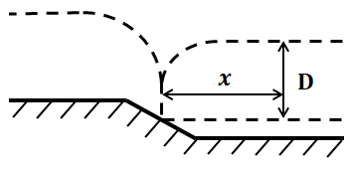
$$60$$
$$30$$
$${Fr}_{1}^{2}$$
$$20$$
$$15$$
$$\frac{D}{D1}$$
$$10$$
$$8$$
$$6$$
$${Fr}_{1}^{2}=4$$
$${Fr}_{1}^{2}=3$$
$${Fr}_{1}^{2}=2$$
$$\frac{x}{D1}$$
23

Slide 37
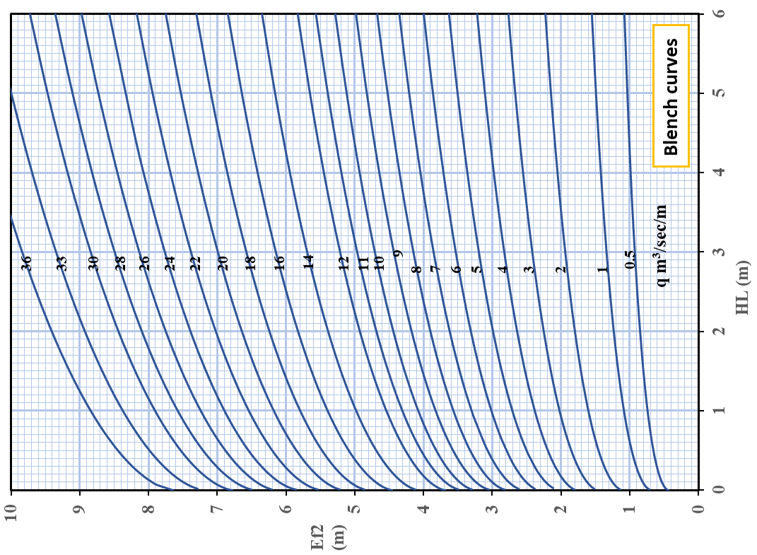
Set by: Othman K. Mohammed

Slide 38
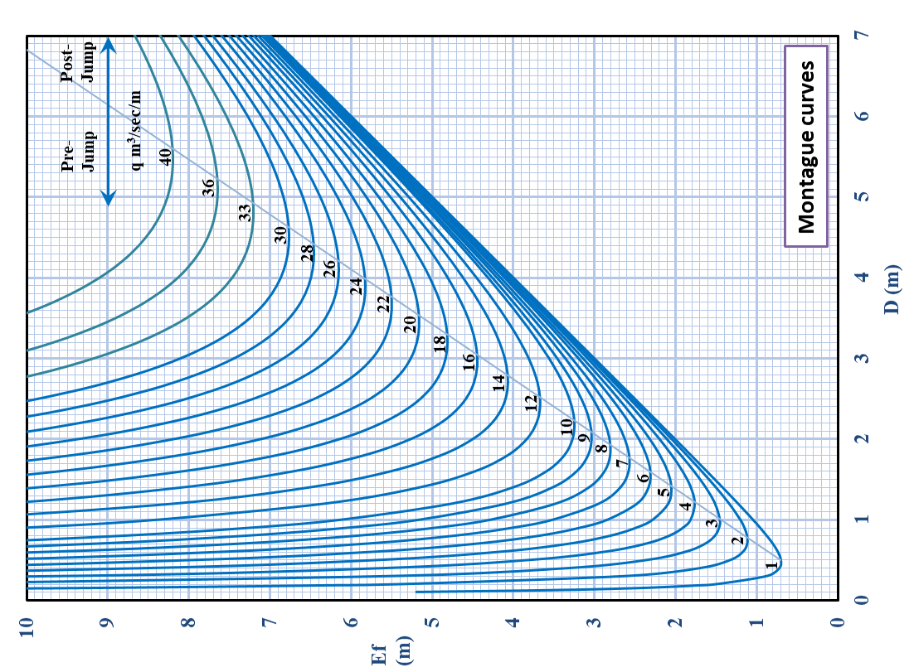
24

Slide 39
Set by: Othman K. Mohammed
Uplift Pressure Under The Hydraulic Structure
$$\text{Uplift} \text{Pressure} (Ui)=φi ∆H$$
$STATIC Condition$
$$∆H=pond level−D.S. Floor level$$
$DYNAMIC Condition$
$$∆H=U.S.\left(HFL\right)High Flood Level−D.S.\left(HFL\right)$$
Plotting the Subsoil Hydraulic Gradient Line
The elevation of the subsoil hydraulic gradient line above the bottom of the floor at any point measures the uplift pressure at that point

Slide 40
Subsoil Hydraulic Grade Line at Static Condition
$$HGL=U\left(i\right)+D.S. Floor level$$
$$φ_{E1} . ∆H$$
$$φ_{C1} . ∆H$$
$$φ_{E2} . ∆H$$
HGL
$$∆H$$
$$φ_{C2} . ∆H$$
$$φ_{E3} . ∆H$$
$$φ_{E1}$$
$$φ_{C1}$$
$$φ_{C3} . ∆H$$
$$φ_{E3}$$
$$φ_{C3}$$
$$φ_{E2}$$
$$φ_{C2}$$
26

Slide 41
Set by: Othman K. Mohammed
Subsoil Hydraulic Grade Line at Dynamic Condition
$$HGL=U\left(i\right)+D.S.Water Surface level$$
$$φ_{E1} . ∆H$$
HGL
$$φ_{E2} . ∆H$$
$$φ_{C1} . ∆H$$
$$∆H$$
$$φ_{E3} . ∆H$$
$$φ_{C2} . ∆H$$
$$φ_{C3} . ∆H$$
$$φ_{E1}$$
$$φ_{C1}$$
$$φ_{E3}$$
$$φ_{C3}$$
$$φ_{E2}$$
$$φ_{C2}$$

Slide 42
Unbalanced Static Head
Balanced Region
$$Unbalanced Head \left(hi\right)=Susoil HGL−D.S. Floor level$$
or
$$=Susoil HGL−Glacis level$$
or
$$=Susoil HGL−Crest level$$
$$hi$$
Unbalanced Region
$$hi$$
$$hi$$
27

Slide 43
Set by: Othman K. Mohammed
Unbalanced Dynamic Head
$$Unbalanced Head \left(hi\right)=Susoil HGL−D.S.Water Surface$$
Unbalanced Region
Balanced Region
$$hi$$

Slide 44
Floor Thickness
The floor should have appropriate thickness to counteract the uplift pressure acting on it.
At selected point let the uplift pressure is U which is the subsoil H.G.L. measured from the top surface of the floor.
F2
$$F1=F2$$
A
$$h . A . γ_{w}=T . A .\left(γ_{C}−γ_{w}\right)$$
T
$$Ti=\frac{h_{i}}{{s.g.}_{conc}−1}$$
h
F1
28

